Slide 1

SMART HEALTH HACKATHON
SwasthyaSetu AI
A Federated AI Platform for National-Scale Health Resource
& Supply Chain Resilience
TEAM EKLAVYA
Team Leader: Rudra Pratap Chaurasiya
Team Members: Sankalp Sachan • Mohammad Sirfan
THEME: RESILIENCE

Slide 2





THE PROBLEM
India’s PHC Network Runs Blind
Public healthcare systems across India face persistent supply chain vulnerabilities. There is no real-time visibility into medicine stock, patient footfall, or resource utilisation across the vast network of Primary Health Centres — leading to stock-outs exactly when the country can least afford them.
Invisible Inventory
Late-Stage Alerts
Trapped Surplus
Slow Emergency Response
No real-time view of medicine stock, beds, or staff attendance across PHCs.
Stock-outs are discovered after they happen, not predicted before.
One district runs short while a neighbouring district holds unused stock.
No mechanism to redistribute resources fast when outbreaks hit.
Net effect: Preventable stock-outs during exactly the moments — outbreaks, disasters — when supply chain resilience matters most.

Slide 3





THE SOLUTION
SwasthyaSetu AI
A federated AI platform — Predict → Detect → Recommend → Redistribute — built on state-local model training so raw health data never leaves a state’s own servers.
1
2
3
4
→
→
→
VISIBILITY
FORECAST
EARLY WARNING
REDISTRIBUTE
Real-time stock, bed &
staff data from every PHC
AI predicts demand &
stock-out probability
Alerts before shortage
actually happens
Optimized cross-district
transfer recommendations
Privacy-Preserving Federated Learning
Each state trains its forecasting model on its own local data. Only model weight updates — never raw patient or stock data — are shared with the National Aggregator (FedAvg), which redistributes an improved global model back to every state.

Slide 4






UNDER THE HOOD
Tech Stack
Frontend & Edge App
Backend
Data Layer
React (PWA) — offline-first PHC data entry
Recharts / Plotly — dashboards
Mapbox — geographic risk view
FastAPI (Python) — REST APIs
JWT-based role auth
Docker Compose — multi-state simulation
PostgreSQL + TimescaleDB
Time-series stock & consumption logs
ABDM-compatible (FHIR) schema design
AI / Forecasting
Federated Learning
Optimization
Prophet / XGBoost — demand forecasting
Stock-out probability modelling
Outbreak / anomaly detection
Flower (flwr) — federated simulation
FedAvg across state nodes
Local training, weights-only sharing
PuLP / OR-Tools
Transportation-problem redistribution
Distance, urgency & shelf-life aware

Slide 5
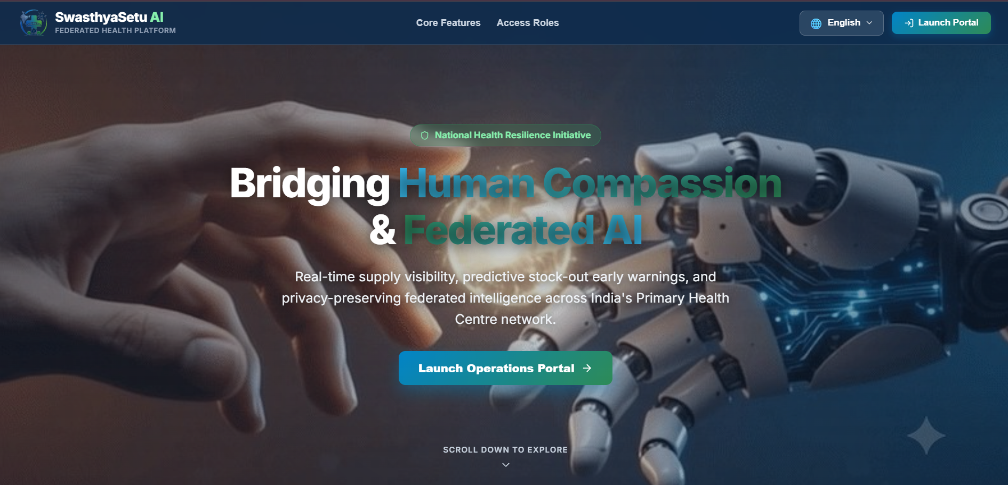
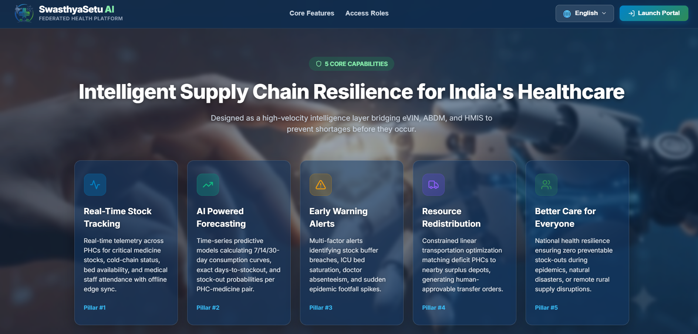
LIVE PROTOTYPE
From Landing Page to Core Capabilities
Landing hero — scroll-scrubbed frame animation, brand tagline & CTA
5 Core Capabilities — bridging eVIN, ABDM & HMIS into one intelligence layer

Slide 6
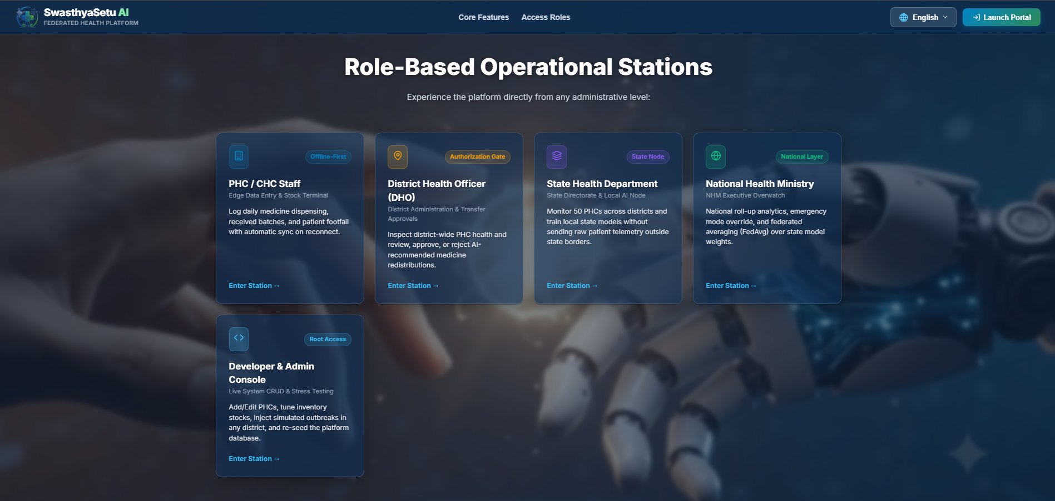
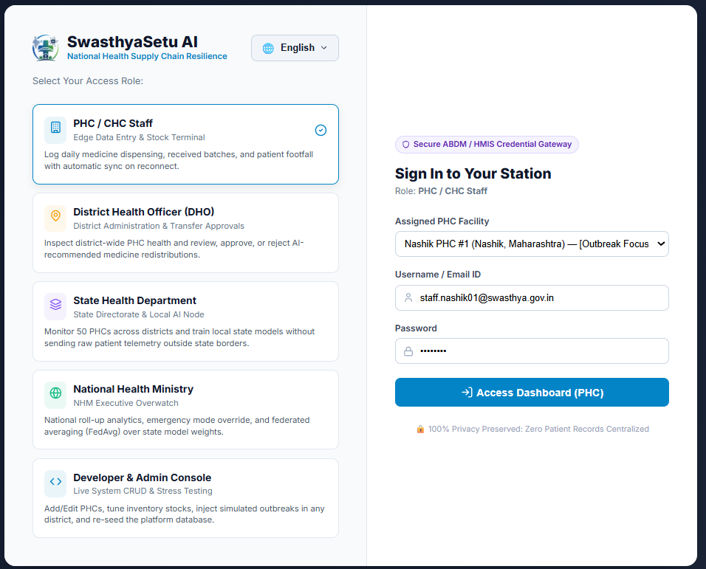
LIVE PROTOTYPE
Role-Based Access, Secured End-to-End
5 operational stations — PHC staff to National Health Ministry, one platform
Secure sign-in — zero patient records ever centralized

Slide 7
Thank You
Building a resilient, privacy-first supply chain for India’s public health system.
TEAM EKLAVYA
Rudra Pratap Chaurasiya (Team Leader)
• Sankalp Sachan • Mohammad Sirfan
SwasthyaSetu AI — Smart Health. Stronger India.

