Slide 1
01 · BUSINESS PROBLEM
Managers need a customer view, not a transaction log
Transactions
Customers
Segments
Actions
9.9 lakh rows
what happened
8.4 lakh profiles
who they are
5 behaviour groups
how they behave
42K Tier A customers
whom to call first
Who should I focus on?
Why them?
What opportunity exists?
Where are they?
How large is it?
Five questions a relationship manager must answer with limited time. The Customer 360 makes each one answerable on a single screen.
Source: KavionLens360 pipeline on the public Kaggle 'Bank Customer Segmentation' dataset (Indian bank, 2016). Not ICICI data. Window 1 Aug - 15 Sep 2016.
1
Notes:
Banks have millions of records but limited relationship-manager time. The question is whom to focus on and why. This project turns a transaction file into one row per customer, groups customers by behaviour and ranks conversation opportunities, so a manager can answer: who, why, what, where and how large.

Slide 2
02 · DATASET & METHODOLOGY
Public data, documented rules, every row accounted for
PostgreSQL 16
staging · 17 cleaning rules
star model · customer_360
Python
EDA · 4 tests with effect sizes
K-Means (k = 5) · scoring
Rejected: 59,620 rows, all logged with a reason (sparse tail after 15 Sep; zero amounts).
Quality: 17 checks pass, 1 documented exception (placeholder birth dates), 6 profiling findings.
Identity: only 0.9% of repeat CustomerIDs keep consistent demographics, so repeat behaviour is weak evidence.
Delivery
Power BI · Excel MIS
web dashboard · this deck
Source: KavionLens360 pipeline on the public Kaggle 'Bank Customer Segmentation' dataset (Indian bank, 2016). Not ICICI data. Window 1 Aug - 15 Sep 2016.
2
Notes:
This is a public dataset, not ICICI data. We profiled it first and found two issues: coverage ends on 15 September, and CustomerIDs are not stable person keys. We fixed the window to 46 days, logged every removed row, built one row per customer in SQL, and segmented in Python. Every total reconciles across SQL, Python, Excel and Power BI.

Slide 3
03 · CUSTOMER 360 INSIGHTS
A young, metro-heavy base where the top 10% of customers drive 63% of value
63%
of value from the top 10% of customers
27%
of value from the top 1%
85%
of customers transacted once
So what: effort pays off unevenly. Protect the top decile with named coverage, and do not judge customers on frequency alone.
Source: KavionLens360 pipeline on the public Kaggle 'Bank Customer Segmentation' dataset (Indian bank, 2016). Not ICICI data. Window 1 Aug - 15 Sep 2016.
3
Notes:
Here is who the customers are and where. 72% are aged 18-34. Mumbai, New Delhi, Bangalore, Gurgaon and Delhi lead on value. Value is extremely concentrated: the top 1% generate 27% and the top 10% generate 63% of transaction value. 85% of customers transacted only once in the window.

Slide 4
04 · CUSTOMER SEGMENTATION
Engaged Repeat Users: 15% of customers, 28% of value; a 35% tail adds 4%
Segment | Median bal. | Txns/cust | Active | Action
Engaged Repeat Users | ₹29,937 | 2.14 | 59% | Deepen the relationship
Recent One-Time Spenders | ₹29,017 | 1.00 | 73% | Convert to repeat use
Lapsed One-Time Spenders | ₹28,730 | 1.00 | 0% | Win-back
Low-Ticket Occasional | ₹12,443 | 1.01 | 33% | Low-cost digital nurture only; no RM time
Near-Zero Balance | ₹86 | 1.01 | 29% | Service check and activation; exclude from cross-sell lists
Source: KavionLens360 pipeline on the public Kaggle 'Bank Customer Segmentation' dataset (Indian bank, 2016). Not ICICI data. Window 1 Aug - 15 Sep 2016.
4
Notes:
Five behaviour segments from K-Means, chosen from k = 3 to 10 on silhouette and stability. A small group carries much of the value, and each segment needs a different action. The two one-time spender groups look alike except for recency: one is recent, one is going quiet.

Slide 5
05 · CROSS-SELL OPPORTUNITIES
Signals are prioritised, not guaranteed: each segment gets a short list of conversations
Segment | Investment / MF | Premium account | Credit card | Insurance | Personal loan* | Re-engagement
Engaged Repeat Users | 32% | 11% | 53% | 29% | 11% | 0%
Recent One-Time Spenders | 21% | 14% | 35% | 32% | 12% | 0%
Lapsed One-Time Spenders | 21% | 14% | 35% | 31% | 0% | 33%
Low-Ticket Occasional | 0% | 5% | 0% | 14% | 0% | 8%
Near-Zero Balance | 0% | 0% | 0% | 0% | 16% | 0%
42,077
A
₹1,721 Cr addressable
126,231
B
₹3,718 Cr addressable
252,463
C
₹3,513 Cr addressable
Share of each segment carrying each signal. *Personal loan = demand signal only; no credit judgement.
Weights stress-tested ±10 pts: 84-100% of the top 1,000 unchanged.
Source: KavionLens360 pipeline on the public Kaggle 'Bank Customer Segmentation' dataset (Indian bank, 2016). Not ICICI data. Window 1 Aug - 15 Sep 2016.
5
Notes:
Product holdings are unknown, so these are signals to start conversations, not recommendations or eligibility decisions. Cards and investments lead for engaged customers; re-engagement comes first for the lapsed group. Tier A is the top 5% by score: 42,077 customers with ₹1,721 Cr addressable balance.

Slide 6
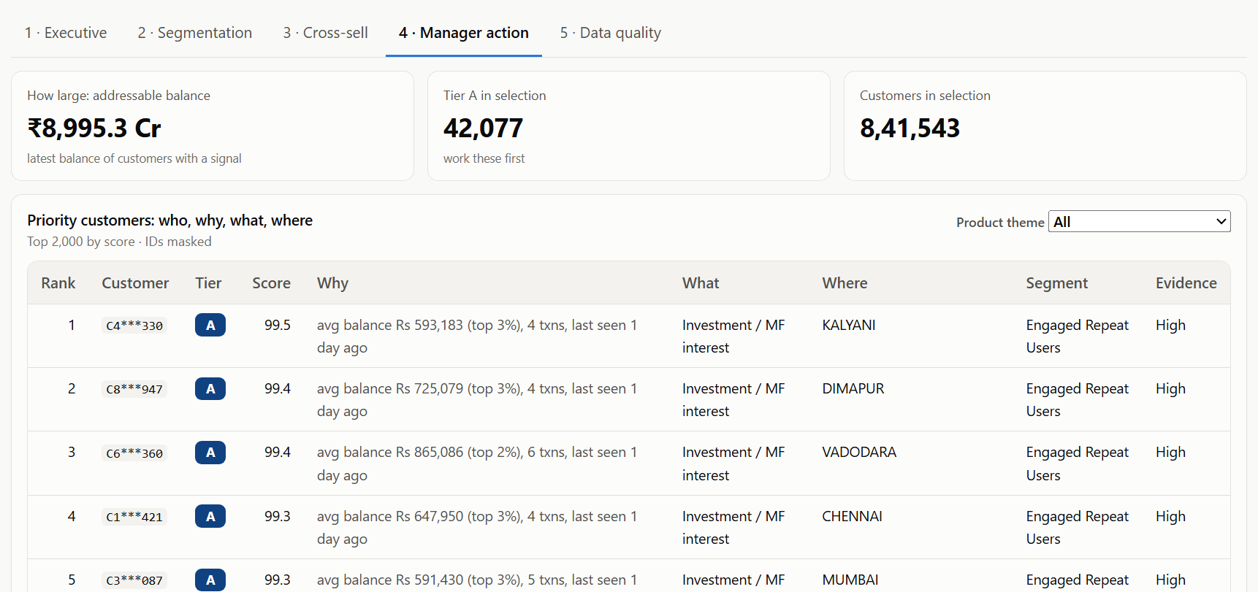
06 · DASHBOARD
A manager can answer five questions on one screen
Who
ranked list, masked IDs
Why
balance, activity, recency in words
What
driving product theme
Where
city filter and column
How large
addressable balance and tier count
Source: KavionLens360 pipeline on the public Kaggle 'Bank Customer Segmentation' dataset (Indian bank, 2016). Not ICICI data. Window 1 Aug - 15 Sep 2016.
6
Notes:
Who, why, what, where, how large. The Manager Action page ranks customers, explains the reason in plain words, names the product theme and city, and sizes the opportunity. Filters for city, segment, tier, theme and evidence level narrow the list to one branch's portfolio. The same view exists in Power BI (Page 4) and on the public web dashboard.

Slide 7
07 · KEY BUSINESS INSIGHTS
What we found, why it matters, what to do
Value is concentrated
Engaged Repeat Users punch above weight
A third of value is going quiet
Top 10% of customers → 63% of value
15% of customers, 28% of value
Lapsed One-Time Spenders: 34% of value, not seen 2+ weeks
→ Named RM coverage for the top decile
→ Deepen: needs review, cards, investments
→ Re-engagement call before any sale
The tail is cheap to serve, not to call
Behaviour beats demographics
Limits
Public 2016 data, 46-day window, no product holdings or revenue. Signals rank conversations; they are not eligibility decisions.
35% of customers, 4.4% of value
Gender and age explain little (V = 0.07, ε² = 0.06)
→ Digital nurture; activation checks
→ Target on behaviour, never on gender
Source: KavionLens360 pipeline on the public Kaggle 'Bank Customer Segmentation' dataset (Indian bank, 2016). Not ICICI data. Window 1 Aug - 15 Sep 2016.
7
Notes:
Five findings, each with its consequence. Numbers are from the reconciled pipeline; none are pre-written.

Slide 8
08 · RECOMMENDED MANAGERIAL ACTIONS
Pilot with Tier A, measure response, refine the rules
Segment | Action | Owner | Timing | Success metric
Engaged Repeat Users | Deepen the relationship: RM introduction call, needs review, bundle offer | Relationship Manager | Within 2 weeks | Products discussed per contact; repeat activity next 30 days
Recent One-Time Spenders | Convert to repeat use: welcome-back nudge and digital activation while the visit is recent | Branch / Digital team | Within 7 days of the transaction | Second transaction within 30 days
Lapsed One-Time Spenders | Win-back: service call or message to understand needs; offer relevant product review | Relationship Manager / Contact centre | This month | Share re-activated within 30 days
Low-Ticket Occasional | Low-cost digital nurture only; no RM time | Digital marketing | Automated | Digital engagement rate; cost per contact
Near-Zero Balance | Service check and activation; exclude from cross-sell lists | Branch operations | Quarterly review | Share with balance above Rs 1,000 next quarter
Weeks 1-4: call Tier A (top 5%), log outcomes
Week 5: compare response by segment and theme
Then: tighten card / insurance rules, learn weights from outcomes
Source: KavionLens360 pipeline on the public Kaggle 'Bank Customer Segmentation' dataset (Indian bank, 2016). Not ICICI data. Window 1 Aug - 15 Sep 2016.
8
Notes:
Actions are specific and measurable: each segment has an owner, timing and KPI. Start with a four-week pilot on Tier A, track the response, then use the outcome data to tighten the broad signal rules and learn the score weights.

