Slide 1
Encryption and Decryption using AES
PREPARED BY
18DCS007 | RUDRA BARAD 18DCS044 | ROHAN MEHTA
6CSE
SUPERVISOR
Prof. Khushi Patel
CSE345 - Cryptography and Network Security
Notes:
Rohan

Slide 2
TABLE OF CONTENTS
01
02
Objective and Motivation
Introduction to AES
03
04
How AES
works ?
Gantt Chart and Implementation
Notes:
Rohan

Slide 3
01
OBJECTIVE & MOTIVATION
Notes:
Rohan

Slide 4
OBJECTIVE
Objective of this project is to create a python script to encrypt and decrypt different types of files, working on the basis of AES Algorithm
Notes:
Rohan

Slide 5
MOTIVATION
Due to faster growth in multimedia technology, internet and cell phones, there is a need for security in digital media. Therefore there is a need for image encryption techniques in order to hide images from such attacks. In this project we use AES to encrypt and decrypt digital media. Such Encryption technique helps to avoid intrusion attacks.
Notes:
Rohan

Slide 6
02
INTRODUCTION TO AES
Notes:
Rudra

Slide 7
WHAT IS AES ?
In the 1990s, DES was rendered insecure due to its relatively small 56-bit key size. So, in 1997, the Advanced Encryption Standard (AES) was proposed to overcome the key size weakness of DES.
The AES algorithm is a symmetrical block cipher algorithm that takes plain text in blocks of 128 bits and converts them to ciphertext using keys of 128, 192, and 256 bits.
It is considered as worldwide standard.
Notes:
Rudra

Slide 8
ADVANTAGES OF AES
High Speed Algorithm
Simple Design
Low Memory Cost
01
02
03
Ciphertext and Plain Text have same size
Most Robust as used in both Hardware and Software
Uses higher key length sizes: 128, 192 & 256 bits
04
05
06
Notes:
Rudra

Slide 9
DISADVANTAGES OF AES
Uses very simple algebraic structure
Every block is always encrypted in same way
01
02
Somewhat hard to implement with software
If key not employed properly, can cause cryptanalytic attack
03
04
Notes:
Rudra

Slide 10
03
HOW AES WORKS
Notes:
Rudra

Slide 11
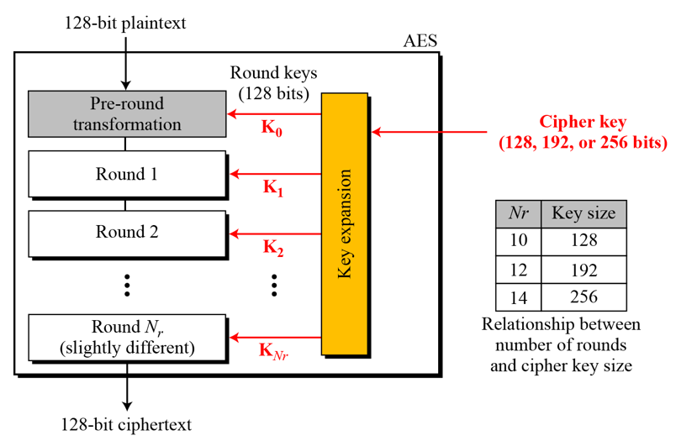
WORKING OF AES
AES operates on an entire block of plain text in the form of a single matrix at each round which includes substitution and permutation. AES uses 10, 12 and 14 rounds
10 rounds : 128-bit key
12 rounds : 192-bit key
14 rounds : 256-bit key
Steps in each round
1. Substitution of the bytes
2. Shifting the rows
3. Mixing the columns
4. Adding the round key
Notes:
Rudra

Slide 12
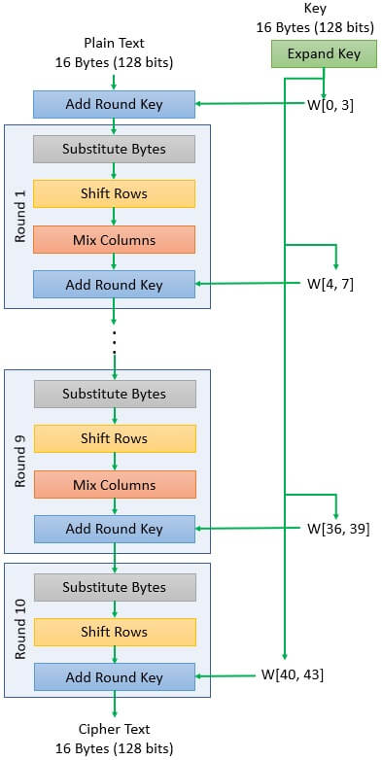
AES ALGORITHM
Notes:
Rudra

Slide 13
04
Gantt Chart
Implementation
Notes:
Rohan

Slide 14
GANTT CHART
 | FEBRUARY | MARCH | APRIL | MAY
PLANNING
RESEARCH
LEARN
IMPLEMENTATION
TESTING & DEBUGGING
Notes:
Rohan

Slide 15
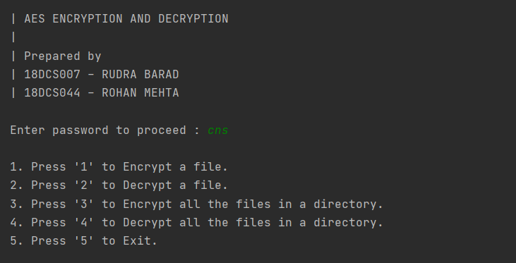
IMPLEMENTATION
SCREENSHOTS
Notes:
Rohan

Slide 16
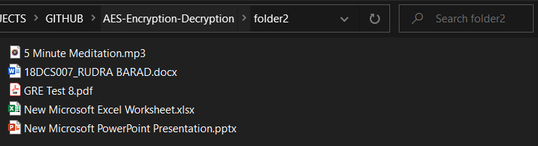
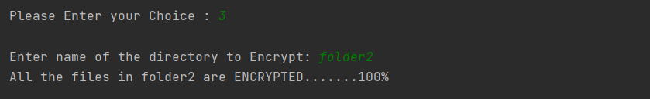
IMPLEMENTATION SCREENSHOTS
Notes:
Rohan

Slide 17
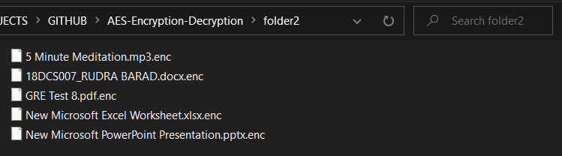
IMPLEMENTATION SCREENSHOTS
Notes:
Rohan

Slide 18
CONCLUSION
Learned and created a program to encrypt and decrypt different types of files using Advanced Encryption Standard (AES)
Using this single/multiple files can be encrypted for storing or sharing amongst different users safely
Notes:
Rohan

Slide 19
REFERENCES
“
https://binaryterms.com/advanced-encryption-standard-aes.html
“
https://www.educative.io/edpresso/what-is-the-aes-algorithm
“
https://www.youtube.com/watch?v=o-MZgVJP-rI
“
https://www.youtube.com/watch?v=BPXEy6FzoWU
Notes:
Rohan

Slide 20
THANKYOU

