Slide 1
Talking Tableau using Alexa Voice Interaction

Slide 2
Alexa Voice Integration for Talking Tableau
Business Solution
Use Case :
Getting the Tableau Dashboard Report using Alexa Voice Interaction.
Benefits :
Business users can have the facility of invoking the dashboard summary just asking Alexa thru Alexa device or thru Mobile Alexa App
Voice Interaction , reduces the licensing cost of the Tableau and data availability on the fly
Voice Interaction gives ease of interaction than any other mode with real feeling of interaction with data.
Technology Stacks:
Alexa Voice Recognition system
Alexa Skill Kit (https://developer.amazon.com/)
AWS (Lambda,S3,DynamoDB,Cloud Watch,IAM role) https://aws.amazon.com/
Programming Language : Node JS 8.3
Postman (Invoking REST calls)
Tableau Rest APIs,Dasboard,Tableau Online/Server
Intended Audiences : CIO and CTO’s of GE Renewable Energy

Slide 3

User asks Tableau dashboard summary
It goes thru Alexa Skill Kit in the form of JSON message
Passed JSON inputs to AWS Lambda function
Node JS try to connect Tableau Online , get the data and fetch the data according to user commands
Dynamo DB saves encrypted REST calls
Goes back to Alexa skill Kit as JSON Output
Ultimately User listens the reply from Alexa

Slide 4
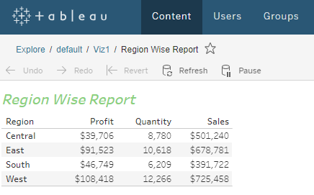
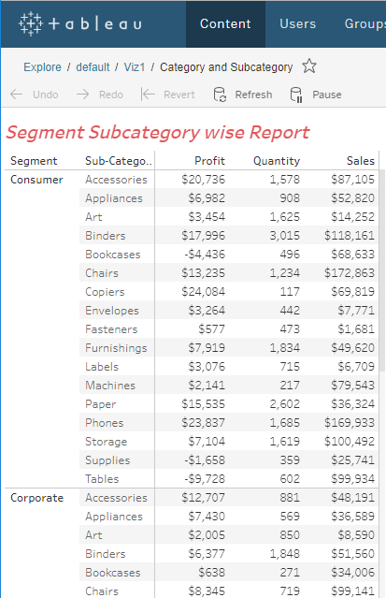
Alexa Voice Integration for Talking Tableau
Sample Tableau Published Report

Slide 5
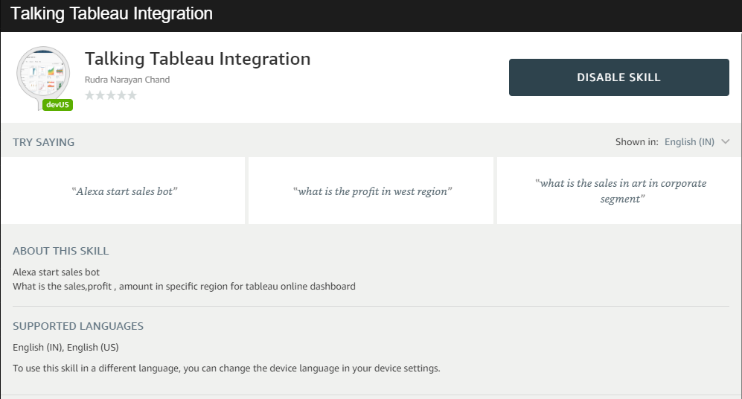
Alexa Voice Integration for Talking Tableau
How to invoke the Skill
Intents ( Alexa Skill Name : Sales Bot)
You can ask Alexa below questions showing in screenshot as an example of retrieving the Tableu report.

