Slide 1
Frequent Path LICM
Due On: Feb 23, 2025

Slide 2
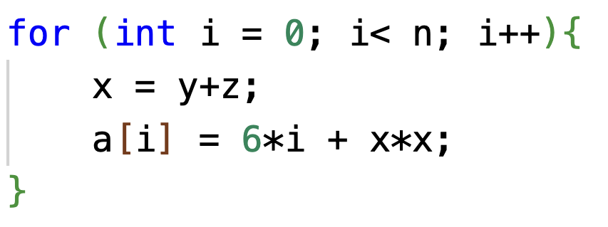
Loop Invariant Code Motion (LICM)
These values do not change within the body of the loop.

Slide 3
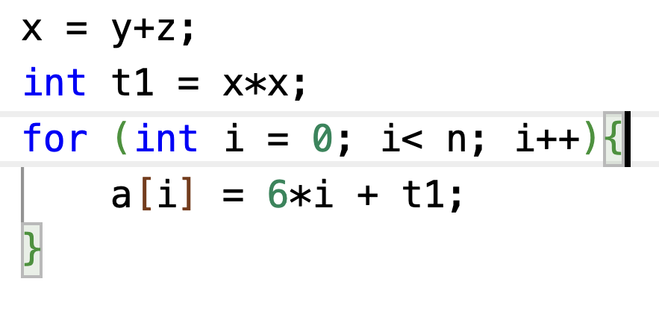
Loop Invariant Code Motion (LICM)
Move operations whose source operands do not change within the loop to the loop preheader.
Execute them only 1x per invocation of the loop.
LICM is already implemented in LLVM
/lib/Transforms/Scalar/LICM.cpp

Slide 4
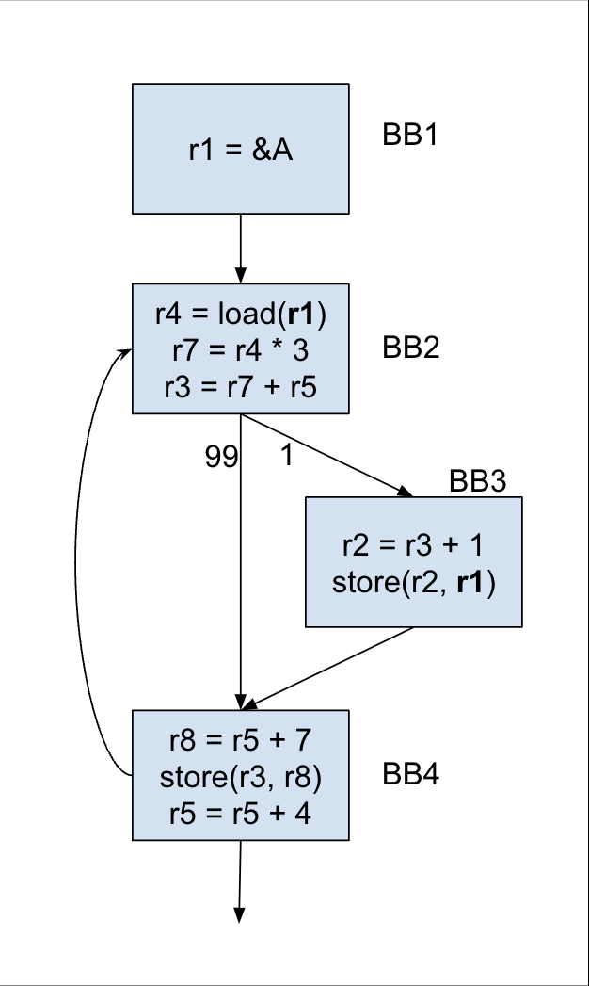
Frequent Path LICM
There is a store-load dependency.
The load cannot be hoisted up because it is not invariant in the loop.
But according to the profile data, it nearly never changes.

Slide 5
Implementation Steps
Identify the loops. Then for each loop:
Identify the frequent path (≥ 80%).
Identify loads that are invariant on the frequent path.
Perform LICM on those loads.
[Bonus] Perform LICM on other instructions.
Add fix-up code to ensure that the execution is correct.

Slide 6
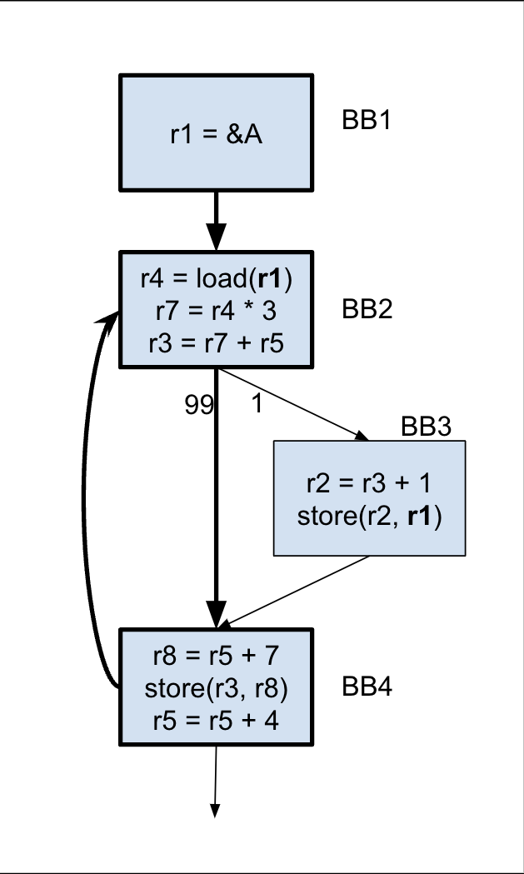
Identify the Frequent Path
Start at the loop header, keep choosing the branch that is taken at least 80% of the time, or until the loop is closed.
We do not consider the cumulative probabilities (may drop lower).
Everything not on the frequent path is considered to be on the infrequent path.
Performance: You can use a different threshold.

Slide 7
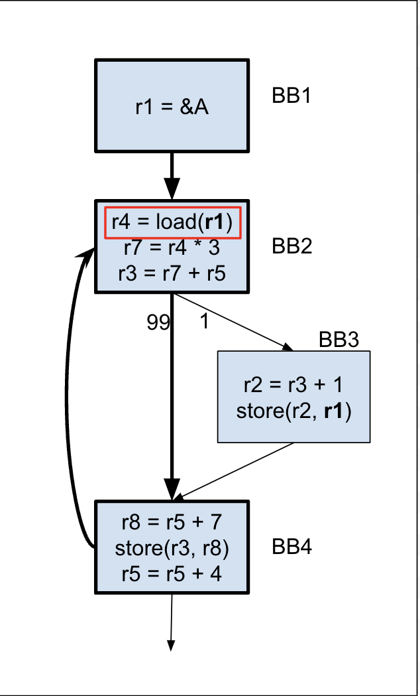
Identify the “almost” invariant loads
Now that we consider only the frequent path, the load has become invariant.
For correctness, you only need to consider the loads.

Slide 8
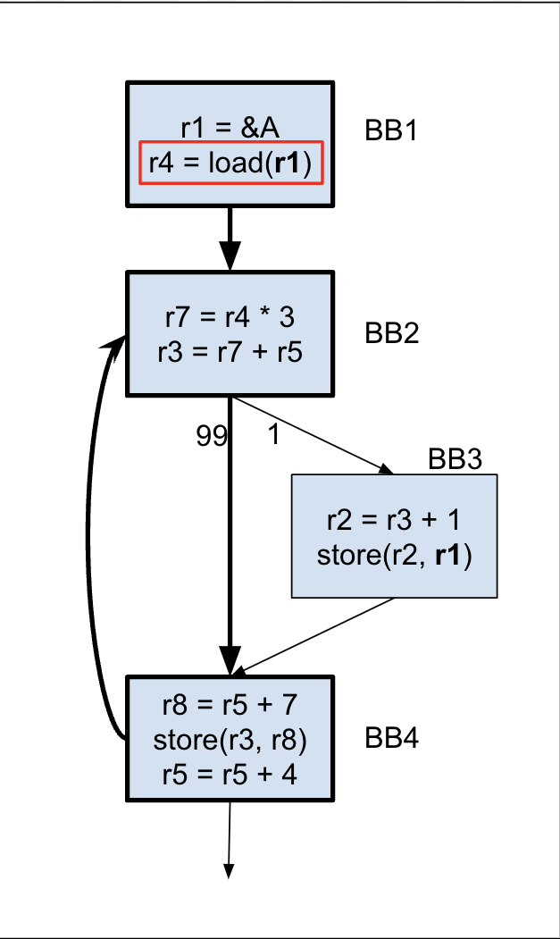
Move the Load
We can now move the load up to the pre-header.
This is the key optimization step as the load is now executed only once.
However it is important to note that the program in its current state will not be correct.

Slide 9
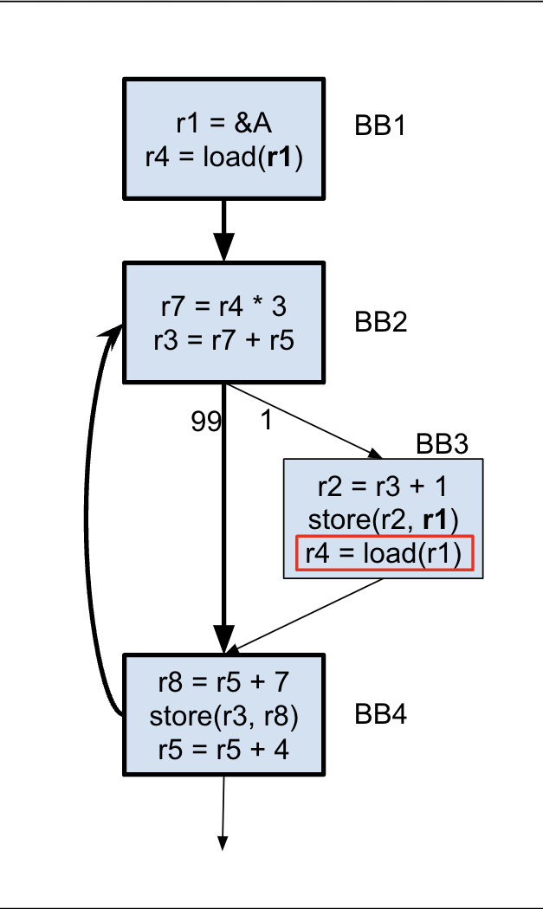
Fixing Up
Now that we have moved the load, we need to add code so that the program execution is correct.
Just copying the load instruction to the infrequent path will ensure that it works correctly.

Slide 10
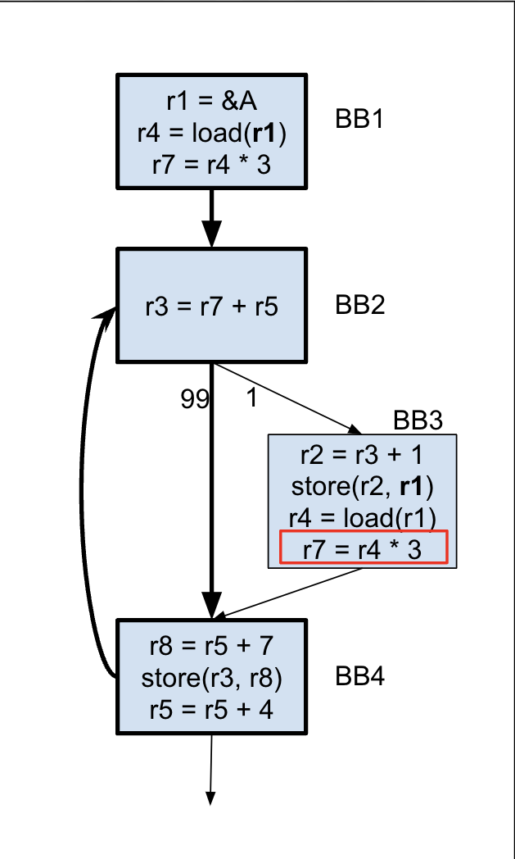
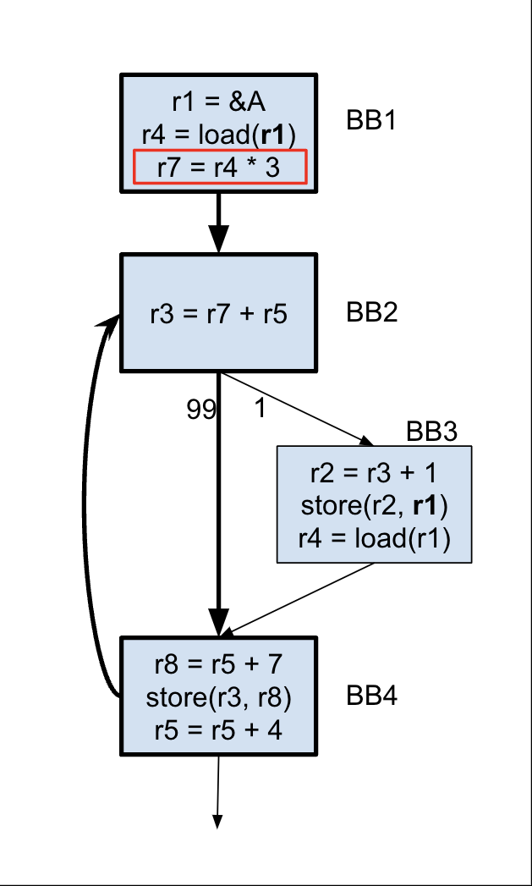
[BONUS] Move more instructions
Since we moved the load, the following instruction has also become invariant in the loop.
So we can move it up to the pre-header as well, adding to our gains.
And we need to add the fix up code too.

Slide 11
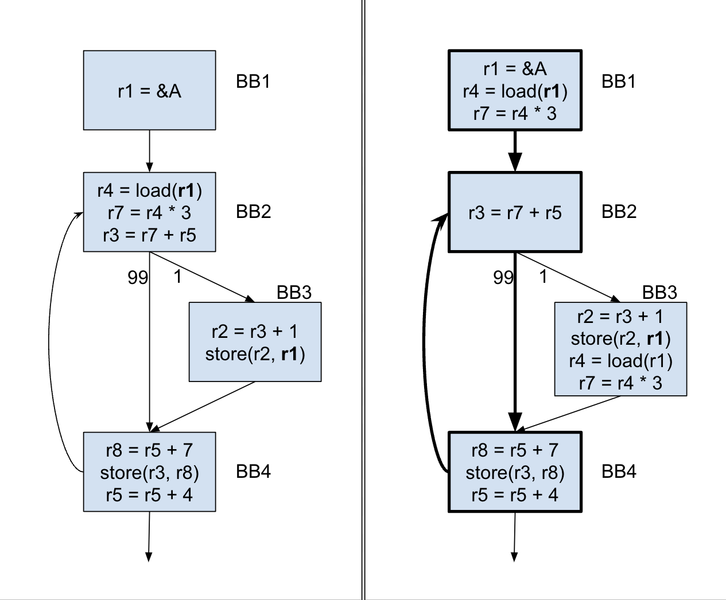
FPLICM
After
Before

Slide 12
What you have been given
A run script
A viz script
Benchmarks
6 correctness (Mandatory)
Simple cases exploring different scenarios that your code should be able to handle.
4 performance (Optional)
Cases with high trip counts and more opportunities for hoisting.
Basic template to write code in.

Slide 13
Some LLVM Resources
Disclaimer: These are only recommendations, you do not have to use these.
Always a useful resource: https://llvm.org/docs/ProgrammersManual.html

Slide 14
Instructions and Variables
Most Instructions have a constructor (look at the documentation)
It allows you to specify operands
It also allows you to specify where you want to insert this instruction.
Many instructions also have a clone() function
Functions that are useful across all Instructions are in llvm/IR/Instructions.h
These include functions that can be used to insert/move instructions
Use AllocaInst to allocate memory space on the stack.

Slide 15
An important note on SSA
LLVM is in SSA form. You have learned it during the course.
This means that when you clone an instruction, the LHS will be different.
You need to ensure that the correct values are used in the correct places.
One solution is to store the value onto the stack (in the pre-header) and retrieve it before any use.
Another solution is to use PHI nodes to merge the values of the copy and the moved instruction.

Slide 16
Final Notes
Read the spec on Canvas carefully and thoroughly.
Start early.
Make sure you do not break the program.
Do not debug your code using autograder, visualize and verify yourself.
Start with the given script and template.
If you finish early, attempt the bonus part.
Check Piazza frequently, someone may have encountered the same issues as you.
For performance, your code needs to be correct, not just fast.

Slide 17
Thank You

