Slide 1

BitCampus
LEARN • TRACK • GROW • BELONG
A Smart Student Portal / Student OS that unifies academics, campus life, career, and student support into one intelligent, retro-modern workspace — entirely frontend-first, beautifully designed, and built for the modern student.
👨‍💻 Author
🔗 Live Demo
Rudraksh Kumar
Sandeep khuswaha
View on Vercel ↗ | GitHub Repo ↗

Slide 2

THE PROBLEM
Fragmented Portals, Frustrated Students
Academic Overload
No Smart Alerts
No single view of CGPA, attendance percentage, pending assignments, and upcoming exams together
Students miss fee deadlines, library due dates, placement drives, and notice-board updates
Career Blindspot
Poor UX
Placement readiness, internship opportunities, and resume health are rarely surfaced proactively
Generic portals lack personality, context-awareness, and any kind of intelligent student guidance
A student juggling 8 different portal sections cannot focus on learning. BitCampus fixes this with one unified, intelligent workspace.

Slide 3
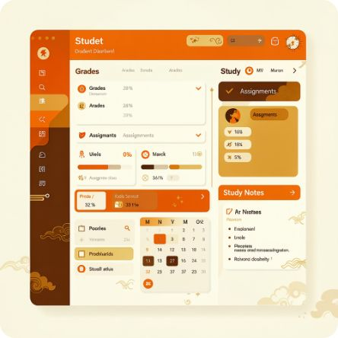
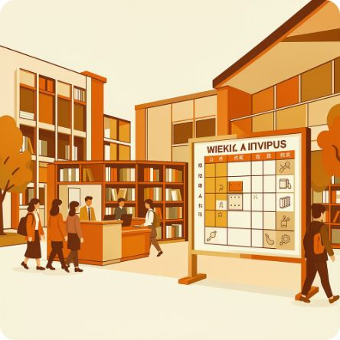

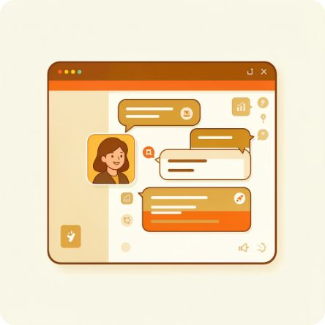
CORE MODULES
Everything a Student Needs, Organised.
BitCampus streamlines the student experience by integrating essential tools and information into intuitive modules:
Academics
Campus Services
Career & Support
BitAI Assistant
Dashboard with CGPA, semester progress, subject-wise attendance (with safe-zone predictor), results, SGPA calculator, and assignment tracker with overdue detection.
Weekly timetable with live-class indicator, library with issue/return and fine estimation, fee breakdown with demo payment, notices, and student registration workflow.
Placement portal with job/internship listings, application tracking, resume readiness score, preparation metrics, feedback/grievance system, and important support links.
Frontend rule-based assistant answering portal questions using page context and localStorage — attendance status, pending fees, CGPA queries, issued books, and more.

Slide 4
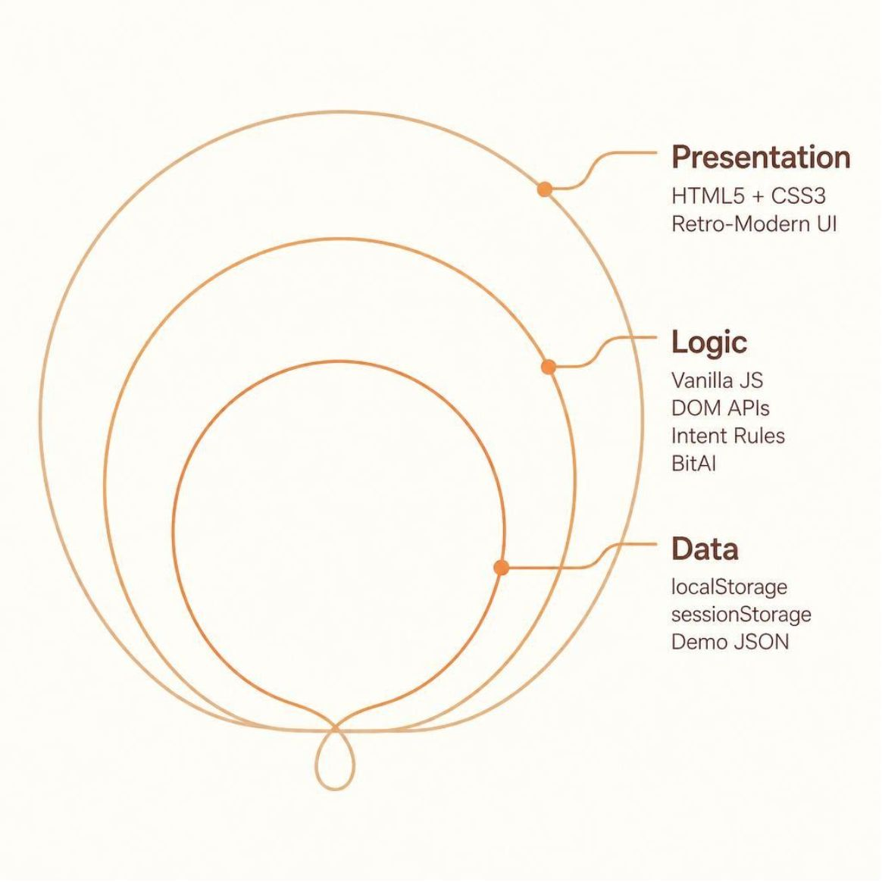

TECHNICAL ARCHITECTURE
Technical Architecture - Smart Layer & Frontend Architecture
Authentication
Frontend session via bitCampusSession key in localStorage. Demo credentials: student@bitcampus.com / 123456. Not production security.
Smart Layer Capabilities
Global search
Attendance safe-zone predictor
Daily Campus Brief
Study streak
Smart alerts
Future Architecture
Node.js/Express or FastAPI backend
secure RBAC auth
university APIs
hosted or local LLM
student risk engine
gamification layer
Frontend-Only Prototype: No real backend, payment gateway, university database, or remote LLM in the current version. All data is demo/local only.

Slide 5
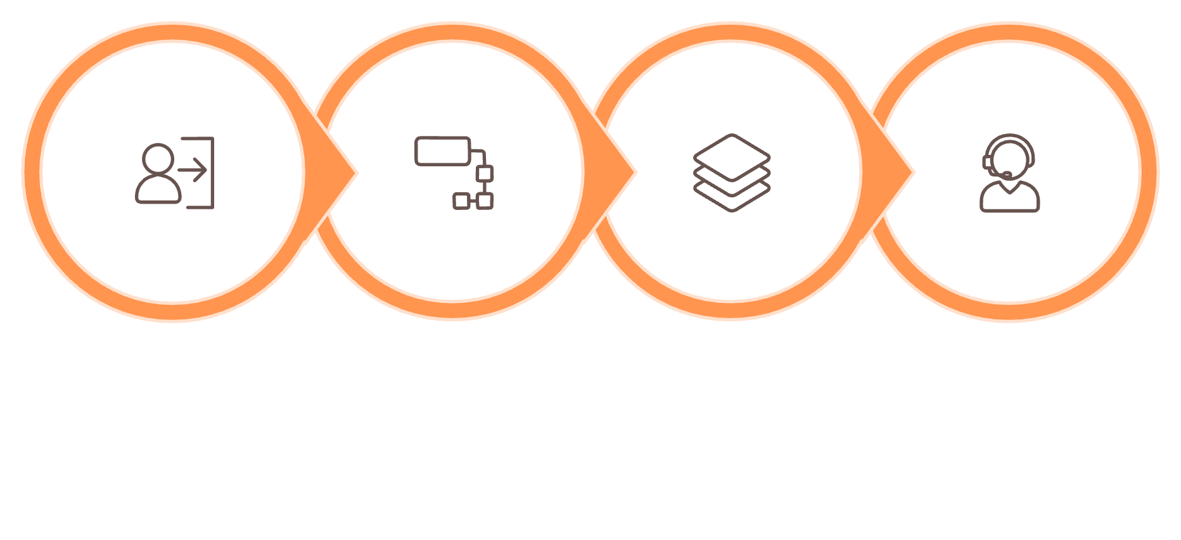
THE SOLUTION
The Solution - One Smart Workspace for Every Student Need
BitCampus delivers a unified, intelligent workspace that seamlessly integrates academics, campus life, career resources, and student support. It transforms the fragmented portal experience into one cohesive retro-modern interface, designed for the modern student.
Student Login
Portal Modules
Smart Layer
BitAI Assistant
Retro-Modern UI
Smart Intelligence
Zero Backend
Parchment panels, dark ink borders, tape motifs — a campus notice-board reborn as a digital OS.
Rule-based BitAI, smart alerts, study streaks, and daily campus briefs — all locally powered.
Pure HTML5, CSS3, and Vanilla JS with localStorage — runs anywhere, instantly, no server needed.

Slide 6
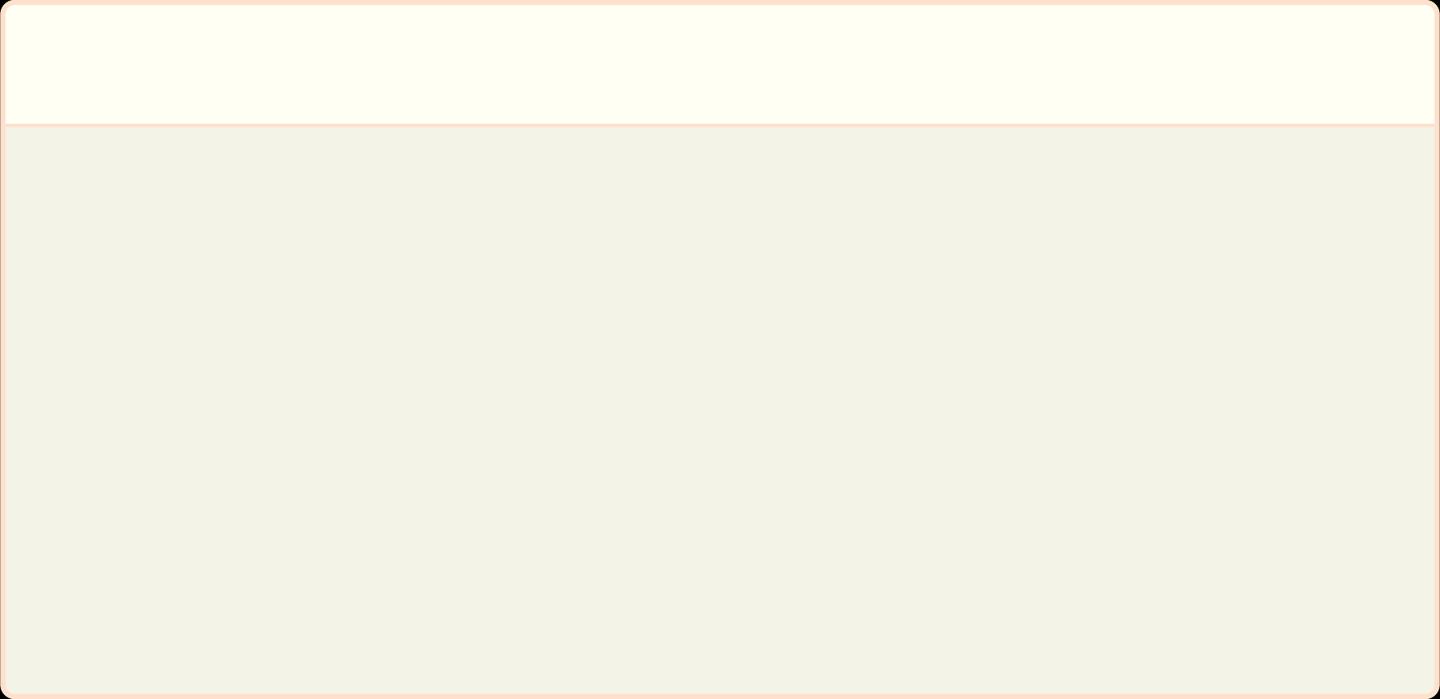
IMPACT & VISION
Impact & Vision - From Student Portal to Smart Student OS
BitCampus delivers a unified, intelligent workspace that seamlessly integrates academics, campus life, career resources, and student support. It transforms the fragmented portal experience into one cohesive retro-modern interface, designed for the modern student.
1
2
Student Value - One login, zero confusion.
Future Vision
Students gain a unified view of academics, campus life, and career readiness — with smart nudges that prevent missed deadlines and attendance drops.
AI study planner
Academic health score
Digital student twin
Career match engine
XP/gamification
Focus mode
Campus knowledge base powered by RAG + local LLM
Live Demo
GitHub Repo
Primary Demo link
View Source link

