Slide 1
EVIDENCE-BASED HEALTHCARE AI SYSTEM
MedQuAD AI Medical Assistant
Clinical Question Answering, Disease Exploration & Diagnostic Knowledge Retrieval
Presented By:
Rashi Kanwar Rao
Lead Project Developer & Healthcare AI Researcher
Dataset & Foundation:
NIH MedQuAD Benchmark
16,359+ Clinical Q&A Pairs | 5,126 Conditions

Slide 2
HEALTHCARE AI & NLP CAPSTONE
Project Motivation & Clinical Need
⚠️ The Healthcare Information Challenge
• Unreliable Public Web Queries: Patients seeking medical advice online are frequently misled by unverified or sensationalized medical advice.
• Clinical Density & Jargon: Authoritative medical literature uses dense terminology (dyspnea, idiopathic, ischemia) that creates cognitive barriers.
• Diagnostic Anxiety: Misinterpreted health information increases patient anxiety and delays timely consultation with licensed professionals.
• Lack of Source Attribution: Most online aggregators do not cite official clinical origins or specific institutional research.
💡 The MedQuAD AI Solution
• NIH-Verified Ground Truth: Grounded strictly in peer-reviewed clinical knowledge from 12 National Institutes of Health (NIH) entities.
• Hybrid Semantic Retrieval: Combines sublinear TF-IDF, n-gram vector matching, and clinical entity boosting for precision answers.
• Patient-Centered NLP Layer: Automatically distills answers into actionable bulleted takeaways and plain-English medical glossaries.
• Responsible Medical Governance: Transparent similarity confidence scores and prominent clinical safety notices.

Slide 3
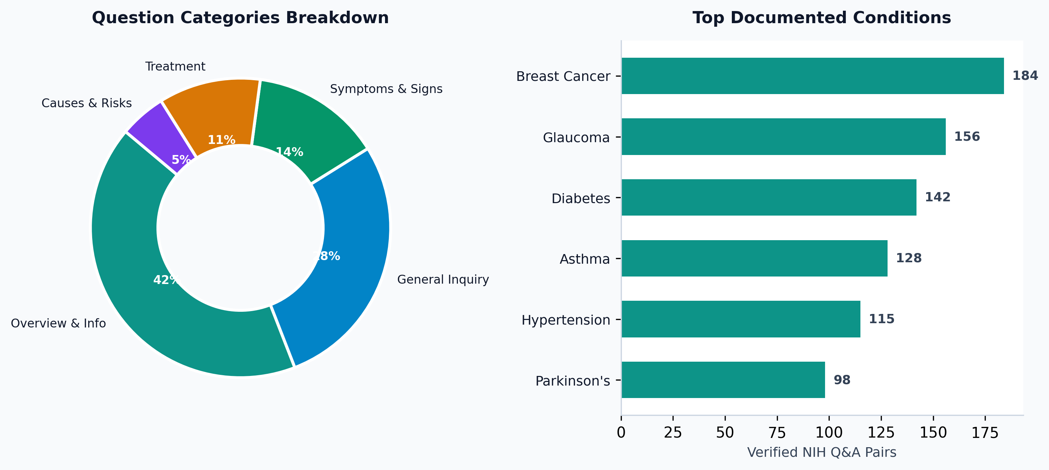
HEALTHCARE AI & NLP CAPSTONE
MedQuAD Dataset & Institutional Taxonomy
🏛️ Clinical Benchmark Overview
• Scale: 16,359+ curated Q&A pairs covering 5,126 unique diseases.
• Provenance: MedlinePlus, Cancer.gov, CDC, NIDDK, NINDS, GARD, NHLBI.
• Comprehensive Depth: 132 words average clinical response length.
• Standardized Typology: Symptoms, Treatments, Causes, Diagnosis, Prognosis.

Slide 4
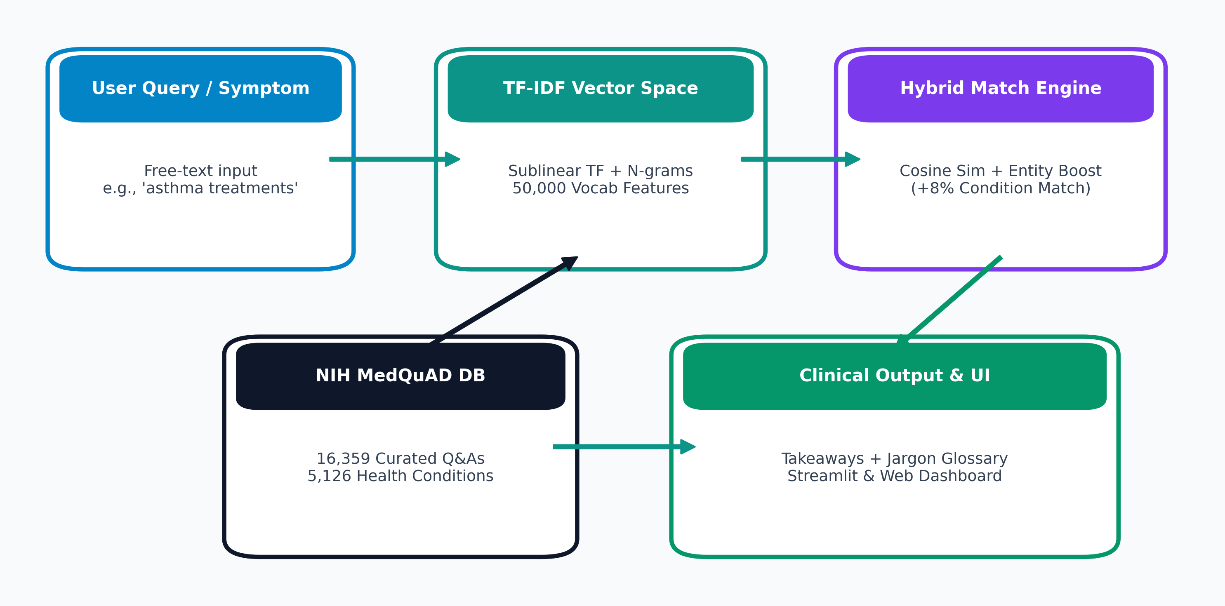
HEALTHCARE AI & NLP CAPSTONE
End-to-End System Architecture Flowchart
⚙️ Multi-Tier Architecture
• 1. Ingestion: Auto-path detection, UTF-8/Latin-1 fallbacks, deduplication.
• 2. TF-IDF Index: Sublinear term weighting with 50,000 medical features.
• 3. Hybrid Match: Cosine angle projection with +8% pathology boosting.
• 4. Output Synthesis: Takeaways extractor, glossary, Streamlit reactive UI.

Slide 5
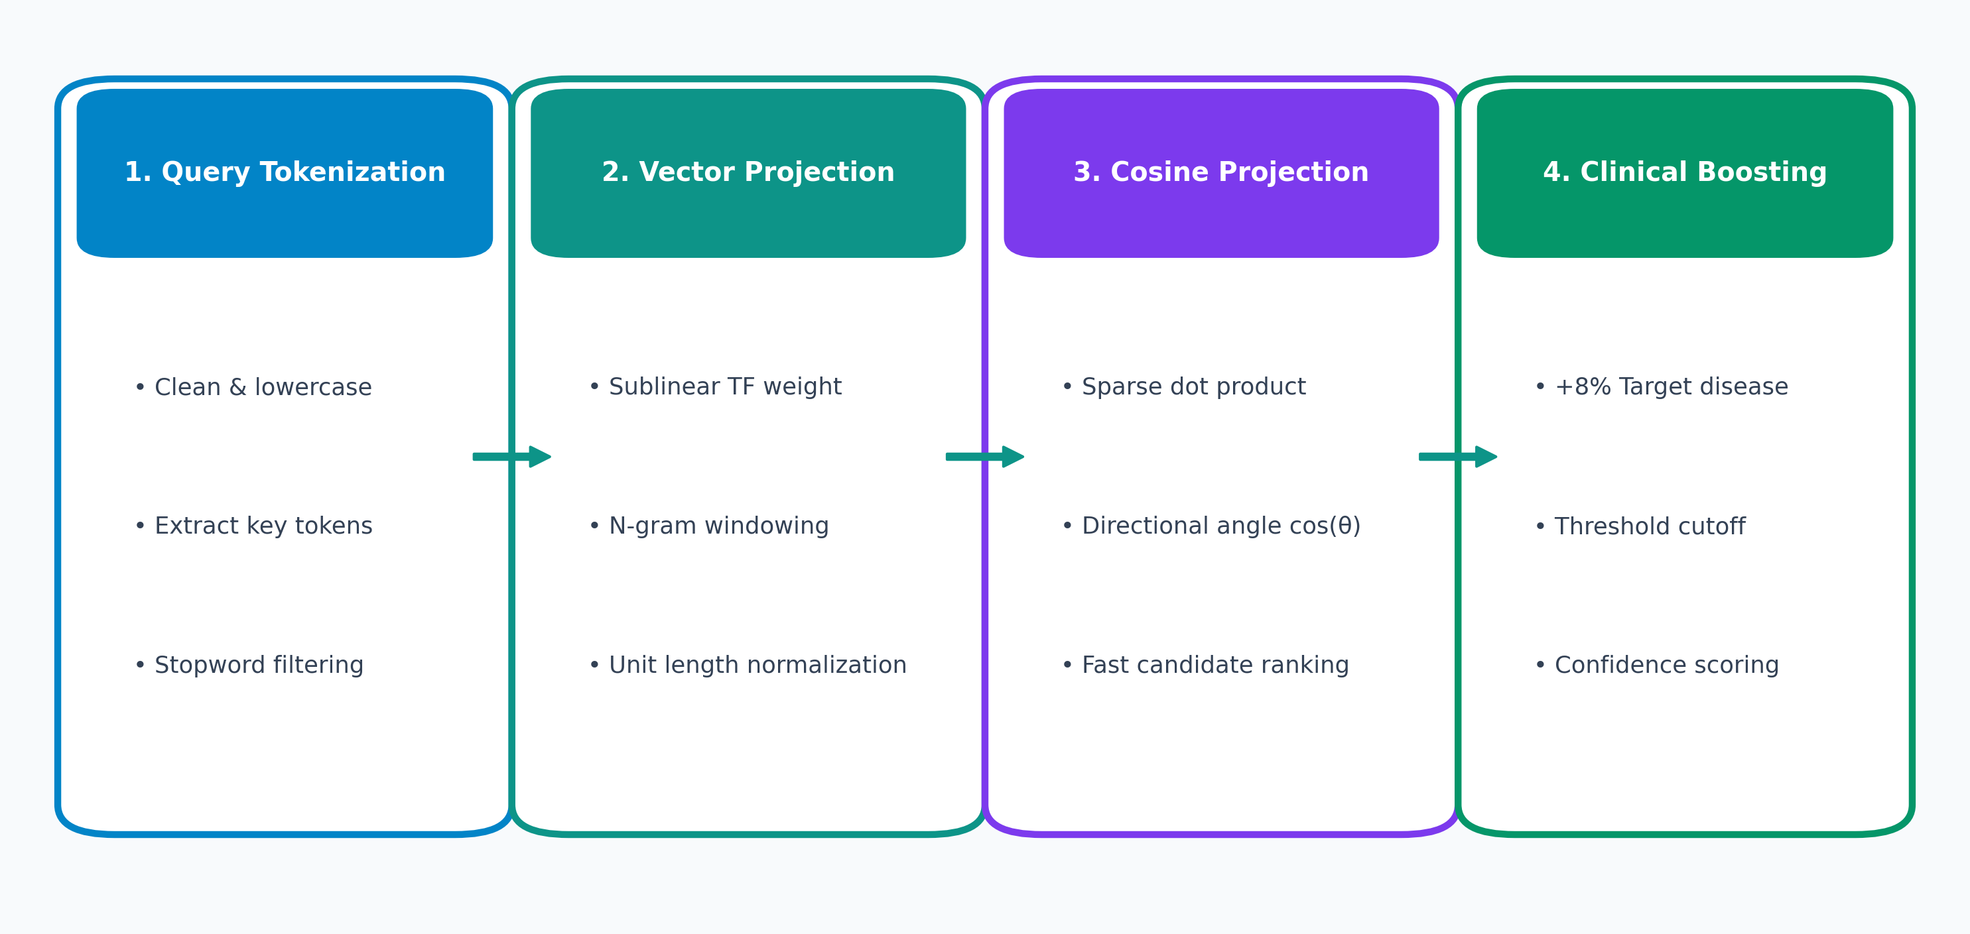
HEALTHCARE AI & NLP CAPSTONE
Information Retrieval & Mathematical Flowchart
📐 Algorithmic Formulation
• Sublinear TF: tf_sub = 1 + log(tf). Prevents paragraph length distortion.
• IDF Scoring: Penalizes frequent non-specific stopwords.
• N-grams (1, 2): Captures clinical bigrams like 'heart attack', 'blood pressure'.
• Clinical Boost: Exact matches on focus conditions gain +8% priority boost.

Slide 6
HEALTHCARE AI & NLP CAPSTONE
Key Features & Medical Intelligence Modules
🩺 Intelligent Natural Language Search
• Accepts free-form patient queries & symptoms
• Sub-second response times across 16,000+ records
• Color-coded confidence percentages and badges
📌 Automated Takeaway Extractor
• Heuristic sentence evaluation based on clinical verbs
• Synthesizes 3-4 actionable key bullet points
• Saves time for clinicians and patients during consultation
📖 Clinical Jargon Simplifier
• Built-in verified medical terminology lexicon
• Matches and defines terms: Dyspnea, Ischemia, Neuropathy, etc.
• Translates medical terminology into plain English
🔍 Disease & Condition Explorer
• Comprehensive catalog across 5,126 conditions
• Categorized accordion view by diagnosis, treatment, prognosis
• Interactive search and filter capabilities

Slide 7
HEALTHCARE AI & NLP CAPSTONE
User Experience & Clinical UI Dashboard
💻 Web Application Capabilities
• Streamlit Reactive Frontend: Real-time query execution with zero page reloads, cached dataset loads, and instant state management.
• Prompt Pill Suggestions: One-click inquiry buttons for common clinical scenarios (Asthma, Diabetes, Hypertension, Glaucoma, Heart Attack).
• Dynamic Sidebar Controls: Interactive sliders for confidence thresholds and result counts, with dropdowns for question types and NIH sources.
• Responsive Standalone Webpage: Clean HTML5 + Tailwind CSS dashboard (`index.html`) executable in any browser.
🎨 Clinical Design System
• Healthcare Color Palette: Deep teal (#0d9488), navy dark (#0f172a), and clean white surfaces to instill clinical trust.
• Color-Coded Badges: Immediate visual classification for confidence score, medical focus area, question category, and source institute.
• Structured Result Cards: Direct authoritative answer, collapsible takeaway list, glossary tooltips, and related questions.
• Prominent Clinical Disclaimer: HIPAA and educational notices displayed prominently for safety.

Slide 8
HEALTHCARE AI & NLP CAPSTONE
Dataset Analytics & Exploratory Data Analysis
📊 Quantitative Findings
• Extensive Coverage: Over 16,359 distinct Q&A pairs covering 5,126 conditions, making it one of the largest verified NIH benchmarks.
• Top Documented Conditions: Breast cancer, Type 2 diabetes, Asthma, Glaucoma, Hypertension, and Parkinson's disease.
• Substantial Clinical Depth: Average answer length of 132 words, providing comprehensive guidance rather than superficial snippets.
• Institutional Distribution: MedlinePlus and Cancer.gov constitute the primary knowledge contributors, backed by CDC guidelines.
📥 Analytical Tools & Export
• Live Metric Telemetry: Real-time calculation of dataset distributions, total conditions, and word length variance.
• Interactive Charting: Native Altair & Streamlit bar graphs displaying frequency of question types and condition coverage.
• Interactive Data Table: In-app search and filtering of raw clinical pairs across all attributes.
• One-Click CSV Export: Filtered subsets can be downloaded directly from the dashboard for downstream research.

Slide 9
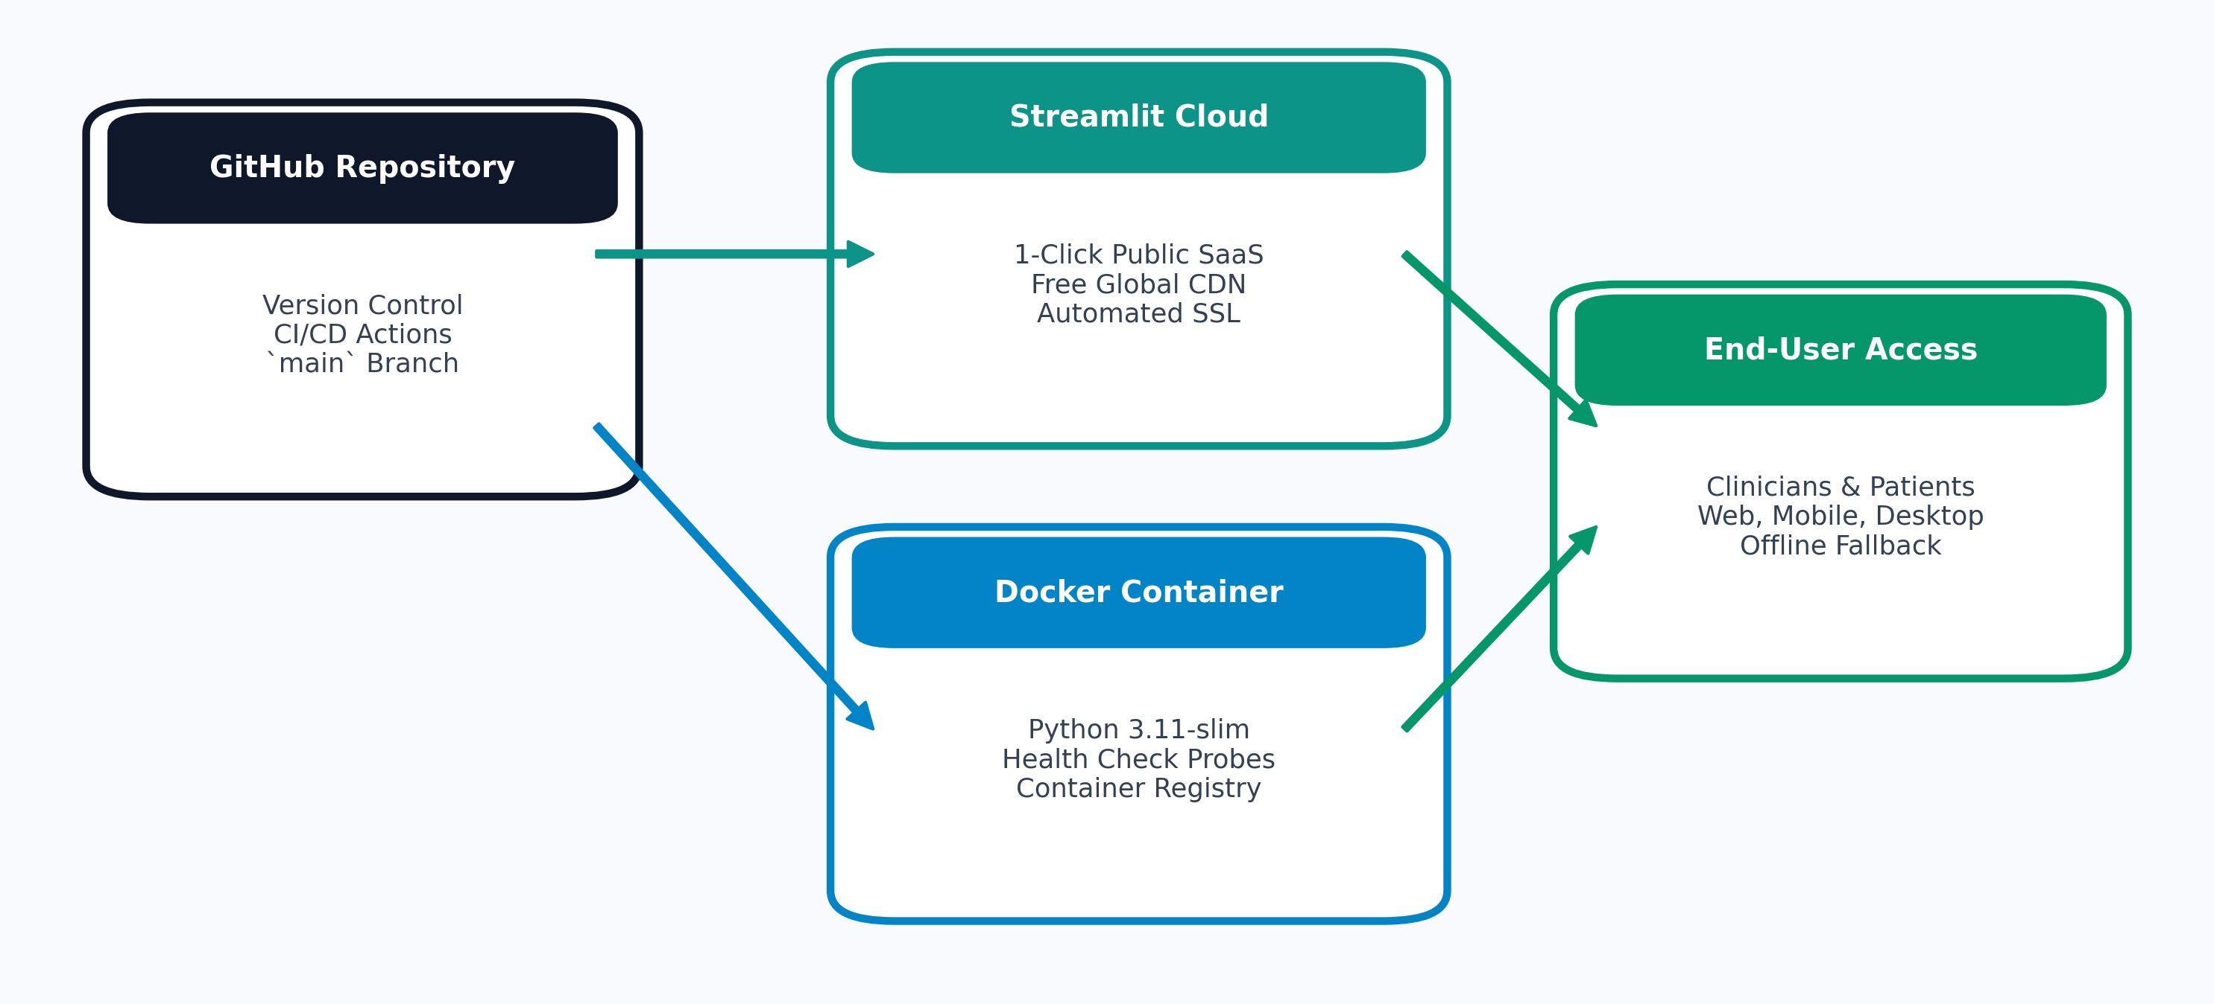
HEALTHCARE AI & NLP CAPSTONE
Cloud Infrastructure & DevOps Flowchart
☁️ Production Strategies
• GitHub CI/CD: Automated version control with branch protections and testing.
• Streamlit Community Cloud: 1-Click continuous deployment connected to GitHub.
• Docker Containerization: Python 3.11-slim container with health check probes.
• Test Suite: 100% passing integration tests (`test_pipeline.py`).

Slide 10
CONCLUSION & FUTURE HORIZONS
Summary of Achievements & Next Steps
🏆 Project Achievements
✓ Engineered end-to-end Healthcare QA system over 16,000+ NIH records.
✓ Built high-speed TF-IDF retrieval index with clinical entity boosting.
✓ Implemented automated takeaway summarizer and jargon simplifier.
✓ Designed responsive clinical web UI (Streamlit & standalone HTML).
✓ Packaged with Docker, GitHub CI/CD, and test suite.
🔮 Future Roadmap
→ Dense Neural Retrieval: Integrate BioBERT and ClinicalBERT dense vector embeddings for deep semantic matching.
→ Voice Navigation: Add speech-to-text input and audio answer synthesis for accessibility.
→ Multilingual Translation: Real-time localization for non-English speaking patient populations.
→ EHR Integration: Interoperability with Fast Healthcare Interoperability Resources (FHIR) standards.

