Slide 1
Project 9: Neural-Network Capacity and Generalization
Separating Learning, Memorization, Overfitting, Inadequate Capacity & Optimization Failure
Six-Member Team Distribution
Member 1: Mathematical Foundations, Derivations & Gradient Verification | Member 2: Synthetic & Real Data Pipelines + Linear Baseline
Member 3: Hidden-Width & Training-Size Experiments | Member 4: Regularization, Early Stopping & Randomized-Label Memorization
Member 5: Computational Budgets & Controlled Diagnostics | Member 6: Integration, Technical Report & Final Reproducibility Audit

Slide 2
Motivation: Why Capacity and Generalization Matter
Low training error is necessary but never sufficient for reliable prediction
Underfitting (High Bias)
Hypothesis class too simple to capture true nonlinear structure.
Both training and validation errors stay high with a small gap.
Cannot be cured by adding more data or running more epochs.
Generalization (Sweet Spot)
Capacity matches signal complexity relative to sample size N and regularization.
Training error approaches irreducible noise without overfitting fluctuations.
Validation and untouched test performance remain closely aligned.
Memorization & Overfitting
Excess degrees of freedom fit sample noise or arbitrary random labels.
Training loss collapses near zero while unseen validation error degrades.
Must diagnose whether failure stems from capacity, variance, or optimization.
Project 9: Neural-Network Capacity and Generalization | Slide 2 / 20

Slide 3
Problem Statement & Central Research Questions
Ten empirical questions tested across synthetic and real-world regression
• Q1. How does hidden-layer width H affect capacity and generalization?
• Q2. How does training-set size N govern variance and gap closure?
• Q3. Can 1-hidden-layer MLPs memorize independently randomized targets?
• Q4. Does greater model capacity always improve test performance?
• Q5. How effective are L2 weight decay, AdamW, and early stopping?
• Q6. How does MLP performance compare against an OLS linear baseline?
• Q7. Can we experimentally separate optimization failure from overfitting?
• Q8. How do fixed-step vs. matched-FLOP budgets alter model comparisons?
• Q9. Do conclusions from 1D synthetic regression transfer to 8D Concrete?
• Q10. What are the mathematical and empirical limitations of this study?
Project 9: Neural-Network Capacity and Generalization | Slide 3 / 20

Slide 4
One-Hidden-Layer Neural Network Architecture
Consistent pure-NumPy & PyTorch architecture across all experiments
Forward Equations & Dimensions
Single observation x ∈ ℝᵈ, hidden width H:
z₁ = W₁ x + b₁ W₁ ∈ ℝ^(H×d), b₁ ∈ ℝ^H
h = φ(z₁) h ∈ ℝ^H
ŷ = W₂ h + b₂ W₂ ∈ ℝ^(1×H), b₂ ∈ ℝ
Total trainable parameters: P(d, H) = H(d + 2) + 1
• Synthetic (d = 1): P = 3H + 1 (H = 4 → 13; H = 256 → 769)
• Concrete (d = 8): P = 10H + 1 (H = 4 → 41; H = 256 → 2561)
Activation Comparison & Selection
tanh(z): smooth C^∞, zero-centered, derivative 1 − tanh²(z).
ReLU(z): piecewise linear, derivative 1[z > 0], kink at z = 0.
Pilot E2 (H = 32, Test R²):
• Synthetic: tanh = 0.9580 vs. ReLU = 0.9415
• Concrete: tanh = 0.8575 vs. ReLU = 0.8410
Selection: tanh chosen as primary controlled activation; ReLU retained for gradient kink & representation diagnostics.
Project 9: Neural-Network Capacity and Generalization | Slide 4 / 20

Slide 5
Observation Model, Loss Function & Regularization
Gaussian MLE equivalence and coupled vs. decoupled weight decay
Gaussian Likelihood ↔ MSE
Model observations as y | x ~ 𝒩(ŷ(x; θ), σ_y²).
Negative log-likelihood over B samples:
−log p(Y | X) = (B/2) log(2πσ_y²) + (1 / 2σ_y²) Σ (ŷᵢ − yᵢ)²
Minimizing NLL is strictly equivalent to minimizing MSE:
L_MSE(θ) = (1 / B) Σᵢ (ŷᵢ − yᵢ)²
Matches torch.nn.MSELoss(reduction='mean') identically.
Regularization Conventions
Coupled L2 (weights W₁, W₂ only; biases excluded):
J(θ) = L_MSE(θ) + (λ / 2)(‖W₁‖_F² + ‖W₂‖_F²)
∇_{W_k} J = ∇_{W_k} L_MSE + λ W_k
Why exclude biases? Shrinking b₂ biases predictions away from target mean.
Coupled L2 vs. AdamW: Under Adam, λ·W is scaled by 1/√v̂; AdamW applies uniform decoupled shrinkage (1 − η·wd) W.
Project 9: Neural-Network Capacity and Generalization | Slide 5 / 20

Slide 6
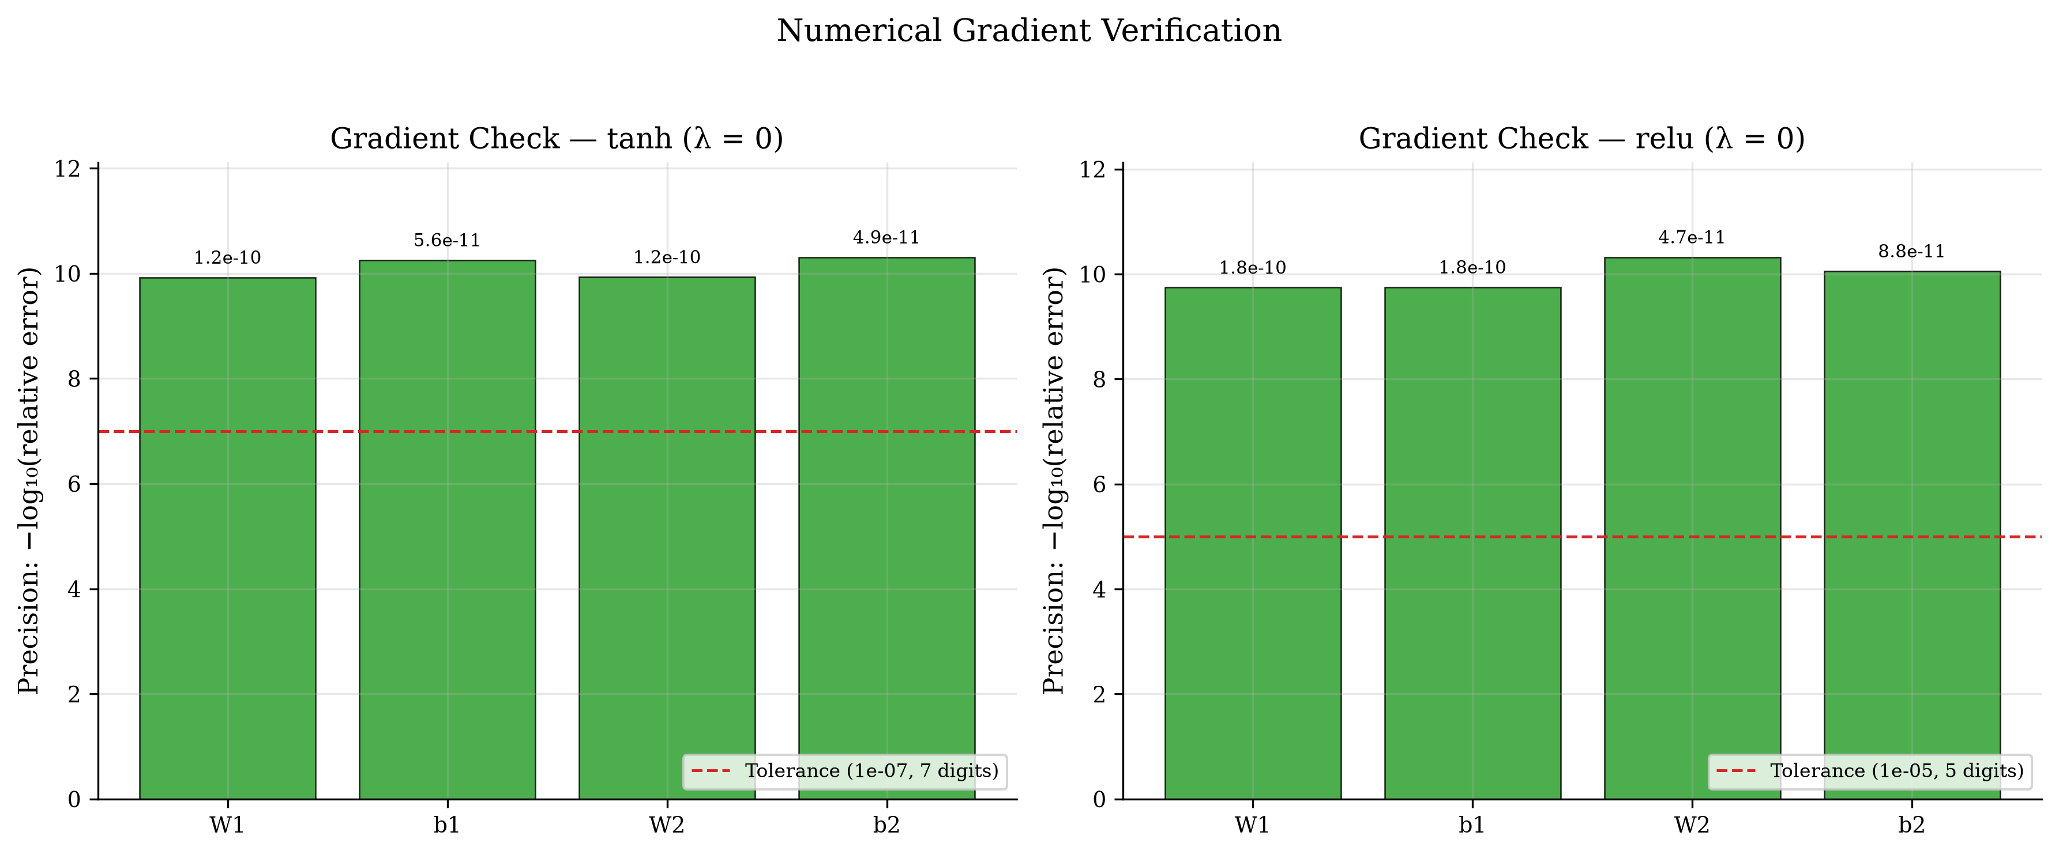
Backpropagation & Finite-Difference Gradient Verification
Analytical vs. central finite differences (ε = 10⁻⁶) vs. PyTorch autograd
• δ_out = (2 / B)(Ŷ − Y)
• dW₂ = δ_outᵀ A₁, db₂ = Σ δ_out
• δ₁ = (δ_out W₂) ⊙ φ′(Z₁)
• dW₁ = δ₁ᵀ X, db₁ = Σ δ₁
• tanh max FD rel error: 1.19e-10 (< 10⁻⁷)
• ReLU (kinks avoided) max FD rel err: 1.80e-10 (< 10⁻⁵)
• PyTorch autograd max rel err: 2.25e-16 (machine precision)
Project 9: Neural-Network Capacity and Generalization | Slide 6 / 20

Slide 7
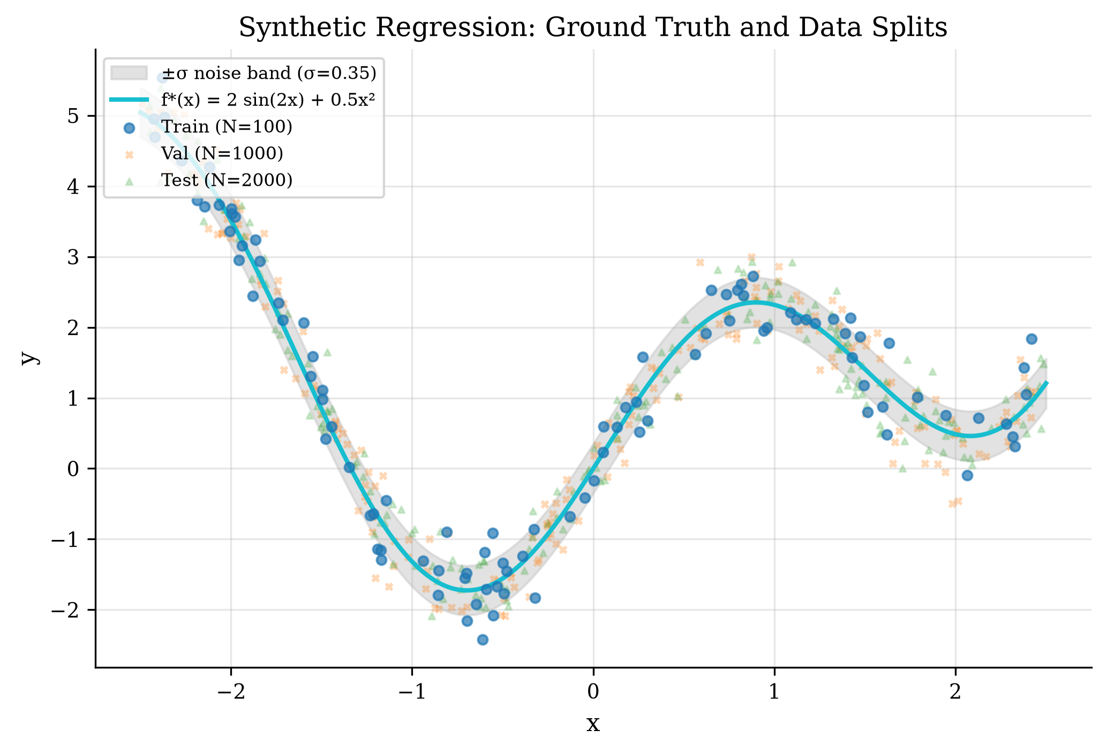
Datasets & Leakage-Free Experimental Design
Controlled synthetic ground truth + UCI Concrete Compressive Strength
• Synthetic: x ~ U(−2.5, 2.5), f*(x) = 2 sin(2x) + 0.5x²
• Noise ε ~ 𝒩(0, 0.35²) → irreducible Bayes MSE = 0.1225
• Splits: N_train = 100 (or sweep), N_val = 1000, N_test = 2000 (isolated seeds)
• Real-World: UCI Concrete (N = 1030, d = 8, target in MPa)
• Split: 60% Train (618) / 20% Val (206) / 20% Test (206)
• Zero leakage: scalers fitted strictly on active train split; test set locked until final post-selection evaluation.
Project 9: Neural-Network Capacity and Generalization | Slide 7 / 20

Slide 8
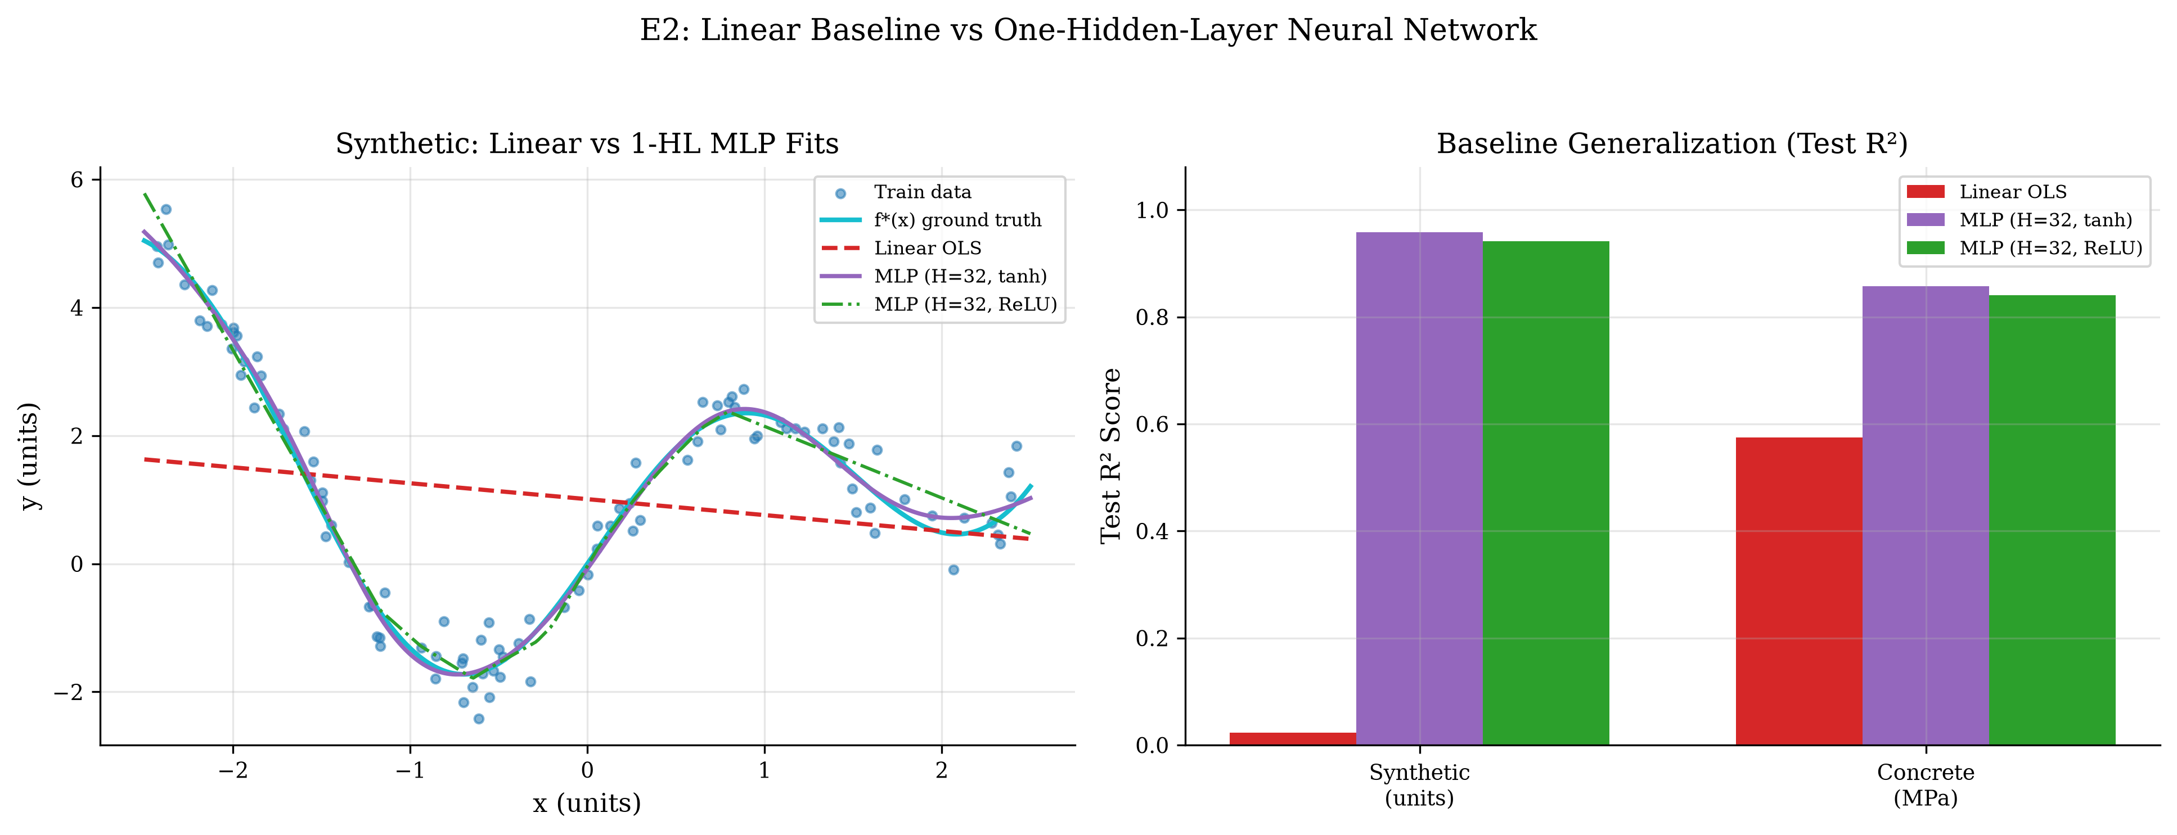
Linear Baseline vs. One-Hidden-Layer MLP (E2)
Linear models fail on nonlinear signal; MLPs capture structure cleanly
Untouched Test Metrics
Synthetic (Bayes MSE = 0.1225):
Linear OLS: MSE = 2.8894, R² = 0.0238
MLP tanh: MSE = 0.1242, R² = 0.9580
Concrete (MPa):
Linear OLS: RMSE = 10.59 MPa, R² = 0.5752
MLP tanh: RMSE = 6.12 MPa, R² = 0.8575
Project 9: Neural-Network Capacity and Generalization | Slide 8 / 20

Slide 9
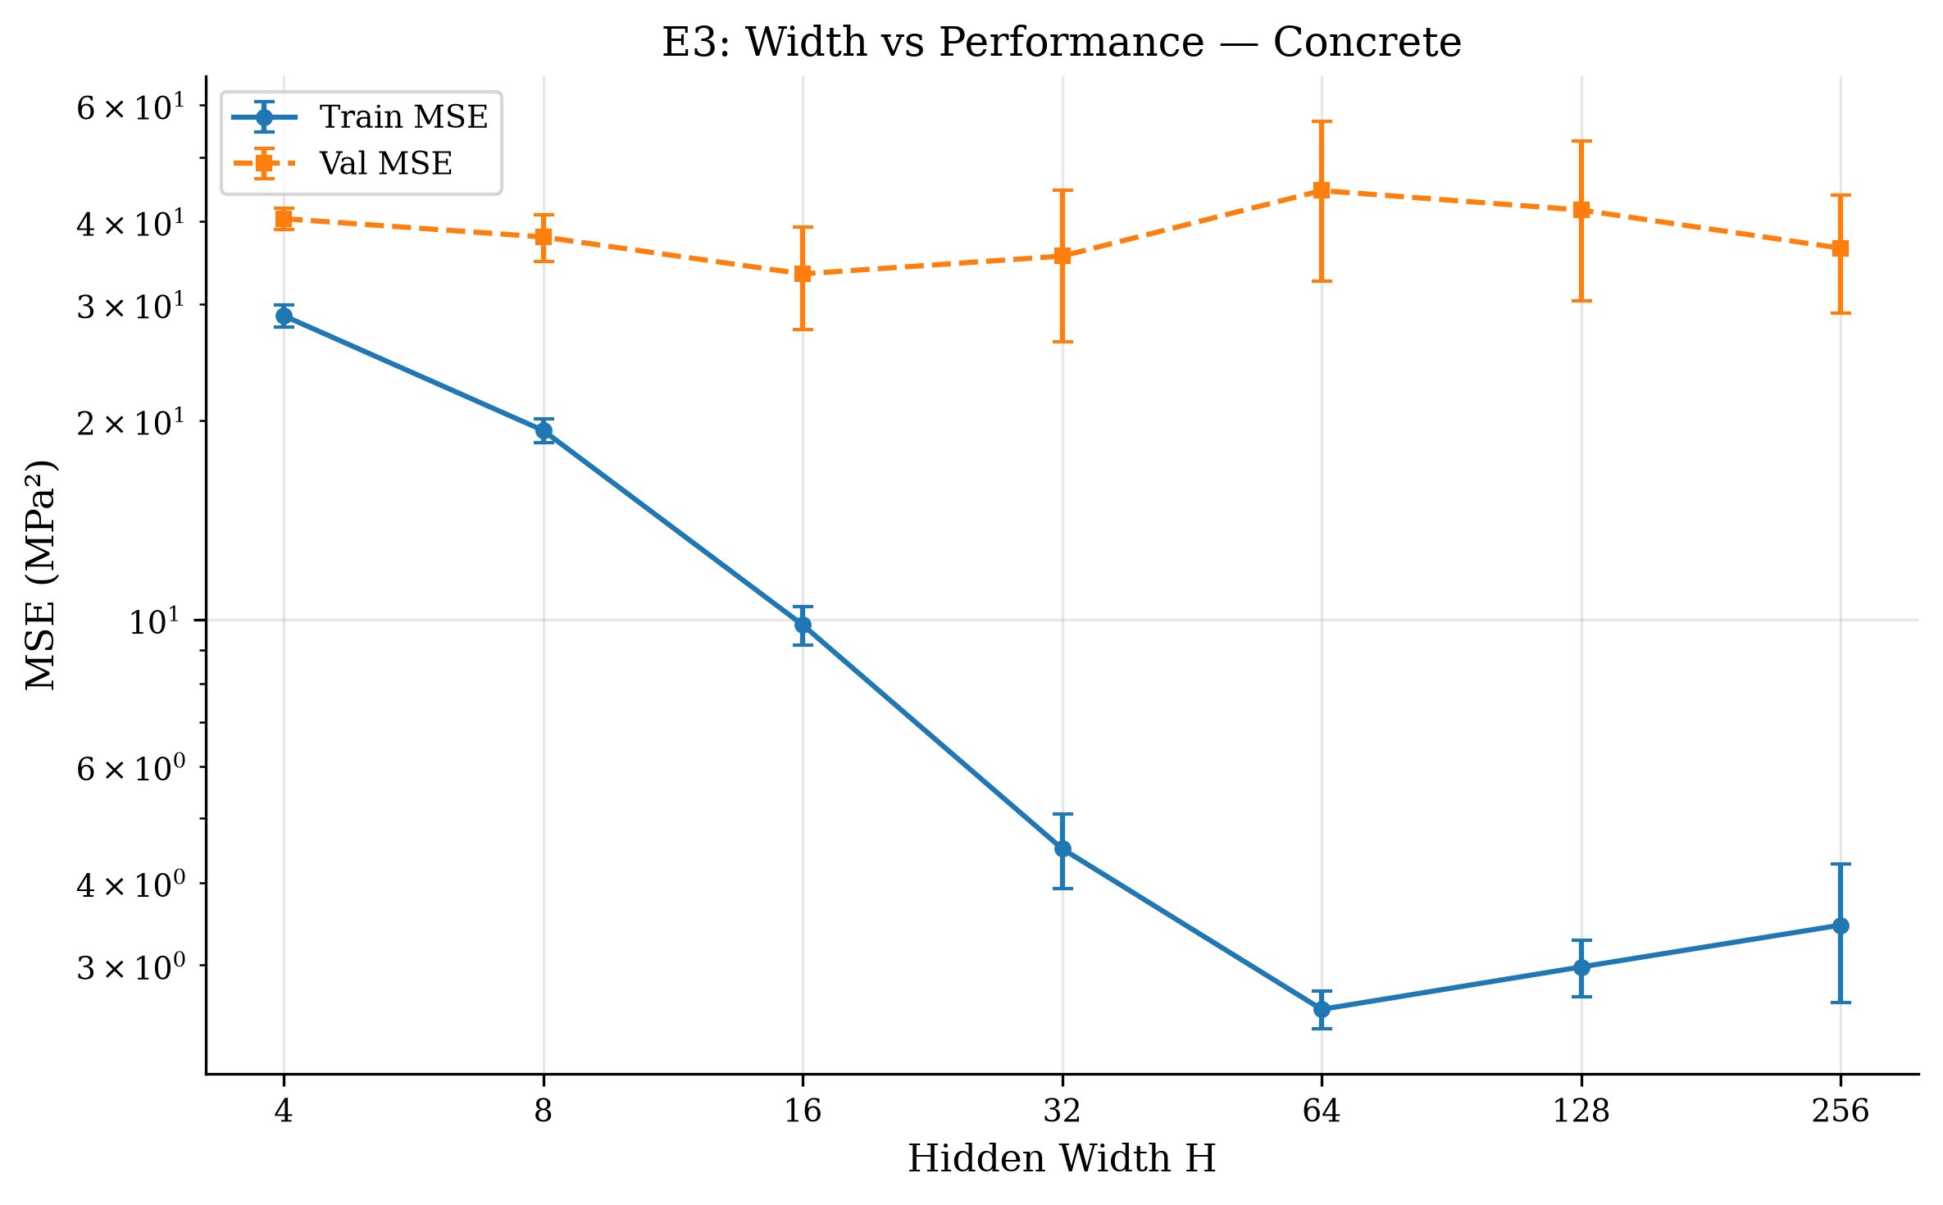
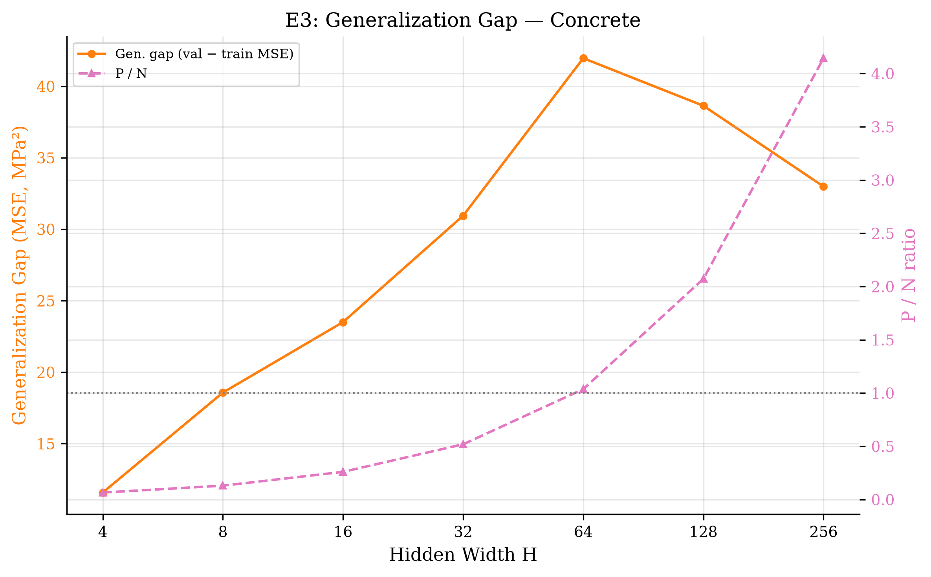
Hidden-Layer Width Experiments (E3)
Increasing width lowers training loss, but high capacity widens the gap on Concrete
Validation-Selected Widths & Post-Selection Test Results
Synthetic: best H* = 128 (val MSE = 0.1265) → test MSE = 0.1221, R² = 0.9587
Concrete: best H* = 16 (val MSE = 33.32 MPa²) → test RMSE = 5.77 MPa, R² = 0.8733
Project 9: Neural-Network Capacity and Generalization | Slide 9 / 20

Slide 10
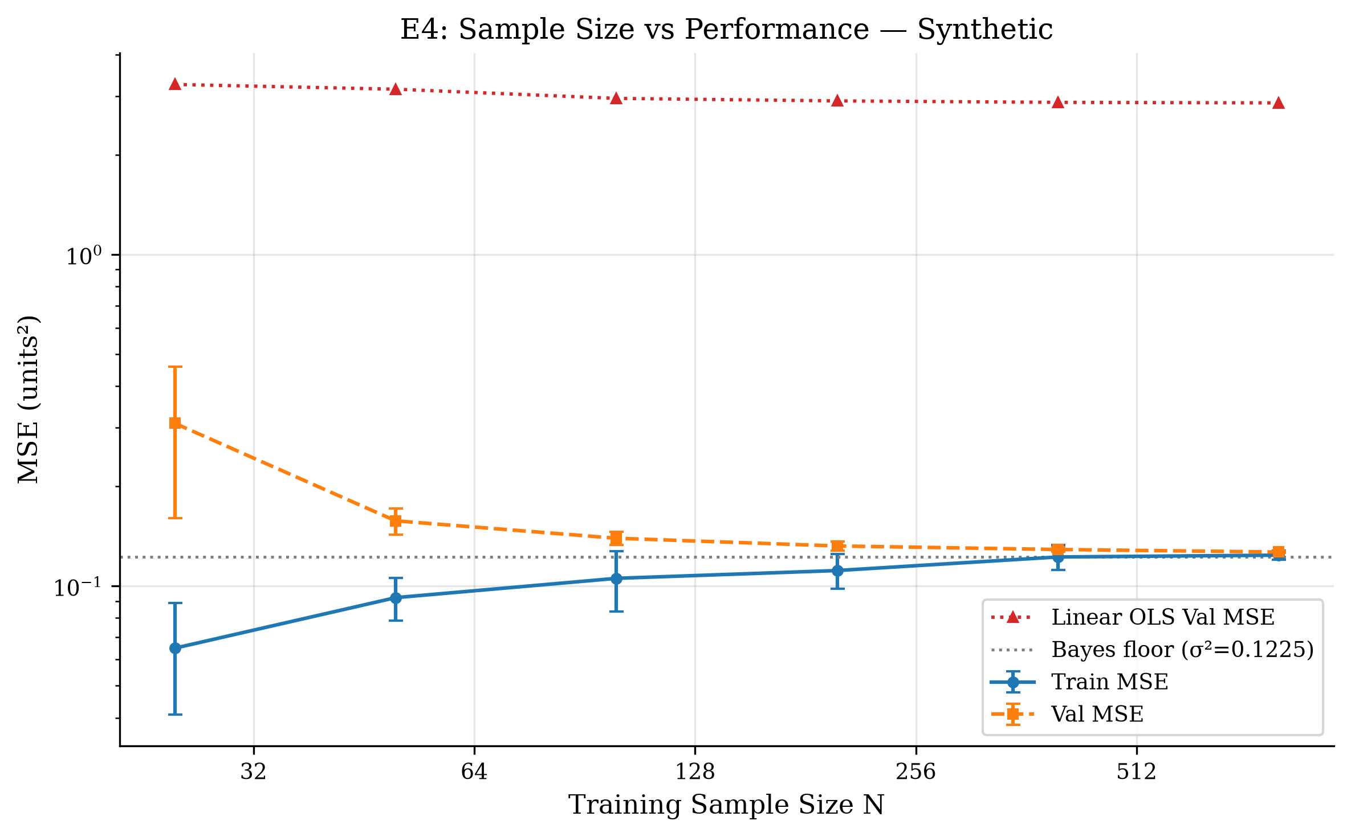
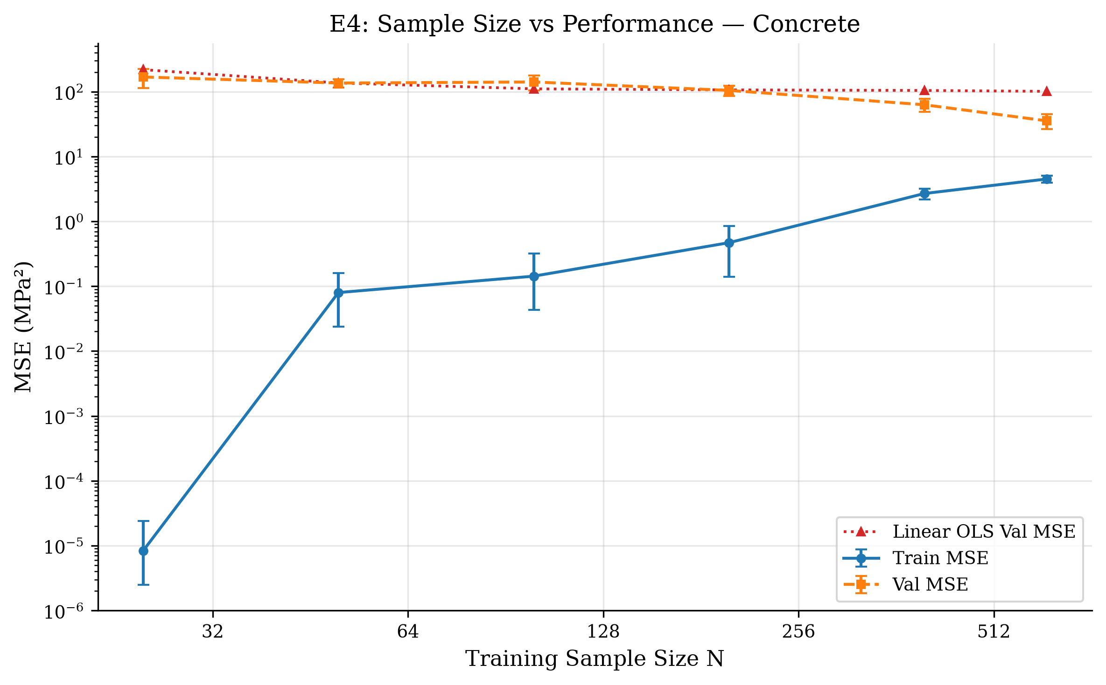
Training-Set Size Experiments (E4, Fixed H = 32)
More observations steadily shrink variance and close the generalization gap
Sample-Size Scaling Summary
Synthetic: N = 25 val = 0.3094 (gap = 0.2445) → N = 800 val = 0.1266 (gap = 0.0027)
Concrete: N = 25 val = 168.25 MPa² → N = 618 val = 35.45 MPa²
Project 9: Neural-Network Capacity and Generalization | Slide 10 / 20

Slide 11
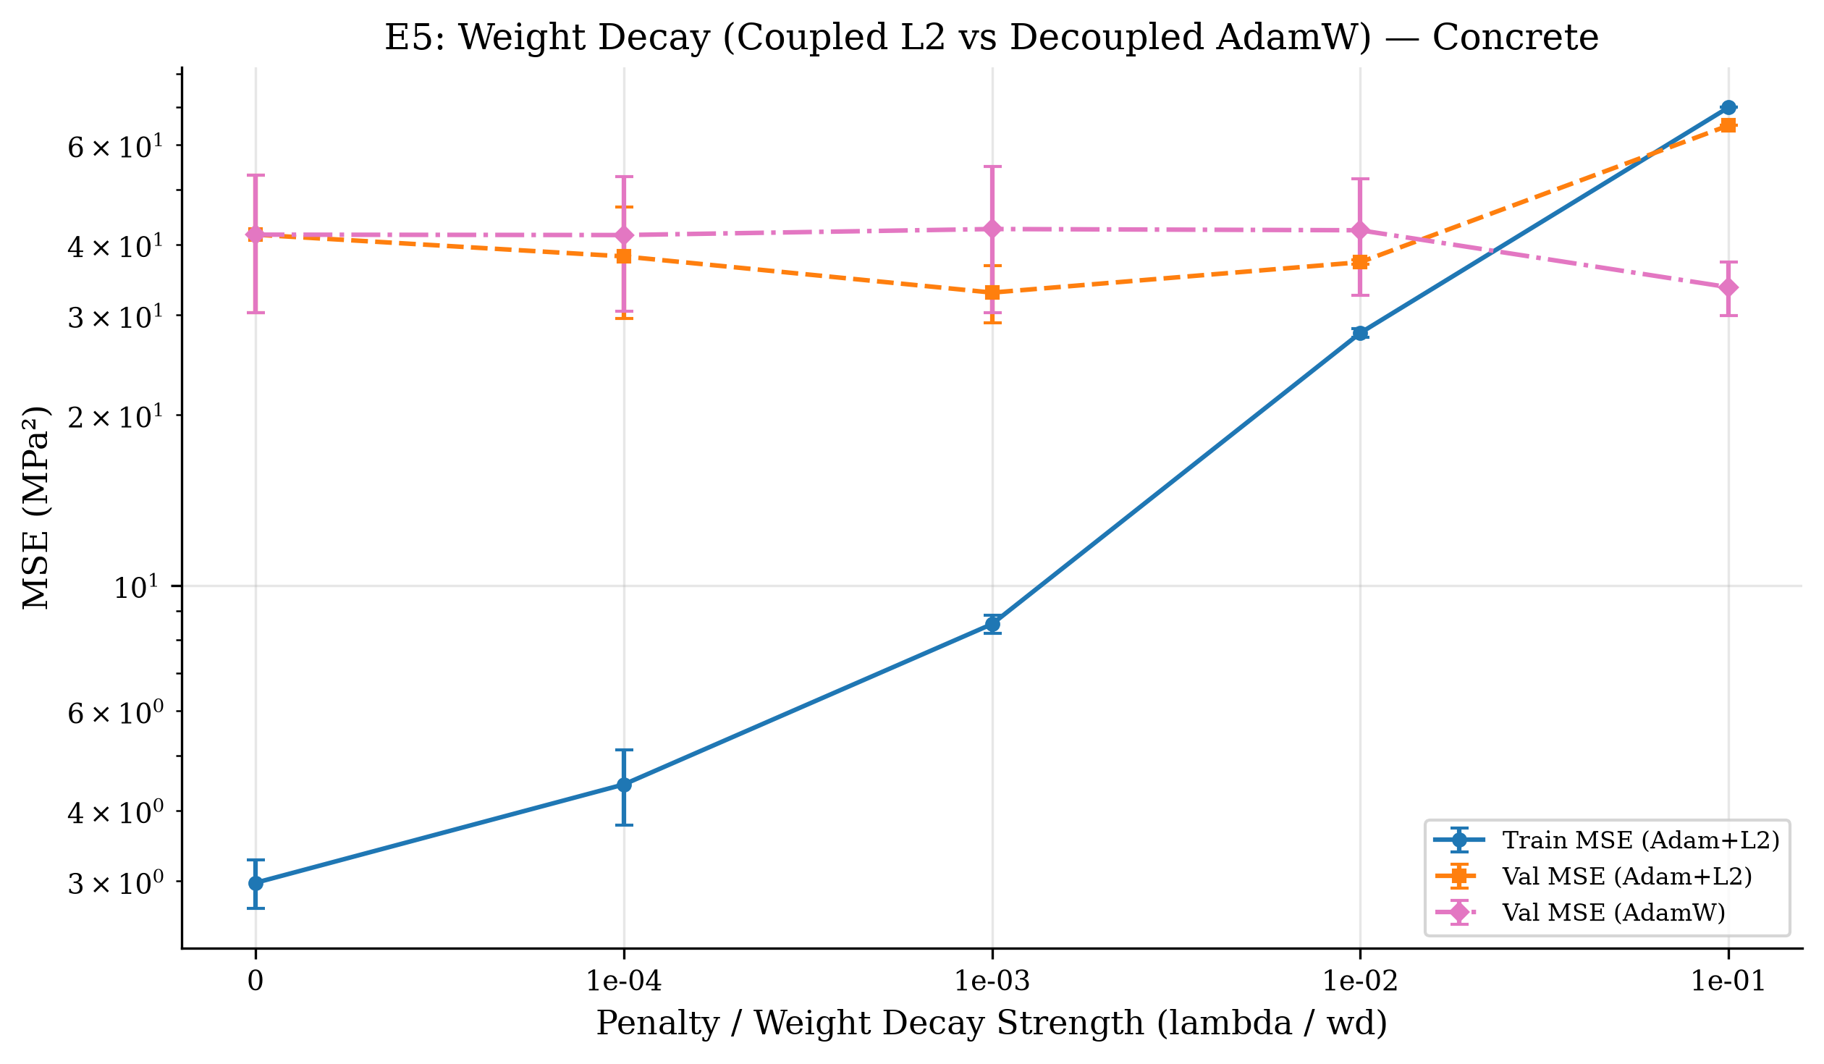
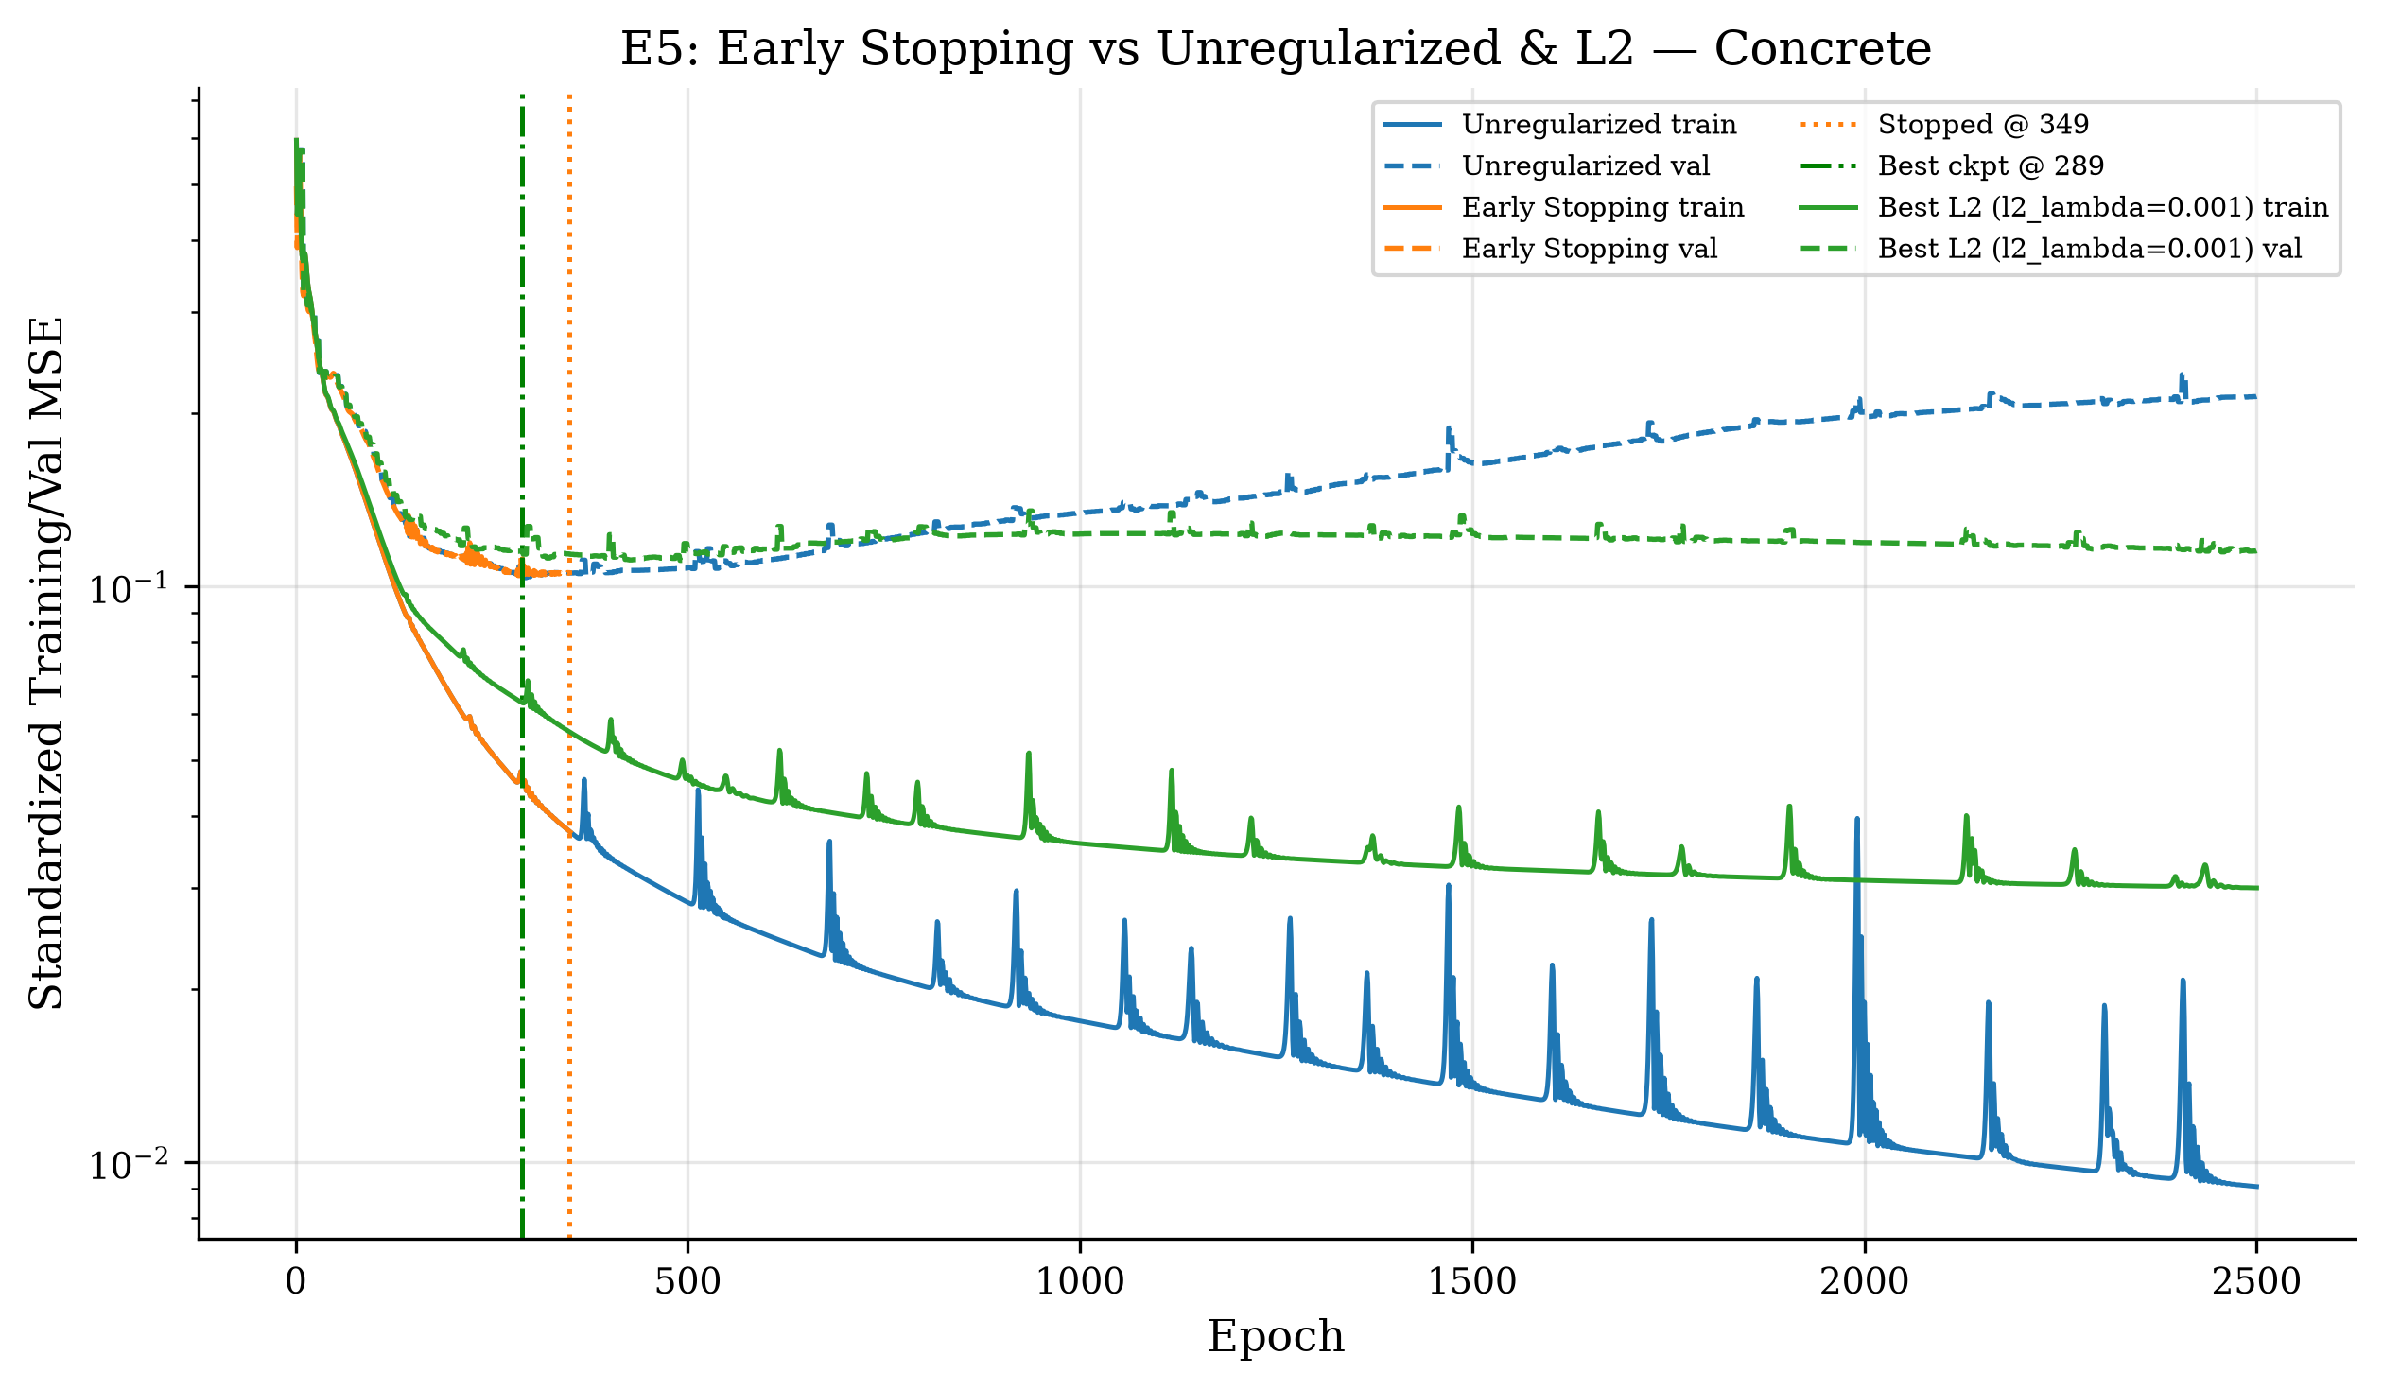
Regularization: Unregularized vs. Weight Decay vs. Early Stopping (E5)
Over-parameterized H = 128 networks need explicit or implicit capacity control on Concrete
Validation-Selected Regularization Results (H = 128)
Synthetic best 'adamw_wd=0.001': test MSE = 0.1219 vs. unreg = 0.1222
Concrete best 'early_stop': test RMSE = 5.53 MPa (R² = 0.8842) vs. unreg RMSE = 6.92 MPa
Project 9: Neural-Network Capacity and Generalization | Slide 11 / 20

Slide 12
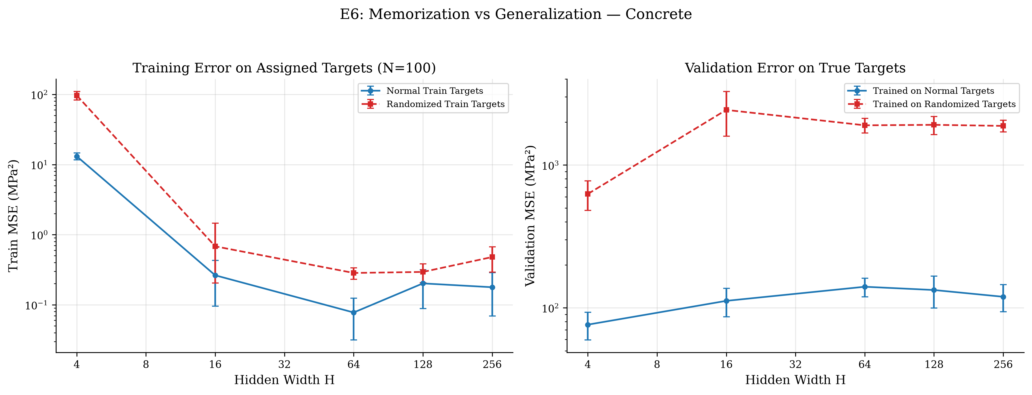
Randomized-Label Memorization Experiment (E6)
Memorization fits arbitrary training targets without learning the population law
Key Contrast (N = 100, H = 256)
Concrete (d = 8) Randomized Targets:
• Train MSE: 0.48 MPa² (mem rate = 1.00)
• Orig Val MSE: 1880.62 MPa²
• Orig Test MSE: 2046.92 MPa²
• Normal Val MSE: 119.40 MPa²
1D Synthetic (d = 1) Spectral-Bias Finding:
• Xavier (b₁ = 0) resists high-freq 1D noise (train MSE = 3.03) while val explodes (4.30).
Project 9: Neural-Network Capacity and Generalization | Slide 12 / 20

Slide 13
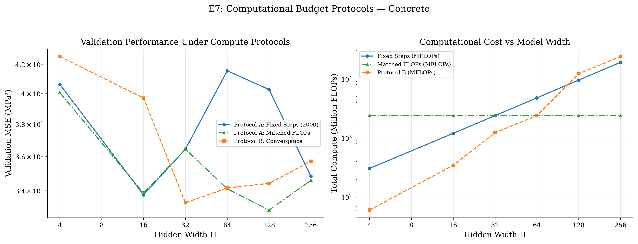
Computational Budget Comparison (E7)
Protocol A (Fixed Steps vs. Matched FLOPs) & Protocol B (Convergence + Max Budget)
Compute-Normalized Insights
Why FLOPs matter:
• Step cost scales as ~6·B·P(d, H).
• Fixed steps give H = 256 > 60× more FLOPs than H = 4.
Concrete Protocol B (Convergence):
• H = 4: 396 epochs, conv = 1.00, val = 42.54 MPa²
• H = 256: 2509 epochs, conv = 0.80, val = 35.71 MPa²
Matched-FLOP comparisons reveal true compute-efficiency sweet spots.
Project 9: Neural-Network Capacity and Generalization | Slide 13 / 20

Slide 14
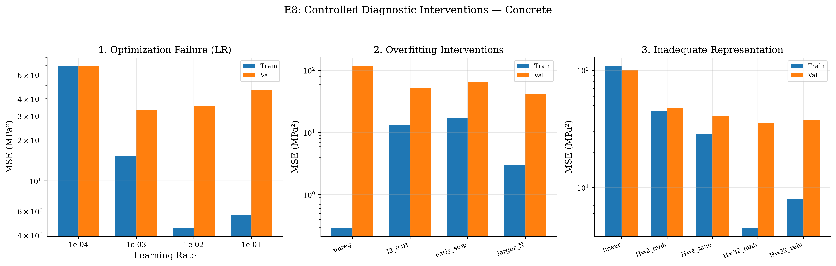
Optimization Failure vs. Overfitting vs. Inadequate Representation (E8)
Controlled experimental interventions isolate the true root cause of poor error
Concrete Diagnostic Verdicts
1. Optimization Failure: Tune LR (to 1e-03), switch optimizer to adam, use Xavier init → Train MSE drops to 15.1663; Val MSE drops to 33.2271
2. Overfitting: Apply larger_N_H128 (weight decay / early stopping / larger N) → Train MSE=2.9805, Val MSE improves from 118.3612 to 41.6191 (gap=38.6386)
3. Inadequate Representation: Increase model expressivity (mlp_H=32_tanh) → Both train MSE (4.4993) and val MSE (35.4482) drop sharply
Project 9: Neural-Network Capacity and Generalization | Slide 14 / 20

Slide 15
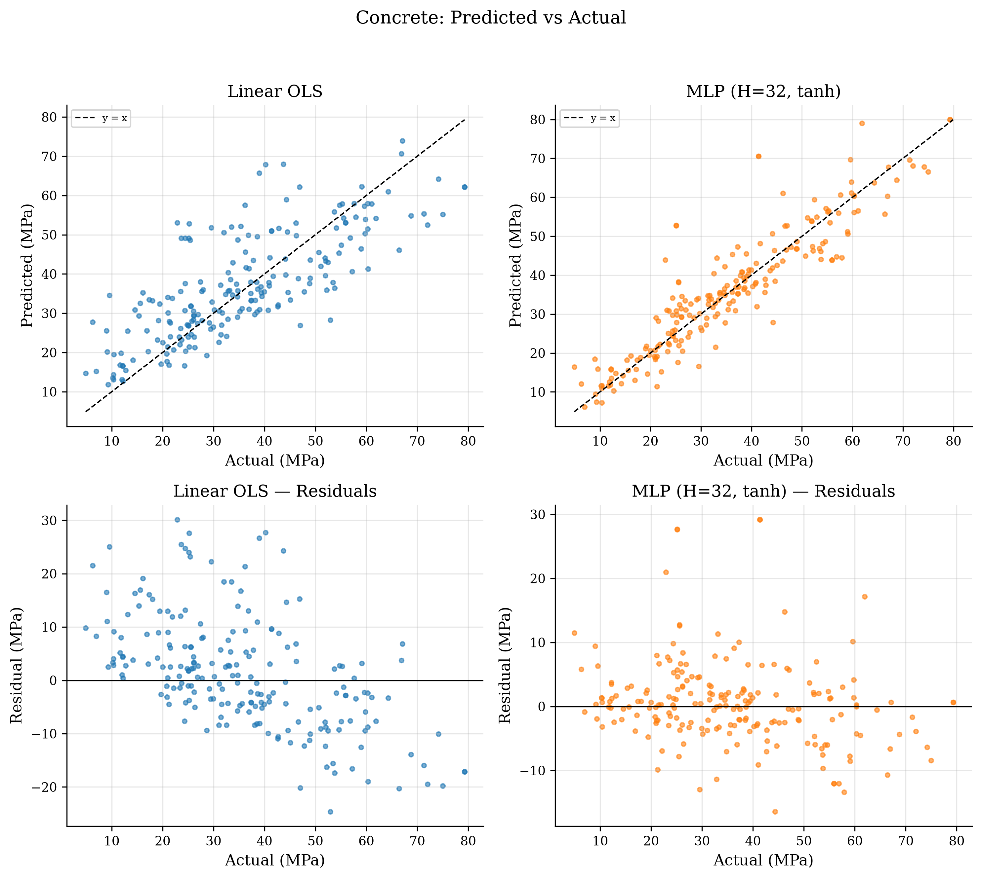
Real-World Benchmark: UCI Concrete Compressive Strength
Predicted vs. actual strength (MPa) and residual diagnostics on test set
Physical Interpretation (MPa)
Linear OLS assumes additive ingredients:
• Test RMSE = 10.59 MPa, R² = 0.5752
• Systematic bias at extreme strength & curing ages.
1-HL MLP captures cement–water–age nonlinearities:
• Unreg H = 32 Test RMSE = 6.12 MPa, R² = 0.8575
• Best Regularized Test RMSE = 5.53 MPa, R² = 0.8842
Project 9: Neural-Network Capacity and Generalization | Slide 15 / 20

Slide 16
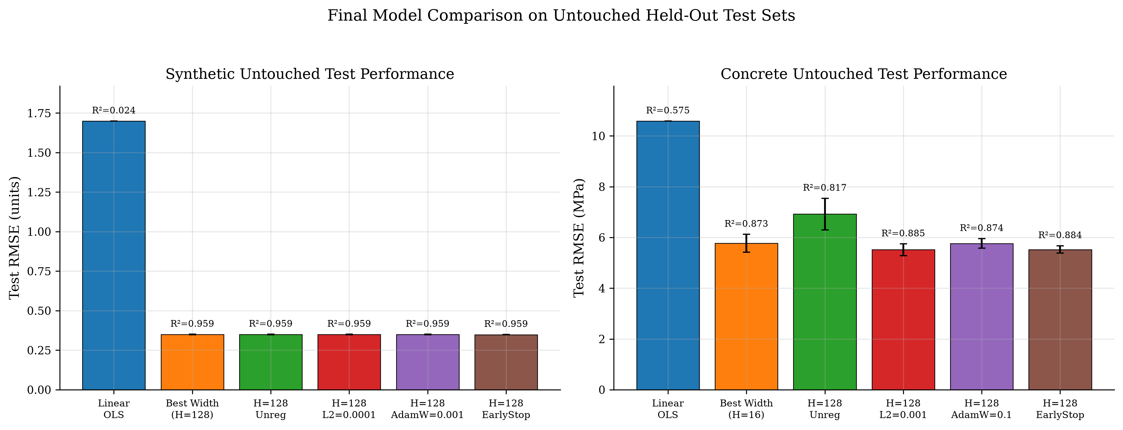
Consolidated Experimental Findings on Untouched Test Sets
Unified comparison across synthetic and Concrete regression benchmarks
• Linear models suffer severe structural underfitting on both benchmarks.
• Optimal width + regularization achieves near-Bayes MSE on synthetic data.
• On 8D Concrete, unregularized wide MLPs overfit heavily; L2 / AdamW / early stopping restores strong test accuracy.
• Randomized-label tests prove low training error ≠ generalization.
Project 9: Neural-Network Capacity and Generalization | Slide 16 / 20

Slide 17
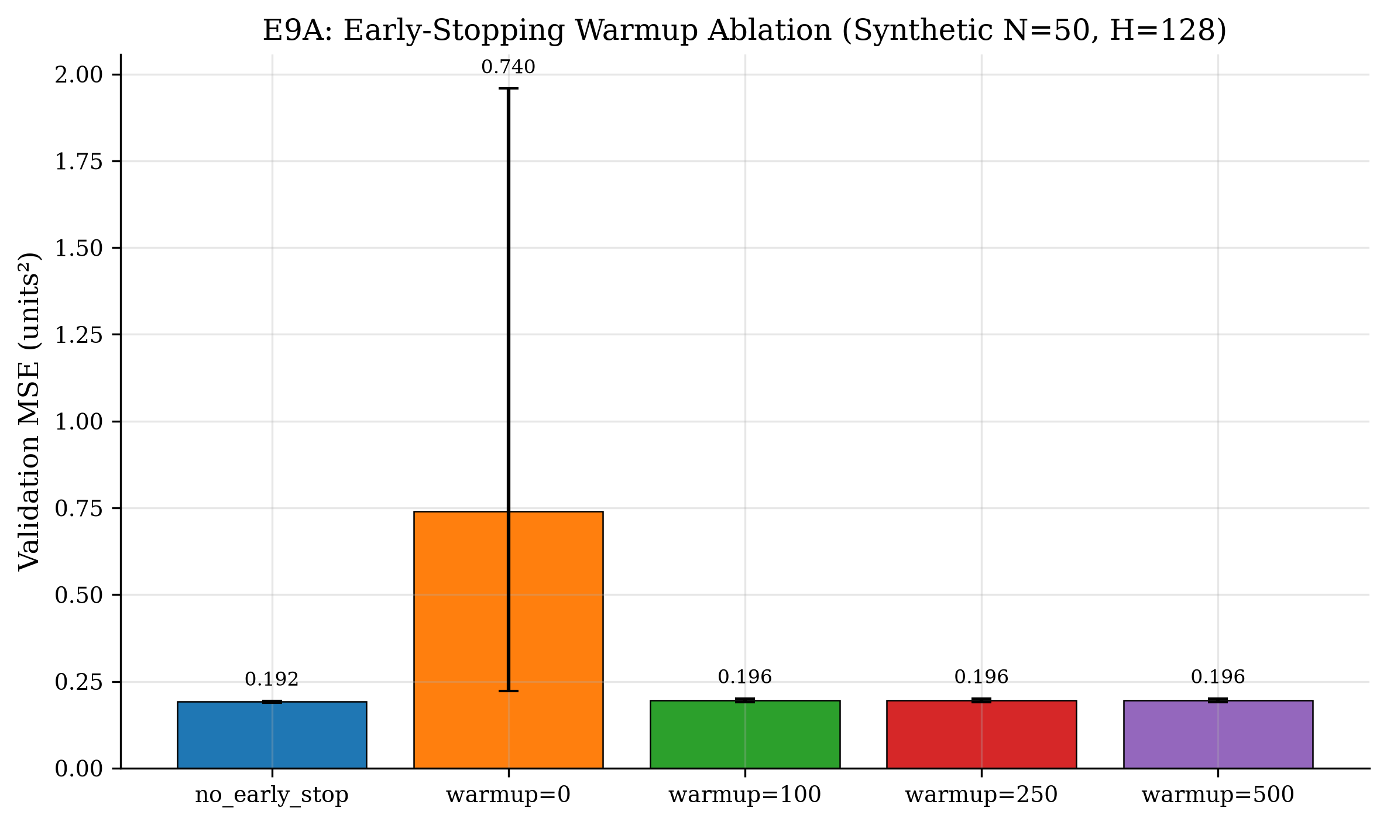
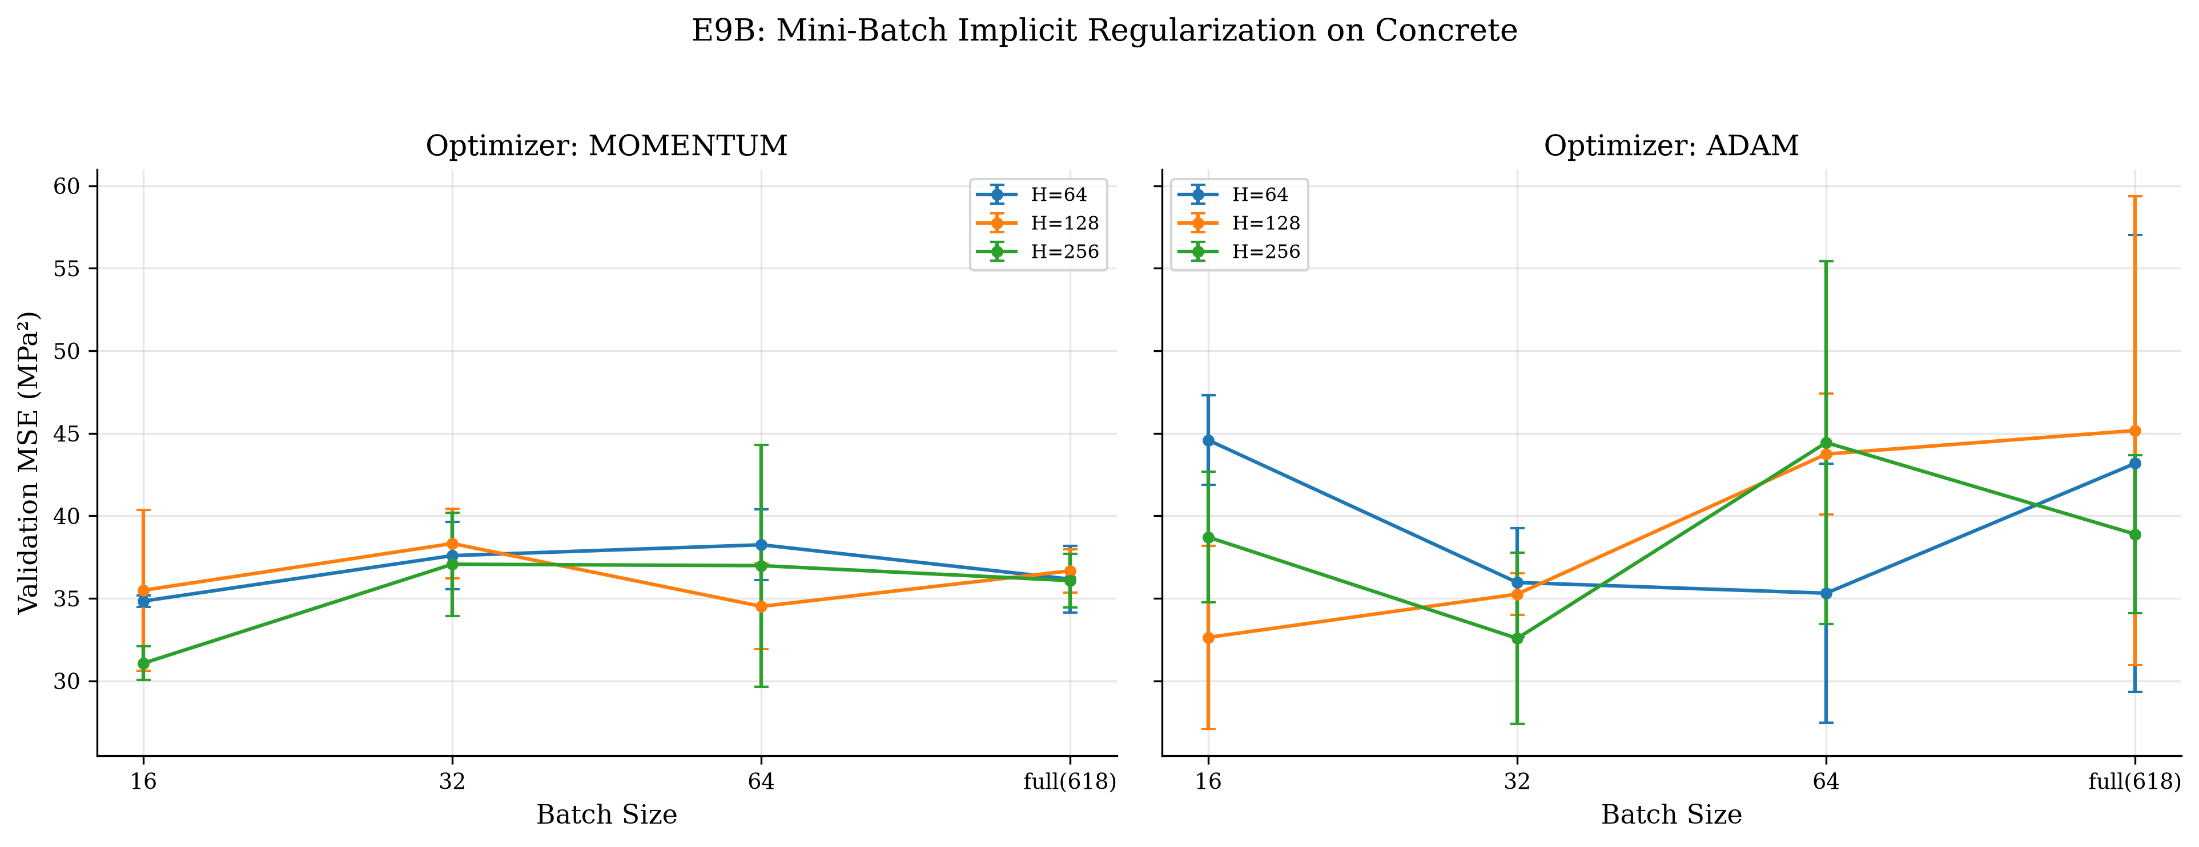
Extensions I: Early-Stopping Warmup & Mini-Batch SGD (E9A–E9B)
Escaping saddle plateaus and leveraging stochastic gradient noise on Concrete
Key Extension Findings (E9A–E9B)
E9A Warmup: warmup = 0 stalls on an early saddle (val = 0.740 ± 1.219); warmup ≥ 100 stabilizes at 0.196 ± 0.005.
E9B Mini-Batch: momentum (H = 256, B = 16) reaches best Concrete val = 31.07 MPa² and test R² = 0.9008.
Project 9: Neural-Network Capacity and Generalization | Slide 17 / 20

Slide 18
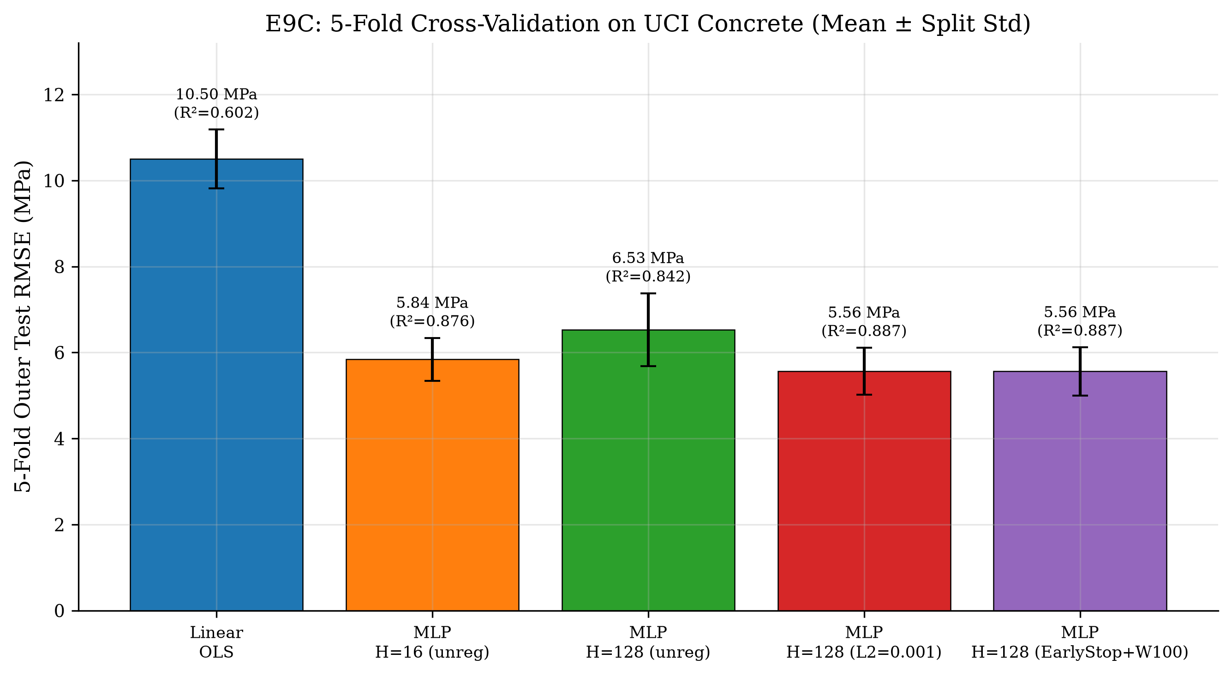
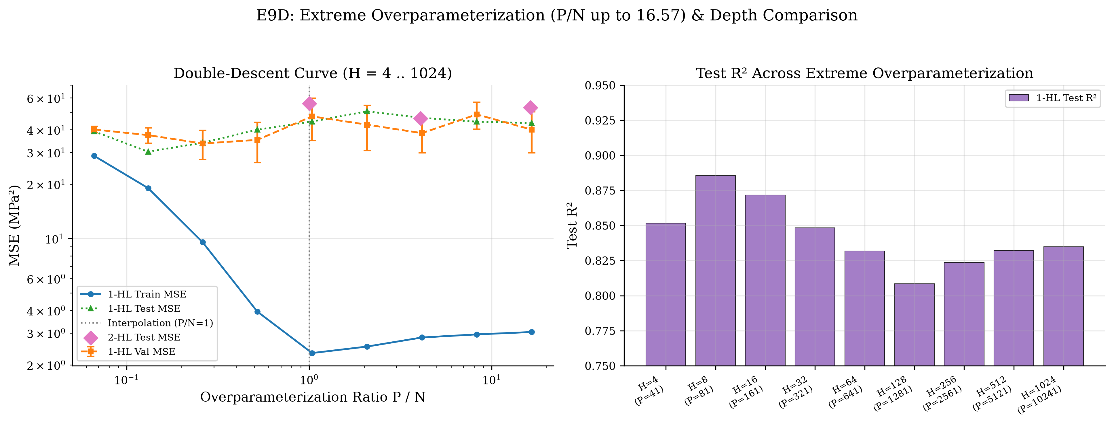
Extensions II: 5-Fold Cross-Validation & Double Descent (E9C–E9D)
Validating split robustness and probing P/N up to 16.57 + 2-hidden-layer depth
Key Extension Findings (E9C–E9D)
E9C 5-Fold CV: Regularized H = 128 holds RMSE = 5.56 ± 0.56 MPa (R² = 0.8872) vs. unreg 6.53 MPa across splits.
E9D Overparameterization: 1-HL test MSE spikes around P/N = 1–2 (50.56 MPa²) then eases at H = 1024 (P/N = 16.57, 43.58 MPa²); 2-HL lowers train loss further but overfits unregularized.
Project 9: Neural-Network Capacity and Generalization | Slide 18 / 20

Slide 19
Limitations & Future Scope
Honest assessment of remaining experimental boundaries
• Depth bound beyond 2 hidden layers: deeper normalized/residual architectures remain outside this study.
• Homoscedastic Gaussian assumption: Concrete residuals widen slightly above 50 MPa; heteroscedastic modeling is future work.
• Extreme overparameterization & mini-batch studies focused on Concrete; cross-domain tabular benchmarks can generalize further.
• 2-HL networks in E9D were kept unregularized to isolate depth expressivity; tuned regularization on 2-HL is an immediate next step.
Project 9: Neural-Network Capacity and Generalization | Slide 19 / 20

Slide 20
Conclusion & Reproducibility Audit
All derivations, experiments, extensions, figures, and reports verified
• Manual NumPy MLP verified to machine precision against central finite differences (< 1.9 × 10⁻¹⁰) and PyTorch autograd (< 2.3 × 10⁻¹⁶).
• Capacity (H), sample size (N), explicit L2 / early stopping, mini-batch stochastic noise, and FLOP budgets govern generalization.
• Controlled interventions cleanly separate optimization failures, overfitting variance, and inadequate representation.
• 5-fold CV (R² = 0.887), warmup early stopping, and P/N = 16.57 double-descent sweeps confirm findings across splits and scales.
• Zero data leakage & single-command reproducibility (python scripts/run_all_experiments.py).
Project 9: Neural-Network Capacity and Generalization | Slide 20 / 20

