Slide 1
CRIME RATE PREDICTION USING MACHINE LEARNING tECHNIQUEs
Submitted By:
Name: Rudraksh Agarwal
University Roll No.: 2021907
Under the Mentorship of
Mr. Vivek Tomar
Assistant Professor

Slide 2
CONTENTS
Introduction
Problem Statement
Methodology
Results & Discussion
Conclusion & Future Work

Slide 3

INTRODUCTION
Crime Rate Prediction involves using statistical methods and machine learning algorithms to forecast the likelihood and frequency of criminal activities in a given area over a specific period.

Slide 4
Problem Statement
The Main Objectives of this Project are:
To design & develop a crime rate prediction model using machine learning algorithms.
To Evaluate the performance of different models on a given dataset.
To analyze the outputs of all the models and find the best model.

Slide 5
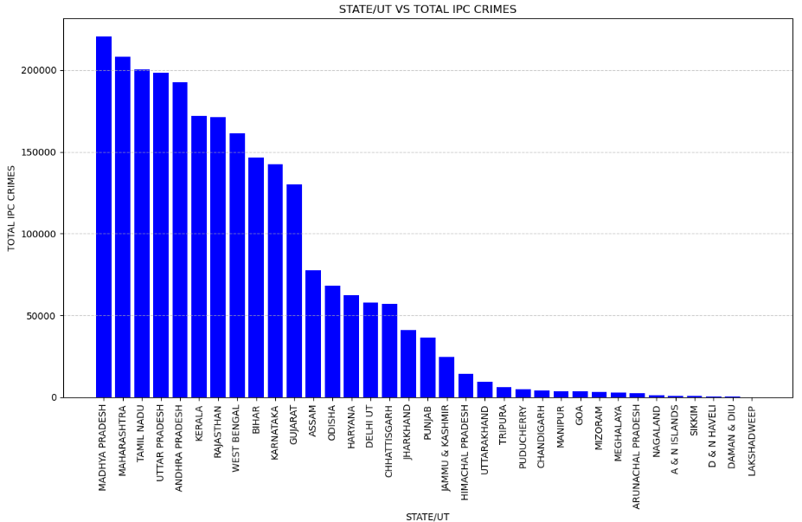

Methodology
We have used the Indian Crime Rate Dataset in which we have state-wise crime record.
The Shape of the Dataset is:
DATASET

Slide 6
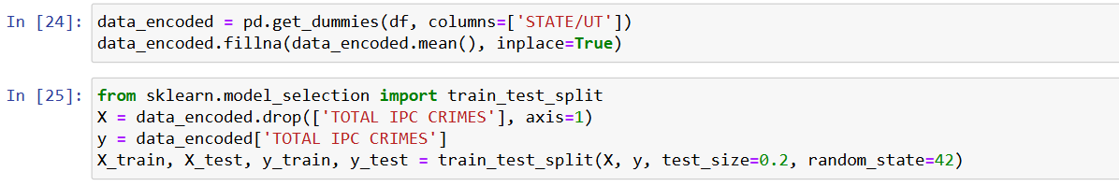
Data Encoding & Train-TEST-SPlit
Here, we have converted the categorical data in the 'STATE/UT' column into numerical dummy variables using one-hot encoding. Also, Missing values are filled with the mean of their respective columns.
Then, In the next step, the Train-Test-Split of data is performed to split the dataset into training and testing sets with 80% for training and 20% for testing, ensuring reproducibility with a fixed random seed.

Slide 7
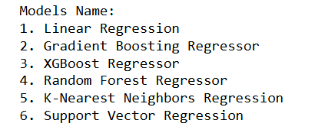
MODEL SELECTION & EVALUATION
In this Project, We have implemented six different Regression Models and Evaluate them on the basis of the Mean Squared Error(MSE). These models are also Ranked based on their MSE. We have also displayed a scatter plots for the Actual VS Predicted Value of Each Model. And we have performed cross validation for the Linear Regression model and displayed a separate scatter plot for Actual Data VS Linear Regression Model.

Slide 8
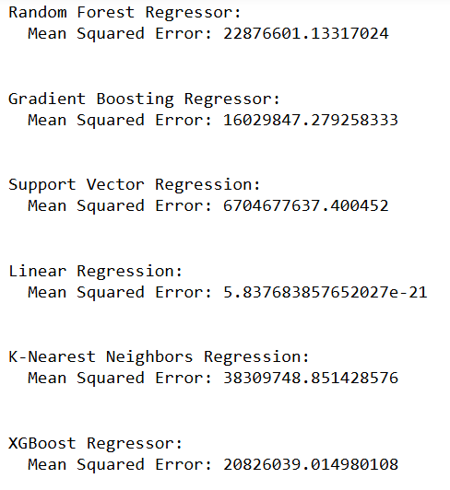
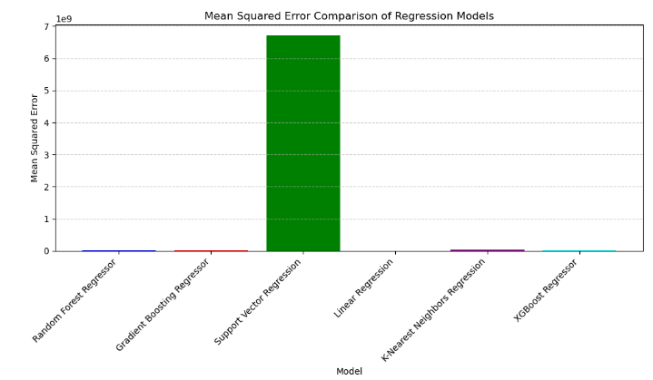
Result & Discussion
With the following results it was observed that out of all the six models, Linear Regression has the least Mean Squared Error, which shows that it is the most suitable algorithm for the model as well as the dataset.

Slide 9
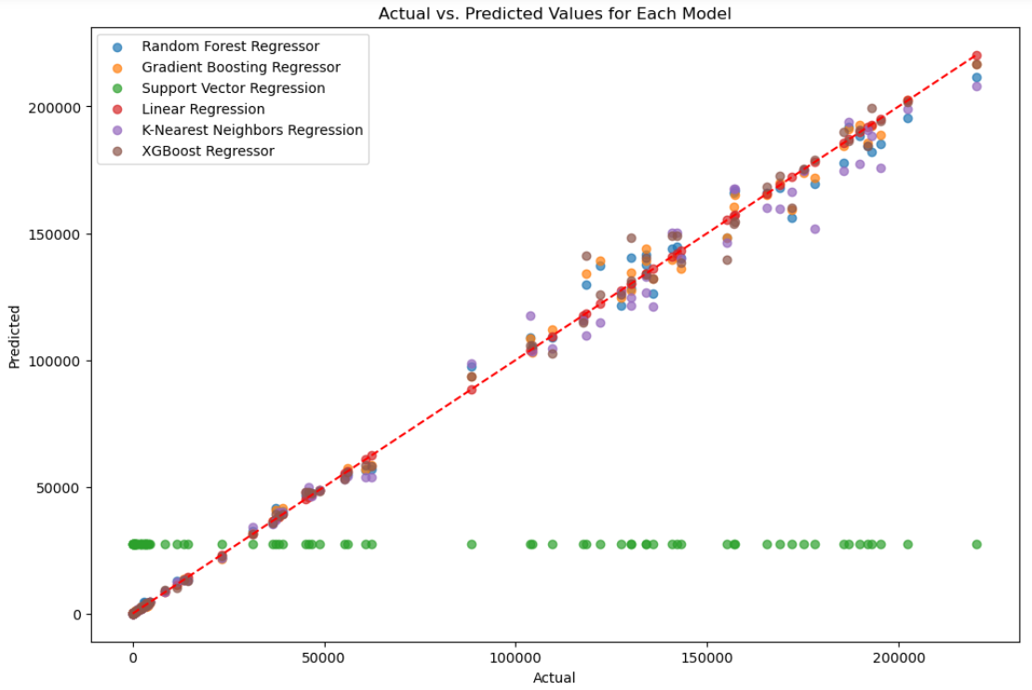

Slide 10
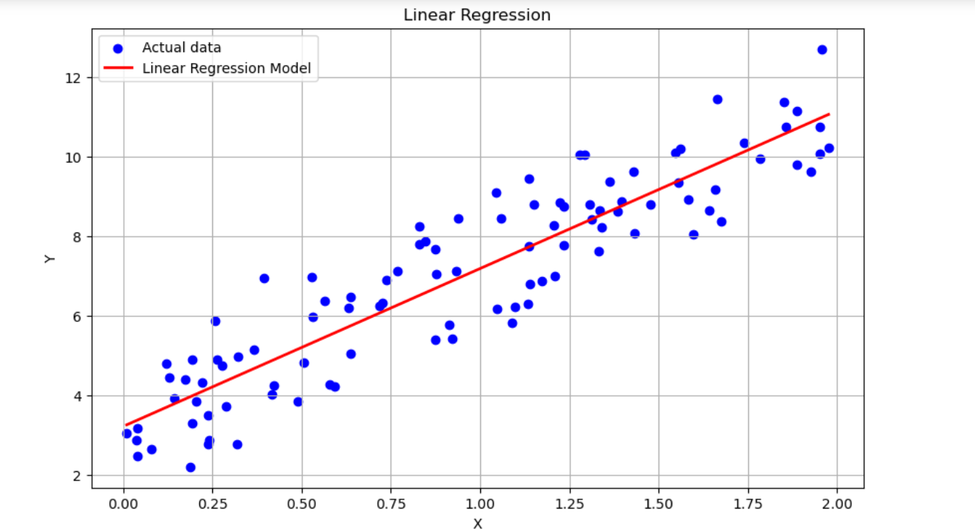

Slide 11
Conclusion & Future Work
The Model for Crime Rate Prediction has been successfully developed using Machine Learning Techniques.
Some Common Applications are:
Law Enforcement and Policing
Crime Prevention
Urban Planning & Infrastructure Development
CONCLUSION
Future works in crime rate prediction will likely integrate AI for real-time analysis, prioritize data ethics, and enhance predictive accuracy further.
FUTURE WORK

Slide 12
thank YOU
RUDRAKSH AGARWAL
2021907
ML

