Slide 1
Text classification using python
Submitted By:
Name: Rudraksh Agarwal
University Roll No.: 2021907
Under the Mentorship of
Dr. Surender Singh Samant
Associate Professor

Slide 2
CONTENTS
Introduction
Problem Statement
Methodology
Results & Discussion
Conclusion & Future Work

Slide 3
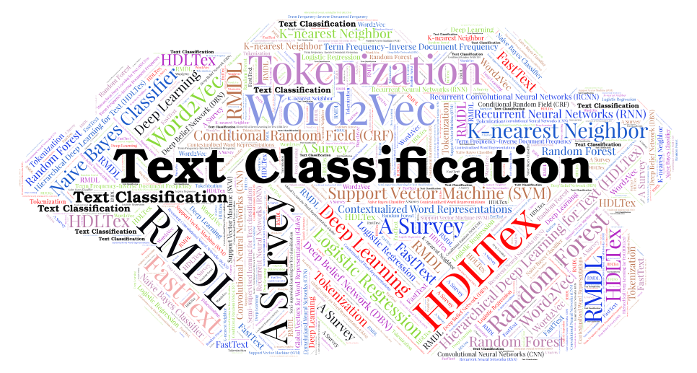
INTRODUCTION
Text Classification is the task of automatically assigning predefined labels to the given textual data.

Slide 4
Problem Statement
The Objective of this Project is to develop a system for Text Classification Using Python
INPUT
(Text)
Text Classification Model
OUTPUT (Label)

Slide 5
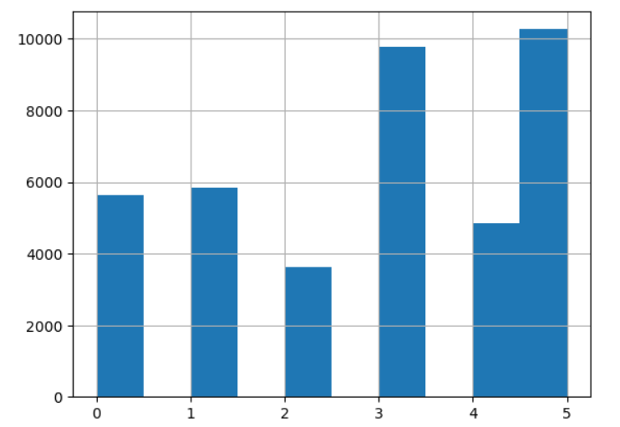
Methodology
We Have Selected the Amazon Product Review dataset with a large size and multiple label categories.
DATASET
Train
Dataset
Test

Slide 6
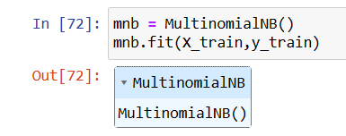

CLASSIFIER
The Multinomial Naïve Bayes Classifier is used
well known especially for Text Classification
VECTORIZER
Count Vectorizer is used for Text Mining
where it extracts useful data

Slide 7

EVALUATION
Classification Report and accuracy score is now calculated to evaluate the model
Classification
Report
F1-Score
Precision
Recall
Support
Accuracy
Score

Slide 8
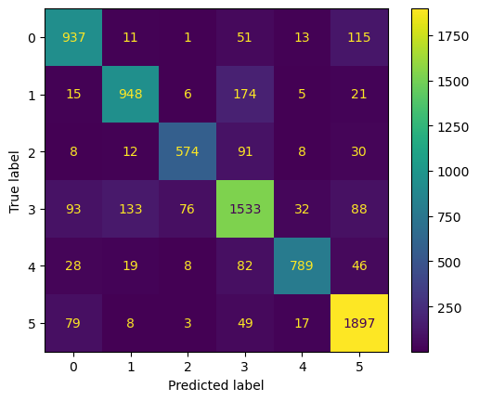
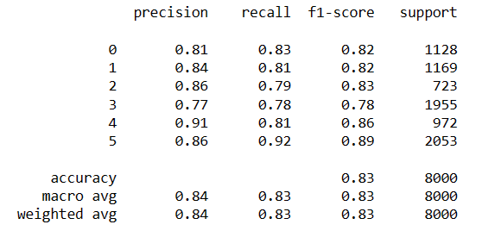
Result & Discussion
As a Result we got 83% accuracy and a good classification report
Confusion Matrix is also displayed

Slide 9






OUTPUT
INPUT

Slide 10
Conclusion & Future Work
The Model for Text Classification has been successfully developed using python
Some Common Applications:
Hate Speech Detection
Fake News Detection
Email Spam Detection
CONCLUSION
Multiple Innovations could be made by adding personalized features and non-textual data classification and many more.
FUTURE WORK

Slide 11
THANK YOU
RUDRAKSH AGARWAL
2021907
ML

