Slide 1
Olist | E-Commerce Sales
& Customer Analytics
End-to-End Data Analytics Project
Rudraksh Gupta
MNIT JAIPUR

Slide 2
Business Questions
Which Product Category contribute to overall sales ?
How many days does an order take to reach the customer ?
What is the Feedback by the customers ?
Are Customers making repeat purchases ?
How do monthly sales vary ?
What % of order are delivered on time ?
Which seller generates the highest sales ?

Slide 3
Data Set & Tools
Olist Brazilian E-Commerce Dataset
Excel + Power Query
PostgreSQL
SQL
Power BI

Slide 4
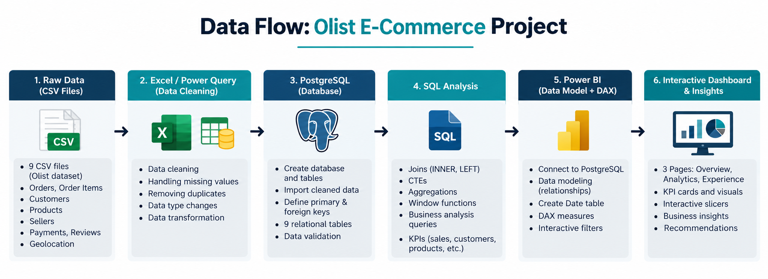

Slide 5
SQL Analysis
Joins
Aggregations (SUM, COUNT, AVG)
GROUP BY and ORDER BY
Subqueries
Date & Time Analysis
Customer, Category & Seller Analysis
Delivery & Review Analysis

Slide 6
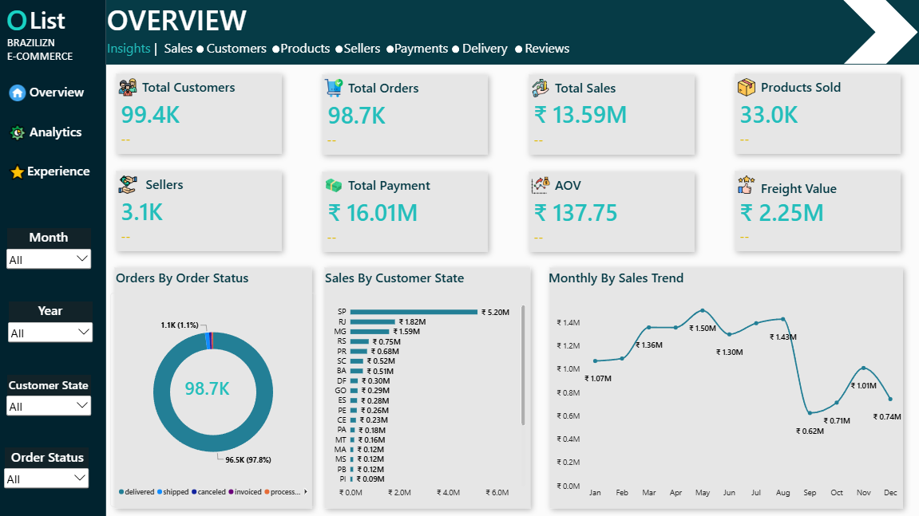
Overview

Slide 7
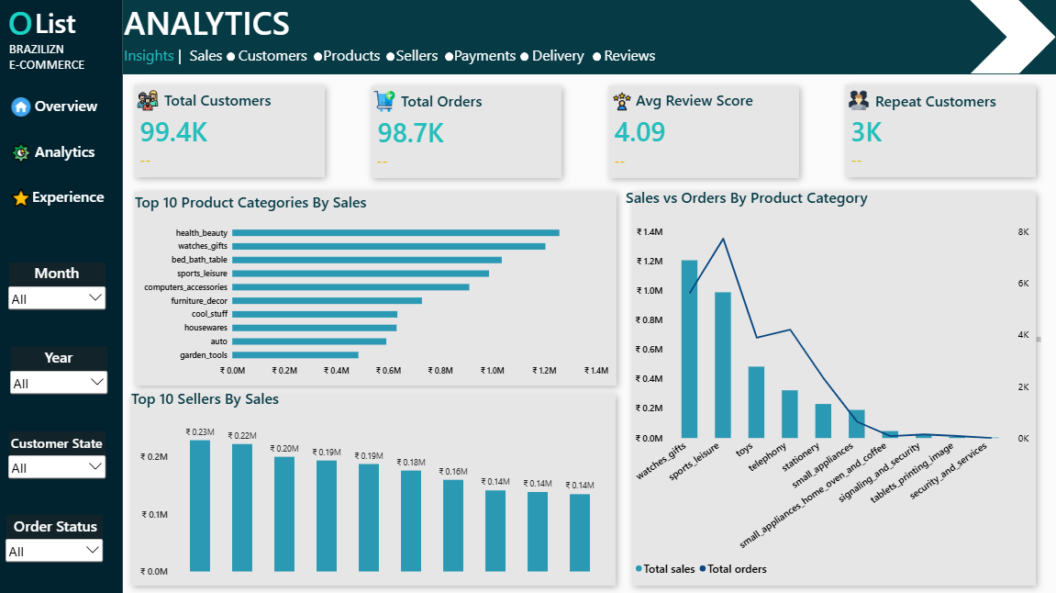
Aanalytics

Slide 8
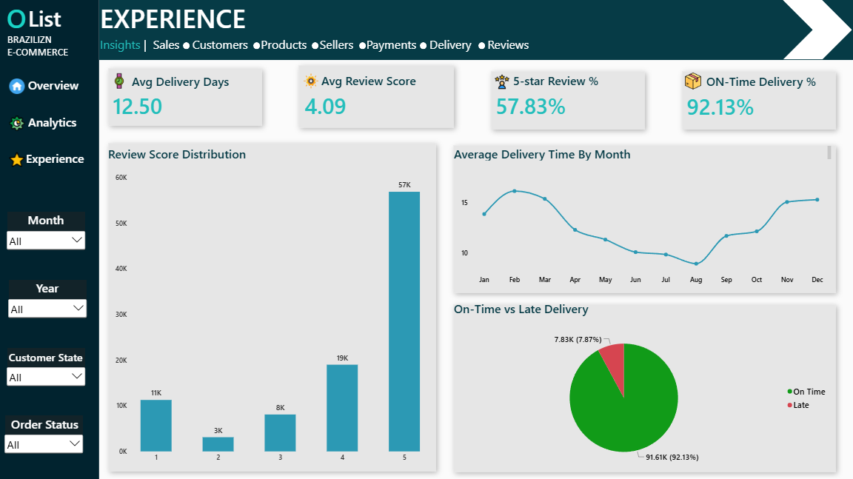
Experience

Slide 9
KPI’s Used
Total Orders — Total number of orders placed
Total Customers — Total number of unique customers
Total Sales — Total revenue generated from product sales
Freight Value — Total amount paid for shipping
Products Sold — Total number of products/items sold
Total Sellers — Total number of sellers
Total Payments — Total value of payments received
AOV (Average Order Value) — Average sales value per order

