Slide 1
BUDtrackGPS tracker
A serverless GPS tracker on cloud.

Slide 2
GPS - BUDtrack
Your location
Location of you friend/family
Will show the user’s location from their device
Will show the current location of the user you want to see

Slide 3
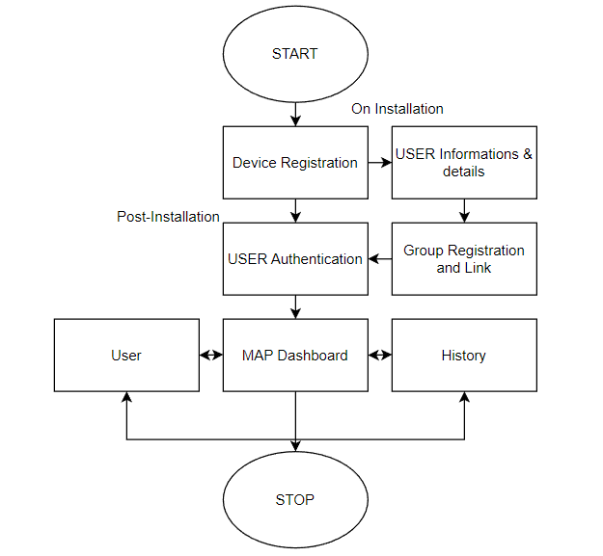
BUDtrack-TASK FLOW

Slide 4
BUDtrack-ON INSTALLATION
User Details
User Authentication
Device Reg.
Group Link
Stored

Slide 5
BUDtrack - POST-INSTALLATION
Authenticated
Users
A
B
C
D
Map Dashboard
History

Slide 6
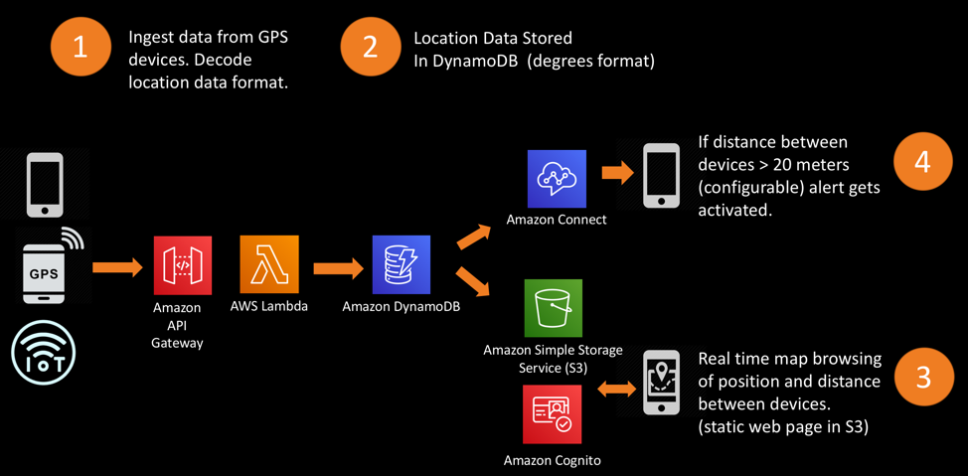
BUDtrack - Approach

Slide 7
BUDtrack - Reasons to use Thread APIs
Improved Performance - Data Ingestion & Storage
1.
Real- time updates - location updates
2.
Increased Scalability - request handling
3.
Asynchronous Processing - responsiveness of application
4.
Notification services to users
5.

Slide 8
BUDtrack - How to use Thread APIs with the app?
Step 1 -
AWS provides SDKs (Software Development Kits) for various programming languages through which I can easily integrate application with AWS services including DynamoDB, S3, and EC2.
Step 2 -
AWS provides several thread APIs that I can use in the application. For example, I am using the Python threading module to create and manage threads in BUDtrack.
Step 3 -
After implementing thread APIs in BUDtrack, I will test the application thoroughly to ensure that it works as expected. For eg, I can use AWS tools like CloudWatch to monitor and identify any performance or scalability issues

Slide 9
BUDtrack
THANK YOU!!

