Slide 1
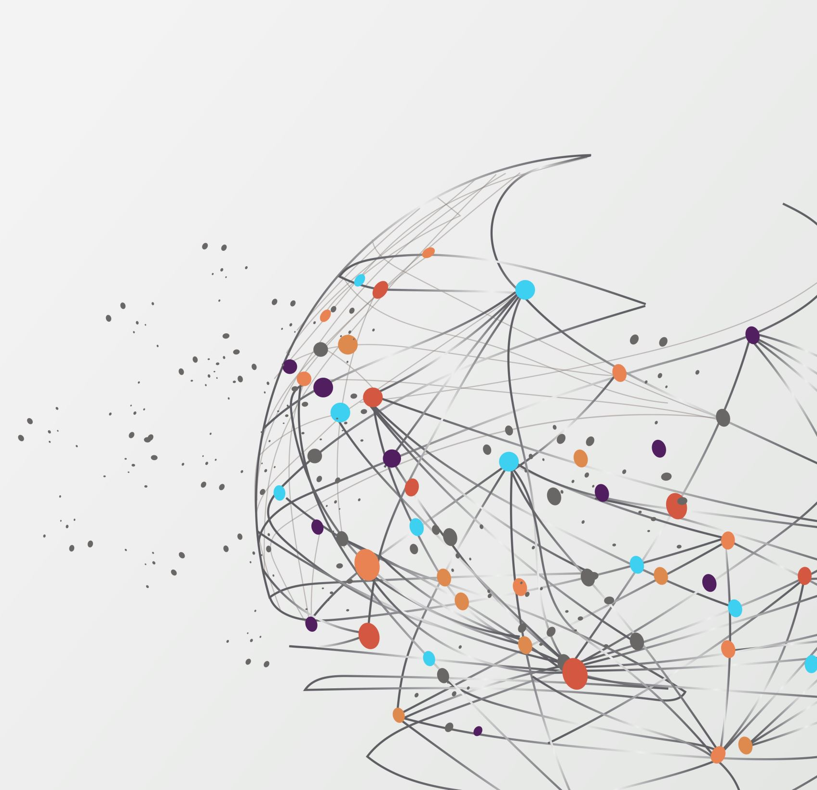
Telco Customer Churn Cluster Analysis
Focused Customer Retention
Rudraksh Mishra

Slide 2
Context
The Telco customer churn data contains information about a fictional telco company that provided home phone and Internet services to 7043 customers in California.
It indicates which customers have left, stayed, or signed up for their service.

Slide 3
Problem Statement
The aim of this project is to find interesting patterns and information from the past data collected using various data mining methods . This is done by forming clusters by identifying and grouping similar data points.

Slide 4
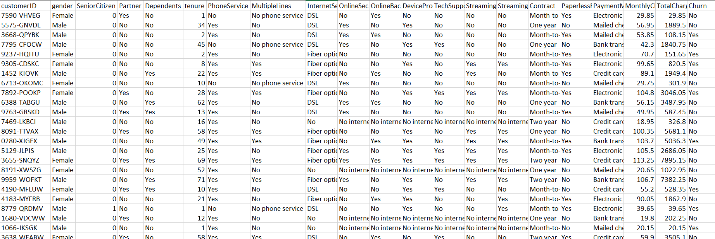
The Data
The data consists of 7,043 rows that represent the 7,043 customers with 21 attributes discussed below.
The data comes from the public repository on the Kaggle database, namely Telco Customer Churn data by BlastChar.

Slide 5
Pre-Processing & Cleaning
The customer ID column has no relevant information that might be useful and so it is dropped.
All the columns have been converted into categorical data
Rows which has tenure value as 0 and rows which has null value in monthly charges has been dropped.
One Hot encoding is done, where all the categorical data has been represented in a binary form

Slide 6
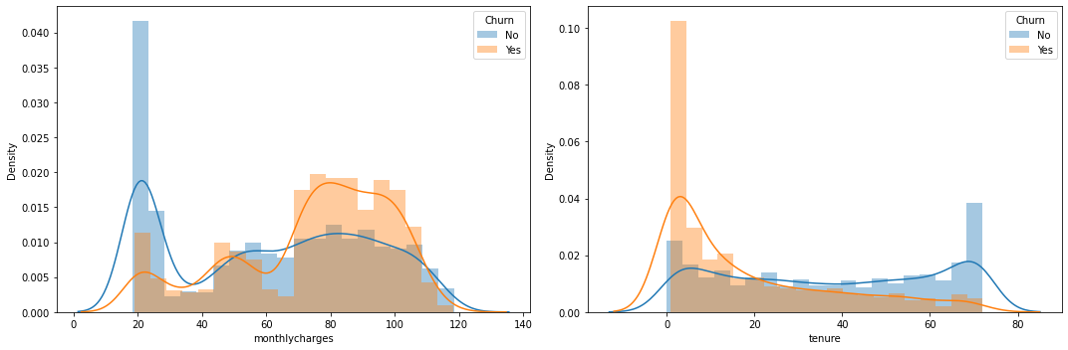
Data Visualization
Visualization of the frequency distribution of monthly charges and tenure.
From this, we can observe that people with low tenure have a high chance of churning, at the same time people with high monthly charges have a high probability of churning too.

Slide 7
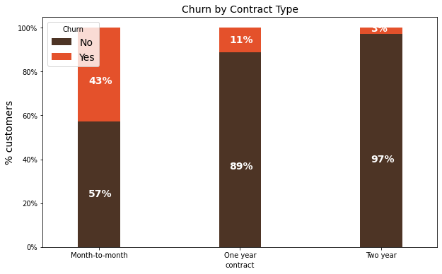
Data Visualization
Customers who have type month-to-month contracts are not yet loyal.
Hence, the customers who use to have a month-to-month contract have a higher possibility of churn than the others.

Slide 8
Outlier Detection
Here we used the PyOD library with an outlier factor of 6% to find the outliers in the data
PyOD is a comprehensive and scalable Python toolkit for detecting outlying objects in multivariate data.
We used Isolation Forest and ABOD methods for outlier detection.

Slide 9
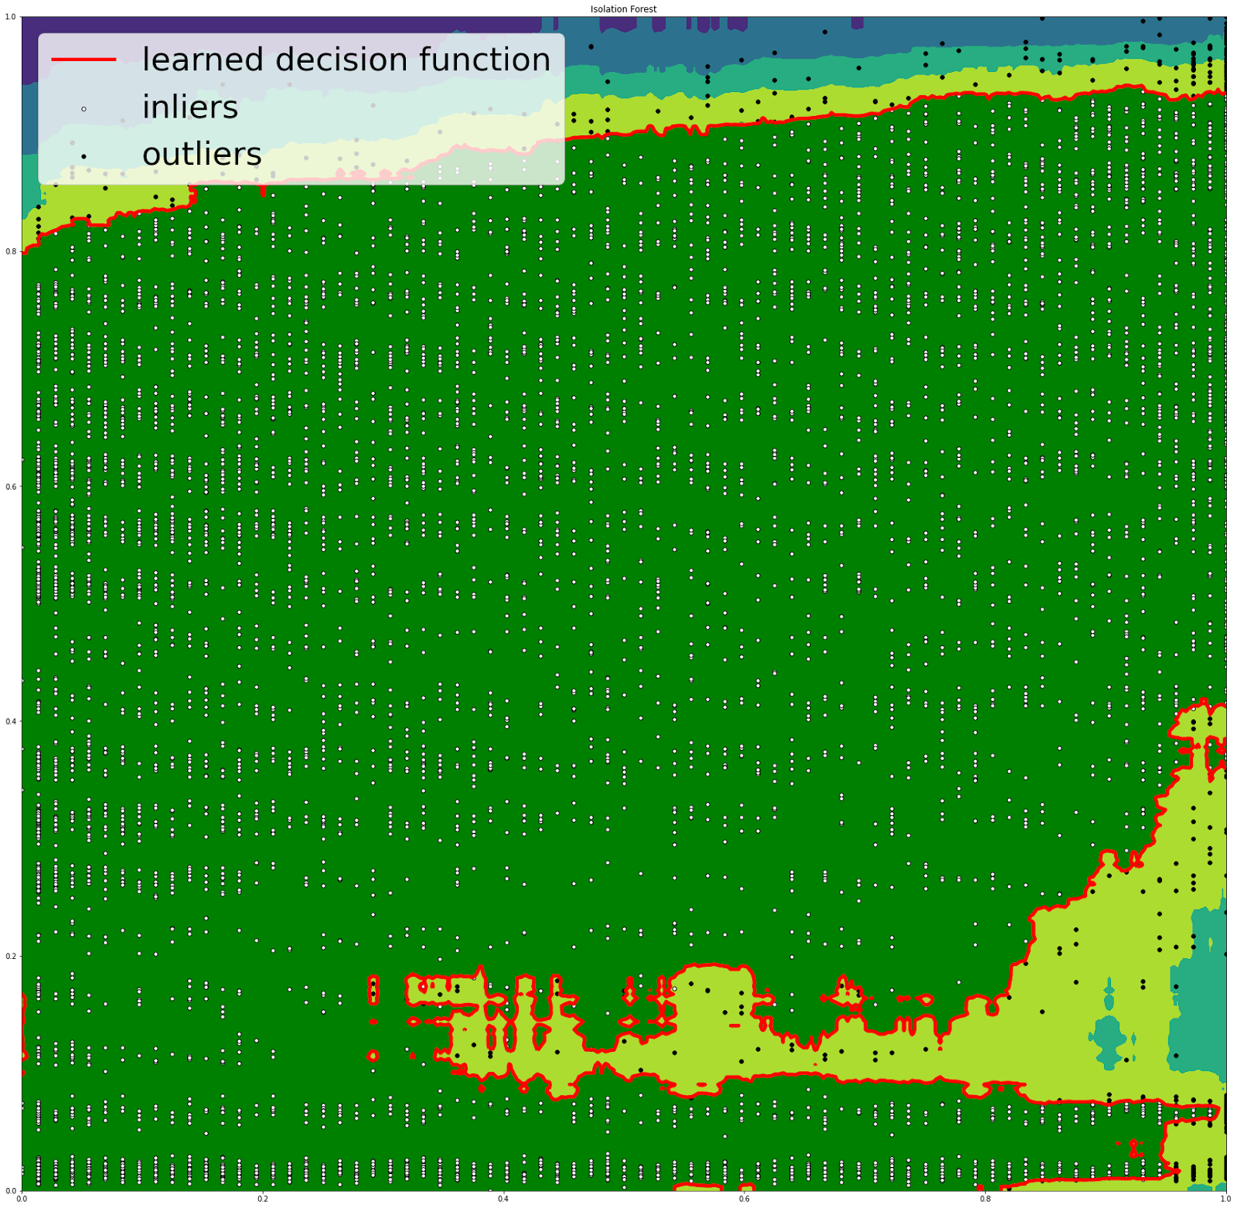
Isolation Forest
Isolation Forest uses decision trees, in these trees, partitions are created by first randomly selecting a feature and then selecting a random split value between the minimum and maximum value of the selected feature.
From Isolation Forest:
Outliers detected: 423
Inliers detected: 6620

Slide 10
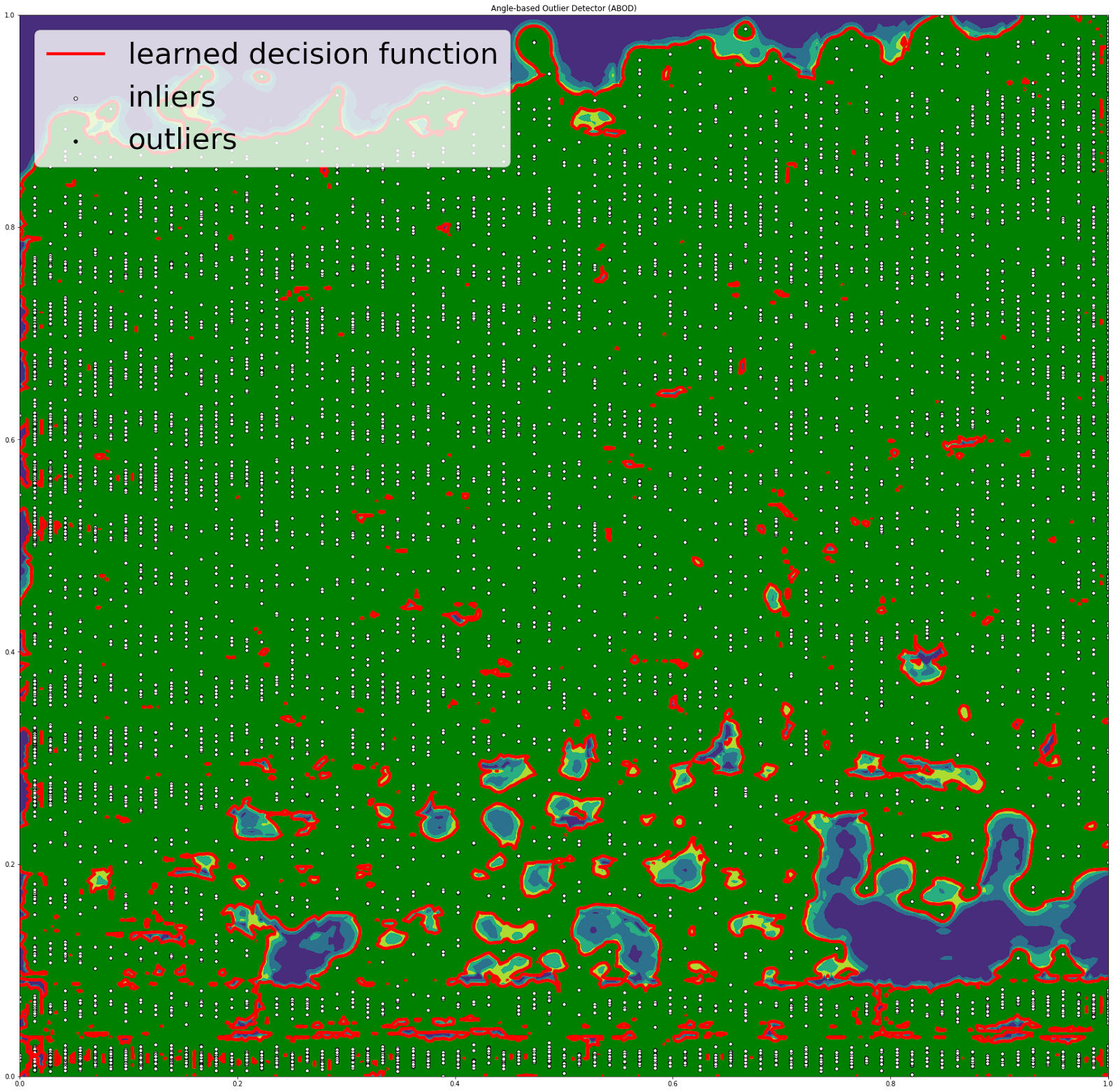
Angle-based Outlier Detector (ABOD):
ABOD assesses the broadness of the angular spectrum of a point as an outlier factor.
From Angle-based Outlier Detector (ABOD):
Outliers detected: 0
Inliers detected: 7043

Slide 11
Chi2 Feature Selection
The test has been performed to test the dependency of the churn based on the other factors.
We use the chi2 value to determine this.
Higher the chi2 value the more the churn is dependent on that factor.
Here churn is the target variable, and the rest are the input features.

Slide 12
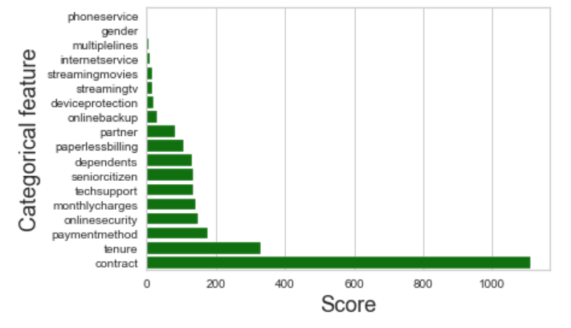
Chi2 Feature Extraction
Chi2 Feature selection has been performed and the resulting chi2 scores has been printed out as the output.
Out of which top 10 has been selected, based on the chi2 values.
The data has been reshaped by only choosing the 10 contributing features.

Slide 13
Association Rule Mining
Association rule mining being done to find interesting frequent item sets.
We use the apriori algorithm to find the frequent itemsets with a minimum support of 0.9 as the threshold.
Association rules has been done with lift as 1 as the minimum threshold.

Slide 14
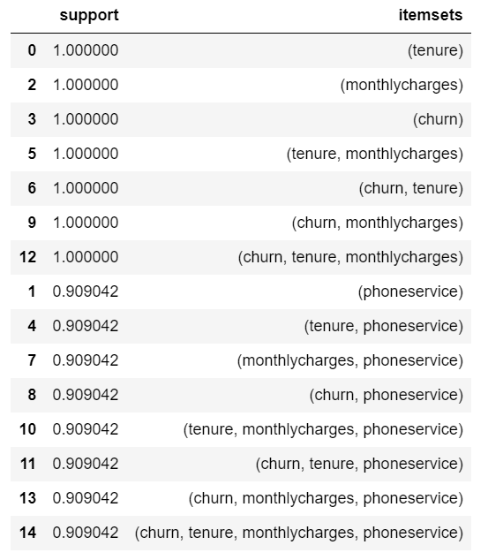
Association Rule Mining
The frequent item sets have been found using apriori algorithm for churn =1

Slide 15
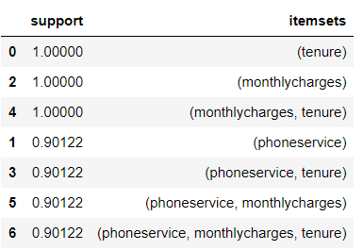
Association Rule Mining
The frequent item sets have been found using apriori algorithm for churn =0

Slide 16
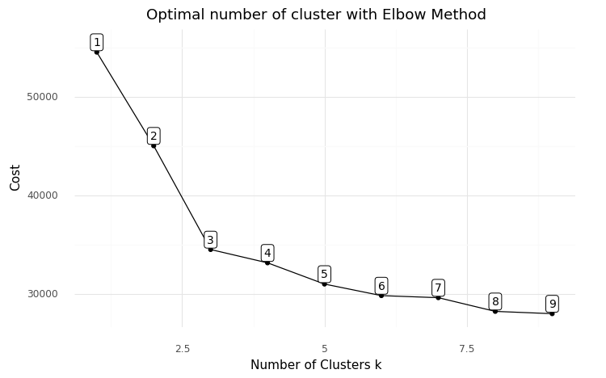
K Elbow
Kmode clustering is done for k in range (1,10)
The result is plotted to find the optimum number of clusters(K) given the cost of each cluster numbers.

Slide 17
Silhouette Method
It is another method used to find the optimum value for K.
It is used to analyze the mean distance between the clusters and is considered a better method than Elbow since it is less ambiguous.
It is done by using the silhouette score which is calculated using the mean intra cluster distance and the mean nearest cluster distance

Slide 18
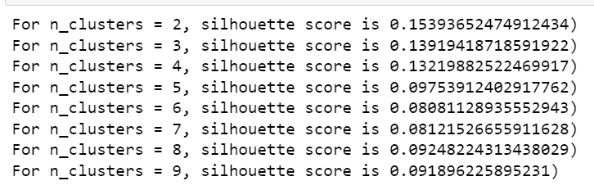
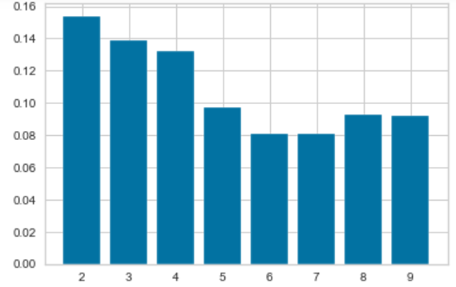
Silhouette Method Observations
Silhouette scores of different cluster numbers
Visual Representation of the Silhouette scores of different Cluster numbers

Slide 19
KModes Clustering
Kmeans is generally the most commonly used clustering technique. But it only works for the numerical data. It’s actually not suitable for the data that contains the categorical data type.
So, Huang proposed an algorithm called k-Modes which is created in order to handle clustering algorithms with the categorical data type.

Slide 20
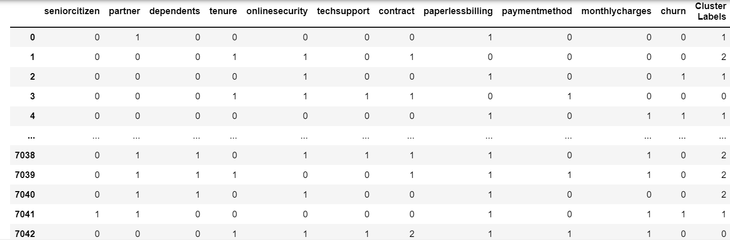
KModes Clustering
After the K modes clustering has been done. Each cluster has been given a label and they have been added to the dataframe.

Slide 21
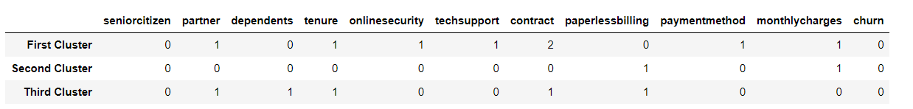
KModes Clustering
The properties of the centroids of three clusters were noted and observed:

Slide 22
Multiple Correspondence Analysis
MCA is applicable specific to categorical features.
The idea of MCA is to apply CA into the one-hot encoded version of the dataset. The result is like the PCA or CA result, two principal components with SVD result as the values.
The results are then plotted in a 2-dimensional plot based on the cluster they belong to.

Slide 23
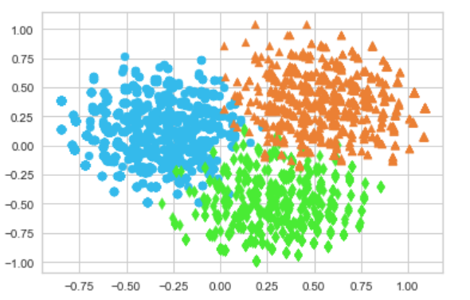
Plotting the result for Kmodes

Slide 24
Limitations of the clustering methods
KModes:
Data types can only be categorical, cannot be a mix of categorical and numerical.
The feature on which the disagreement matters. Because K-Modes simply counts the number of dissimilarities, it doesn’t matter to the algorithm on which “features” points are different. If a given category is particularly prevalent, this may become an issue as the algorithm will not take it into account when clustering.
Association Rule Mining:
They have a large number of discovered rules with low comprehensibility.

Slide 25
References
https://community.ibm.com/community/user/businessanalytics/blogs/steven-macko/2019/07/11/telco-customer-churn-1113
https://www.kaggle.com/blastchar/telco-customer-churn
https://www.kaggle.com/ashydv/telecom-churn-prediction-logistic-regression
https://towardsdatascience.com/accuracy-precision-recall-or-f1-331fb37c5cb9
https://amva4newphysics.wordpress.com/2016/10/26/into-the-world-of-clustering-algorithms-k-means-k-modes-and-k-prototypes/comment-page-1/

Slide 26
THANK YOU

