Slide 1

Connected Autonomy: An IoT-based Autonomous Car using Deep Learning Approach
Prepared By:
Rudranarayan Sahu (15830V23028)
Soumya Ranjan Panda (15830V23032)
Prabin Kumar Sahoo (15830V23024)
Under the Supervision of:
Dr. Lalatendu Muduli
Assistant Professor
Utkal University, Vani Vihar, Bhubaneswar
P.G Department of Computer Science and Applications
Utkal University, Vani Vihar, Bhubaneswar

Slide 2
Presentation outline
1
2
3
4
Introduction
Motivation
Objective
Problem Statement
5
6
7
8
Methodology
Conclusion
Research
Roadmap
Simulation
Environment
Setup

Slide 3
introduction
Autonomous vehicles (AVs), also referred to as self-driving or driverless vehicles, are a class of advanced automotive systems capable of navigating and performing driving tasks without direct human intervention.
They achieve this through the integration of complex hardware and software systems that enable real-time perception, decision-making, and control.
They use sensing technologies like Lidar, Radar, Ultrasonic sensors, camera; mapping techniques like GPS and different algorithms to process the data.

Slide 4
Technology Used
Machine Learning and Deep learning ( Tensorflow, PyTorch, Numpy, Ultralytics YOLO, Matplotlib)
Vision Programming ( Python, OpenCV)
IoT( Arduino Programming C ++, UART Communication, BLE Communication, Edge Computing)

Slide 5
Motivation & Objective
The self-driving technology aims to eliminate the need for a constant human attention while driving.
This can lead to a better driving experience, enhanced safety of the passengers, correct navigation to the destination, and reducing the cost for transportation and increased accessibility.

Slide 6
Problem Statement
The main aim to develop Autonomous vehicles is to reduce traffic accidents and improve efficiency
They enhance mobility by replacing human drivers with intelligent, automated systems.
They address critical issues like human error, congestion, and limited accessibility in current transportation.

Slide 7
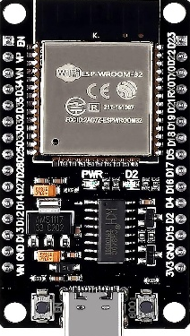
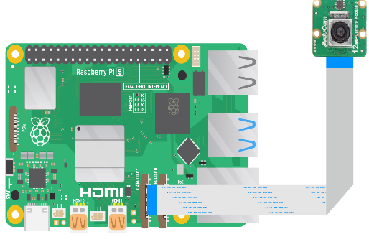
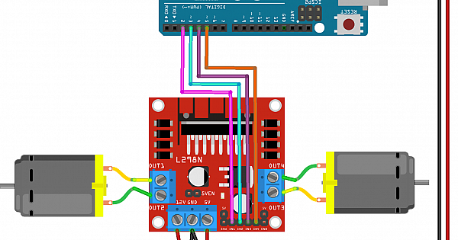
Simulation Environment Setup
Raspberry pi / Jetson Nano (Edge Device)
ESP32 / Arduino (Intermediate Controller)
4 Channel Relay
L298 Motor driver
BO Gear motor
Sensors (Ultrasonic, MQ2, etc..)
Raspberry pi camera module rev 3
Send result as command
Perform actuation and send the data to cloud

Slide 8
Research Roadmap
Tasks Performed | Timeline
Literature review and Finalization of title | January 2025
Studying of used methodology and collection of dataset for research | February 2025
Simulation environment setup and simulation run | March 2025
Performance analysis and writing of dissertation | April 2025

Slide 9
Conclusion
Autonomous vehicles have the potential to revolutionize transportation.
They offer increased safety, efficiency, and convenience.
Continued innovation in AI, sensors, and data processing is key.
Challenges remain in regulation, ethics, security, and public trust.
Collaboration between industries and governments is essential.
With proper development, AVs can lead to a smarter, safer future.

Slide 10
References
Parekh, D.; Poddar, N.; Rajpurkar, A.; Chahal, M.; Kumar, N.; Joshi, G.P.; Cho, W. A Review on AutonomousVehicles: Progress, Methods and Challenges. Electronics 2022, 11, 2162.
Khanam, Rahima & Hussain, Muhammad. (2024). What is YOLOv5: A deep look into the internal features of the popular object detector. 10.48550/arXiv.2407.20892.
Bimbraw, Keshav. (2015). Autonomous Cars: Past, Present and Future - A Review of the Developments in the Last Century, the Present Scenario and the Expected Future of Autonomous Vehicle Technology. ICINCO 2015 - 12th International Conference on Informatics in Control, Automation and Robotics, Proceedings. 1. 191-198. 10.5220/0005540501910198.
Wang, Jun & Zhang, Li & Huang, Yanjun & Zhao, Jian & Bella, Francesco. (2020). Safety of Autonomous Vehicles. Journal of Advanced Transportation. 2020. 1-13. 10.1155/2020/8867757.

Slide 11
Thank You

