Slide 1
Amazon Prime TV Shows & Movies Analysis
Exploratory Data Analysis & Tableau Dashboard Project

Slide 2
Project Overview
This project analyzes Amazon Prime Movies and TV Shows datasets using Python, Pandas,
Matplotlib, Seaborn, and Tableau. The goal was to discover content trends, audience
preferences, ratings behavior, regional distribution, and content growth patterns.

Slide 3
Objectives
• Analyze distribution of Movies vs TV Shows
• Identify popular genres and rating categories
• Understand global content distribution
• Study IMDb and TMDB score relationships
• Track release trends over time
• Generate actionable business insights

Slide 4
Tools & Technologies
Python, Pandas, NumPy, Matplotlib, Seaborn, Tableau, Google Colab, GitHub

Slide 5
Data Cleaning & Feature Engineering
• Handled missing values using median and custom labels
• Removed duplicate records
• Converted list-like columns using ast.literal_eval
• Created new features like runtime_category, rating_category, content_age
• Merged titles and credits datasets
• Created Tableau-ready dataset

Slide 6
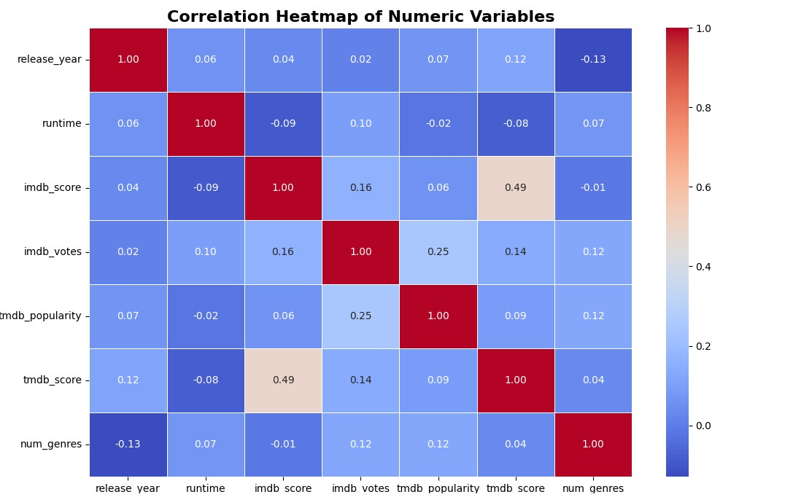
Correlation Heatmap

Slide 7
Correlation Heatmap of Numeric Variables
Why This Chart?
A correlation heatmap was selected to understand the relationships between important numerical variables such as IMDb Score, TMDB Score, Runtime, Votes, Popularity, and Release Year.
This chart helps identify whether certain variables move together positively or negatively.
Key Insights Found
IMDb Score and TMDB Score show a moderate positive correlation (0.49).
This indicates both platforms generally agree on content quality.
TMDB Popularity and IMDb Votes show a positive relationship.
More popular content receives higher audience engagement.
Runtime has very weak correlation with ratings.
Longer movies do not necessarily perform better.
Release Year and Number of Genres show slight negative correlation.
Recent content tends to focus on fewer genres.
Business Impact
Helps Amazon Prime understand what factors influence audience engagement.
Confirms rating consistency across platforms, improving recommendation reliability.
Supports data-driven content acquisition decisions.
The heatmap reveals that audience ratings and popularity metrics are moderately connected, while runtime has minimal impact on content success. This insight can help streaming platforms focus more on quality storytelling and audience engagement rather than content duration.

Slide 8
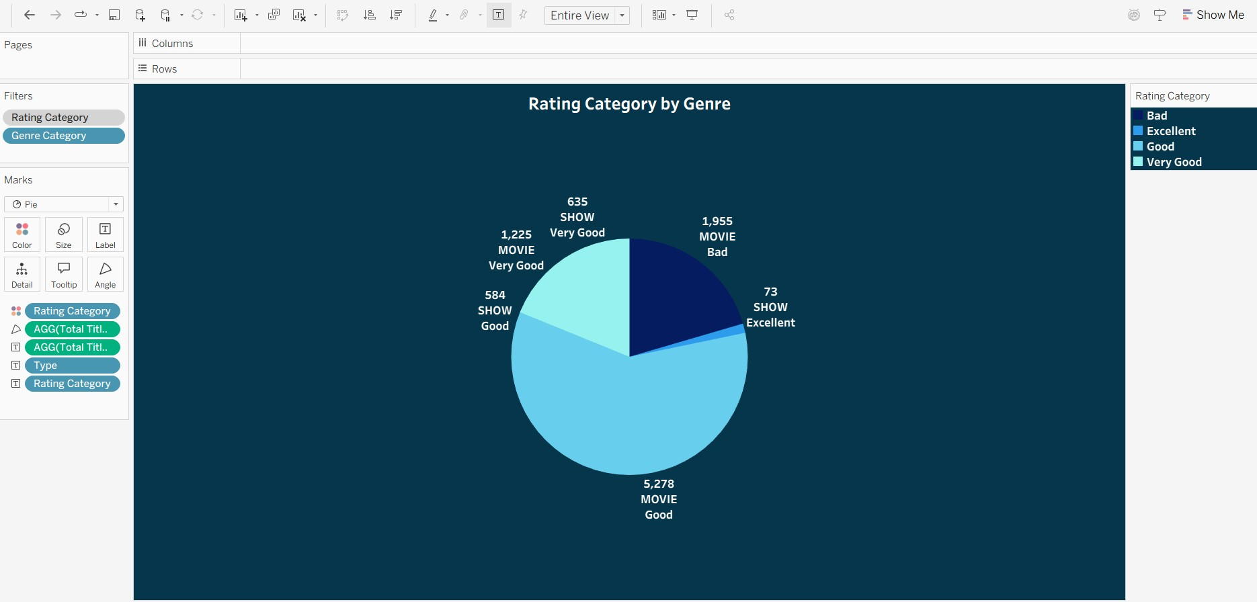
Rating Category by Genre

Slide 9
Rating Category by Genre (Pie Chart)
Why This Chart?
A pie chart was used to visualize the proportion of content distributed across different rating categories such as:
Bad
Good
Very Good
Excellent
This makes it easy to compare overall audience satisfaction levels.
Key Insights Found
Most Amazon Prime content falls under the “Good” rating category.
Very few titles fall under the “Excellent” category.
Shows and Movies both contribute heavily to mid-range ratings.
Poorly rated content still forms a significant portion of the library.
Business Impact
Helps identify overall platform content quality.
Shows that Amazon Prime has strong mid-performing content but fewer exceptional titles.
The analysis shows Amazon Prime maintains a strong volume of moderately successful content, but there is room to increase critically acclaimed titles. Strategic investments in premium productions may improve customer retention and brand perception.

Slide 10
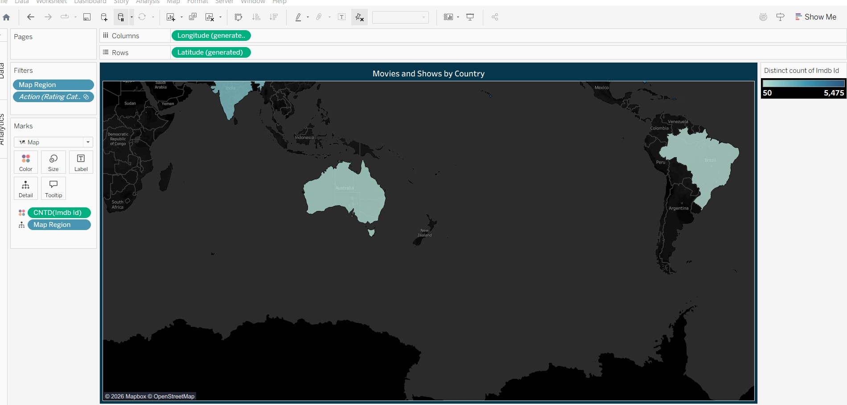
Movies and Shows by Country

Slide 11
Movies and Shows by Country (Map Visualization)
Why This Chart?
A geographic map visualization was chosen to analyze the global distribution of Amazon Prime content production.
Maps are highly effective for identifying regional dominance and content concentration.
Key Insights Found
North America and parts of Asia dominate content production.
Countries like the US and India contribute heavily to the platform library.
Several regions show low content representation.
Amazon Prime’s catalog is concentrated in selected entertainment markets.
Business Impact
Identifies underserved regions for future market expansion.
Helps Amazon Prime localize content strategies.
Supports international audience targeting.
Useful for planning regional investments and partnerships.
The geographic analysis highlights strong content concentration in major entertainment-producing countries. The findings suggest opportunities for Amazon Prime to expand localized content production in emerging global markets.

Slide 12
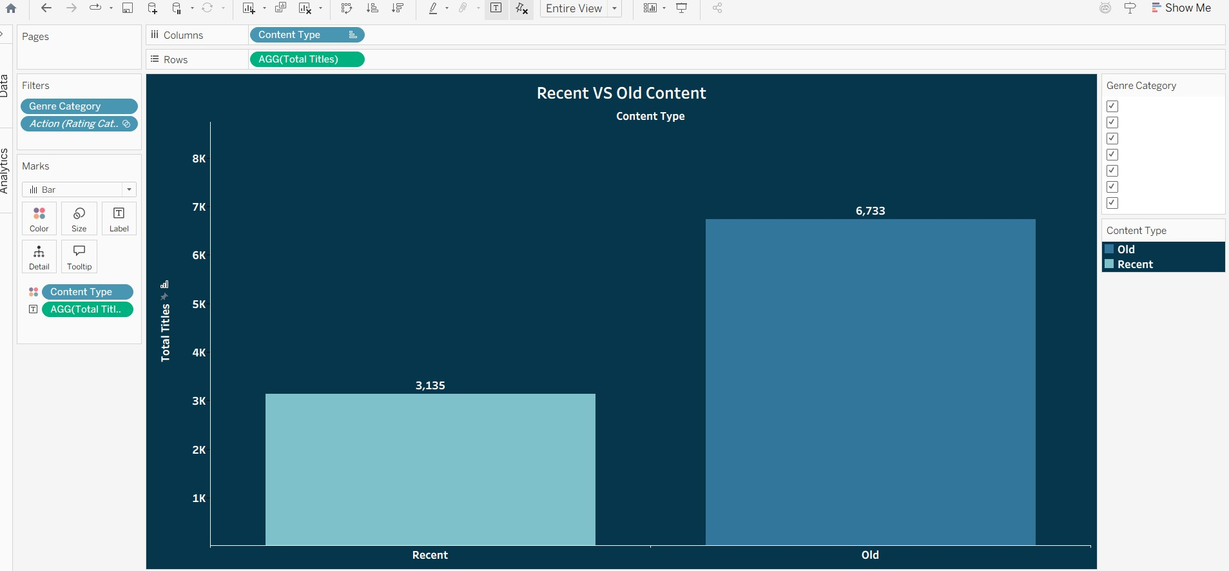
Recent vs Old Content

Slide 13
Recent vs Old Content (Bar Chart)
Why This Chart?
A bar chart was used because it clearly compares two groups:
Recent Content
Old Content
This allows quick comparison of platform content growth patterns.
Key Insights Found
Older content dominates the Amazon Prime library.
Recent content additions are significantly lower.
The platform relies heavily on legacy content.
Content acquisition and production have increased gradually in recent years.
Business Impact
Shows dependency on older catalog content.
Indicates need for continuous fresh content releases.
Helps measure content freshness and competitiveness.
The analysis reveals that Amazon Prime’s catalog is still heavily dominated by older titles. While recent content is increasing, consistent investment in fresh releases will be important for long-term audience engagement and subscriber growth.

Slide 14
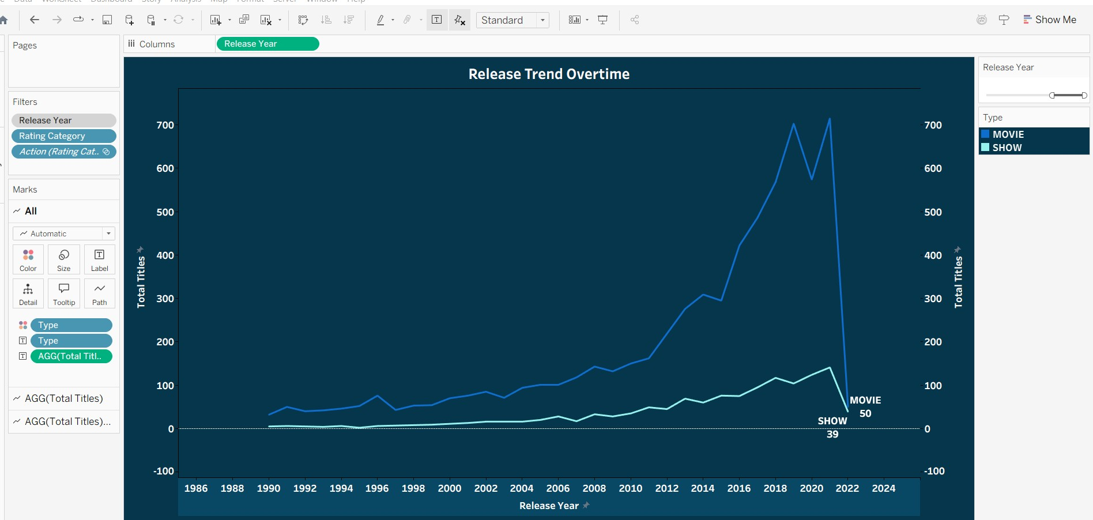
Release Trend Over Time (Dual Axis Line Chart)

Slide 15
Release Trend Over Time (Dual Axis Line Chart)
Why this chart was used
The dual axis line chart was chosen to analyze how Amazon Prime Video content has evolved over time for both Movies and TV Shows simultaneously. A dual axis chart is effective here because it allows comparison of two related trends across the same timeline without creating multiple separate charts.
Insights Found from the Chart
1. Strong Growth After 2010
The chart shows a significant rise in content releases after 2010, especially between 2015–2020. This indicates Amazon Prime aggressively expanded its content library during the streaming boom period.
2. Movies Dominate the Platform
Movies consistently remain much higher in volume compared to TV Shows across almost every year. This suggests Amazon Prime focuses heavily on movie-based content acquisition and production.
3. TV Shows Started Growing Gradually
Although Shows are fewer than Movies, the chart reveals steady growth in TV Show releases over recent years. This reflects the increasing industry trend toward binge-worthy streaming series.
4. Peak Around Recent Years
The sharp rise near recent years indicates rapid platform scaling and higher investment in entertainment content before slowing slightly afterward.
5. Content Strategy Shift
The growth trajectory suggests Amazon Prime transitioned from a smaller content platform into a large-scale global streaming ecosystem.

Slide 16
Positive Business Impact
Better Content Investment Decisions
The chart helps stakeholders identify which type of content contributes more to platform growth. Since Movies dominate, Amazon can continue leveraging movie licensing while strategically increasing premium series production.
Trend Forecasting
The release trend helps predict future content demand patterns and supports planning for upcoming content budgets.
Audience Retention Strategy
The gradual increase in TV Shows suggests serialized content may improve subscriber retention because shows encourage longer platform engagement.
Competitive Benchmarking
The visualization helps compare Amazon Prime’s expansion timeline against competitors like Netflix or Disney+.
Content Portfolio Optimization
Understanding historical growth helps determine whether the platform has balanced diversification between Movies and Shows.
Final Report / Conclusion from the Chart
The Release Trend Over Time dual axis chart reveals that Amazon Prime Video experienced substantial content growth over the past decade, with Movies contributing the majority of releases while TV Shows steadily gained momentum. The platform significantly accelerated expansion during the streaming era, particularly after 2015.
Overall, the chart demonstrates:
Rapid platform expansion
Strong movie dominance
Increasing investment in streaming series
Evolving content strategy aligned with modern entertainment trends
This visualization provides valuable strategic insight for content planning, audience engagement, and long-term streaming business growth.

Slide 17
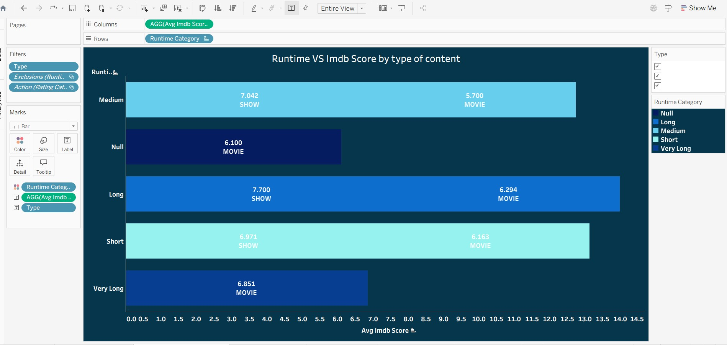
Runtime vs IMDb Score by Type of Content

Slide 18
Runtime vs IMDb Score by Type of Content (Bar Chart)
Why this chart was used
A horizontal grouped bar chart was selected to compare IMDb ratings across different runtime categories for both movies and TV shows. This chart effectively highlights performance differences between content durations and content types.
Insights from the chart
Long-format shows received some of the highest IMDb scores.
Medium and short runtime content also performed consistently well.
Very long movies generally had lower ratings compared to long-format shows.
TV shows tend to maintain stronger audience engagement across longer runtimes than movies.
Business impact
Streaming platforms can prioritize producing high-quality long-form series since viewers appear to engage positively with them.
Runtime optimization helps content creators understand audience preferences.
Insights from runtime behavior can improve content acquisition and production strategies.
The “Runtime vs IMDb Score” visualization demonstrates a clear relationship between content duration and audience ratings. Long-format TV shows generally outperform movies in viewer satisfaction, suggesting that episodic storytelling creates stronger engagement over time. The analysis supports strategic investment in high-quality series content while emphasizing the importance of balancing runtime with viewer retention and entertainment value.

Slide 19
Business Insights
• Movies dominate the platform more than TV Shows
• Good-rated content receives stronger audience engagement
• Global expansion opportunities exist in underrepresented regions
• High-rated long-form content performs consistently well
• Recent content growth suggests increased investment in fresh releases

Slide 20
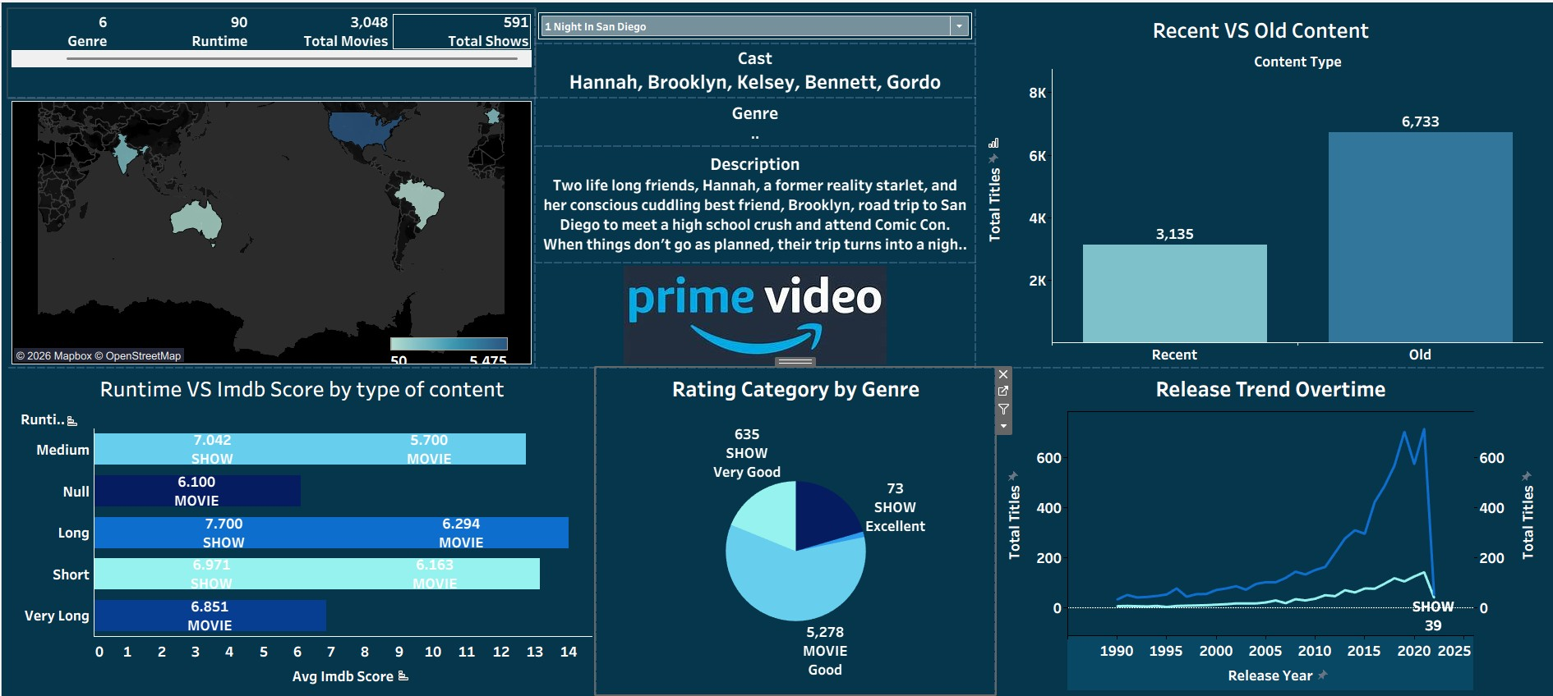
Dashboard

Slide 21
Conclusion
This EDA project on Amazon Prime Movies and TV Shows successfully uncovered key insights about content distribution, audience preferences, genre trends, regional presence, and release patterns using Python and Tableau.
The analysis showed that Movies dominate the platform, while TV Shows have grown significantly in recent years. Genres related to Entertainment, Family, and Drama were the most common, and highly rated content generally had longer runtimes and stronger audience engagement.
Interactive dashboards and visualizations such as trend analysis, KPI cards, maps, scatter plots, and dual-axis charts helped transform raw data into meaningful business insights. These findings can support content strategy, audience targeting, and data-driven decision-making for streaming platforms.
Overall, the project demonstrates practical skills in data cleaning, feature engineering, exploratory data analysis, visualization, and business storytelling.

