Slide 1
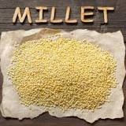

Millets : super food or a diet fad
-by Rudransh Bhardwaj
Class:-9th C
School :Dr.BR Ambedkar School of Specialized Excellence Civil Lines

Slide 2
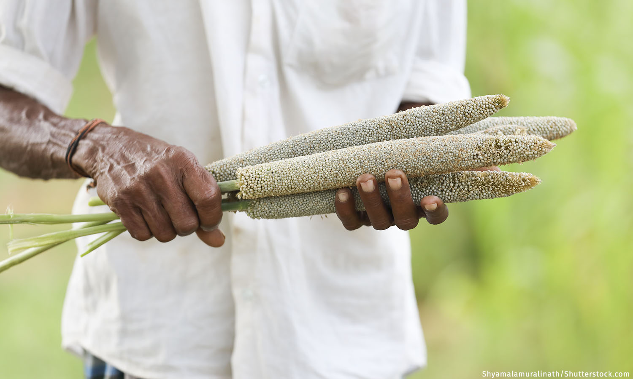
International Year of Millets 2023
Millets are a highly varied group of small-seeded grasses, widely grown around the world as cereal crops or grains for fodder and human food.
They are ‘powerhouse of nutrition’ and a ‘super food’.
In 2023, UN celebrating International Year of Millets 2023 (IYM) with the aim to create awareness and increase production & consumption of millets.

Slide 3
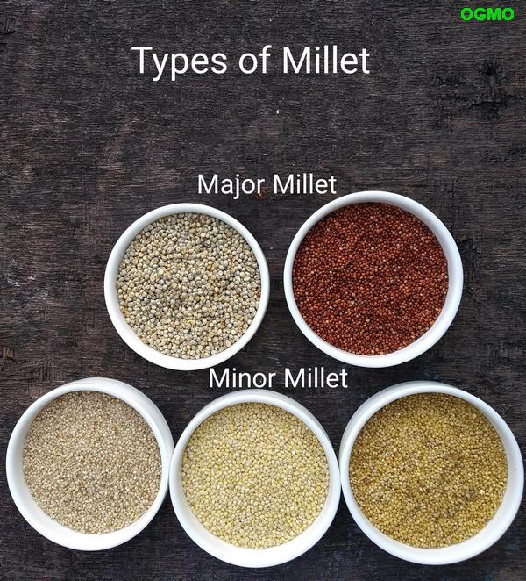
Types of millet
Millets are small-seeded grasses belonging to the botanical family Poaceae.
They are mainly of 2 types major and minor millet.

Slide 4
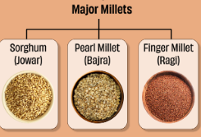
Major millet
Rich in insoluble and soluble fibers .
It helps in digestion.
They are also known for its anti-cancer properties.
They are gluten free and beneficial for celiac disease patients.
Ex-pearl millet (king of millet) , sorghum and etc.
…..other countless benefits

Slide 5
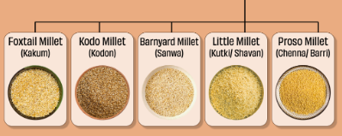
Minor Millets
Rich in iron and calcium and aid in boosting immunity.
They are rich in magnesium which can greatly lower the risk of type-2 diabetes .
Ex-Little millet , kodo millet and etc.
…….

Slide 6
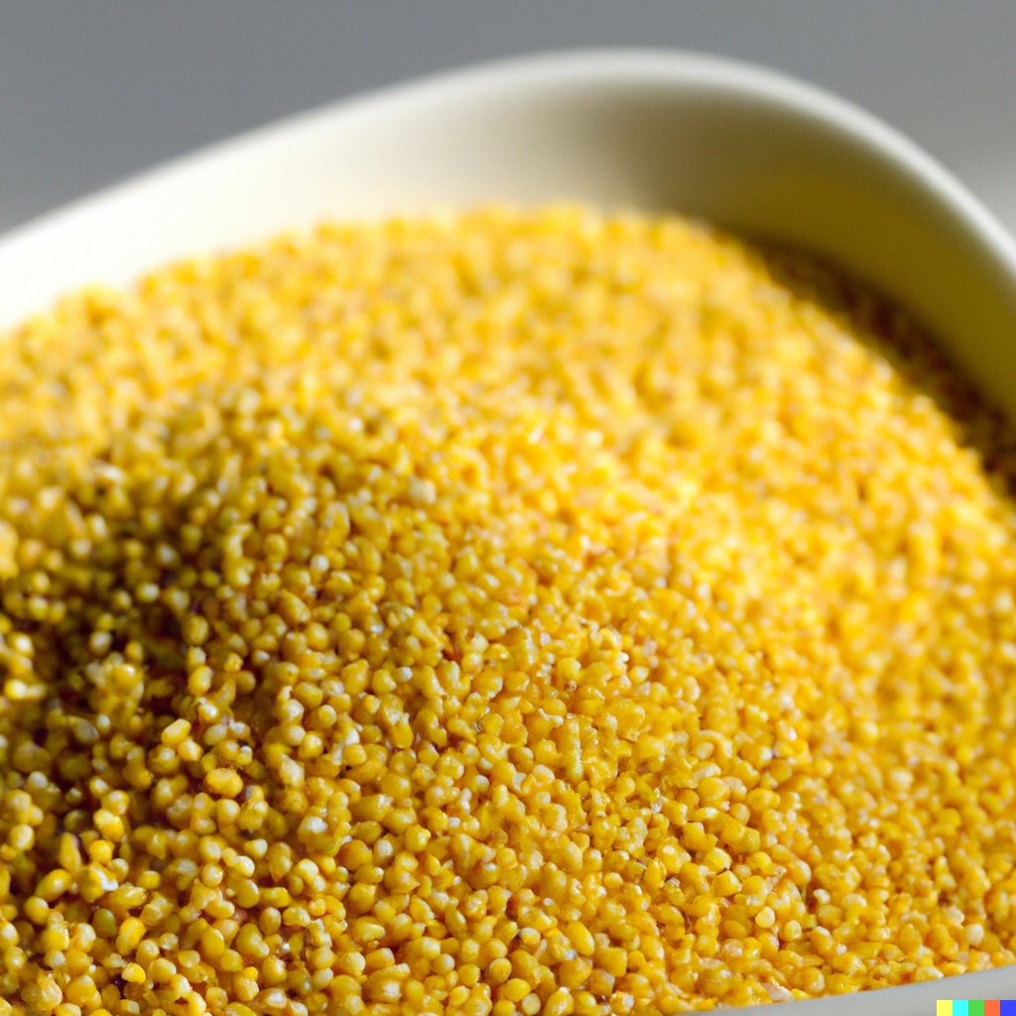
Pros of millets
Nutrient Rich.
Gluten Free
Rich in anti-oxidants like Vitamin C & E , Beta Carotene etc.
Improves food security as it can grow in extreme temperatures with low inputs and without fertilizers.
Before Green Revolution , millets made up around 40% of cultivated grains in India.

Slide 7
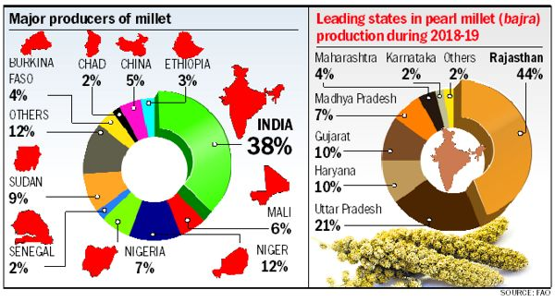
Leading producer of millets

Slide 8

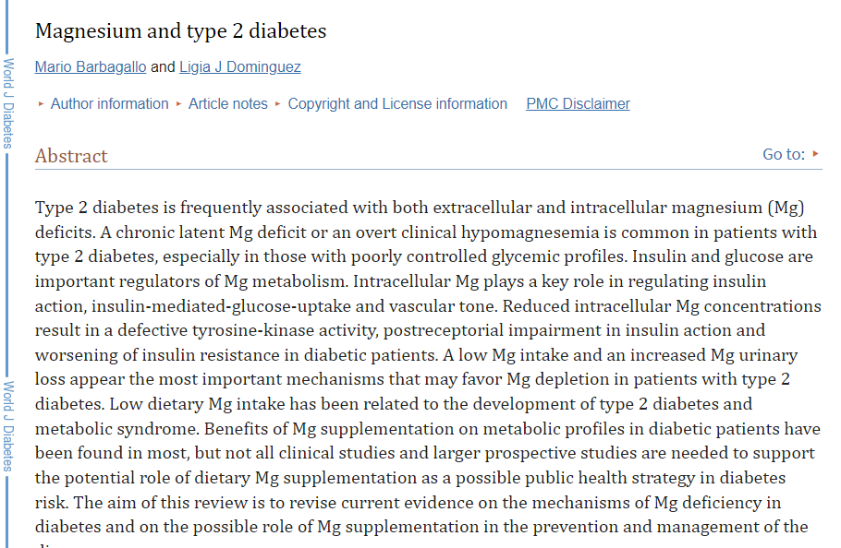
Millets and type-2 diabetes

Slide 9
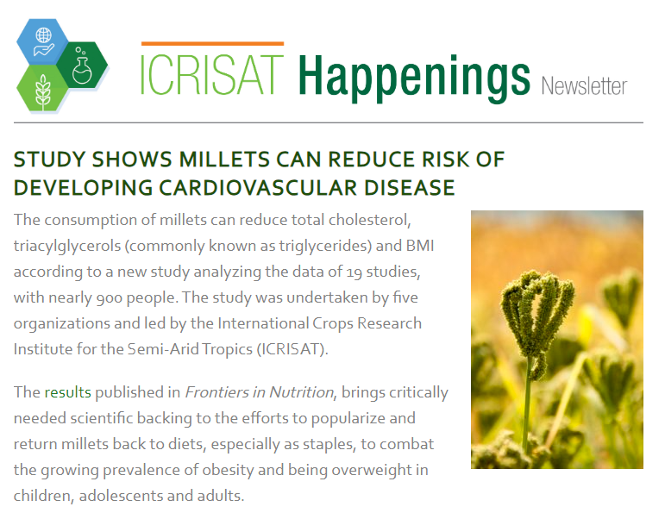

Slide 10
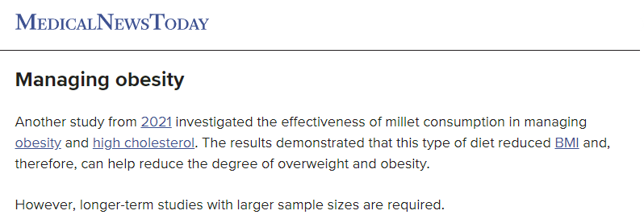
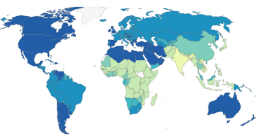
13% of adult are obese

Slide 11
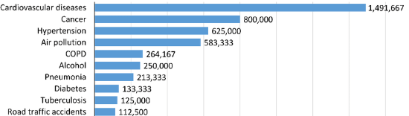

Slide 12
Conclusion
Millet is a nutrient-rich superfood known for its exceptional health benefits. Packed with essential nutrients like fiber, protein, vitamins, and minerals, millet supports digestion, boosts energy, and aids in maintaining a healthy weight. Its low glycemic index helps regulate blood sugar levels, making it suitable for diabetes management. Millet's versatility allows it to be incorporated into various dishes, from breakfast porridge to salads, showcasing its role as a versatile and nutritious addition to a balanced diet.

Slide 13
Thank You

Slide 14
I hope you liked it .

