Slide 1


LDRP INSTITUTE OF TECHNOLOGY
AND RESEARCH
PRESENTED BY: GUIDED BY:
AGRAWAL PRATHAM PROF. NIMESH PATEL
ACHARYA YAGNANG
PATEL RUDRA
CHAUDHARY TUSHYAM

Slide 2
ANONYMOUS FEEDBACK
Definition
Anonymous feedback refers to comments, opinions, or evaluations provided by individuals without revealing their identities. This type of feedback is often used in surveys, performance reviews, or customer satisfaction assessments to encourage honesty and reduce fear of repercussions. The anonymity helps ensure that the feedback is candid, unbiased, and reflective of the true sentiments of the respondents.

Slide 3
Benefits of Anonymous Feedback
Increased Transparency
Anonymous feedback promotes a culture of openness and accountability, where employees feel empowered to share their honest perspectives without fear of retaliation
2. Improved Decision-Making
The insights gained from anonymous feedback allow organizations to make more informed decisions that address the needs and concerns of their employees
3. Enhanced Employee Engagement
When employees feel their voices are heard and their feedback is acted upon, they are more likely to be engaged, motivated, and committed to the organization's success.
4. Effective Problem Solving
Anonymous feedback can help identify and resolve issues that may have gone unnoticed or unaddressed, leading to a more productive and harmonious work environment

Slide 4




Strategies for Improving Feedback Collection
Promote Awareness
Regularly communicate the importance of anonymous feedback and the changes it has brought about within the organization.
Schedule Regularly
Implement a consistent feedback collection schedule, such as quarterly or bi-annual surveys, to maintain employee engagement
Encourage Participation
Incentivize or reward employees for providing constructive feedback, fostering a culture of continuous improvement
Gather Diverse Perspectives
Ensure the feedback collection process reaches a wide range of employees, representing different departments, levels, and demographics.

Slide 5
Working Of Anonymous Feedback System
1.Feedback Collection
2.Anonymity Measures
3.Submission
4.Data Processing
5.Review and Action
6.Follow-Up

Slide 6
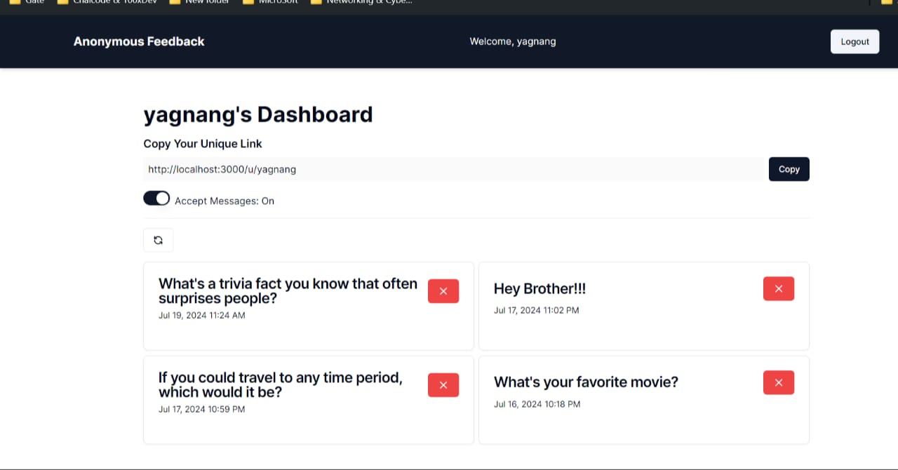
Result

Slide 7
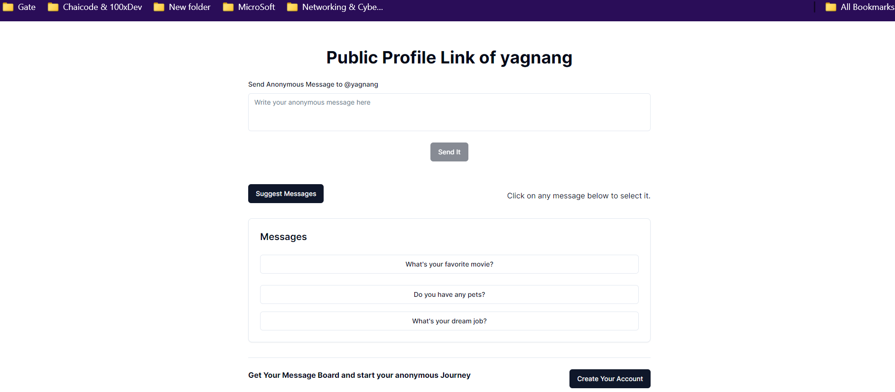
Result

Slide 8
ADVANTAGE
HONEST INPUT
UNBIASED
OPINION
IMPROVED TRUST
EMPLOYEE
ENGAGEMENT
FOCOUS ON ISSUES

Slide 9

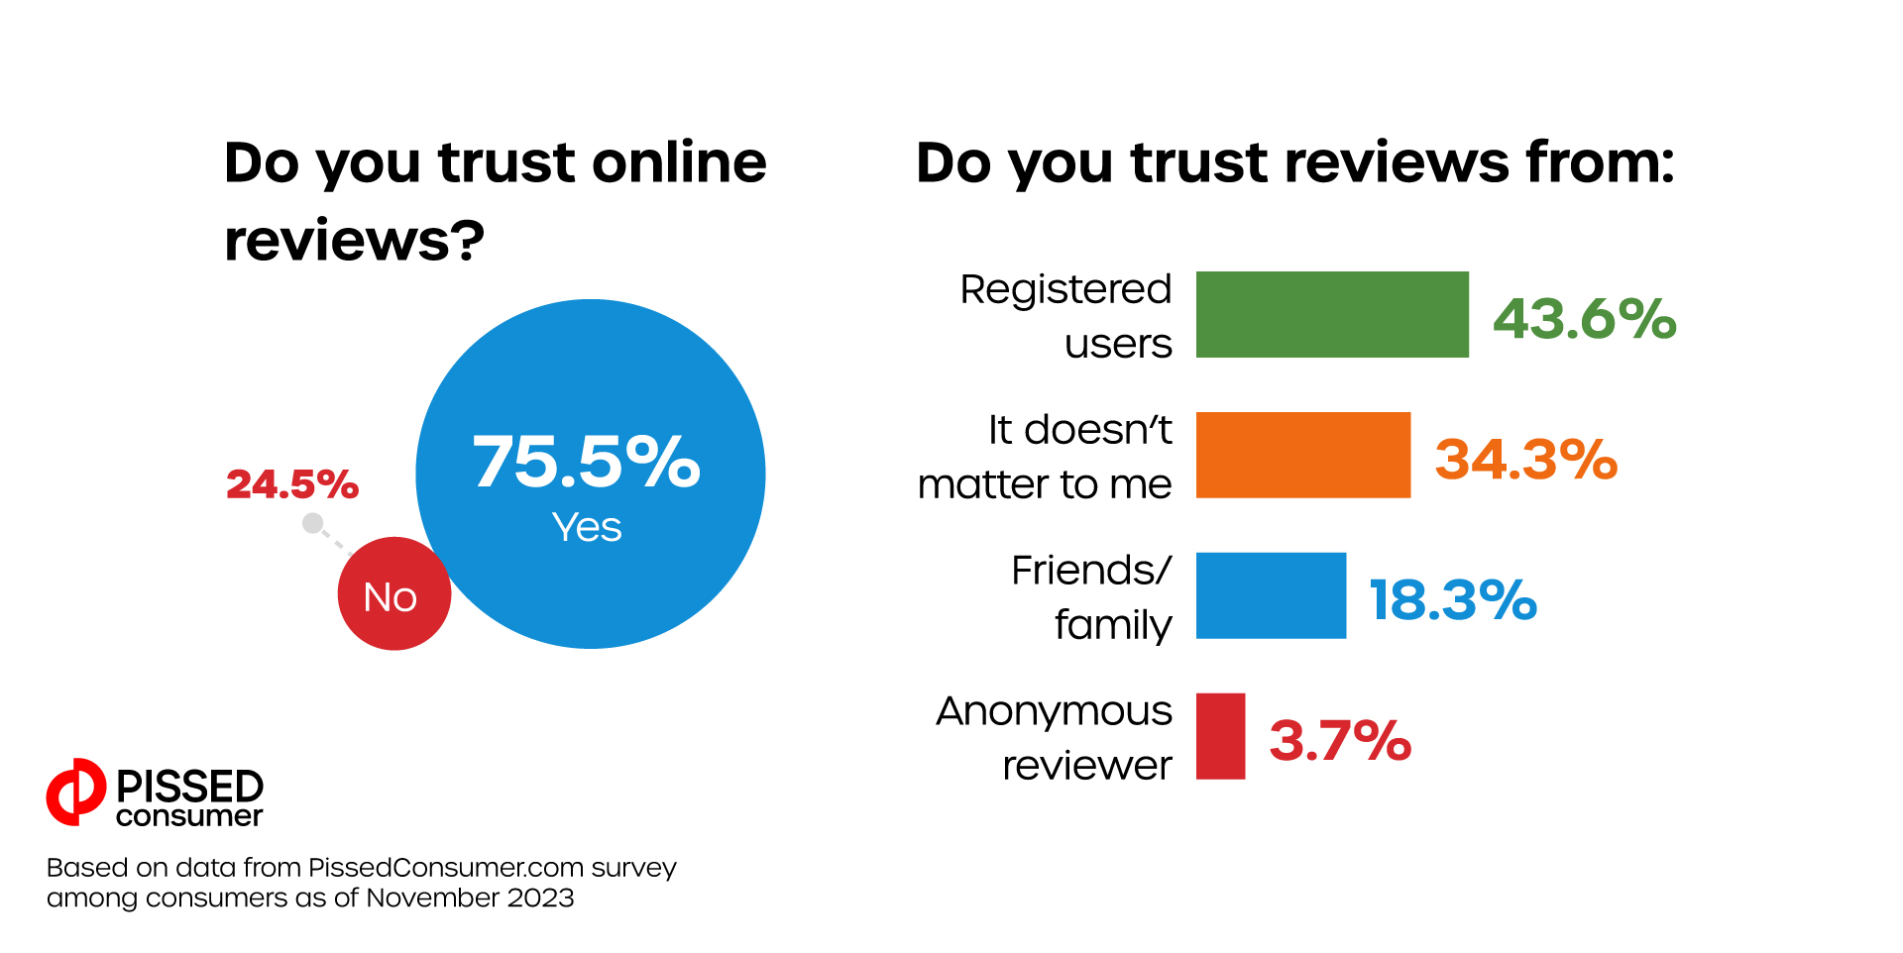
Statistical Data

Slide 10
Conclusion
Anonymous feedback systems play a crucial role in fostering an environment of open and honest communication. By ensuring confidentiality, these systems encourage more candid responses, increase participation, and provide unbiased insights that are essential for continuous improvement. Implementing effective anonymity measures not only builds trust within an organization but also enhances employee engagement and morale. Ultimately, anonymous feedback helps organizations identify genuine issues, gather diverse perspectives, and create action plans that drive meaningful change. By valuing and acting on anonymous feedback, organizations demonstrate their commitment to listening to all voices and continuously improving their processes and culture.

