Slide 1
Malicious jPEG Detector using ML
Notes:
1

Slide 2
Objective
Detect Malicious Jpeg images using static Analysis
Notes:
2

Slide 3
Team members
Shankar Kashamshetty – Working as General Manager – Data scientist in Vodafone Idea.
Rudranil
Abhilash
Suresh Raghava
Shrijith Pillai
Kunaal Chawla
Notes:
3

Slide 4
Why do we need?
Cyber attacks targeting individuals, businesses, and organizations have increased in recent years and attackers are constantly searching for new and effective ways to launch attacks and deliver a malicious payload to victims.
Executable les (i.e.,.exe) are known to be dangerous, attackers are increasingly using non-executable les (e.g., .pdf, .docx, etc.) which are mistakenly considered to be safe for use by most users. Some non-executable files allow an attacker to run arbitrary malicious code on the targeted victim machine when the file is opened.
Notes:
4

Slide 5
Why Images? JPEG?
Images are used on a daily basis by millions of people around the world, and most users consider images to be safe for use; however, some types of images can contain a malicious payload and perform harmful actions.
JPEG is the most popular image format, primarily due to its lossy compression.
It is used by almost everyone, from individuals to large organizations, and can be found on almost every device (on digital cameras and smartphones, websites, social media, etc.). Because of their harmless reputation, massive use, and high potential for misuse, JPEG images are used by cyber criminals as an attack vector.
Notes:
5

Slide 6


Solution Architecture/blocks
JPEG Reader
Malicious
Data Preparation
ML Model
Pre-Processing
Feature Creation
Benign
Notes:
6

Slide 7
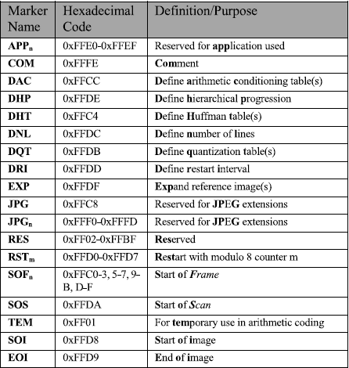
JPEG READER
DataSet:
Benign – 1200
Malicious - 930
JPEG Reader:
It reads jpeg images and extract markers. Below tables explains all the marker details
Notes:
7

Slide 8
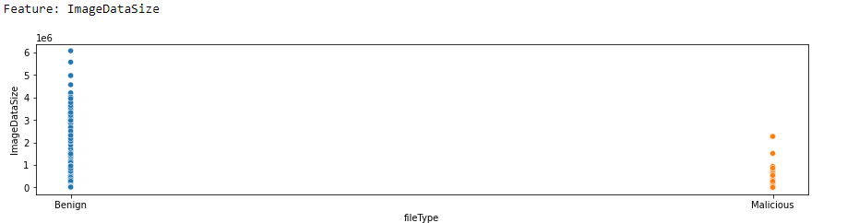
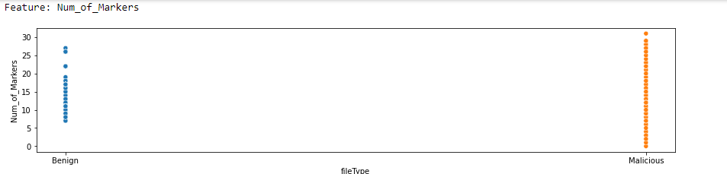
Exploratory Analysis
Notes:
8

Slide 9
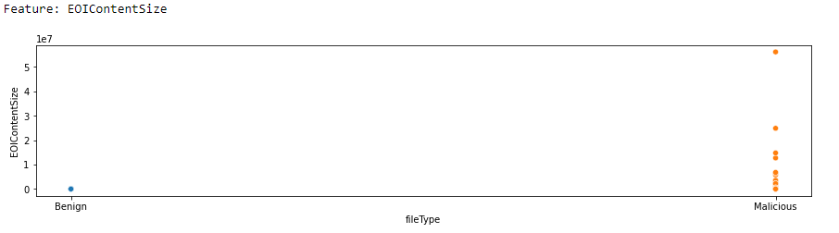
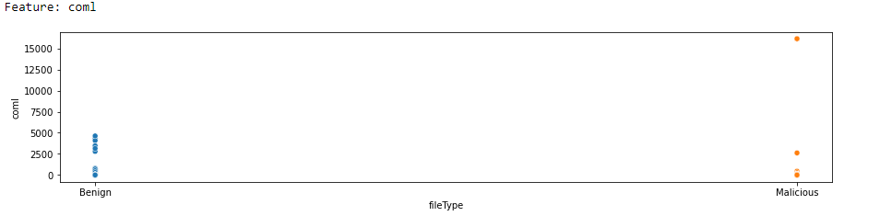
Exploratory Analysis

Slide 10
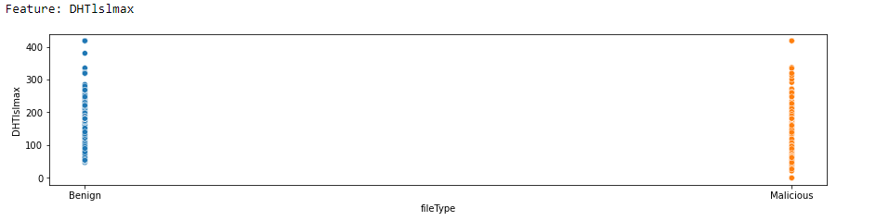
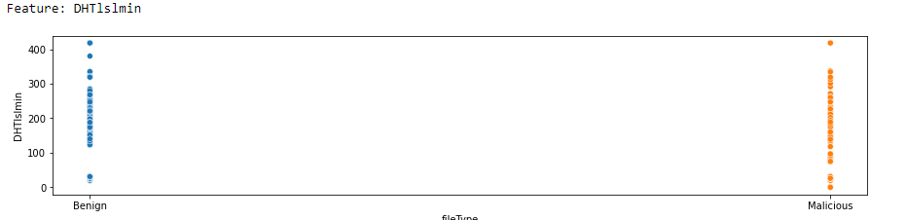
Exploratory Analysis

Slide 11
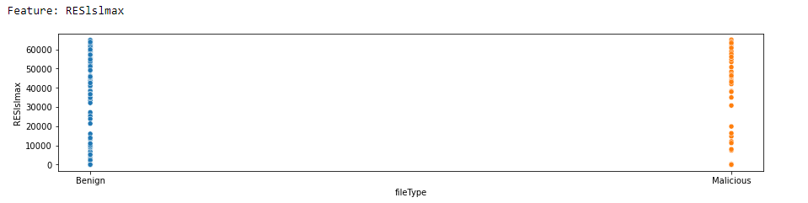
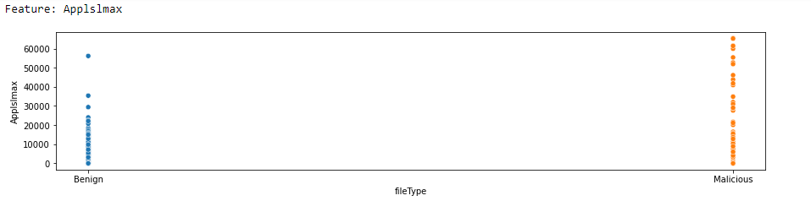
Exploratory Analysis

Slide 12
Feature creation
This Module generates additional below features for each marker
No of times each marker occurred
length of marker
Minimum length of Marker
Maximum length of Marker
Remove unwanted features – Used ML to remove insignificant and correlated features
Notes:
12

Slide 13
Modelling & Performance
ML Model:
Light GBM ML algorithm with 10 fold cross validation Grid-search for best parameters tuning
Performance of the model (Test data):
AUC: 95%
ACCURACY: 95% on Malware
99% for benign
FPR: 10%
Notes:
13

Slide 14
Important features/identifiers for malicious files
Image Data Size – smaller size for Image data
Maximum length of DHT marker – higher length
Maximum length of APP marker – Length of these markers are large to accommodate malicious content in images
Length of comment Marker – comment marker length is high for malicious files
Number of markers in Jpeg file – more markers (count) in malicious files
Notes:
14

Slide 15
Important features/identifiers for malicious files
Length of RES – reserved marker – more length
Data size after End of marker – Malicious files stores content after end of marker which is end point of JPEG metadata
Number of APP markers – more APP markers
DHT count – more count
DQT count – more count
Notes:
15

Slide 16
References
https://yasoob.me/posts/understanding-and-writing-jpeg-decoder-in-python/
https://ieeexplore.ieee.org/document/8967109
https://ijsret.com/wp-content/uploads/2020/11/IJSRET_V6_issue6_730.pdf
Notes:
16

Slide 17
Next actions
Enhance this application with more Malicious Images
Build Chrome plugin
Extend this application to different image types and Videos

Slide 18
THANKS

