Slide 1
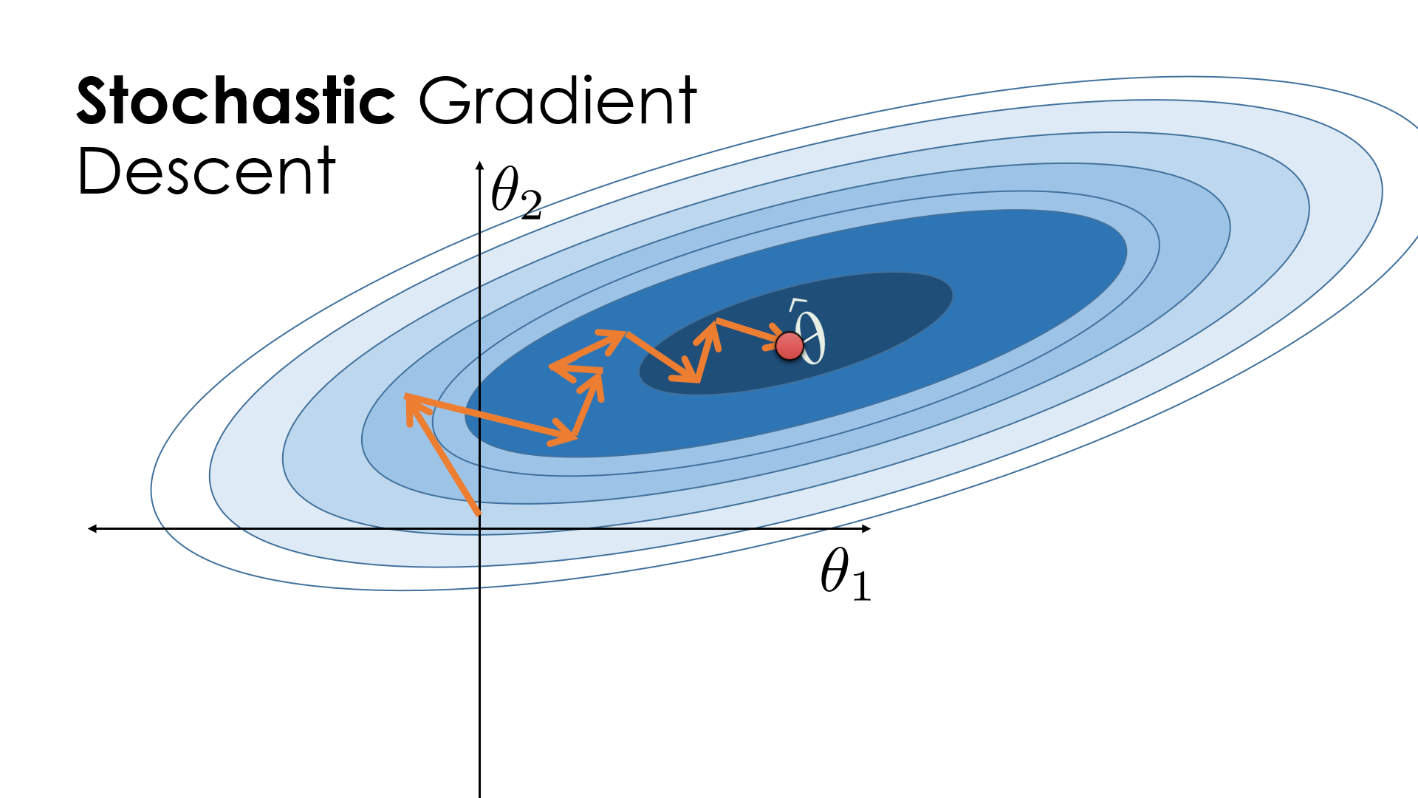
stocHastic gradient decent vs gradient decent
Rudra Saha
ID 19301104
COURSE ;CSE431

Slide 2
AGENDA
Introduction
Primary goals
Function
Timeline
Summary

Slide 3

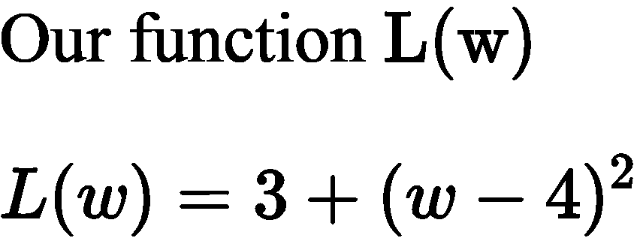
our fucntion

Slide 4
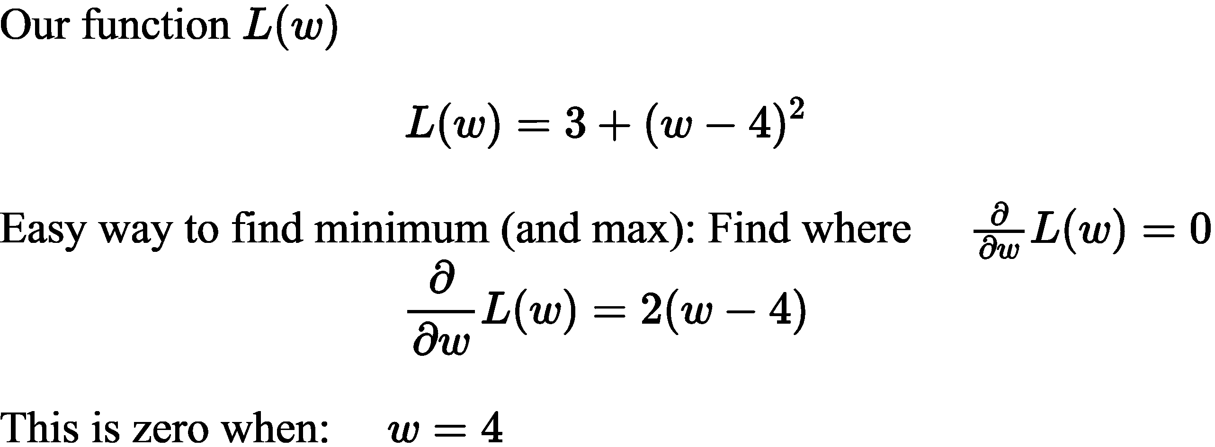
OUR FUNCTION L(W)

Slide 5
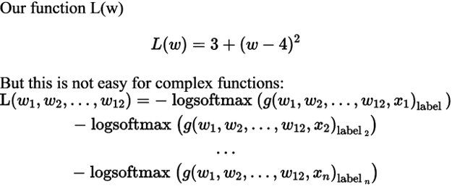
OUR FUNCTION L(W)
​ | CATEGORY 1 | CATEGORY 2 | CATEGORY 3​ | CATEGORY 4​
Q1 | 4.5​ | 2.3​ | 1.7​ | 5​.0
Q2 | 3.2​ | 5.1​ | 4.4​ | 3​.0
Q3 | 2.1​ | 1.7​ | 2.5​ | 2.8​
Q4 | 4.5​ | 2.2​ | 1.7​ | 7.0

Slide 6
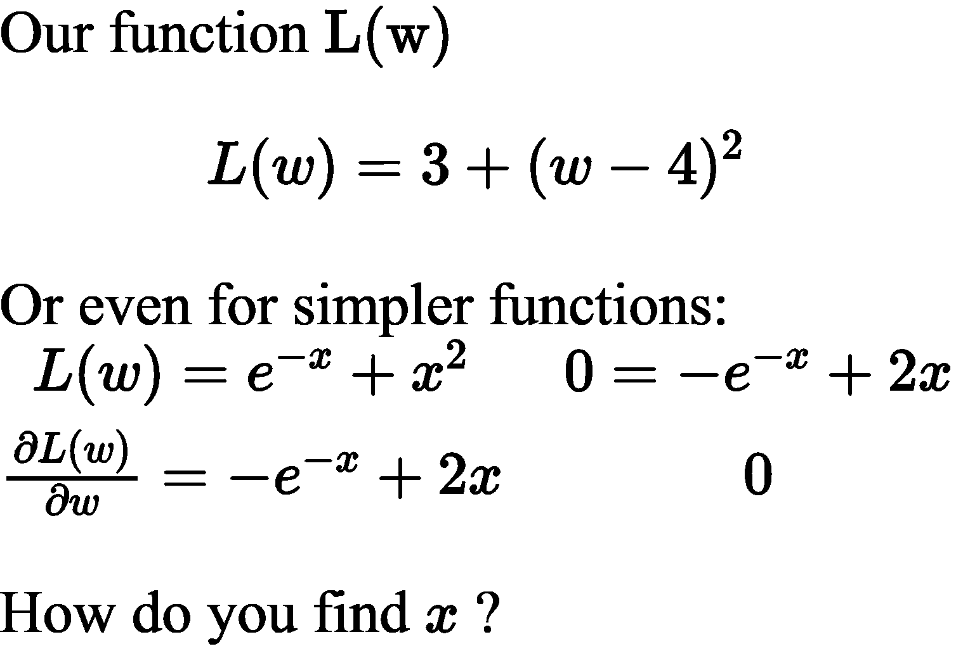

Slide 7
What is Stochastic Gradient Descent? 1.Stochastic gradient descent is a method to find the optimal parameter configuration for a machine learning algorithm. It iteratively makes small adjustments to a machine learning network configuration to decrease the error of the network. 2.Stochastic gradient descent attempts to find the global minimum by adjusting the configuration of the network after each training point. Instead of decreasing the error, or finding the gradient, for the entire data set, this method merely decreases the error by approximating the gradient for a randomly selected batch (which may be as small as single training sample). 3.Stochastic gradient descent can adjust the network parameters in such a way as to move the model out of a local minimum and toward a global minimum. 4.A benefit of stochastic gradient descent is that it requires much less computation than true gradient descent (and is therefore faster to calculate), while still generally converging to a minimum (although not necessarily a global one).

Slide 8
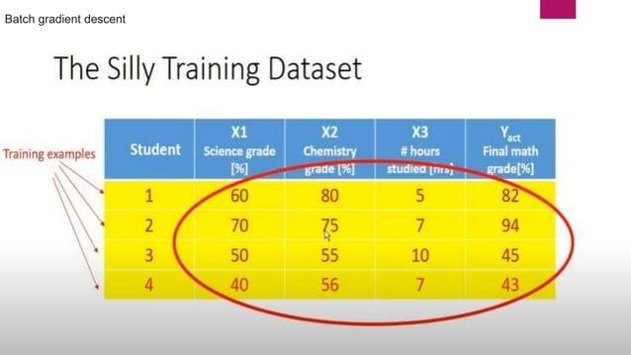

Slide 9
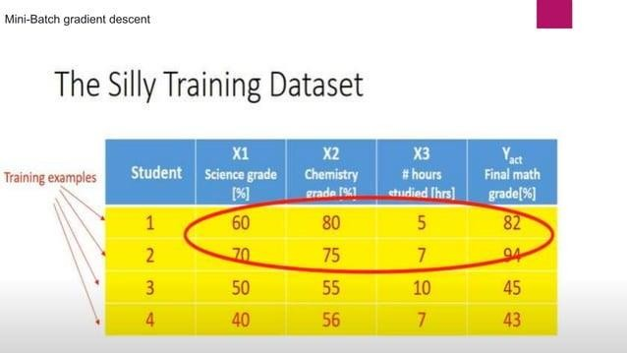
TABLE

Slide 10
AREAS OF FOCUS

Slide 11
NOTE
-EACH TIME WE USE THE ENTIRE TRAINING DATASET, THAT IS CALLED AN EPOCH
-SO IN OUR CASE, FOR STOCHASTIC GRADIENT DESCENT, WE WOULD HAVE CARRIED OUT 4 PASSES BEFORE COMPLETING ONE EPOCH
- AND FOR MINI-BATCH, WE WOULD HAVE CARRIED OUT 2 PASSES TO COMPLETE AN EPOCH.
- AND FOR BATCH, WE WOULD HAVE CARRIED OUT 1 PASS TO COMPLETE AN EPOCH.
- THAT IT WILL MOST LIKELY TAKE MANY EPOCHS BEFORE THE MODEL IS FULLY TRAINED.
-W( new) (old) dw(old) [Weight Updating formula]
-Here dL/dw(old) n data point Batch gradient descent (gradient descnet)
-Here (old) data point Mini-Batch gradient descent
-Here (old) data point Stochastic Gradient Descent

Slide 12
Advantages of Stochastic Gradient
Descent
-It is easier to fit into memory due to a single training sample being processed by the network
-It is computationally fast as only one sample is processed at a time
-For larger datasets it can converge faster as it causes updates to the parameters more frequently
-Due to frequent updates the steps taken towards the minima of the loss function have oscillations which can help getting out of local minimums of the loss function (in case the computed position turns out to be the local minimum)

Slide 13
Disadvantages of Stochastic Gradient
Descent
-Due to frequent updates the steps taken towards the minima are very noisy. This can often lead the gradient descent into other directions.
-Also, due to noisy steps it may take longer to achieve convergence to the minima of the loss function
-Frequent updates are computationally expensive due to using all resources for processing one training sample at a time
-It loses the advantage of vectorized operations as it deals with only a single example at a time

Slide 14
Gradient Descent
- Gradient Descent is an optimization algorithm.
- Purpose: To find the optimal value of the cost function
- MSE/SSE is the default cost functions
- End goal is to find the best fit line.
- Used in both ML and DL

Slide 15
What is an error/residue in linear regression
- A residual is a measure of how far away a point is vertically from the regression line.
- Simply, it is the error between a predicted value and the observed actual value.

Slide 16
What is loss function in linear regression
- In statistics and machine learning, a loss function quantifies the losses generated by the errors that we commit when:
-Loss function =(y( { actual })-y({ pred }))^{\wedge} 2

Slide 17
Types of loss function
Types of loss function
- Mean Absolute Error (MAE).
- Mean Absolute Percentage Error (MAPE).
- Mean Squared Error (MSE).
- Root Mean Squared Error (RMSE).
- Huber Loss.
- Log-Cosh Loss.

Slide 18
Partial Differentiation
1. The process of finding the partial differentiation of the given function is called partial differentiation.
2. It is used when we take one of the target lines of the graph of a given function \& obtain its slope.

Slide 19
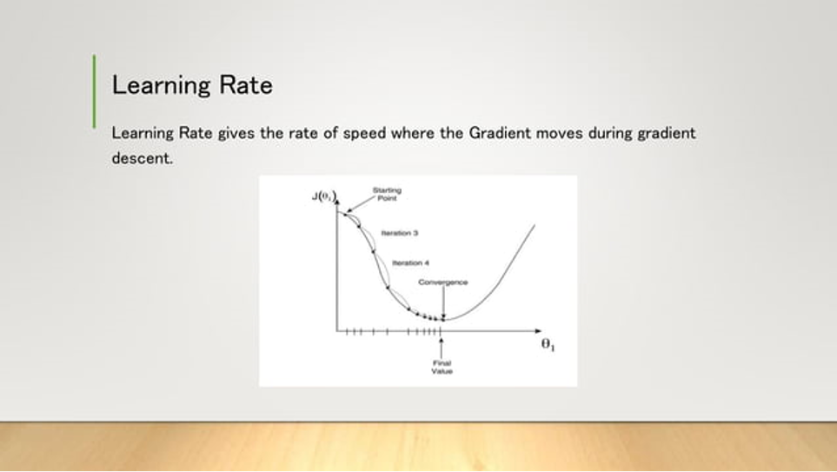

Slide 20
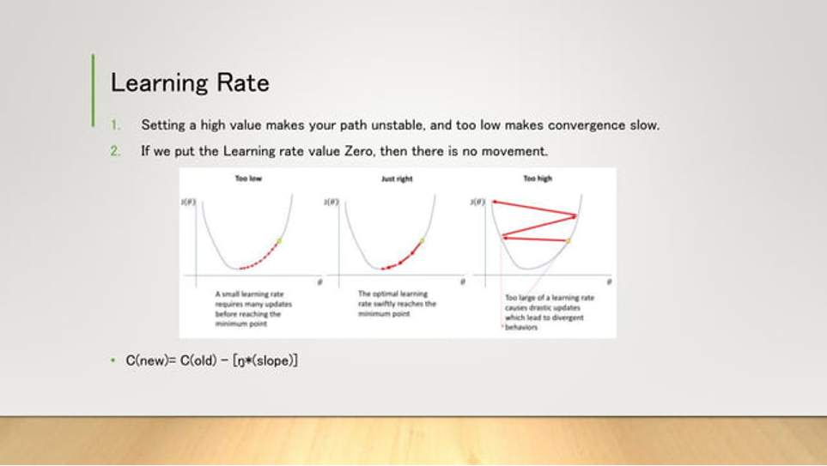

Slide 21
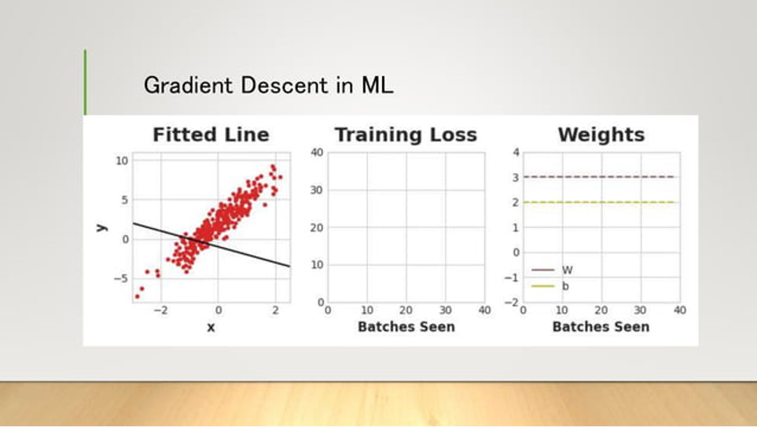

Slide 22
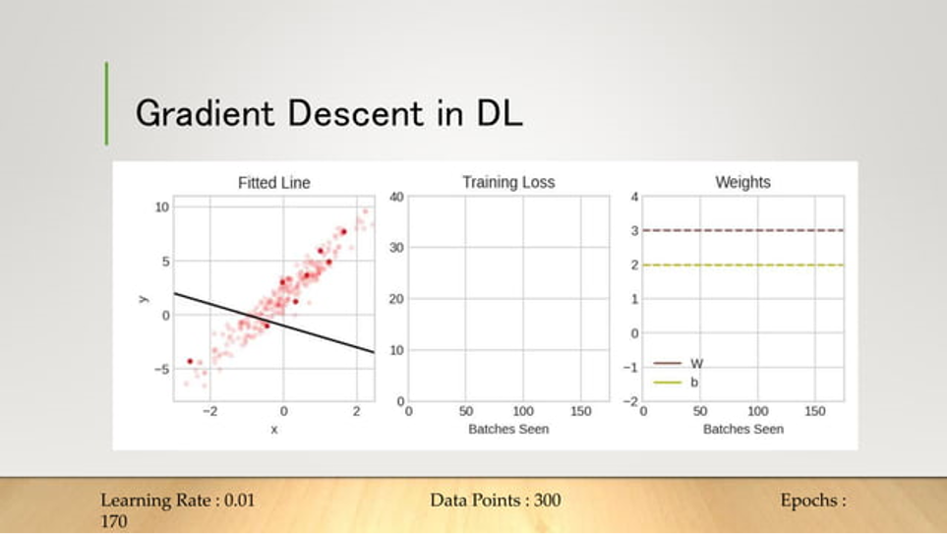

Slide 23
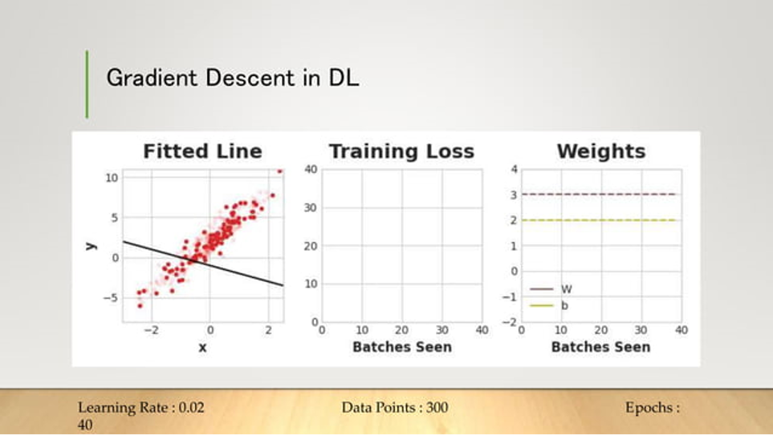

Slide 24
THANK YOU
MD.ASHIQ UL ISLAM SAJID
ID:20201225
CSE 425

