Slide 1
MACHINE LEARNING FOR MIX DESIGN OF CONCRETE
Under the supervision of
Prof. Damodar Maity
Rudra Sai Teja
21CE31010

Slide 2
Objectives
Collection of datasets of concrete composition for various grades of concrete complying with standard codes
Choosing proper ML algorithms for the optimization and prediction of the ratio of materials and strengths for different grades of concrete
Automate the process of estimation of mix proportions of the concrete

Slide 3
Research gaps and Scope
The availability of the quality data is a major research gap
Improving the accuracy of the ML algorithms and reducing the deviation of the compressive strength is another major challenge
This method can reduce wastage of natural resources, manpower
If more diverse datasets are provided then the efficiency of models can be increased

Slide 4
Literature Review
Concrete mix design is a systematic process that involves the selection and proportioning of materials to achieve the desired strength, durability and workability for specific applications
The important components of concrete are
Cement
Fine Aggregates
Coarse Aggregates
Water
Additional ingredients or Admixtures

Slide 5
Literature Review
Based on the guidelines of IS 10262:2009 and IS 10262:2019, we can estimate the mix proportion of the ingredients of the concrete for a particular compressive strength
This is done by the estimation of the following
Water-cement (w/c) ratio
Water content required (in kg)
Cement content (in kg)
Air entrapped (%volume of concrete)
Ratio of coarse aggregates to the total aggregates
Admixture contents

Slide 6
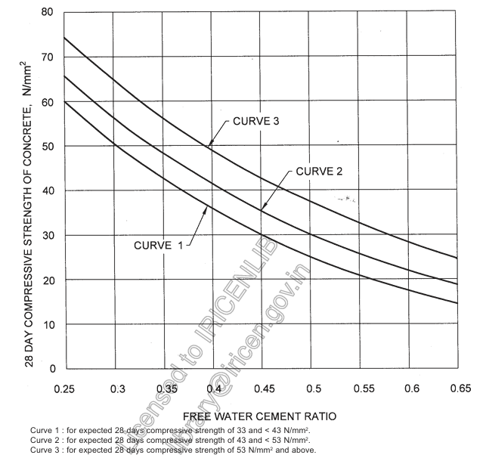

Slide 7
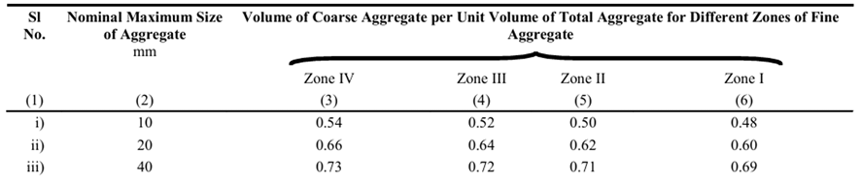
Sl No. | Nominal Max size of the aggregates (mm) | Water Content, kg
1 | 10 | 208
2 | 20 | 186
3 | 40 | 165
Sl No. | Nominal Max size of the aggregates (mm) | Entrapped Air, as percentage of volume of concrete
1 | 10 | 1
2 | 12.5 | 0.8
3 | 20 | 0.5

Slide 8
Zone | Percentage
Zone 1 | 15% to 34%
Zone 2 | 34% to 59%
Zone 3 | 60% to 79%
Zone 4 | 80% to 100%
Classification of fine aggregates into different zones based on % passing through 600µ sieve
V = $\frac{1}{1000}∗[ W + \frac{C}{SC} + \frac{1}{p}∗ \frac{FA}{SFA}]$for fine aggregate …............1
V = $\frac{1}{1000}∗[ W + \frac{C}{SC} + \frac{1}{(1−p)}∗ \frac{CA}{SCA}]$for coarse aggregate ....2
where p is the volume of coarse aggregates per unit total volume of aggregates

Slide 9
Methodology
The traditional method though efficient and reliable, it is labour intensive
So alternative approach has to be developed in solving this problem
Machine Learning techniques can solve this problem if given a quality dataset with good variability
5 models with 8 input features mapping 1 output have been trained with the datasets

Slide 10
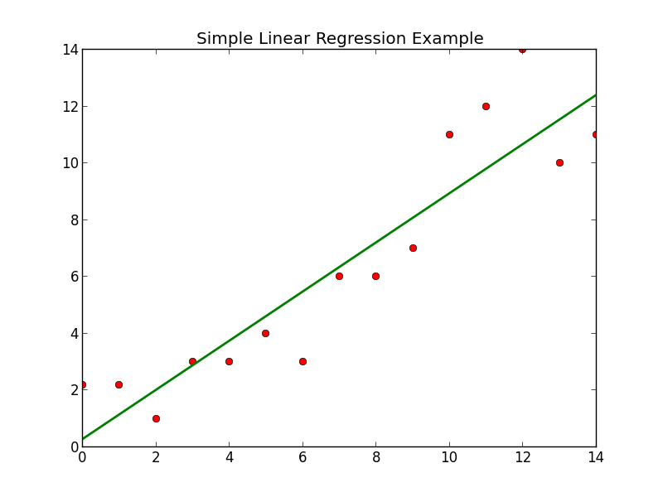
Linear regression tries to fit the data with a best possible straight line with minimum error (residual sum of squares)
Lasso and Ridge regressions are modified versions of linear regression which aims in reducing the complexity of the models
The loss functions and approach in minimising these errors are also different in both these approaches

Slide 11
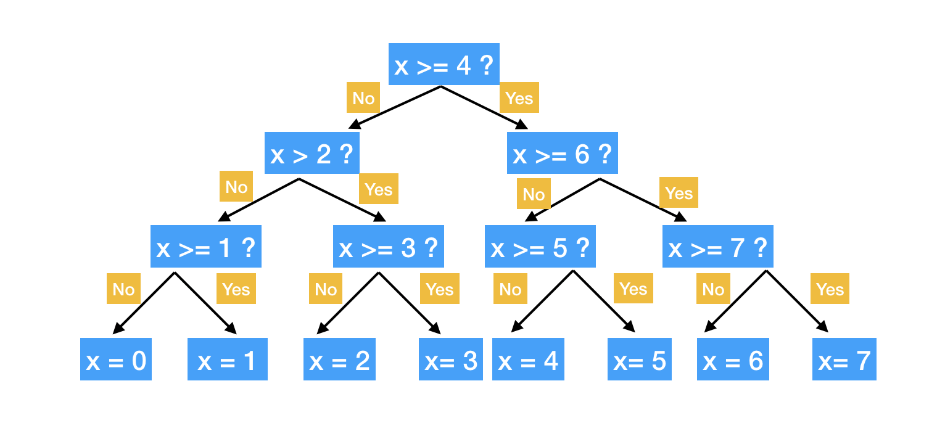
Decision Tree regressor model predicts numerical values using a tree-like structure.
It splits data based on key features, starting from a root question and branching out. Each node asks about a feature, dividing data further until reaching leaf nodes with final predictions.
Decision Tree Regressor

Slide 12
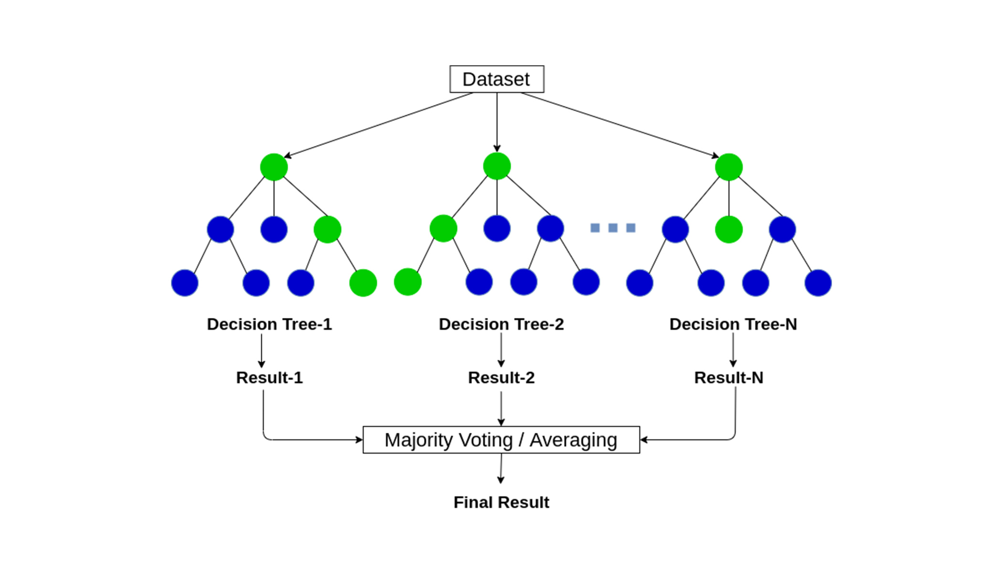
Random Forest regressor model is a combination of multiple decision trees which takes the average of all the predictions
It trains on random datasets for each decision tree so that the variance of the final results is minimized
Random Forest Regressor

Slide 13
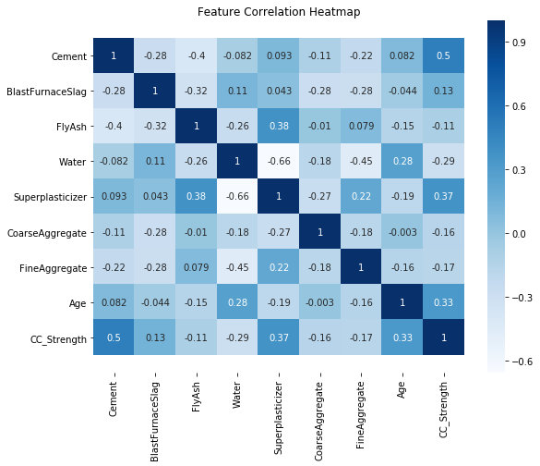
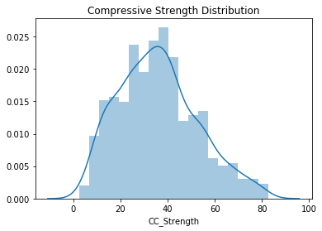
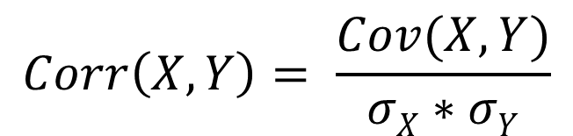
Results
$$Corr\left(X,Y\right)= \frac{Cov(X, Y)}{σX∗σY}$$

Slide 14
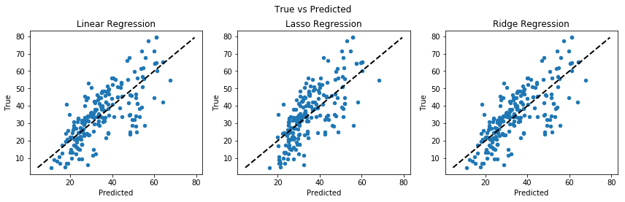
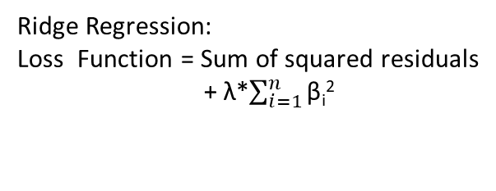
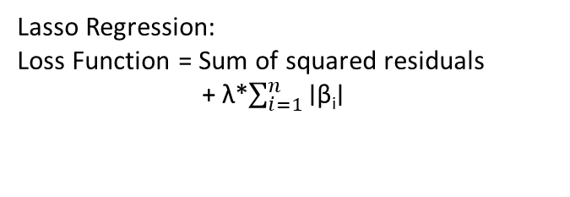
y=β₀ + β₁x₁ + β₂x₂ + ⋯ + β_{n}x_{n} +ϵ
Linear Regression:
Loss Function = Sum of squared residuals
Lasso Regression:
Loss Function = Sum of squared residuals
+ λ*$\sum_{i=1}^{n}{\text{∣}\text{β}\text{i}\text{∣}}$
Ridge Regression:
Loss Function = Sum of squared residuals
+ λ*$\sum_{i=1}^{n}{\text{β}\text{i}\text{2}}$
where λ is a regularization parameter

Slide 15
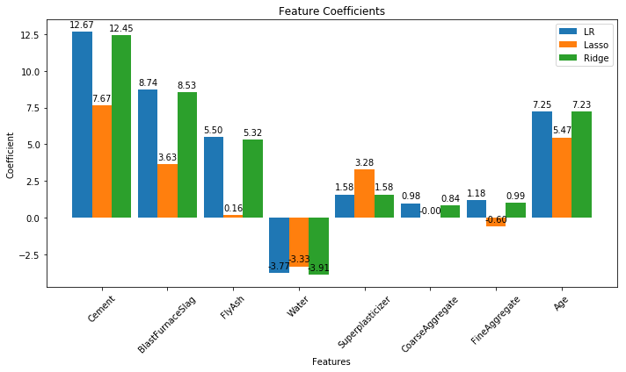
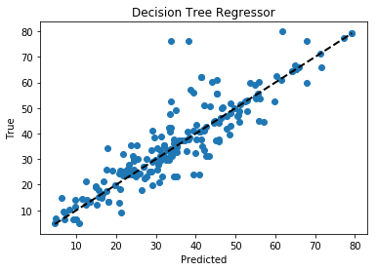
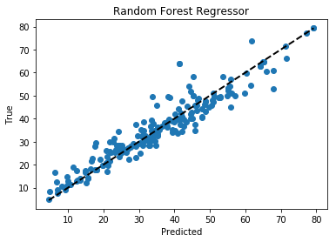

Slide 16
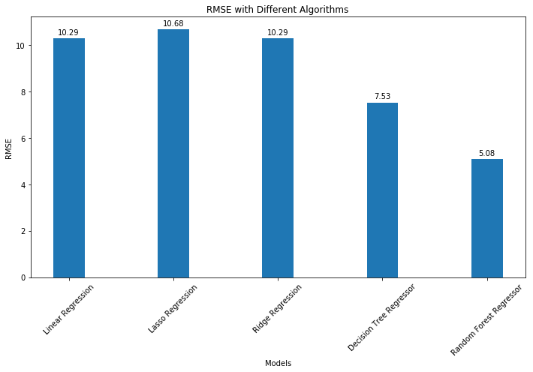
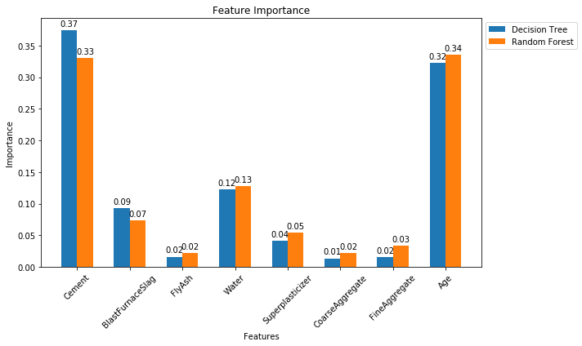

Slide 17
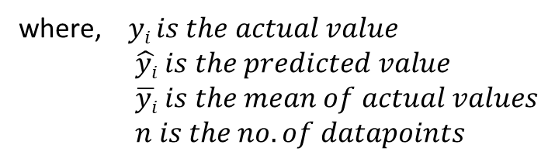
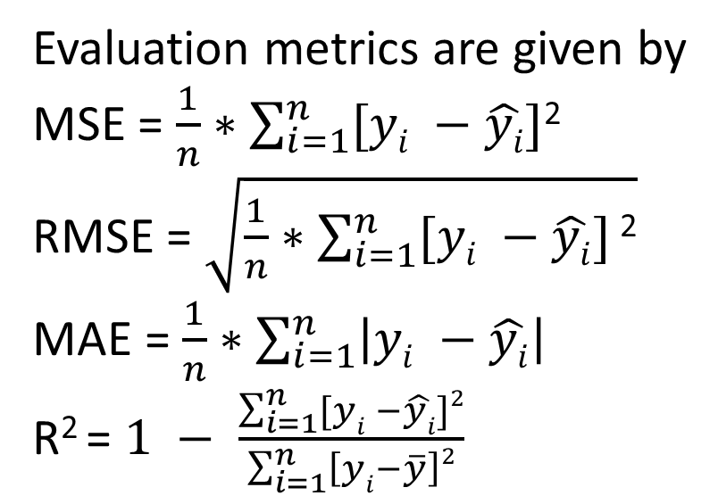
Model | RMSE | MSE | MAE | R²
Linear Regression | 10.29 | 105.78 | 8.23 | 0.57
Lasso Regression | 10.68 | 114.13 | 8.66 | 0.54
Ridge Regression | 10.29 | 105.86 | 8.24 | 0.57
Decision Tree Regressor | 7.53 | 56.69 | 4.66 | 0.77
Random Forest Regressor | 5.08 | 25.85 | 3.51 | 0.89
Evaluation metrics are given by
MSE = $\frac{1}{n}∗\sum_{i=1}^{n}{[yi −\hat{yi}]}$²
RMSE = $\sqrt{\frac{1}{n}∗\sum_{i=1}^{n}{[yi −\hat{yi}]}\text{2}}$
MAE = $\frac{1}{n}∗\sum_{i=1}^{n}{\left|yi −\hat{yi}\right|}$
R² = $1 −$ $\frac{\sum_{i=1}^{n}{[yi −\hat{yi}]}2}{\sum_{i=1}^{n}{\left[yi−\overline{y}\right]2}}$
where, $yi is the actual value$
$\hat{yi} is the predicted value$
$\overline{yi} is the mean of actual values$
$n is the no. of datapoints$

Slide 18
Discussion and Conclusion
From the results, Random Forest Regressor performs better, with more accuracy
Feature importance and feature coefficient shows that cement content and age are the two important factors that affect the compressive strength of the concrete
Cement performs the role of binding aggregates, as its content increases with w/c ratio, binding and hydration increases
As the age increases, the hydration of cement also increases making it more denser and stronger

Slide 19
Future Work
Strong models with more accuracy needs to be developed
Should create models predicting the ratios and strength of concrete, with much less information as input
Should create a User Interface (UI) for making these models accessible

Slide 20
References
IS:10262-2009. Indian Standard Concrete Mix Proportioning-Guidelines. Bureau of Indian Standards, New Delhi, India.
IS:10262-2019. Indian Standard Concrete Mix Proportioning-Guidelines (Second Revision). Bureau of Indian Standards, New Delhi, India.
Journal of Building Material Science https://ojs.bilpublishing.com/index.php/jbms
Machine Learning Techniques in Concrete Mix Design by Patryk Ziolkowski and Maciej Niedostatkiewicz 2019 https://www.researchgate.net/publication/332479160_Machine_Learning_Techniques_in_Concrete_Mix_Design
UCI Machine Learning Repository “Concrete Compressive Strength 08-02 2007” https://archive.ics.uci.edu/dataset/165/concrete+compressive+strength

Slide 21
Thank You

