Slide 1
MIX DESIGN OF CONCRETE
Presenter: Rudra Sai Teja(21CE31010)
Supervisor: Prof. Damodar Maity
Department of Civil Engineering, IIT Kharagpur

Slide 2
Concrete Mix Design
Concrete mix design can be defined as the selection of appropriate ingredients in right proportions with the objective of achieving concrete with certain strength and durability as economically as possible.
To achieve the designed/ desired workability in the plastic stage
To achieve the desired minimum strength in the hardened stage
To achieve the desired durability in the given environment conditions

Slide 3
Concrete Mis Design
Some aspects to be kept in mind are
Cost
Specifications of the concrete
Workability
Strength and Durability
Minimum Compressive Strength required
Minimum water/ cement ratio
Maximum cement content to avoid shrinkage cracks
Maximum aggregate / cement ratio

Slide 4
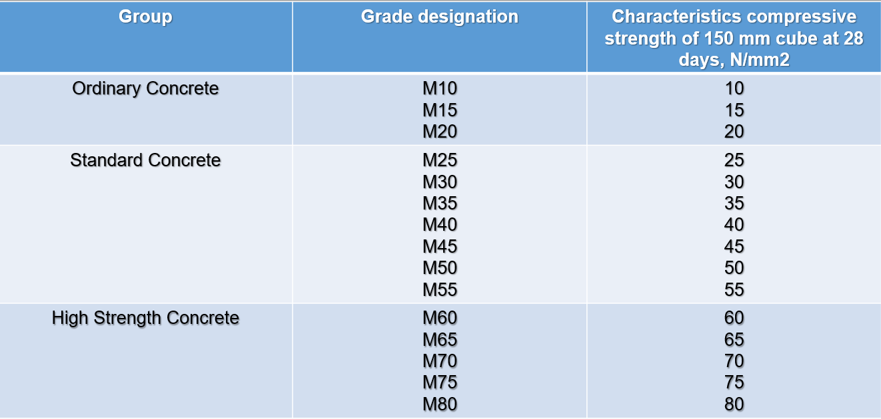
Grades of Concrete

Slide 5
M 20 Concrete
In this M stands for Mix
20 refers to characteristic compressive strength of 150 mm cube at 28 days in N/mm²
The minimum Grade of Plain Concrete (PCC) shall be 15 N/mm²
The minimum grade of reinforced Concrete ( RCC) shall be 20 N/mm²

Slide 6
Important Terminology
Water-Cement Ratio (w/c) — The ratio is calculated by dividing the mass of the mixing water by the mass of the cement. It refers to the ratio corresponding to the saturated surface dry condition of aggregates.
Water-Cementitious Materials Ratio (w/cm) — The ratio (w/cm) is calculated by dividing the mass of the mixing water by the combined mass of the cement and fly ash or other cementitious materials or a combination thereof. It refers to the ratio corresponding to the saturated surface dry condition of aggregates.

Slide 7

Target Strength for Mix Proportioning
Whichever is higher among the both is considered
f’ck = target mean compressive strength at 28 days, in N/mm2;
fck = characteristic compressive strength at 28 days, in N/mm2;
S = standard deviation, in N/mm2
X = factor based on the grade of concrete,

Slide 8
Ordinary and Standard Grades of Concrete
For selecting mix proportions, these are the required steps
Selection of Water-Cement Ratio
Estimation of Air Content
Selection of Water Content and Admixture Content
Calculation of Cement/Cementitious Materials Content
Estimation of Coarse Aggregate Proportion
Combination of Different Coarse Aggregate Fractions
Estimation of Fine and Coarse Aggregate Contents
Trial Mixes

Slide 9
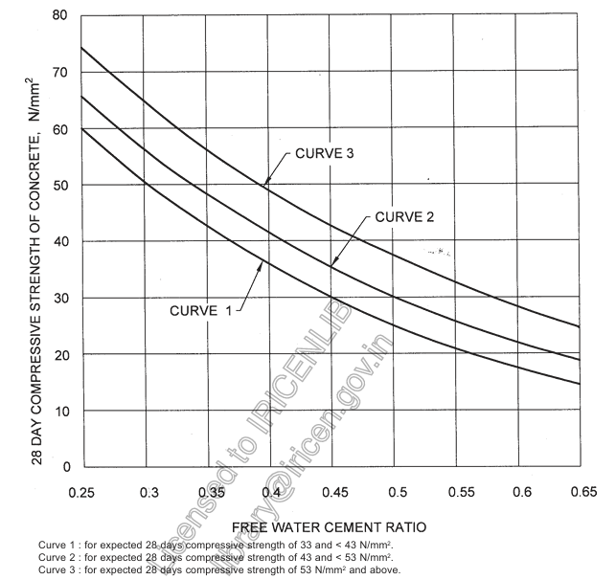
Free water cement ratio

Slide 10
Selection of Mix Proportions
After selecting the water cement ratio, then we estimate the water content
The estimation of water and admixture content is primarily based on the nominal maximum size of the aggregates
Sl No. | Nominal Max size of the aggregates (mm) | Water Content (kg)
1 | 10 | 208
2 | 20 | 186
3 | 40 | 165

Slide 11
Selection of Mix Proportions
After selecting the water content using w/c ratio we estimate the cement content or cementitious materials content
Then estimation of air content
Sl No. | Nominal Max size of the aggregates (mm) | Entrapped Air, as Percentage of Volume of Concrete
1 | 10 | 1.5
2 | 20 | 1.0
3 | 40 | 0.8

Slide 12
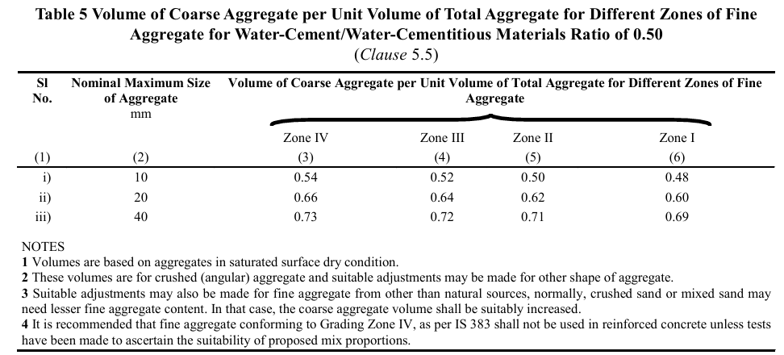
Selection of Mix Proportions
Estimation of Coarse aggregates proportion

Slide 13
Selection of Mix Proportions
The different zones of fine aggregates correspond to its gradation characteristics
This represents the proportion of the fine aggregates that pass through the sieve size of 600 micron
Zone | Percentage
Zone I | 15% to 34%
Zone II | 34% to 59%
Zone III | 60% to 79%
Zone IV | 80% to 100%

Slide 14
Selection of Mix Proportions
Calculation of Aggregate content
•V= [ W + C/Sc + 1/p x fa/Sfa ] x1/1000 for fine aggregate …......1
And
V = [ W + C/Sc + 1/(1-p) x Ca/Sca ] x1/1000 for coarse aggregate …………..2
the proportion of volume of coarse aggregates to that of total aggregates is increased at the rate of 0.01 for every decrease in water-cement/cementitious materials ratio by 0.05 and decreased at the rate of 0.01 for every increase in water cement ratio by 0.05.

Slide 15
Selection of Mix Proportions
Trial Mixes
The calculated mix proportions shall be checked by means of trial batches
Workability of the trial mix No. 1 shall be measured
If the measured workability of Trial Mix No. 1 is different from the stipulated value, the water and/or admixture content shall be adjusted suitably
With this Trial Mix 2 is recalculated using the free water-cement/water-cementitious materials ratio at the pre-selected value
In addition to this 2 more trial mixes are made with a variation of + and – 10% of the pre-selected values while satisfying the workability criteria

Slide 16
Selection of Mix Proportions
With all these mixes from 2-4 we get sufficient information, including the relationship between compressive strength and water-cement ratio, from which the mix proportions can be finalized
These are done in such a way that the strength and durability criteria are satisfied
Additional field trails are recommended particularly for the requirement of workability
The concrete for field trials shall be produced by methods of actual concrete production

Slide 17
Selection of Mix Proportions
For high strength grades of concrete i.e., compressive strength of 65 N/mm2 or more specially selected cementitious materials and chemical admixtures, that is, super plasticizers are used, and achieving a low water–cementitious materials ratio (w/ cm) is considered essential
The procedure for proportioning higher grades of concrete is similar to that of the ordinary concrete. But here few additional steps are needed to be kept in mind
Apart from w/c ratio, water and cement content here we also use chemical admixtures and plasticizers of required amount which are to be calculated accordingly

Slide 18
Types of concrete used in different purposes
Higher Strength Concrete grades
Self-Compacting Concrete
Mass Concrete
In all these types of concrete though used for different purposes their procedure is similar with few variations in one or two steps
These variations corresponds to w/c ratio, size of aggregates, water content, use of admixtures and plasticizers

Slide 19
Types of concrete used in different purposes
Higher strength concrete grades are employed in the places with harsh conditions, aggressive environments like coastal conditions, places with high chemical activies, etc..
Self-Compacting Concrete is highly flowable, non-segregating that fills uniformly and completely in the formwork due to its own weight
It is used in areas which are highly congested, or areas with restricted access for placement and consolidation
It usually have very high value of slump compared to the ordinary concrete and has higher workability

Slide 20
Types of concrete used in different purposes
On the basis of slump value it is categorized into 3 different areas with each having their individual applications based on the working site conditions
Mass concreting is used for heavy structures like dams, etc..
In these special measures need to be taken in the generation of heat from the hydration of cement and attendant volume change to minimize cracking
The primary objective of proportioning for mass concrete is to establish economical mixes of proper strength, durability and permeability
In these mass concreting lower grades of concrete with higher sizes of coarse aggregates are used

Slide 21
Types of concrete used in different purposes
In certain cases, like thick raft foundation, retaining wall, etc.., mass concreting may be of higher grade of concrete
Certain factors are to be considered
The water requirement may change
Early age strength may become critical, and
For maximum economy, the age at which design strength is attained should be greater

Slide 22
References
IS No. | Title
269 : 2015 | Specification for ordinary Portland cement
383 : 2016 | Specification for coarse and fine aggregates for concrete
456 : 2000 | Code of practice for plain and reinforced concrete
1199 (Part 6) : 2018 | Fresh concrete — Methods of sampling, testing and analysis: Part 6 Tests on fresh self compacting concrete
1489 | Specification for Portland pozzolana cement
(Part 1) : 2015 | Fly ash based
(Part 2) : 2015 | Calcined clay based

Slide 23
References
IS No. | Title
2386 (Part 3) : 1963 | Methods of test for aggregates for concrete: Part 3 Specific gravity, voids, absorption and bulking
3812 (Part 1) : 2013 | Specification for pulverized fuel ash: Part 1 For use as pozzolana in cement, cement mortar and concrete
9103 : 1999 | Specification for admixtures for concrete
15388 : 2003 | Specification for silica fume
16714 : 2018 | Ground granulated blast furnace slag for use in cement, mortar and concrete — Specification

Slide 24
Thank You

