Slide 1
MACHINE LEARNING FOR MIX DESIGN OF CONCRETE
Presenter: Rudra Sai Teja(21CE31010)
Supervisor: Prof. Damodar Maity
Department of Civil Engineering, IIT Kharagpur

Slide 2
Objectives
Review the standard codes on mix design of concrete
Gather datasets of concrete composition for various grades of concrete
Choosing proper ML algorithms for the optimization and prediction of the ratio of materials for different grades of concrete and vice-versa
Create a User Interface(UI) and make these ratios accessible to everyone

Slide 3
Scope
The scope of ML in mix design of concrete is huge and it covers various stages from planning and material selection to the final performance evaluation. But the key areas are
Prediction model for concrete properties
Optimization of concrete mix proportions
Data Analysis and knowledge extraction
Generalization of this to all types of conditions
Enhancing durability and estimation of the service life

Slide 4
Review on the literature and Research gaps
Civil engineering had already begun incorporating machine learning and the concrete industry is following the same path
We have been using ML algorithms in predicting the compressive strength of the concrete
This helps in reducing the wastage of materials and human power, i.e., reducing the cost of estimation
It also reduces the carbon footprint and reduces environment impact and move towards sustainability

Slide 5
Review on the literature and Research gaps
Concrete mix design comprises of few important components and steps
The important ingredients of concrete are cement, fine and coarse aggregates, water
Other ingredients include fly ash, blast furnace slag
Additives include superplasticizers and water reducing admixtures
The selection of ingredient quantities should comply with the IS Code

Slide 6
Review on the literature and Research gaps
The availability of the data and its quality is a major research gap
Improving the accuracy of the ML algorithms selected for this purpose
Reducing the deviation of the compressive strength on site is another major challenge
Large scale validation of these results is to be done before relying on this completely

Slide 7
Works Done
Completed the study of standard codes for concrete mix design, including IS 10262:2009 and IS 10262:2019, along with relevant American and British standard codes
Collected some of the datasets of material composition of concrete
Completed some ML models
Completed a detailed report/presentation on Mix Design of Concrete based on IS 10262:2019

Slide 8
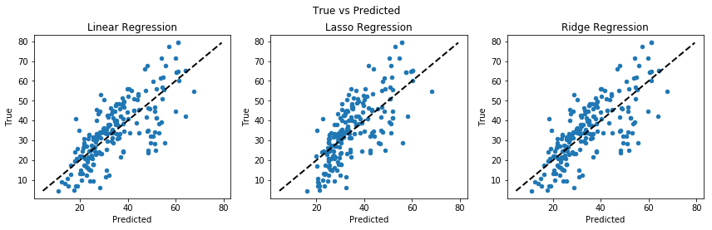
Works Done

Slide 9
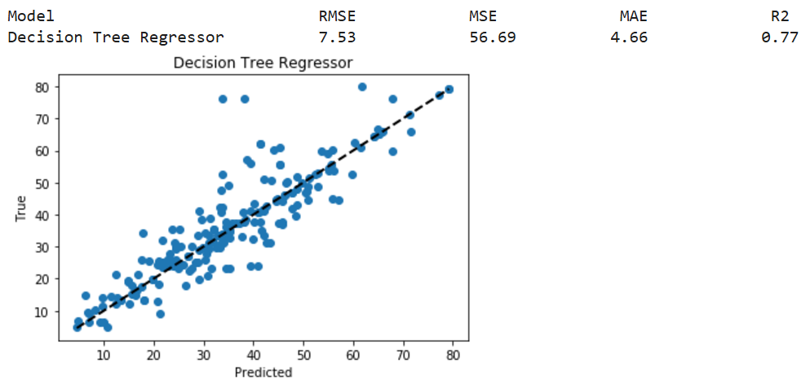
Works Done

Slide 10
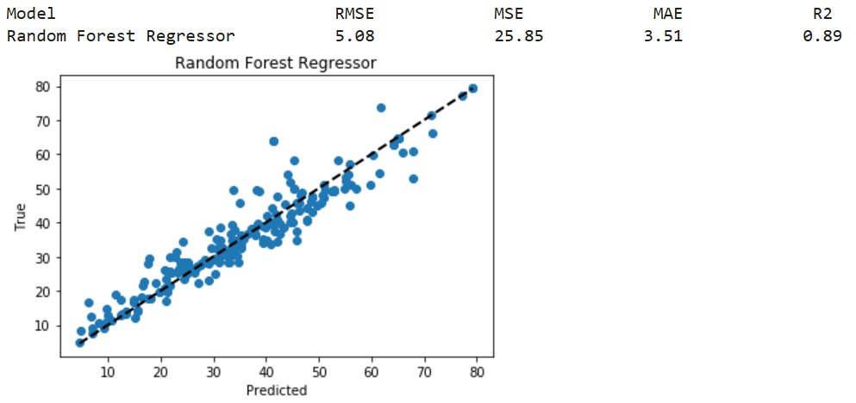
Works Done

Slide 11
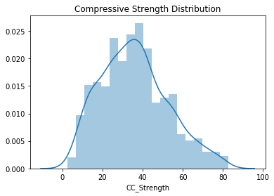
Works Done

Slide 12
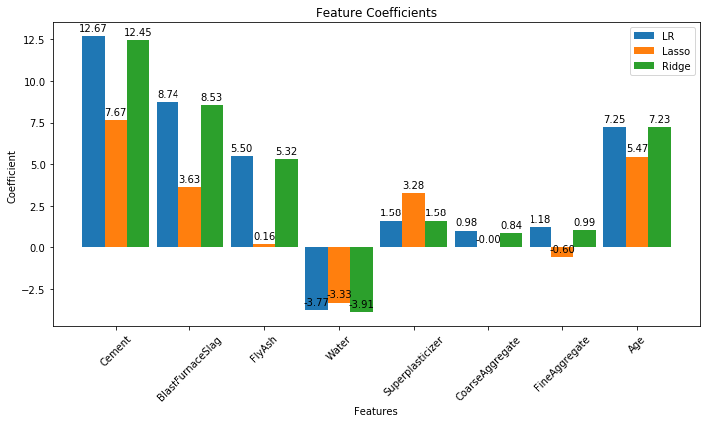
Works Done

Slide 13
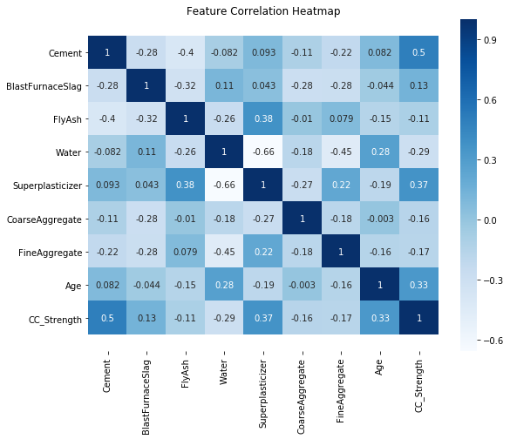
Works Done

Slide 14
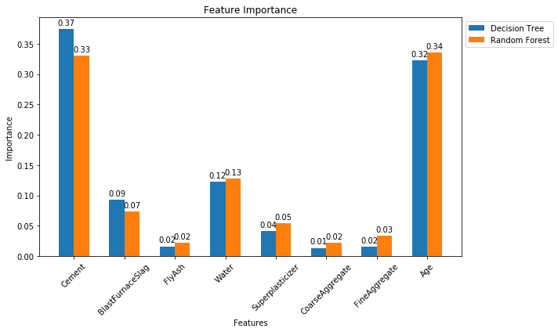
Works Done

Slide 15
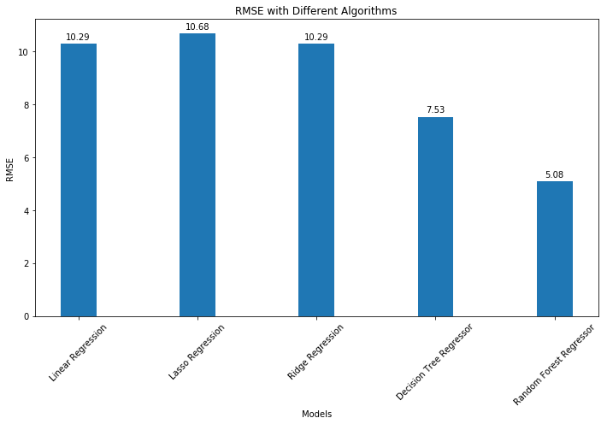
Works Done

Slide 16
Works to Complete
Should make a good ML model to predict the concrete mix proportions by giving the strength as input to the model
Should create a User Interface(UI) and put all these predicted values

Slide 17
Constraints
Since there are many variables i.e., 8 features it is difficult to get them as output by giving 1 input i.e., design strength of concrete
Due to this the outputs given by the model i.e., concrete mix ratio is very much staggered and far away from prescribed ratios of IS Code

Slide 18
References
IS 10262:2009 and IS 10262:2019
Machine Learning Techniques in Concrete Mix Design Patryk Ziolkowski and Maciej Niedostatkiewicz
Concrete Mix Design by IS, ACI and BS Methods: A Comparative Analysis Ashish Chhachhia

Slide 19
Thank You

