Slide 1

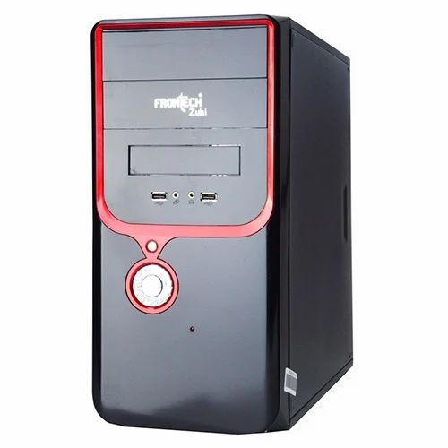

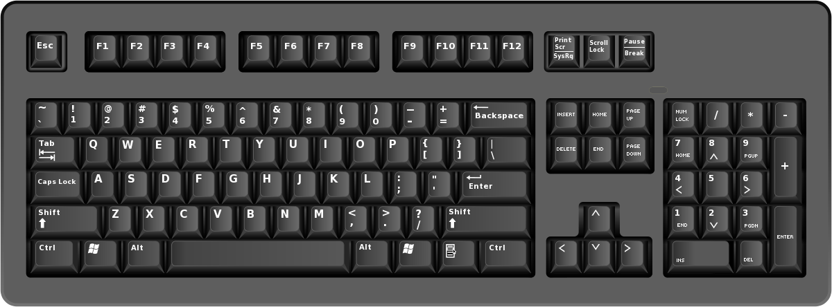
HARDWARE : Physical component of the
Computer system, which is tangible and can be touched

Slide 2




SOFTWARE : Virtual component of the
Computer system, which is non-tangible and controls the hardware
or runs on it

Slide 3



A Software can be
A group of programs
Some Data
Instructions
That tell the hardware what to do

Slide 4
SOFTWARE
Operating System Software
Responsible for interacting with the
hardware, and provides common services for the computer programs
Application Software
Runs on top of the operating system, serves particular purposes based on the needs of the user

Slide 5
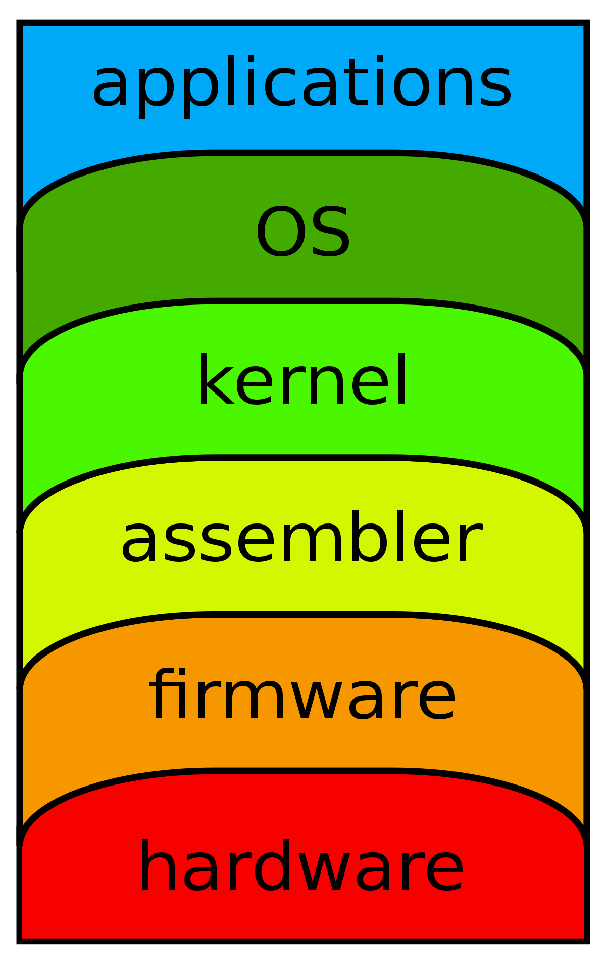

Slide 6
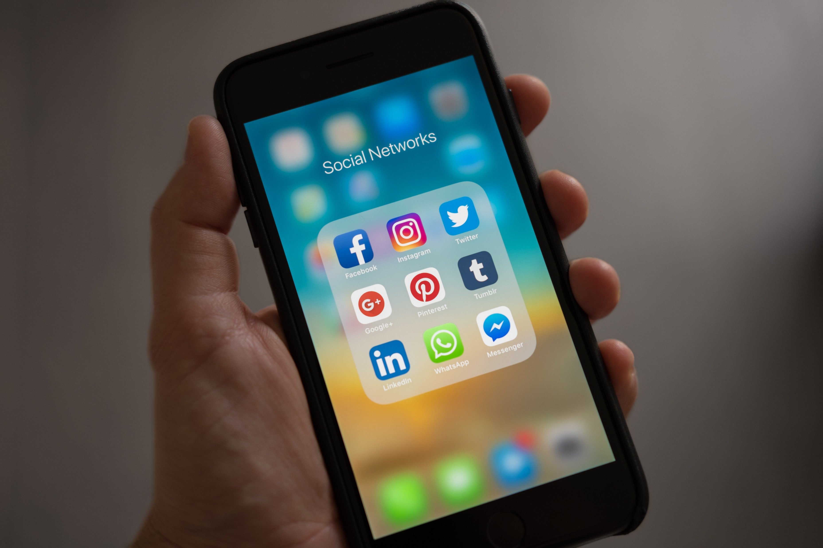

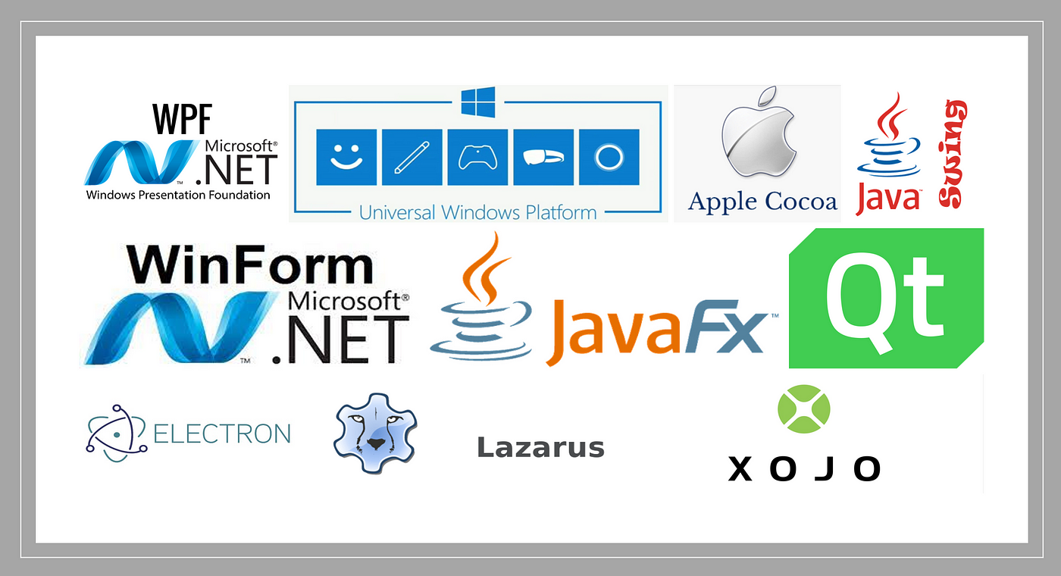
Desktop Applications
Mobile Application
Web Applications
APPLICATIONS
Platform based categorization

