Slide 1
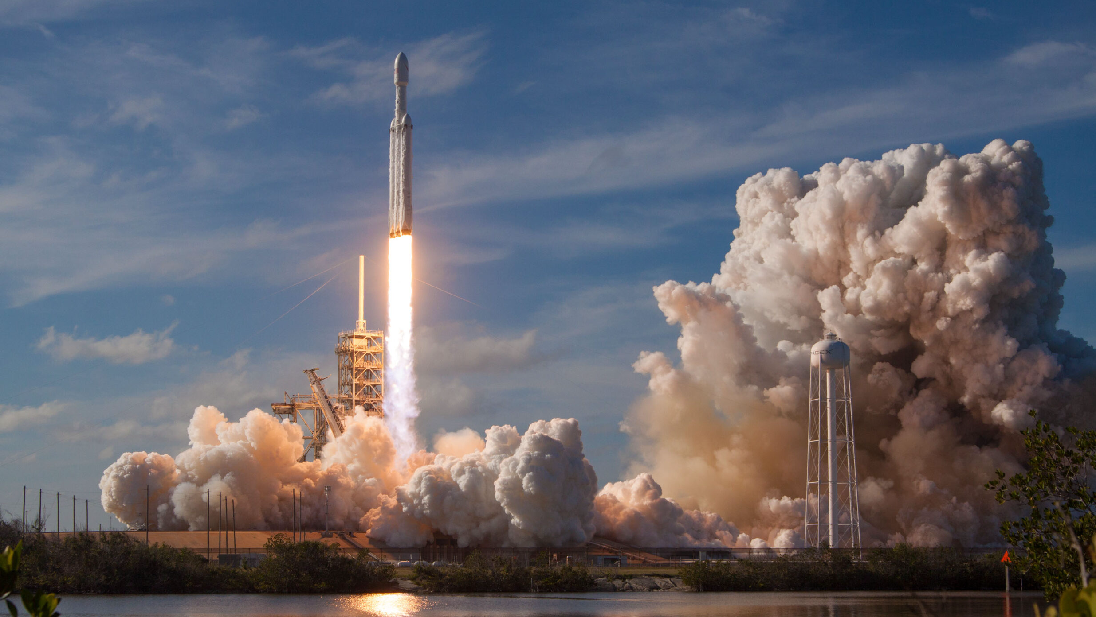

Applied Data Science capstone
Rudrajit Das
05 November, 2026

Slide 2
OUTLINE
Executive Summary
Introduction
Methodology
Results
Discussion
Conclusion

Slide 3
Outline
EXECUTIVE SUMMARY
In this capstone project, we will predict if the SpaceX Falcon 9 first stage will land successfully using several machine learning classification algorithms.
The main steps in this project include:
  Data collection, wrangling, and formatting
  Exploratory data analysis
  Interactive data visualization
  Machine learning prediction
Our graphs show that some features of the rocket launches have a correlation with the outcome of the launches, i.e., success or failure.
It is also concluded that decision tree may be the best machine learning algorithm to predict if the Falcon 9 first stage will land successfully.

Slide 4
Outline
INTRODUCTION
In this capstone, we will predict if the Falcon 9 first stage will land successfully. SpaceX advertises Falcon 9 rocket launches on its website with a cost of 62 million dollars; other providers cost upward of 165 million dollars each, much of the savings is because SpaceX can reuse the first stage. Therefore if we can determine if the first stage will land, we can determine the cost of a launch. This information can be used if an alternate company wants to bid against SpaceX for a rocket launch.
Most unsuccessful landings are planned. Sometimes, SpaceX will perform a controlled landing in the ocean.
The main question that we are trying to answer is, for a given set of features about a Falcon 9 rocket launch which include its payload mass, orbit type, launch site, and so on, will the first stage of the rocket land successfully?

Slide 5
Outline
METHODOLOGY
The overall methodology includes:
  Data collection, wrangling, and formatting, using:
    SpaceX API
    Web scraping
  Exploratory data analysis (EDA), using:
    Pandas and NumPy
    SQL
  Data visualization, using:
    Matplotlib and Seaborn
    Folium
    Dash
  Machine learning prediction, using
    Logistic regression
    Support vector machine (SVM)
    Decision tree
    K-nearest neighbors (KNN)

Slide 6
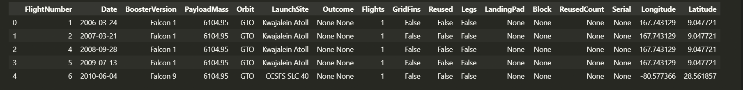
Outline
METHODOLOGY
Data collection, wrangling, and formatting
1
SpaceX API
  The API used is https://api.spacexdata.com/v4/launches/past
  The API provides data about many types of rocket launches done by SpaceX, the data is therefore filtered to include only Falcon 9 launches.
  Every missing value in the data is replaced the mean the column that the missing value belongs to.
  We end up with 90 rows or instances and 17 columns or features. The picture below shows the first few rows of the data:

Slide 7
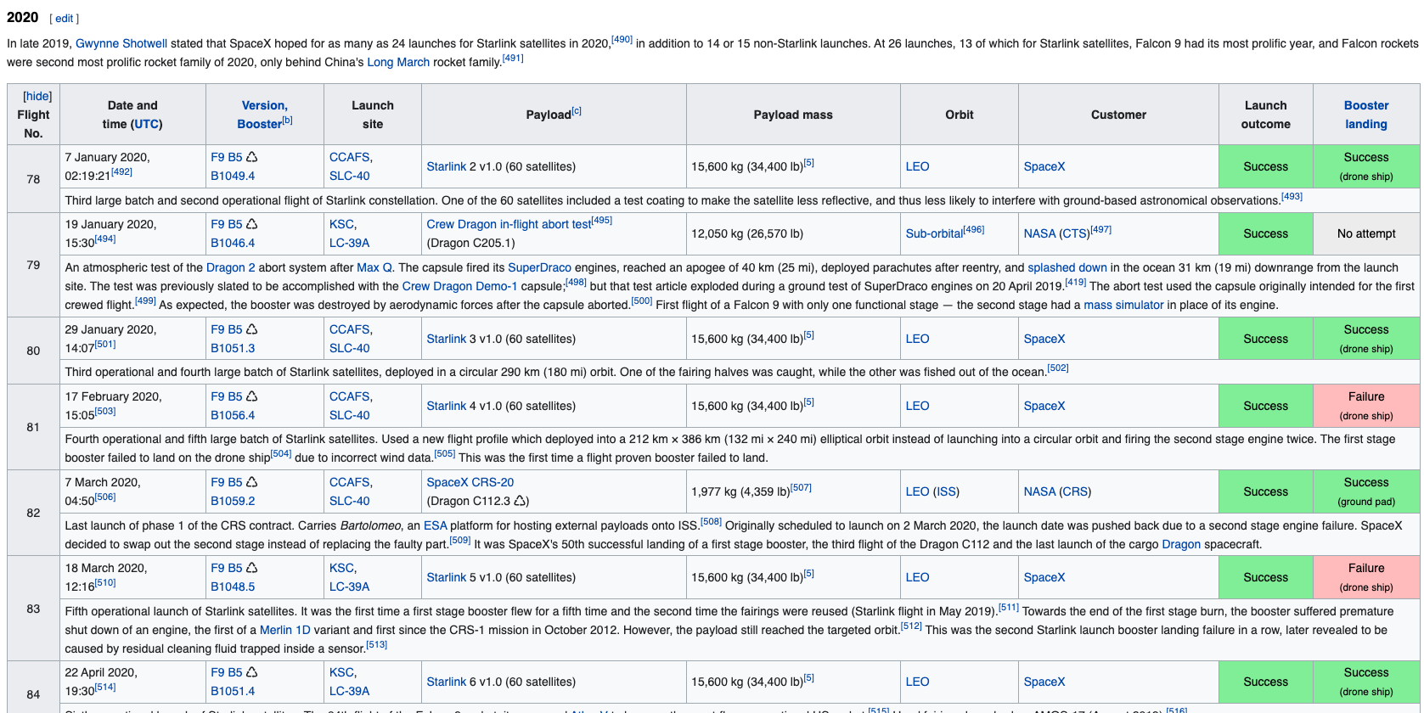
Outline
METHODOLOGY
Data collection, wrangling, and formatting
1
Web scraping
The data is scraped from https://en.wikipedia.org/w/index.php?title=List_of_Falcon_9_and_Falcon_Heavy_launches&oldid=1027686922
  The website contains only the data about Falcon 9 launches.
  We end up with 121 rows or instances and 11 columns or features. The picture below shows the first few rows of the data:

Slide 8
Outline
METHODOLOGY
Data collection, wrangling, and formatting
1
The data is later processed so that there are no missing entries and categorical features are encoded using one-hot encoding.
An extra column called ‘Class’ is also added to the data frame. The column ‘Class’ contains 0 if a given launch is failed and 1 if it is successful.
In the end, we end up with 90 rows or instances and 83 columns or features.

Slide 9



Outline
METHODOLOGY
Exploratory Data Analysis (EDA)
2
Pandas and NumPy
  Functions from the Pandas and NumPy libraries are used to derive basic information about the data collected, which includes:
    The number of launches on each launch site
    The number of occurrence of each orbit
    The number and occurrence of each mission outcome
SQL
  The data is queried using SQL to answer several questions about the data such as:
    The names of the unique launch sites in the space mission
    The total payload mass carried by boosters launched by NASA (CRS)
    The average payload mass carried by booster version F9 v1.1

Slide 10



Outline
METHODOLOGY
Data Visualization
3
Matplotlib and Seaborn
  Functions from the Matplotlib and Seaborn libraries are used to visualize the data through scatterplots, bar charts, and line charts.
  The plots and charts are used to understand more about the relationships between several features, such as:
    The relationship between flight number and launch site
    The relationship between payload mass and launch site
    The relationship between success rate and orbit type
Folium
  Functions from the Folium libraries are used to visualize the data through interactive maps.
  The Folium library is used to:
    Mark all launch sites on a map
    Mark the succeeded launches and failed launches for each site on the map
    Mark the distances between a launch site to its proximities such as the nearest city, railway, or highway

Slide 11

Outline
METHODOLOGY
Data Visualization
3
Dash
  Functions from Dash are used to generate an interactive site where we can toggle the input using a dropdown menu and a range slider.
  Using a pie chart and a scatterplot, the interactive site shows:
    The total success launches from each launch site
    The correlation between payload mass and mission outcome (success or failure) for each launch site

Slide 12

Outline
METHODOLOGY
Machine Learning Prediction
4
Functions from the Scikit-learn library are used to create our machine learning models.
The machine learning prediction phase include the following steps:
  Standardizing the data
  Splitting the data into training and test data
  Creating machine learning models, which include:
    Logistic regression
    Support vector machine (SVM)
    Decision tree
    K nearest neighbors (KNN)
  Fit the models on the training set
  Find the best combination of hyperparameters for each model
  Evaluate the models based on their accuracy scores and confusion matrix

Slide 13
Outline
RESULTS
The results are split into 5 sections:
  SQL (EDA with SQL)
  Matplotlib and Seaborn (EDA with Visualization)
  Folium
  Dash
  Predictive Analysis
In all of the graphs that follow, class 0 represents a failed launch outcome while class 1 represents a successful launch outcome.

Slide 14
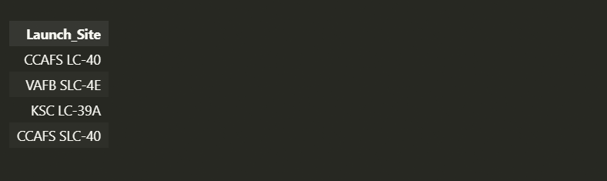
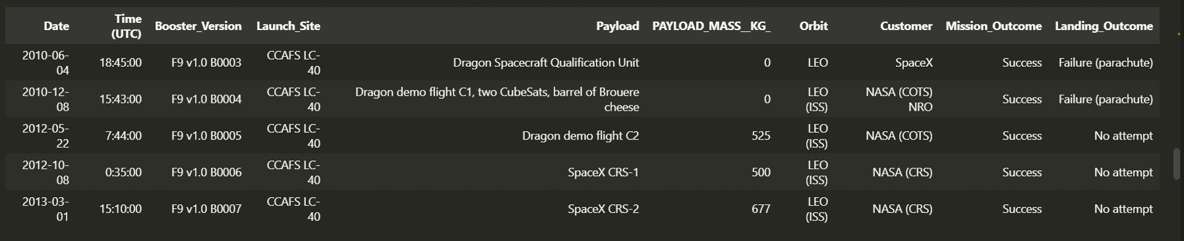
Outline
RESULTS
SQL (EDA with SQL)
1
The names of the unique launch sites in the space mission
5 records where launch sites begin with ‘CCA’

Slide 15
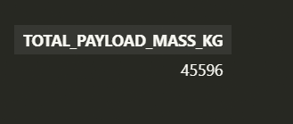
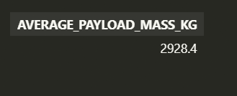
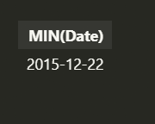
Outline
RESULTS
SQL (EDA with SQL)
1
The total payload mass carried by boosters launched by NASA (CRS)
The average payload mass carried by booster version F9 v1.1
The date when the first successful landing outcome in ground pad was achieved

Slide 16
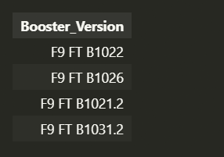
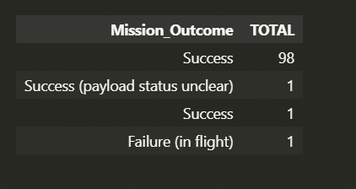
Outline
RESULTS
SQL (EDA with SQL)
1
The names of the boosters which have success in drone ship and have payload mass greater than 4000 but less than 6000
The total number of successful and failure mission outcomes

Slide 17
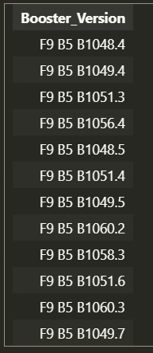
Outline
RESULTS
SQL (EDA with SQL)
1
The names of the booster versions which have carried the maximum payload mass

Slide 18
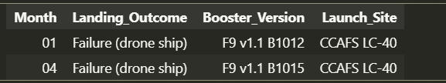
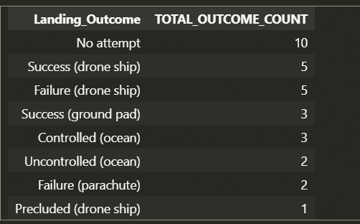
Outline
RESULTS
SQL (EDA with SQL)
1
The failed landing outcomes in drone ship, their booster versions, and launch site names for in year 2015
The count of landing outcomes between the date 2010-06-04 and 2017-03-20, in descending order

Slide 19
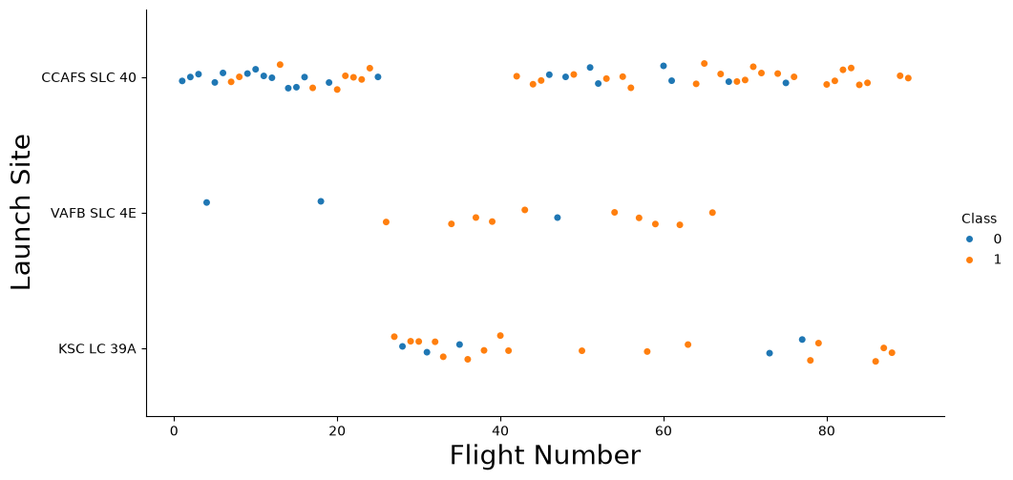
Outline
RESULTS
Matplotlib and Seaborn (EDA with Visualization)
2
The relationship between flight number and launch site

Slide 20
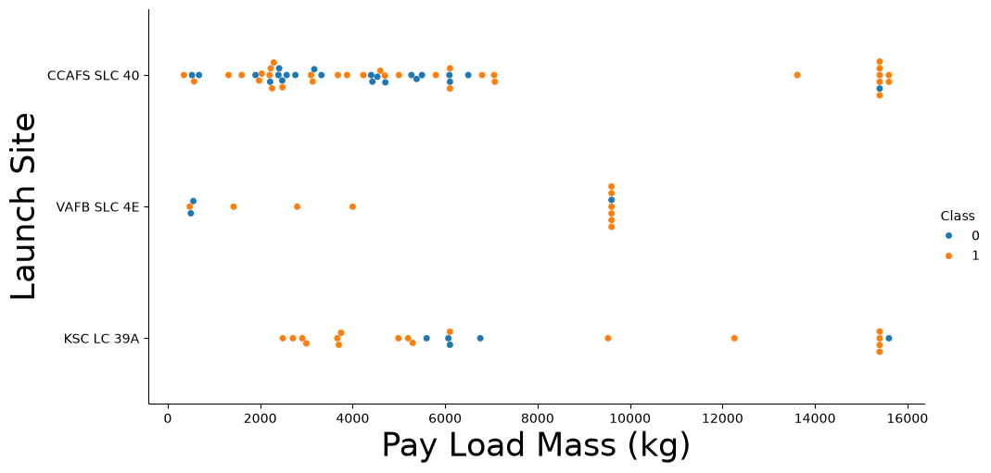
Outline
RESULTS
Matplotlib and Seaborn (EDA with Visualization)
2
The relationship between payload mass and launch site

Slide 21
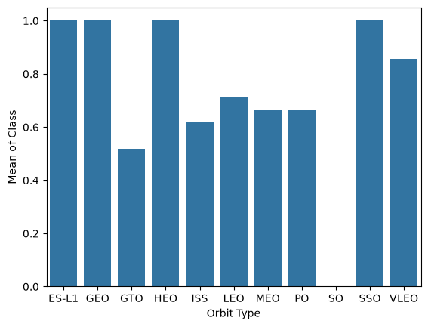
Outline
RESULTS
Matplotlib and Seaborn (EDA with Visualization)
2
The relationship between success rate and orbit type

Slide 22
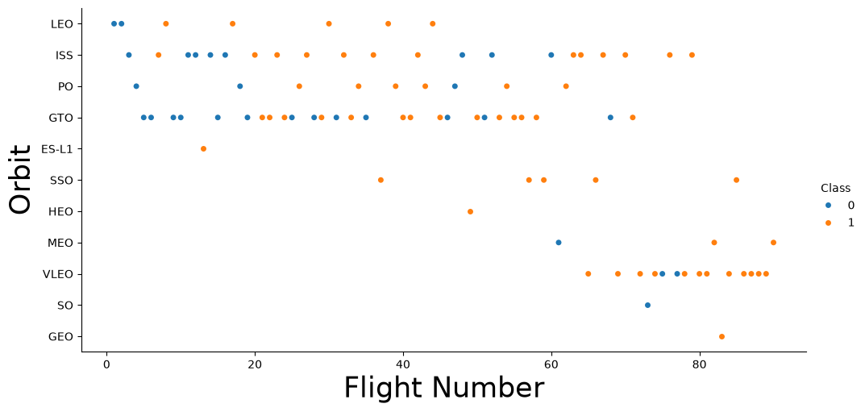
Outline
RESULTS
Matplotlib and Seaborn (EDA with Visualization)
2
The relationship between flight number and orbit type

Slide 23
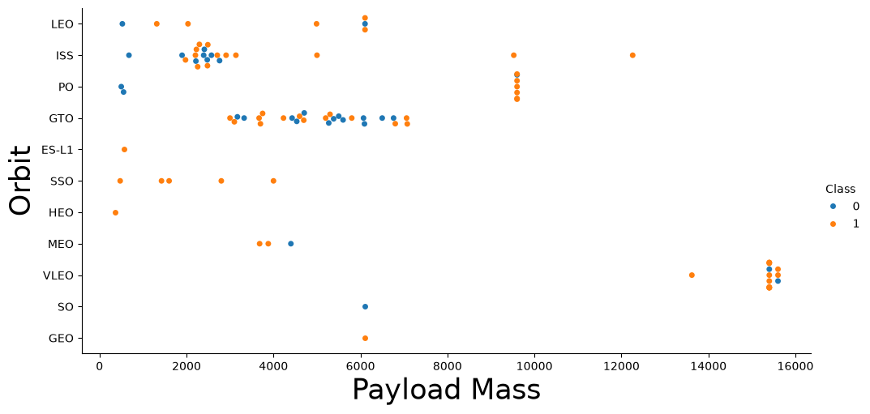
Outline
RESULTS
Matplotlib and Seaborn (EDA with Visualization)
2
The relationship between payload mass and orbit type

Slide 24
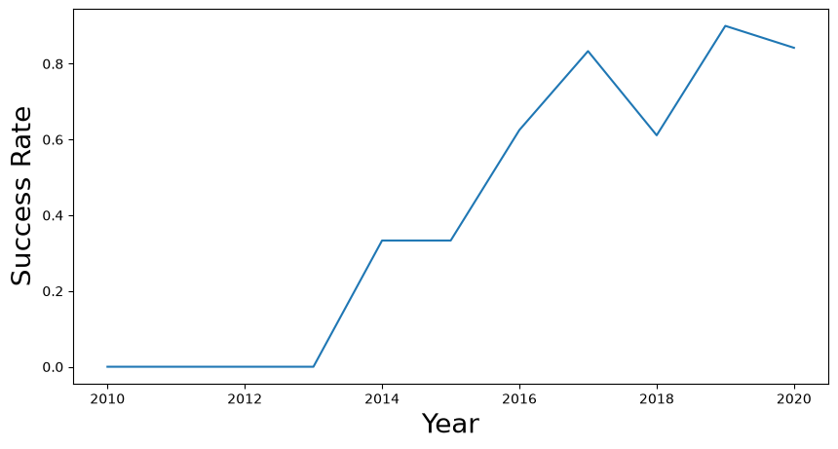
Outline
RESULTS
Matplotlib and Seaborn (EDA with Visualization)
2
The launch success yearly trend

Slide 25
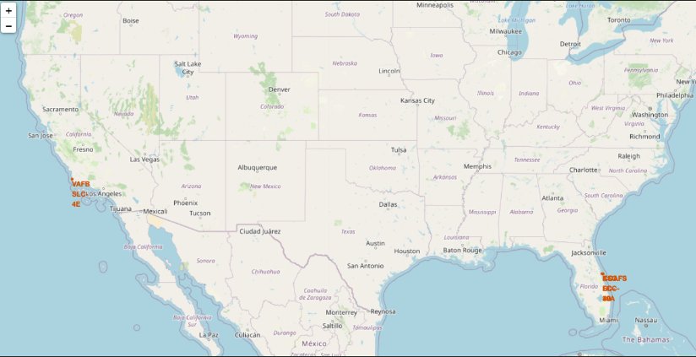
Outline
RESULTS
Folium
3
All launch sites on map

Slide 26
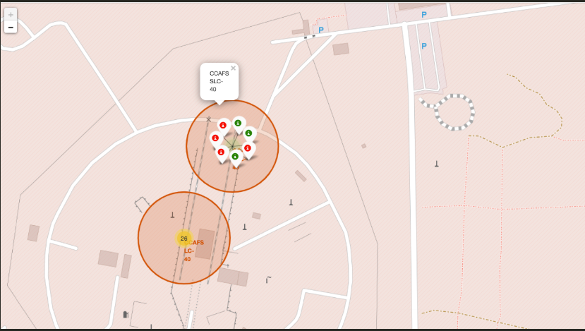
Outline
RESULTS
Folium
3
The succeeded launches and failed launches for each site on map
  If we zoom in on one of the launch site, we can see green and red tags. Each green tag represents a successful launch while each red tag represents a failed launch

Slide 27
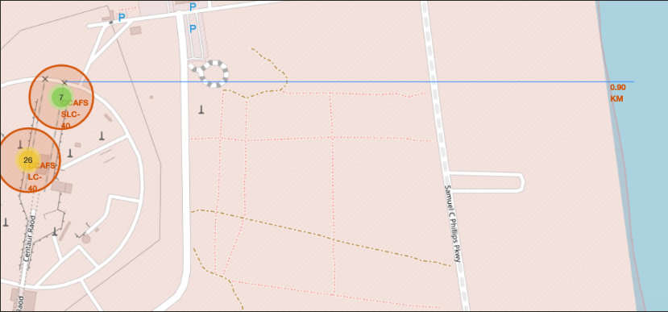
Outline
RESULTS
Folium
3
The distances between a launch site to its proximities such as the nearest city, railway, or highway
  The picture below shows the distance between the VAFB SLC-4E launch site and the nearest coastline

Slide 28
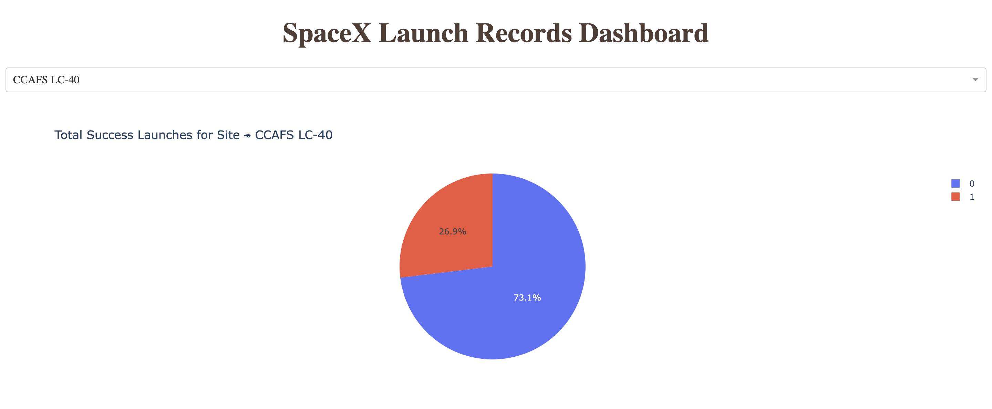
Outline
RESULTS
Dash
4
The picture below shows a pie chart when launch site CCAFS LC-40 is chosen.
0 represents failed launches while 1 represents successful launches. We can see that 73.1% of launches done at CCAFS LC-40 are failed launches.

Slide 29
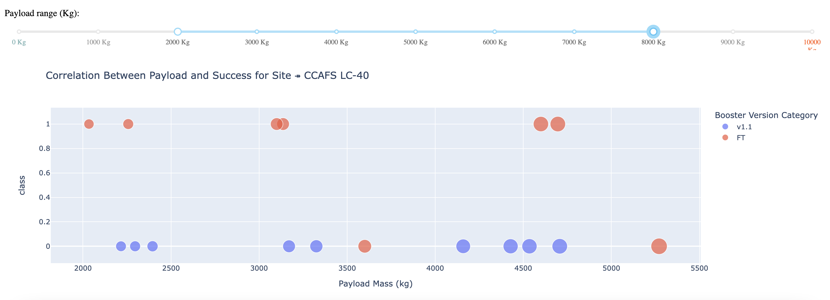
Outline
RESULTS
Dash
4
The picture below shows a scatterplot when the payload mass range is set to be from 2000kg to 8000kg.
Class 0 represents failed launches while class 1 represents successful launches.

Slide 30
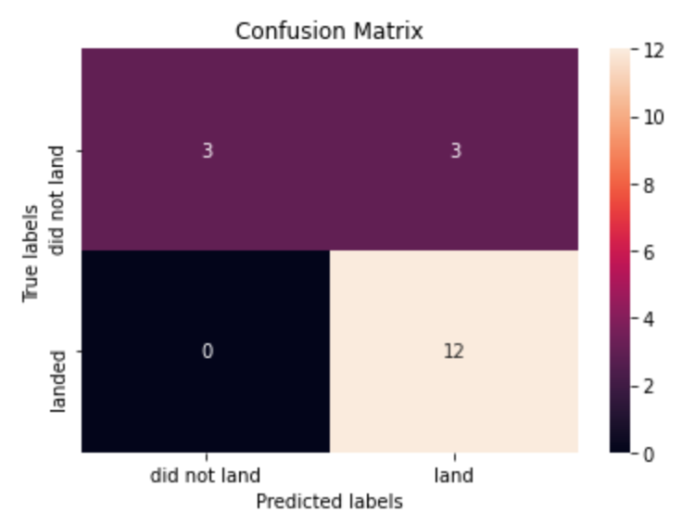
Outline
RESULTS
Predictive Analysis
5
Logistic regression
  GridSearchCV best score: 0.8464285714285713
  Accuracy score on test set: 0.8333333333333334
  Confusion matrix:

Slide 31
Outline
RESULTS
Predictive Analysis
5
Support vector machine (SVM)
  GridSearchCV best score: 0.8482142857142856
  Accuracy score on test set: 0.8333333333333334
  Confusion matrix:

Slide 32
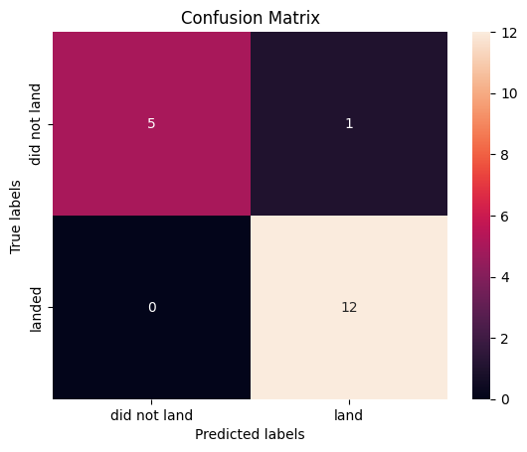
Outline
RESULTS
Predictive Analysis
5
Decision tree
  GridSearchCV best score: 0.8892857142857142
  Accuracy score on test set: 0.94
  Confusion matrix:

Slide 33
Outline
RESULTS
Predictive Analysis
5
K nearest neighbors (KNN)
  GridSearchCV best score: 0.85
  Accuracy score on test set: 0.8333333333333334
  Confusion matrix:

Slide 34
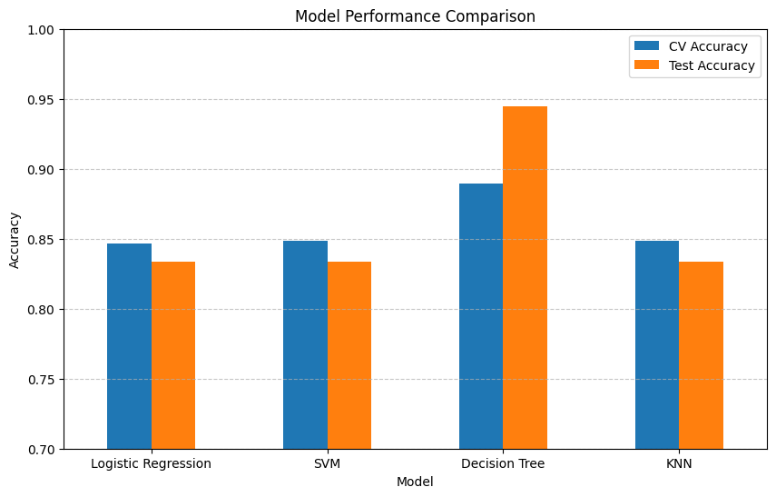
Outline
RESULTS
Predictive Analysis
5
The GridSearchCV best scores are used to rank them instead. Based on the GridSearchCV best scores, the models are ranked in the following order with the first being the best and the last one being the worst:
  Decision tree (GridSearchCV best score: 0.8892857142857142)
  K nearest neighbors, KNN (GridSearchCV best score: 0.8482142857142858)
  Support vector machine, SVM (GridSearchCV best score: 0.8482142857142856)
  Logistic regression (GridSearchCV best score: 0.8464285714285713)

Slide 35
Outline
DISCUSSION
From the data visualization section, we can see that some features may have correlation with the mission outcome in several ways. For example, with heavy payloads the successful landing or positive landing rate are more for orbit types Polar, LEO and ISS. However, for GTO, we cannot distinguish this well as both positive landing rate and negative landing(unsuccessful mission) are both there here.
Therefore, each feature may have a certain impact on the final mission outcome. The exact ways of how each of these features impact the mission outcome are difficult to decipher. However, we can use some machine learning algorithms to learn the pattern of the past data and predict whether a mission will be successful or not based on the given features.

Slide 36
Outline
CONCLUSION
In this project, we try to predict if the first stage of a given Falcon 9 launch will land in order to determine the cost of a launch.
Each feature of a Falcon 9 launch, such as its payload mass or orbit type, may affect the mission outcome in a certain way.
Several machine learning algorithms are employed to learn the patterns of past Falcon 9 launch data to produce predictive models that can be used to predict the outcome of a Falcon 9 launch.
The predictive model produced by decision tree algorithm performed the best among the 4 machine learning algorithms employed.

