Slide 1
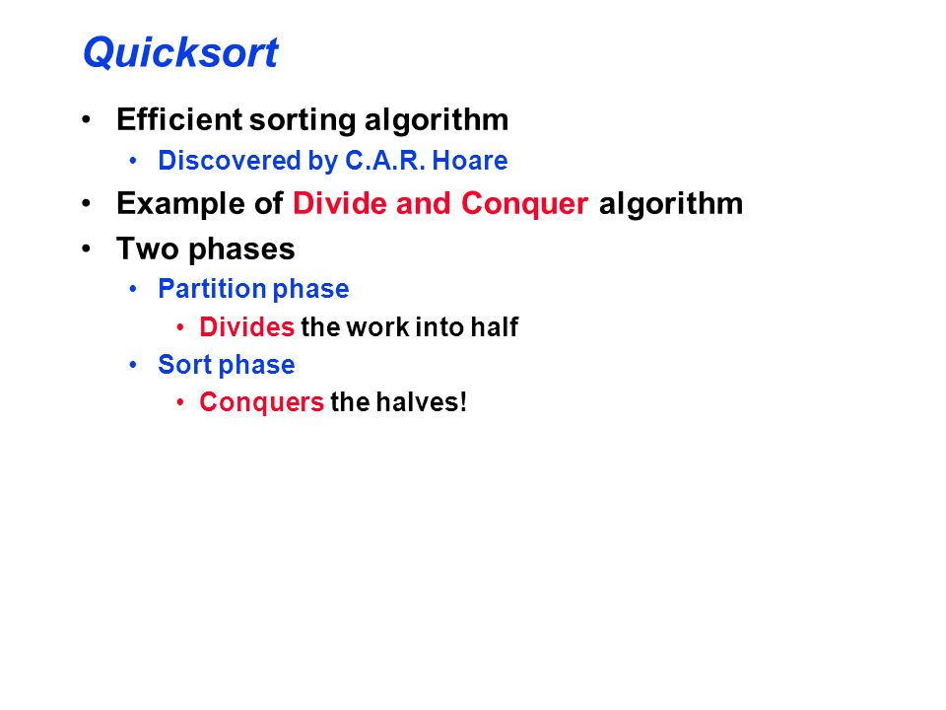

Slide 2
Partition Pseudo code
Partition( arr[],p,q) arr[p….q]
{
pivot=arr[p]
i=p
for j=p+1 to q
{
do if arr[j]<=x
{
then i=i+1
exchange a[i],a[j]
}
}
exchange a[p],a[i]
return i

Slide 3
Quicksort pseudocode
QUICKSORT(A, p, r)
if p < r
then q = PARTITION(A, p, r)
QUICKSORT(A, p, q)
QUICKSORT(A, q+1, r)
Initial call: QUICKSORT(A, 1, n)

Slide 4
Partitioning
Example :
6 10 13 5 8 3 2 11
6 5 13 10 8 3 2 1
6 5 3 10 8 13 2 11
6 5 3 2 8 13 10 11
2 5 3 6 8 13 10 11

Slide 5
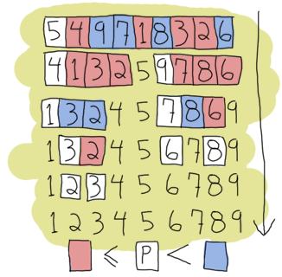
Example

Slide 6
Quickselect
Quickselect(A, low, high, k):
1) m = Partition(A, low, high) // m is how many values are less
// than the partition element.
2) if k ≤ m, return Quickselect(low, low+m-1, k)
3) else if k=m+1 return the partition element, A[low+m]
4) else return Quickselect(low+m+1, high, k-m-1)

Slide 7
Merge Sort
A Divide and conquer algorithm
MERGE-SORT A[1 . . n] To sort n numbers:
1.If n = 1, done.
2.Recursively sort A[ 1 . . ┌ n/2┐ ] and A[┌ n/2 ┐ +1 . . n ] .
3.“Merge” the 2 sorted lists.

Slide 8
