Slide 1

IILM UNIVERSITY
GREATER NOIDA, U.P.
CODSOFT VIRTUAL INTERNSHIP
Artificial Intelligence
A 4-Week Project-Based Internship Presentation
Rudra Akash
Roll No.: 25SCS1003003601 | B.Tech CSE (AI & ML) | Batch 2025-29
Internship Duration: 15 July 2026 - 15 August 2026 (4 Weeks)

Slide 2
Candidate & Program Overview
1
Candidate Details
2
Internship Profile
Student Name
Program Name
Rudra Akash
CodSoft Virtual Internship
Roll Number
Specialization Domain
25SCS1003003601
Artificial Intelligence
Degree
Duration
B.Tech (CSE - AI & ML)
4 Weeks (Jul 15 - Aug 15, 2026)
Academic Batch
Certificate ID
2025-2029
f806a3e
University
Tasks Completed
IILM University, Greater Noida, U.P.
Chatbot, Tic-Tac-Toe AI, Recommendation System
02

Slide 3
Organization Profile: CodSoft
CodSoft is a technology education and software development platform that helps aspiring developers turn theoretical knowledge into practical, industry-relevant skills.
1
Virtual Internships
2
AI-Driven Career Tools
Structured, project-based internship tracks across AI, Web Development, and Software Engineering.
Resume builder, ATS score checker, AI interview coach, and portfolio builder for career readiness.
3
Project-Based Learning
4
Placement & Network Support
Learners independently design and build real, working applications rather than following tutorials.
Career roadmap guidance, 1-on-1 sessions, and networking opportunities with peers.
03

Slide 4
Problem Statement & Scope
The Challenge
Scope of Work
Academic coursework introduces search algorithms, NLP, and recommendation theory - but students rarely get to independently design and build complete, working AI systems from first principles, without relying on high-level libraries that hide the underlying logic.
Adversarial search & game-playing agents (Minimax)
Rule-based natural language pattern matching
Content-based & collaborative-filtering recommenders
Each project built, tested, and validated standalone
Why It Matters
Building all three systems from first principles - rather than calling a single high-level library function - was the point of the internship: it demonstrates genuine understanding of the algorithms, not just familiarity with an API.
04

Slide 5
Core Project Objectives
1
2
3
4
Adversarial Search
Pattern Matching
Recommendation Systems
Applied Vectorization
Implement Minimax with Alpha-Beta Pruning for optimal game-playing decisions.
Design a rule-based conversational system using regular expressions.
Implement and compare content-based and collaborative filtering.
Apply TF-IDF and cosine similarity to real-world-style datasets.
05

Slide 6
Technologies & Tools Used
Language & Runtime
Core AI Algorithms
Libraries
Tooling & Delivery
Python 3
Command-line interface (argparse)
Minimax + Alpha-Beta Pruning
Regex pattern matching
TF-IDF + Cosine Similarity
pandas
NumPy
scikit-learn
Visual Studio Code
Git & GitHub
All three tasks were implemented from scratch in Python - no pre-built AI/ML framework did the core reasoning for us.
06

Slide 7
Development Methodology
Every task followed the same six-step, project-based workflow:
1
2
3
4
5
6
Understand
Concept
Design
Structure
Implement
in Python
Test Edge
Cases
Document
Code
Demo &
Submit
This mirrors real-world AI development practice, where correctness is validated through systematic testing rather than assumed from design alone.
07

Slide 8
TASK 1
Chatbot with Rule-Based Responses
A pattern-matching conversational agent built without machine learning, using regex-based intent recognition.
How It Works
Key Techniques
Ordered rule list pairs regex patterns with candidate responses; first match wins.
Recognizes greetings, farewells, small talk, and requests for time/date.
Extracts the user's name via a regex capture group and personalizes replies.
Falls back to a clarification response when no rule matches - no hard failures.
Built entirely with Python's built-in 're' module - zero external NLP dependencies.
Regular Expressions
Randomized Responses
Fallback Handling
08

Slide 9
TASK 2
Tic-Tac-Toe AI
An unbeatable game-playing agent built with adversarial search over the full game tree.
How It Works
Key Techniques
Minimax algorithm explores every possible continuation of the game.
Alpha-Beta Pruning discards branches that cannot affect the final decision, cutting search time without changing the result.
Scoring favors faster wins and slower losses by factoring in search depth.
Board represented as a flat 9-cell array; wins checked across rows, columns, diagonals.
Result: the AI always wins or draws - it can never lose.
Minimax Algorithm
Alpha-Beta Pruning
Adversarial Search
09

Slide 10
TASK 4
Recommendation System
Two complementary recommendation paradigms implemented and compared on the same dataset.
How It Works
Key Techniques
Content-based: TF-IDF vectorizes genre tags; cosine similarity finds movies with the closest profile.
Collaborative filtering: builds a user-item ratings matrix and computes item-item similarity from rating patterns.
Predicts unseen-movie ratings as a similarity-weighted average of a user's existing ratings.
Both approaches share one sample dataset, so recommendations can be directly compared.
Delivered as a CLI tool with both modes plus list-movies / list-users utilities.
TF-IDF Vectorization
Cosine Similarity
Collaborative Filtering
10

Slide 11
Key Skills Demonstrated
Adversarial Search
NLP Pattern Matching
Designed and implemented Minimax with Alpha-Beta Pruning for a fully optimal game-playing agent.
Built rule-based intent recognition using regular expressions and capture groups.
Recommendation Engineering
Clean Software Design
Applied TF-IDF, cosine similarity, and collaborative filtering to real-world-style data.
Wrote modular, well-documented, testable Python CLI applications across all three tasks.
11

Slide 12
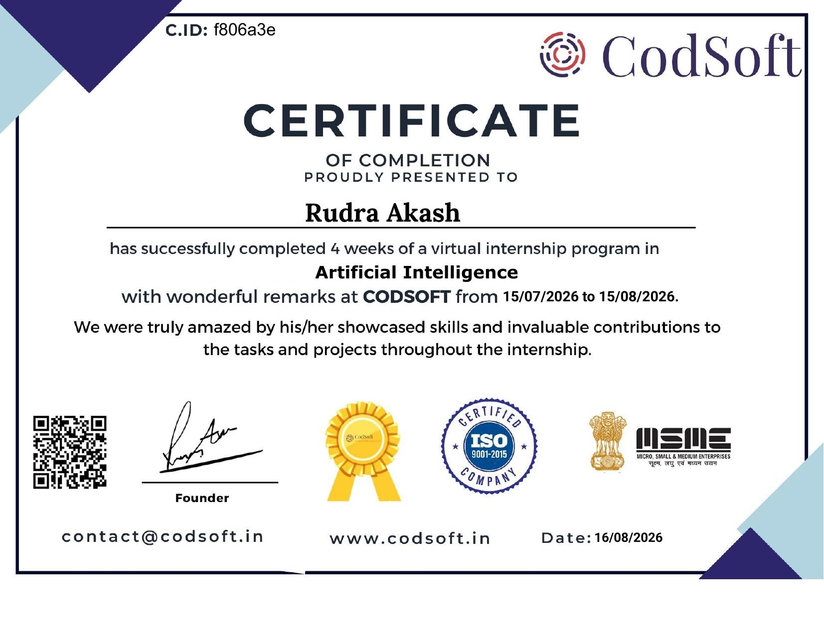
Certification & Verification
Internship Title
Artificial Intelligence Virtual Internship
Issuing Organization
CodSoft
Candidate Name
Rudra Akash
Certificate ID
f806a3e
Duration
15 Jul 2026 - 15 Aug 2026 (4 Weeks)
Date of Issue
16 August 2026
12

Slide 13
Thank You!
Rudra Akash
School of Computer Science & Engineering
IILM University, Greater Noida, U.P. | Roll No.: 25SCS1003003601

