Slide 1
Chapter 22
Transaction Management
Pearson Education © 2014

Slide 2


Chapter 22 - Objectives
Function and importance of transactions.
Properties of transactions.
Concurrency Control
  Meaning of serializability.
  How locking can ensure serializability.
  Deadlock and how it can be resolved.
  How timestamping can ensure serializability.
  Granularity of locking.
Pearson Education © 2014

Slide 3
Chapter 22 - Objectives
Recovery Control
  Some causes of database failure.
  Purpose of transaction log file.
  Purpose of checkpointing.
  How to recover following database failure.
Pearson Education © 2014

Slide 4
Transaction Support
  Transaction
  Action, or series of actions, carried out by user or application, which reads or updates contents of database.
Logical unit of work on the database.
Application program is series of transactions with non-database processing in between.
Transforms database from one consistent state to another, although consistency may be violated during transaction.
Pearson Education © 2014

Slide 5
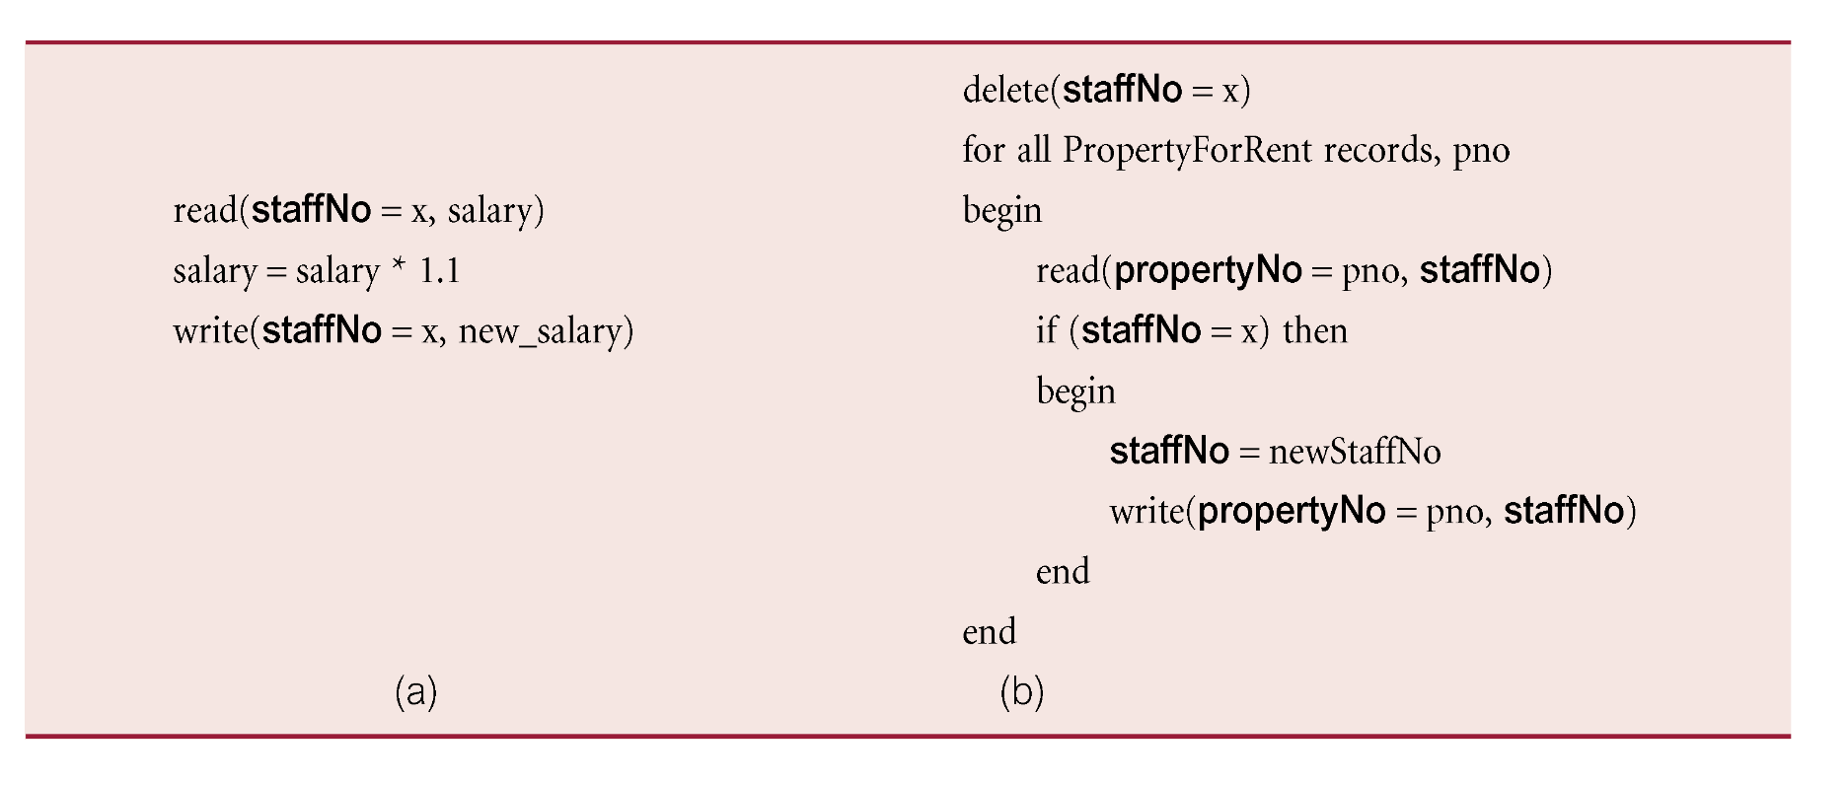
Example of two different Transactions
Pearson Education © 2014

Slide 6
Transaction Support
Can have one of two outcomes:
  Success - transaction commits and database reaches a new consistent state.
  Failure - transaction aborts, and database must be restored to consistent state before it started.
  Such a transaction is rolled back or undone.
Committed transaction cannot be aborted.
Aborted transaction that is rolled back can be restarted later.
Pearson Education © 2014

Slide 7
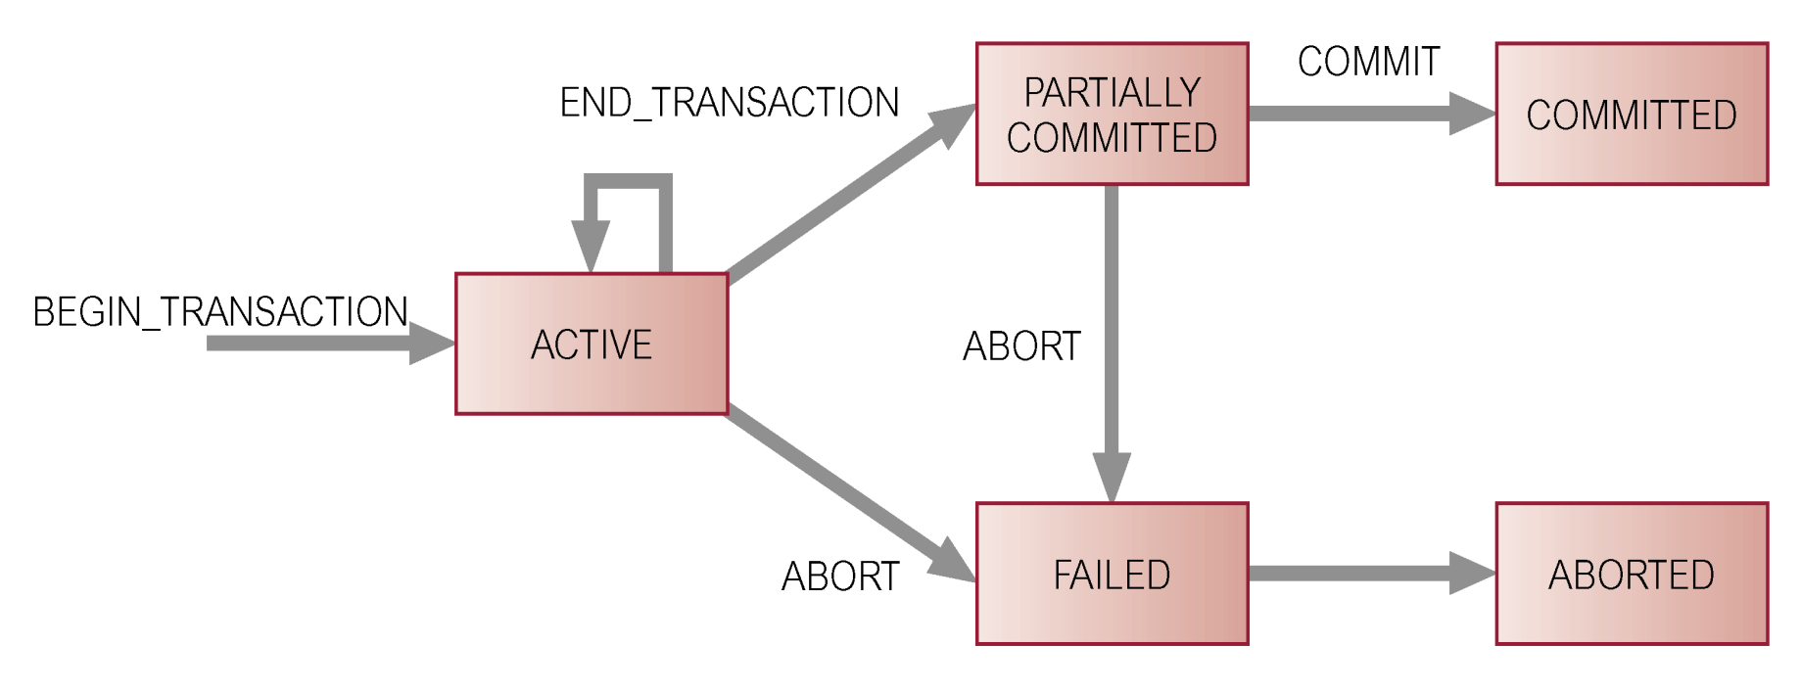
State Transition Diagram for Transaction
Pearson Education © 2014

Slide 8
Properties of Transactions
Four basic (ACID) properties that define a transaction are:
Atomicity ‘All or nothing’ property.
Consistency Must transform database from one consistent state to another.
Isolation Partial effects of incomplete transactions should not be visible to other transactions.
Durability Effects of a committed transaction are permanent and must not be lost because of later failure.
Pearson Education © 2014

Slide 9
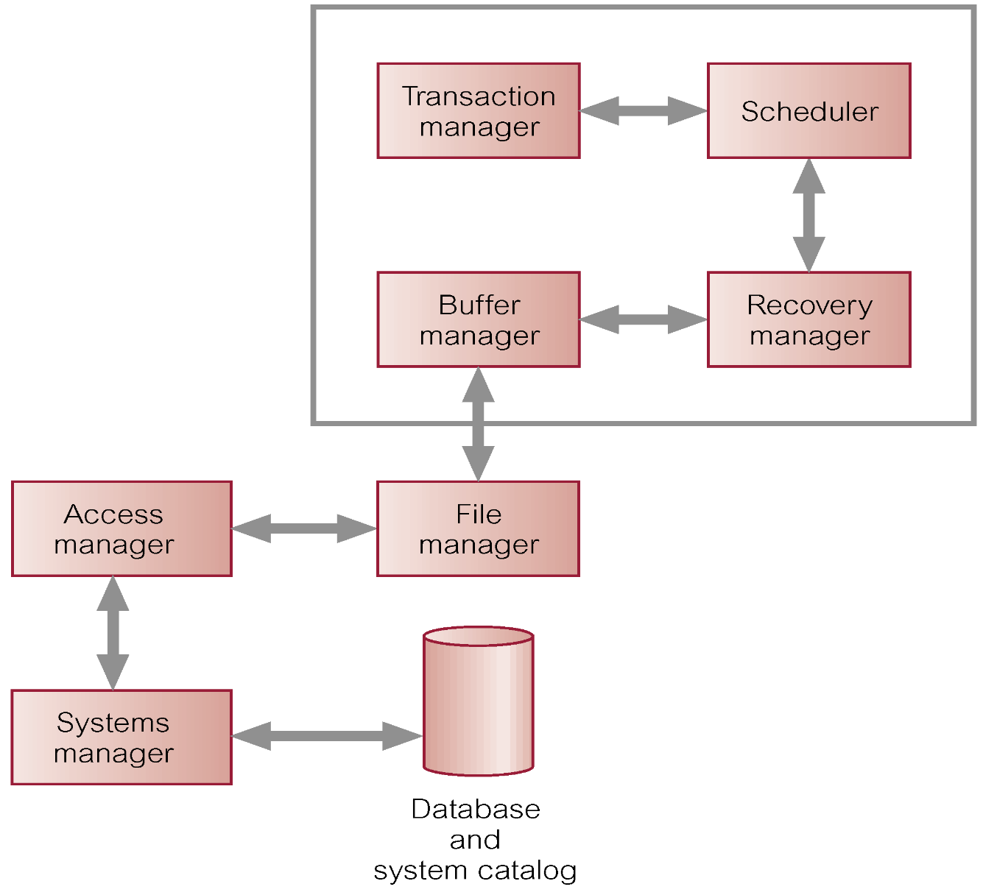
DBMS Transaction Subsystem
Pearson Education © 2014

Slide 10
Concurrency Control
Process of managing simultaneous operations on the database without having them interfere with one another.
Prevents interference when two or more users are accessing database simultaneously and at least one is updating data.
Although two transactions may be correct in themselves, interleaving of operations may produce an incorrect result.
Pearson Education © 2014

Slide 11
Need for Concurrency Control
Three examples of potential problems caused by concurrency:
  Lost update problem.
  Uncommitted dependency problem.
  Inconsistent analysis problem.
Pearson Education © 2014

Slide 12
Lost Update Problem
Successfully completed update is overridden by another user.
T₁ withdrawing £10 from an account with bal_{x}, initially £100.
T₂ depositing £100 into same account.
Serially, final balance would be £190.
Pearson Education © 2014

Slide 13
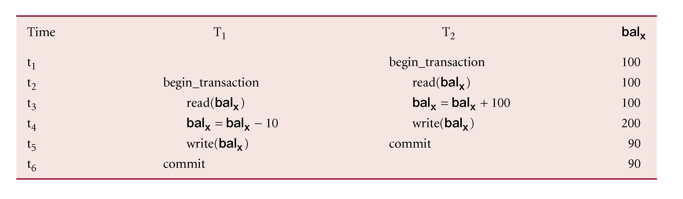
Lost Update Problem (write this on the board to make interleaving more clear).
Loss of T₂’s update avoided by preventing T₁ from reading bal_{x} until after update.
Pearson Education © 2014

Slide 14
Uncommitted Dependency Problem
Occurs when one transaction can see intermediate results of another transaction before it has committed.
T₄ updates bal_{x} to £200 but it aborts, so bal_{x} should be back at original value of £100.
T₃ has read new value of bal_{x} (£200) and uses value as basis of £10 reduction, giving a new balance of £190, instead of £90.
Pearson Education © 2014

Slide 15
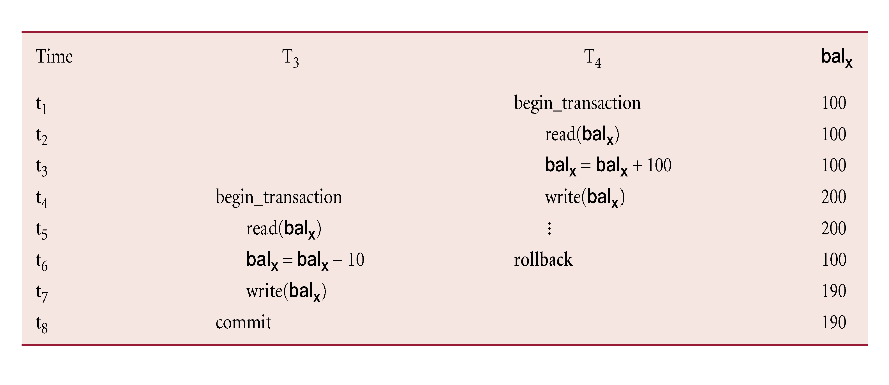
Uncommitted Dependency Problem
Problem avoided by preventing T₃ from reading bal_{x} until after T₄ commits or aborts.
Pearson Education © 2014

Slide 16
Inconsistent Analysis Problem
Occurs when transaction reads several values but second transaction updates some of them during execution of first.
Sometimes referred to as dirty read or unrepeatable read.
T₆ is totaling balances of account x (£100), account y (£50), and account z (£25).
Meantime, T₅ has transferred £10 from bal_{x} to bal_{z}, so T₆ now has wrong result (£10 too high).
Pearson Education © 2014

Slide 17
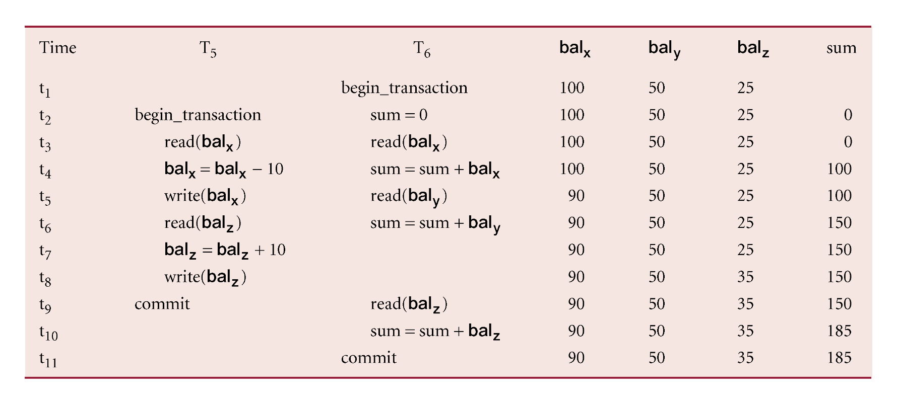
Inconsistent Analysis Problem
Problem avoided by preventing T₆ from reading bal_{x} and bal_{z} until after T₅ completed updates.
Pearson Education © 2014

Slide 18
Serializability
Objective of a concurrency control protocol is to schedule transactions in such a way as to avoid any interference.
Could run transactions serially, but this limits degree of concurrency or parallelism in system.
Serializability identifies those executions of transactions (one of these is called a schedule(interleaves)) guaranteed to ensure consistency.
Pearson Education © 2014

Slide 19
Serializability
  Schedule
  Sequence of reads/writes by set of concurrent transactions.
  Serial Schedule
  Schedule where operations of each transaction are executed consecutively without any interleaved operations from other transactions.
No guarantee that results of all serial executions of a given set of transactions will be identical. For example, add all deposits to an account, and then add the interest, or vice-versa.
Pearson Education © 2014

Slide 20
Nonserial Schedule
Schedule where operations from set of concurrent transactions are interleaved.
Objective of serializability is to find nonserial schedules that allow transactions to execute concurrently without interfering with one another.
In other words, want to find nonserial schedules that are equivalent to some serial schedule. Such a schedule is called serializable.
Pearson Education © 2014

Slide 21
Serializability
In serializability, ordering of read/writes is important:
  (a) If two transactions only read a data item, they do not conflict and order is not important.
  (b) If two transactions either read or write separate data items, they do not conflict and order is not important.
  (c) If one transaction writes a data item and another reads or writes same data item, order of execution is important.
Pearson Education © 2014

Slide 22
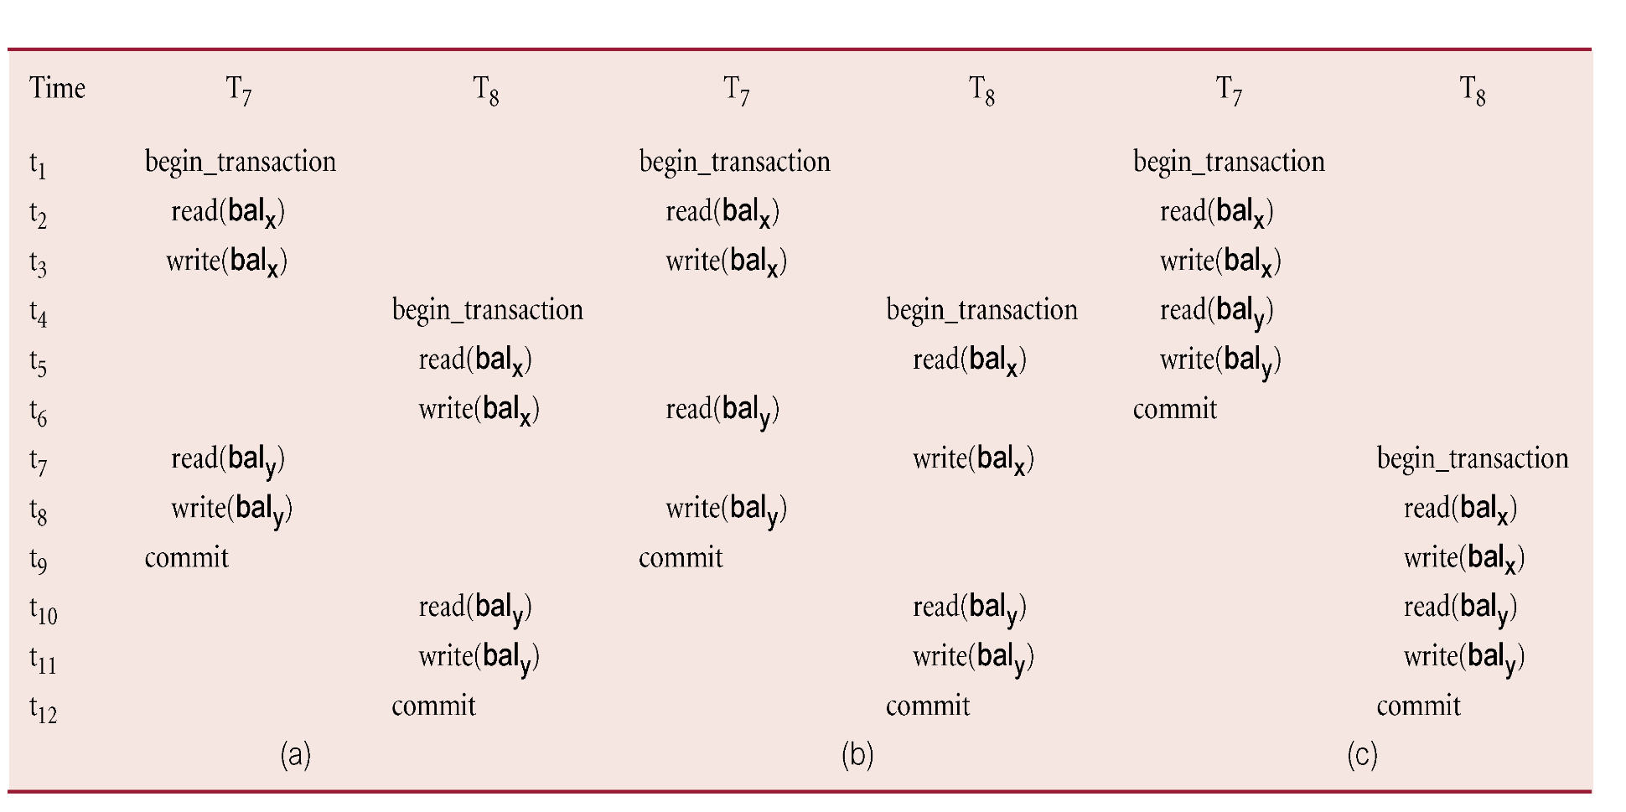
Example of Conflict Serializability
Pearson Education © 2014

Slide 23
Serializability
Conflict serializable schedule orders any conflicting operations in same way as some serial execution.
Under constrained write rule (transaction updates data item based on its old value, which is first read), use precedence graph to test for serializability.
Pearson Education © 2014

Slide 24
Precedence Graph
Create:
  node for each transaction;
  a directed edge T_{i} → T_{j}, if T_{j} reads the value of an item written by T_{I};
  a directed edge T_{i} → T_{j}, if T_{j} writes a value into an item after it has been read by T_{i}.
  also write -> write.
If precedence graph contains cycle, schedule is not conflict serializable.
(Conflict serializable means it is a good
schedule.)
Pearson Education © 2014

Slide 25
Example - Non-conflict serializable schedule
T₉ is transferring £100 from one account with balance bal_{x} to another account with balance bal_{y}.
T₁₀ is increasing balance of these two accounts by 10%.
Precedence graph has a cycle and so is not serializable. (See the next slide.)
Pearson Education © 2014

Slide 26
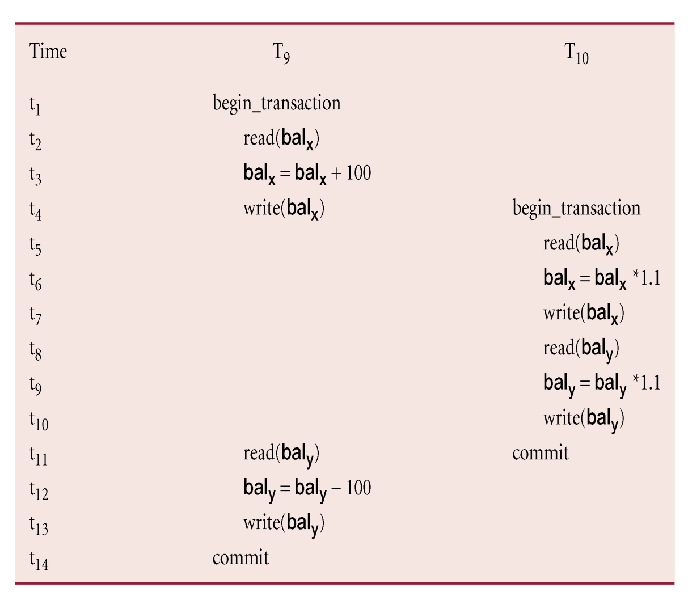
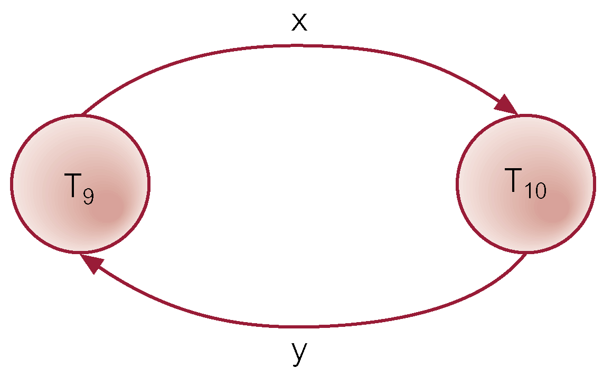

Example - Non-conflict serializable schedule
Pearson Education © 2014

Slide 27
Recoverability
Serializability identifies schedules that maintain database consistency, assuming no transaction fails.
Could also examine recoverability of transactions within schedule.
If transaction fails, atomicity requires effects of transaction to be undone.
Durability states that once transaction commits, its changes cannot be undone (without running another, compensating, transaction).
Pearson Education © 2014

Slide 28
Recoverable Schedule
A schedule where, for each pair of transactions T_{i} and T_{j}, if T_{j} reads a data item previously written by T_{i} (a ‘dirty’ read), then the commit operation of T_{i} precedes the commit operation of T_{j.}
This is only for write -> read
(Commit for the write must be first!)
Pearson Education © 2014

Slide 29
Concurrency Control Techniques
Two basic concurrency control techniques:
  Locking,
  Timestamping.
Both are conservative approaches: delay transactions in case they conflict with other transactions.
Optimistic methods assume conflict is rare and only check for conflicts at commit.
Pearson Education © 2014

Slide 30
Locking
Transaction uses locks to deny access to other transactions and so prevent incorrect updates.
Most widely used approach to ensure serializability.
Generally, a transaction must claim a shared (read) or exclusive (write) lock on a data item before read or write.
Lock prevents another transaction from modifying item or even reading it, in the case of a write lock.
Pearson Education © 2014

Slide 31
Locking - Basic Rules
If transaction has shared lock on item, can read but not update item.
If transaction has exclusive lock on item, can both read and update item.
Reads cannot conflict, so more than one transaction can hold shared locks simultaneously on same item.
Exclusive lock gives transaction exclusive access to that item.
Pearson Education © 2014

Slide 32
Locking - Basic Rules
Some systems allow transaction to upgrade read lock to an exclusive lock, or downgrade exclusive lock to a shared lock.
Pearson Education © 2014

Slide 33
Two-Phase Locking (2PL) – Needed to ensure conflict serializability
Transaction follows 2PL protocol if all locking operations precede first unlock operation in the transaction.
Two phases for transaction:
  Growing phase - acquires all locks but cannot release any locks.
  Shrinking phase - releases locks but cannot acquire any new locks.
Pearson Education © 2014

Slide 34
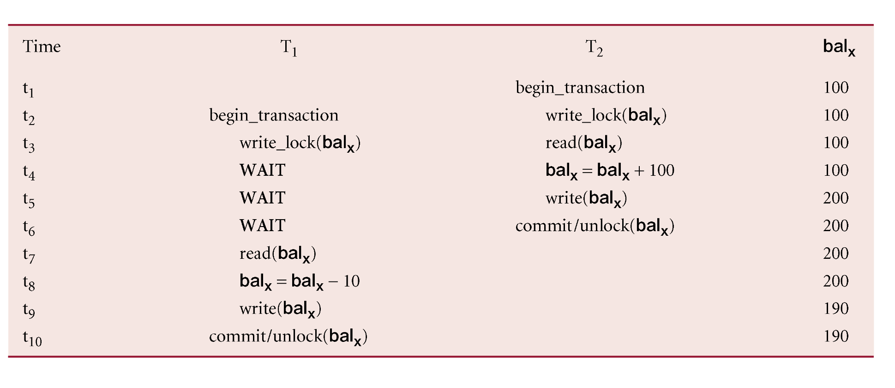
Preventing Lost Update Problem using 2PL
Pearson Education © 2014

Slide 35
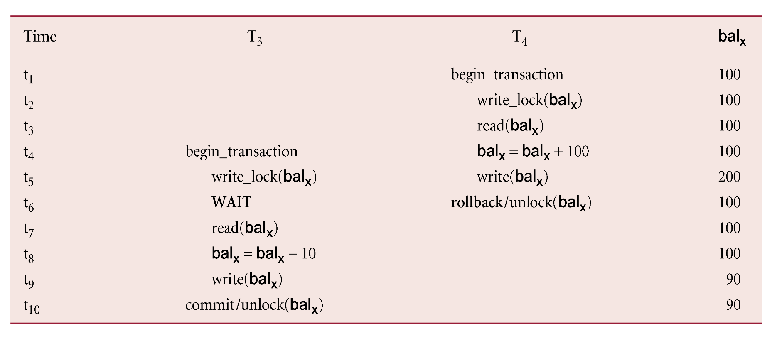
Preventing Uncommitted Dependency Problem using 2PL
Pearson Education © 2014

Slide 36
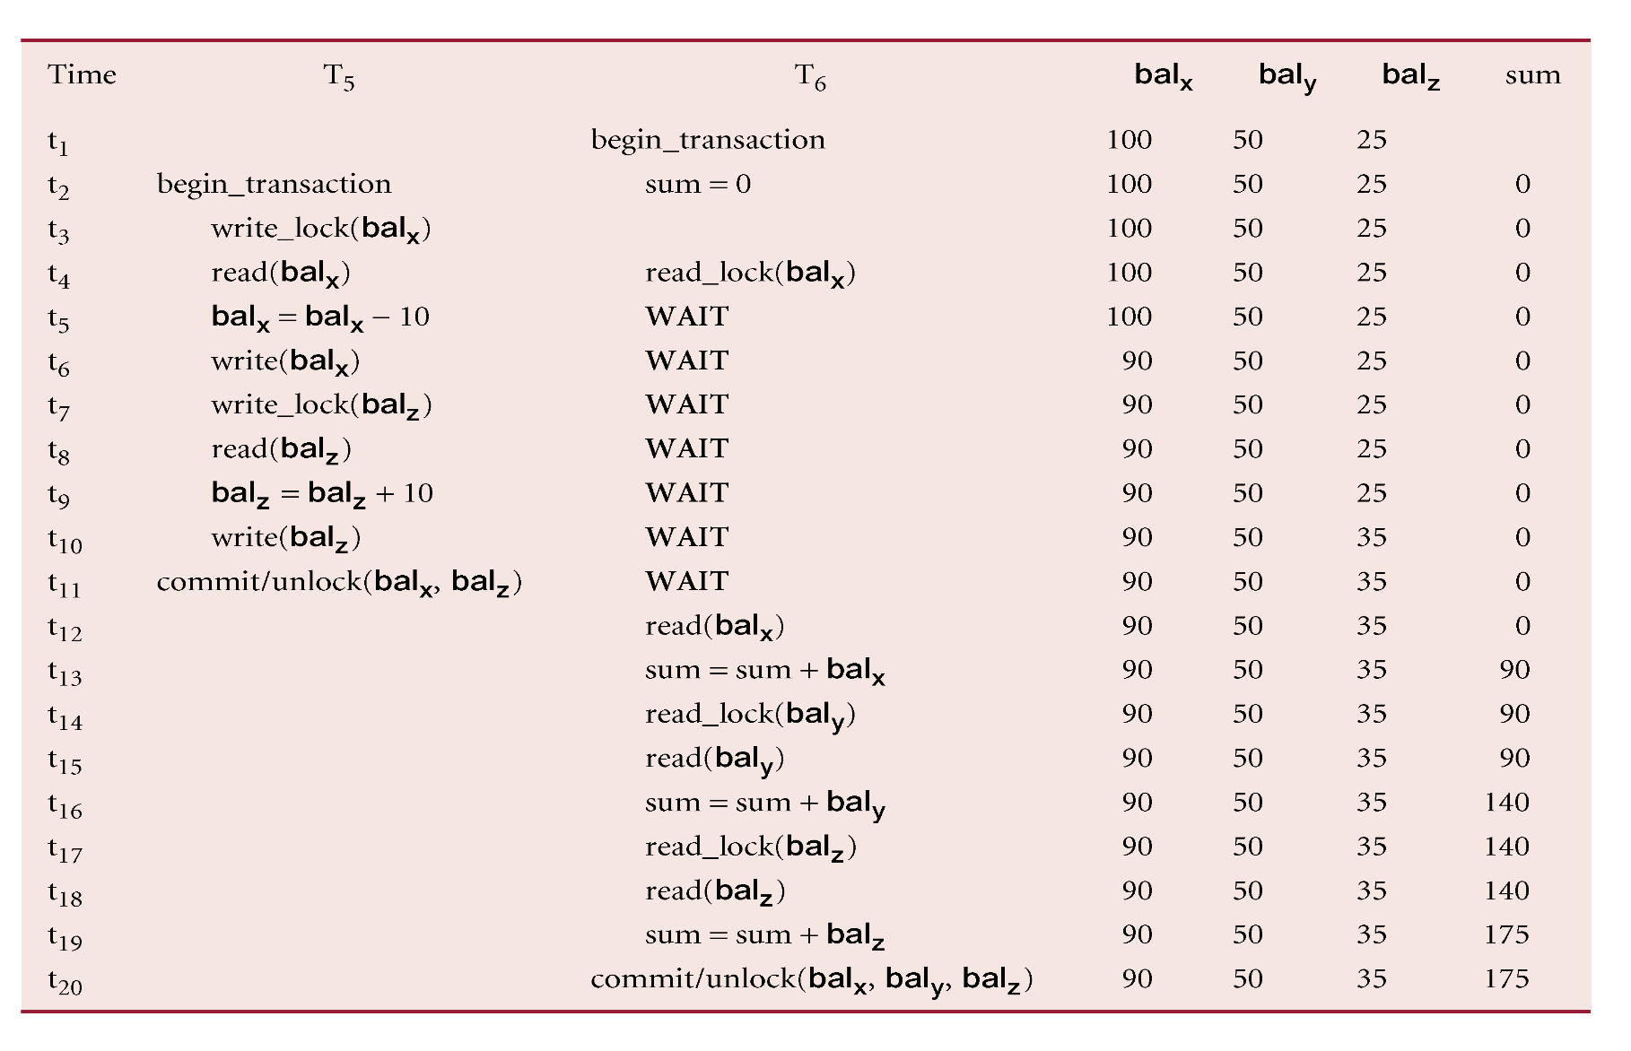
Preventing Inconsistent Analysis Problem using 2PL
Pearson Education © 2014

Slide 37
Cascading Rollback
If every transaction in a schedule follows 2PL, schedule is serializable.
However, problems can occur with interpretation of when locks can be released.
Pearson Education © 2014

Slide 38
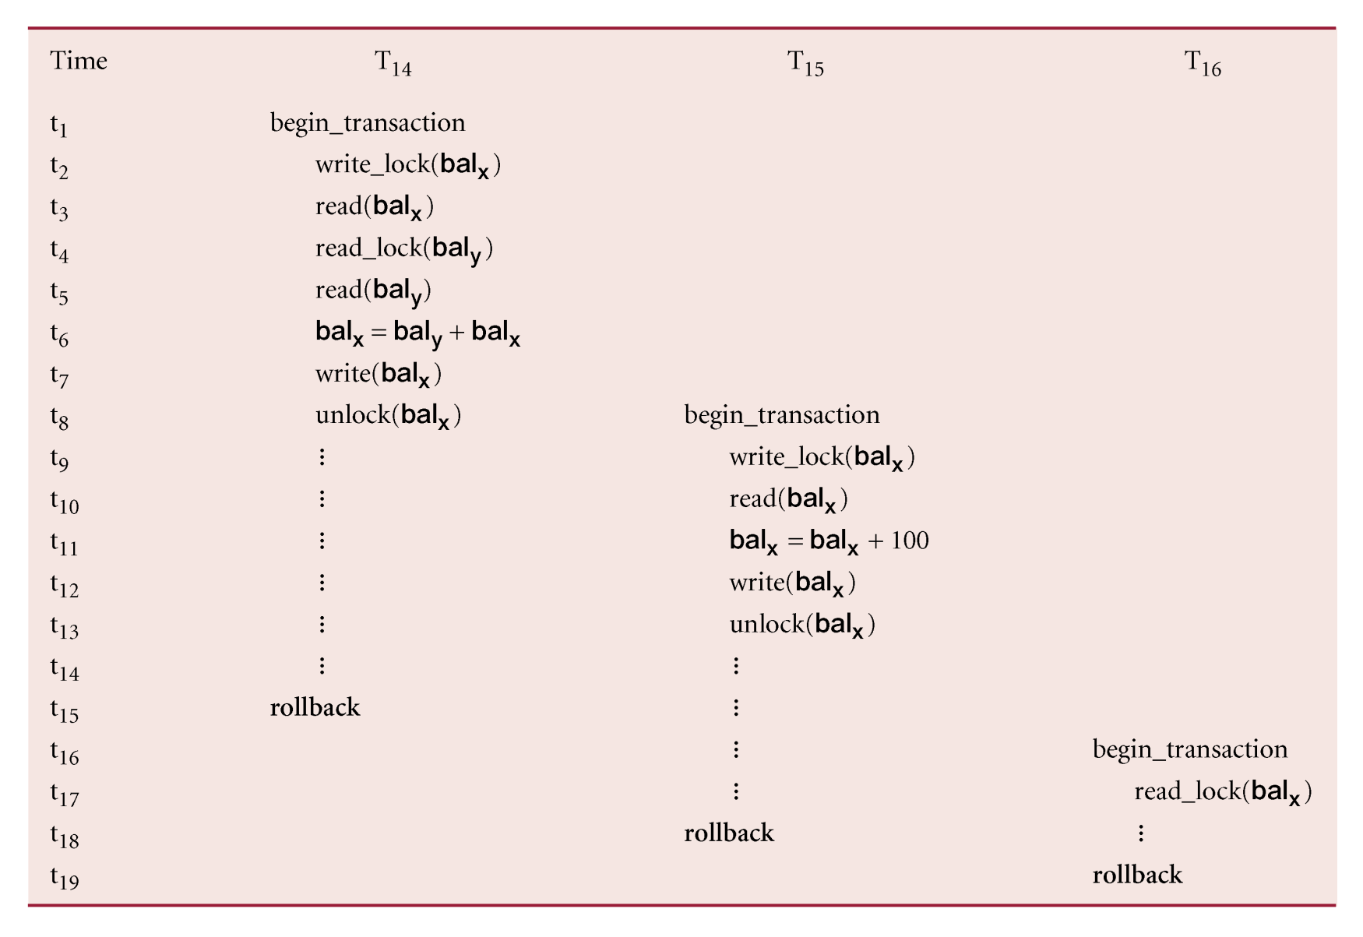
Cascading Rollback
Pearson Education © 2014

Slide 39
Cascading Rollback
Transactions conform to 2PL.
T₁₄ aborts.
Since T₁₅ is dependent on T₁₄, T₁₅ must also be rolled back. Since T₁₆ is dependent on T₁₅, it too must be rolled back.
This is called cascading rollback.
To prevent this with 2PL, leave release of all locks until end of transaction.
(So, you can either have 2PL with cascading
rollback, or, release all locks at end. Either
is okay.)
Pearson Education © 2014

Slide 40
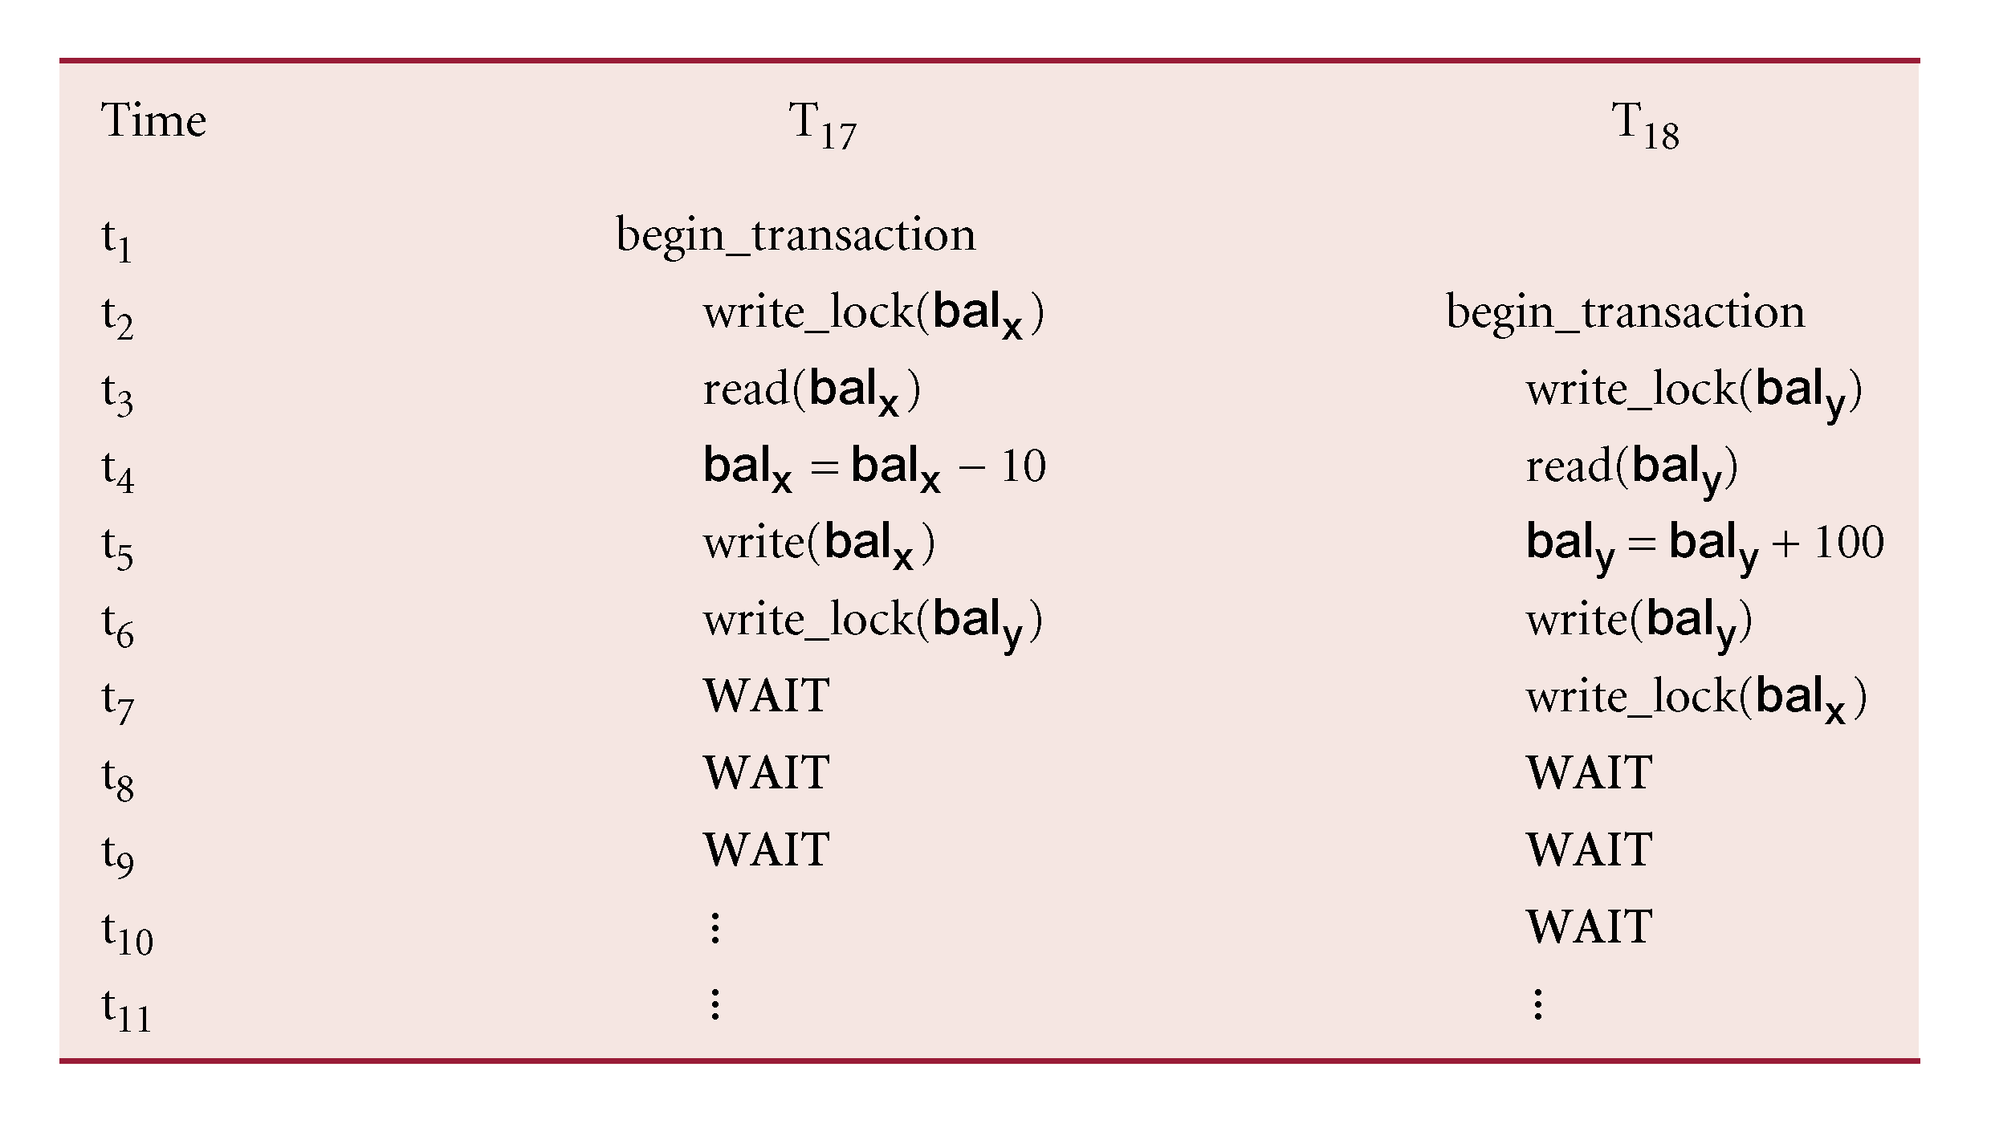
Deadlock
An impasse that may result when two (or more) transactions are each waiting for locks held by the other to be released.
Pearson Education © 2014

Slide 41
Deadlock
Only one way to break deadlock: abort one or more of the transactions.
Deadlock should be transparent to user, so DBMS should restart transaction(s).
However, in practice DBMS cannot restart aborted transaction since it is unaware of transaction logic even if it was aware of the transaction history (unless there is no user input in the transaction or the input is not a function of the database state).
Pearson Education © 2014

Slide 42
Deadlock
Three general techniques for handling deadlock:
  Timeouts.
  Deadlock prevention.
  Deadlock detection and recovery.
Pearson Education © 2014

Slide 43
Timeouts – Do briefly!
Transaction that requests lock will only wait for a system-defined period of time.
If lock has not been granted within this period, lock request times out.
In this case, DBMS assumes transaction may be deadlocked, even though it may not be, and it aborts and automatically restarts the transaction.
Pearson Education © 2014

Slide 44
Deadlock Prevention
DBMS looks ahead to see if transaction would cause deadlock and never allows deadlock to occur.
Could order transactions using transaction timestamps:
  Wait-Die - only an older transaction can wait for younger one, otherwise transaction is aborted (dies) and restarted with same timestamp.
  Wound-Wait - only a younger transaction can wait for an older one. If older transaction requests lock held by younger one, younger one is aborted (wounded).
Pearson Education © 2014

Slide 45
Deadlock Detection and Recovery
DBMS allows deadlock to occur but recognizes it and breaks it.
Usually handled by construction of wait-for graph (WFG) showing transaction dependencies:
  Create a node for each transaction.
  Create edge T_{i} -> T_{j}, if T_{i} waiting to lock item locked by T_{j}.
Deadlock exists if and only if WFG contains cycle.
WFG is created at regular intervals.
Pearson Education © 2014

Slide 46
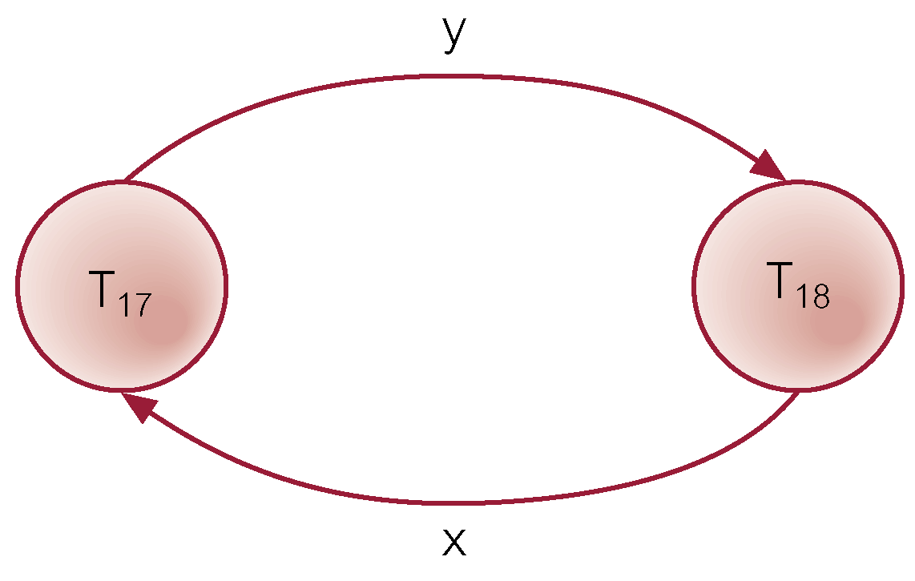
Example - Wait-For-Graph (WFG)
Pearson Education © 2014

Slide 47
Recovery from Deadlock Detection
Several issues:
  choice of deadlock victim (who to abort);
  how far to roll a transaction back;
  avoiding starvation.
Pearson Education © 2014

Slide 48
Timestamping
Transactions ordered globally so that older transactions, transactions with smaller timestamps, get priority in the event of conflict.
Conflict is resolved by rolling back and restarting transaction.
No locks so no deadlock.
Pearson Education © 2014

Slide 49
Timestamping
  Timestamp
  A unique identifier created by DBMS that indicates relative starting time of a transaction.
Can be generated by using system clock at time transaction started, or by incrementing a logical counter every time a new transaction starts.
Pearson Education © 2014

Slide 50
Timestamping – Do Briefly!
Read/write proceeds only if last update on that data item was carried out by an older transaction.
Otherwise, transaction requesting read/write is restarted and given a new timestamp.
Also timestamps for data items:
  read-timestamp - timestamp of last transaction to read item;
  write-timestamp - timestamp of last transaction to write item.
Pearson Education © 2014

Slide 51
Optimistic Techniques – Do Briefly!
Based on assumption that conflict is rare and more efficient to let transactions proceed without delays to ensure serializability.
At commit, check is made to determine whether conflict has occurred.
If there is a conflict, transaction must be rolled back and restarted.
Potentially allows greater concurrency than traditional protocols.
Pearson Education © 2014

Slide 52
Optimistic Techniques
Three phases:
  Read
  Validation
  Write
Pearson Education © 2014

Slide 53
Optimistic Techniques - Read Phase
Extends from start until immediately before commit.
Transaction reads values from database and stores them in local variables. Updates are applied to a local copy of the data.
Pearson Education © 2014

Slide 54
Optimistic Techniques - Validation Phase
Follows the read phase.
For read-only transaction, checks that data read are still current values. If no interference, transaction is committed, else aborted and restarted.
For update transaction, checks transaction leaves database in a consistent state, with serializability maintained.
Pearson Education © 2014

Slide 55
Optimistic Techniques - Write Phase
Follows successful validation phase for update transactions.
Updates made to local copy are applied to the database.
Pearson Education © 2014

Slide 56
Granularity of Data Items
Size of data items chosen as unit of protection by concurrency control protocol.
Ranging from coarse (big) to fine (small):
  The entire database.
  A file.
  A page (or area or database spaced).
  A record.
  A field value of a record.
Pearson Education © 2014

Slide 57
Granularity of Data Items
Tradeoff:
  coarser, the lower the degree of concurrency;
  finer, more locking information that is needed to be stored.
Best item size depends on the types of transactions.
Pearson Education © 2014

Slide 58
Hierarchy of Granularity
Could represent granularity of locks in a hierarchical structure.
Root node represents entire database, level 1s represent files, etc.
When node is locked, all its descendants are also locked.
DBMS should check hierarchical path before granting lock.
Pearson Education © 2014

Slide 59
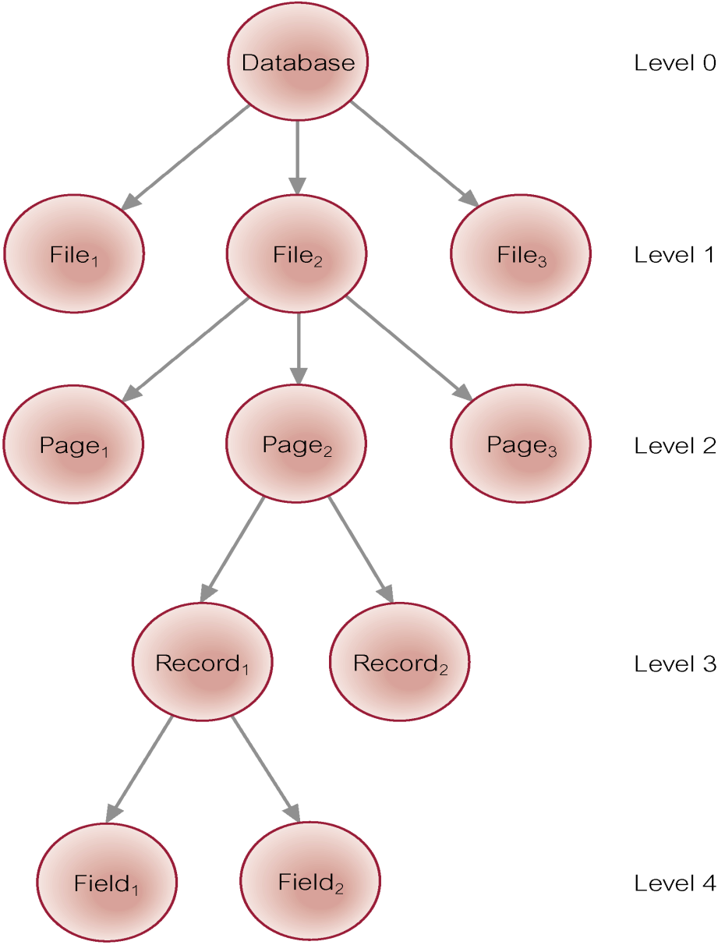
Levels of Locking
Pearson Education © 2014

Slide 60
Database Recovery
Process of restoring database to a correct state in the event of a failure.
Need for Recovery Control
  Two types of storage: volatile (main memory) and nonvolatile.
  Volatile storage does not survive system crashes.
  Stable storage represents information that has been replicated in several nonvolatile storage media with independent failure modes.
Pearson Education © 2014

Slide 61
Types of Failures
System crashes, resulting in loss of main memory.
Media failures, resulting in loss of parts of secondary storage.
Application software errors.
Natural physical disasters.
Carelessness or unintentional destruction of data or facilities.
Sabotage.
Pearson Education © 2014

Slide 62
Transactions and Recovery
Transactions represent basic unit of recovery.
Recovery manager responsible for atomicity and durability.
If failure occurs between commit and database buffers being flushed to secondary storage then, to ensure durability, recovery manager has to redo (rollforward) transaction’s updates.
Pearson Education © 2014

Slide 63
Transactions and Recovery
If transaction had not committed at failure time, recovery manager has to undo (rollback) any effects of that transaction for atomicity.
Partial undo - only one transaction has to be undone.
Global undo - all transactions have to be undone (for example if the system crashed).
Pearson Education © 2014

Slide 64
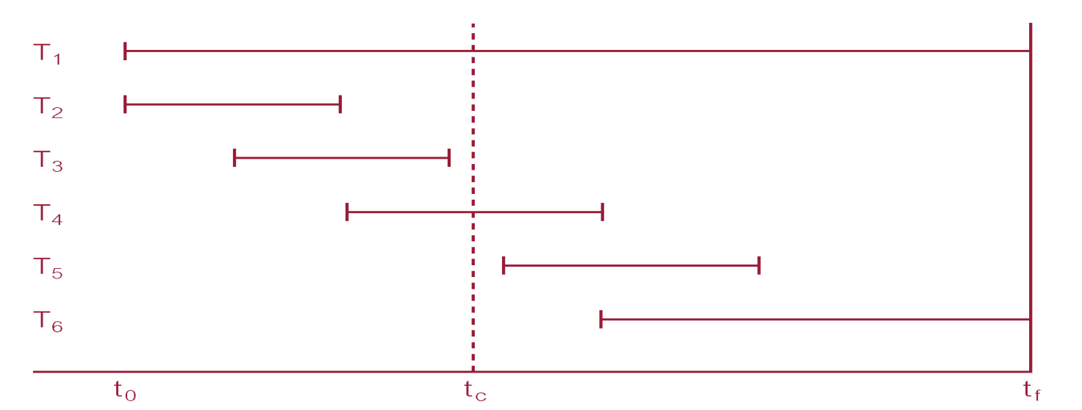
Example
DBMS starts at time t₀, but fails at time t_{f}. Assume data for transactions T₂ and T₃ have been written to secondary storage.
T₁ and T₆ have to be undone. In absence of any other information, recovery manager has to redo T₂, T₃, T₄, and T₅.
Pearson Education © 2014

Slide 65
Recovery Facilities
DBMS should provide following facilities to assist with recovery:
  Backup mechanism, which makes periodic backup copies of database.
  Logging facilities, which keep track of current state of transactions and database changes.
  Checkpoint facility, which enables updates to database in progress to be made permanent.
  Recovery manager, which allows DBMS to restore database to consistent state following a failure.
Pearson Education © 2014

Slide 66
Log File
Contains information about all updates to database:
  Transaction records.
  Checkpoint records.
Often used for other purposes (for example, auditing).
Pearson Education © 2014

Slide 67
Log File
Transaction records contain:
  Transaction identifier.
  Type of log record, (transaction start, insert, update, delete, abort, commit).
  Identifier of data item affected by database action (insert, delete, and update operations).
  Before-image of data item.
  After-image of data item.
  Log management information.
Pearson Education © 2014

Slide 68
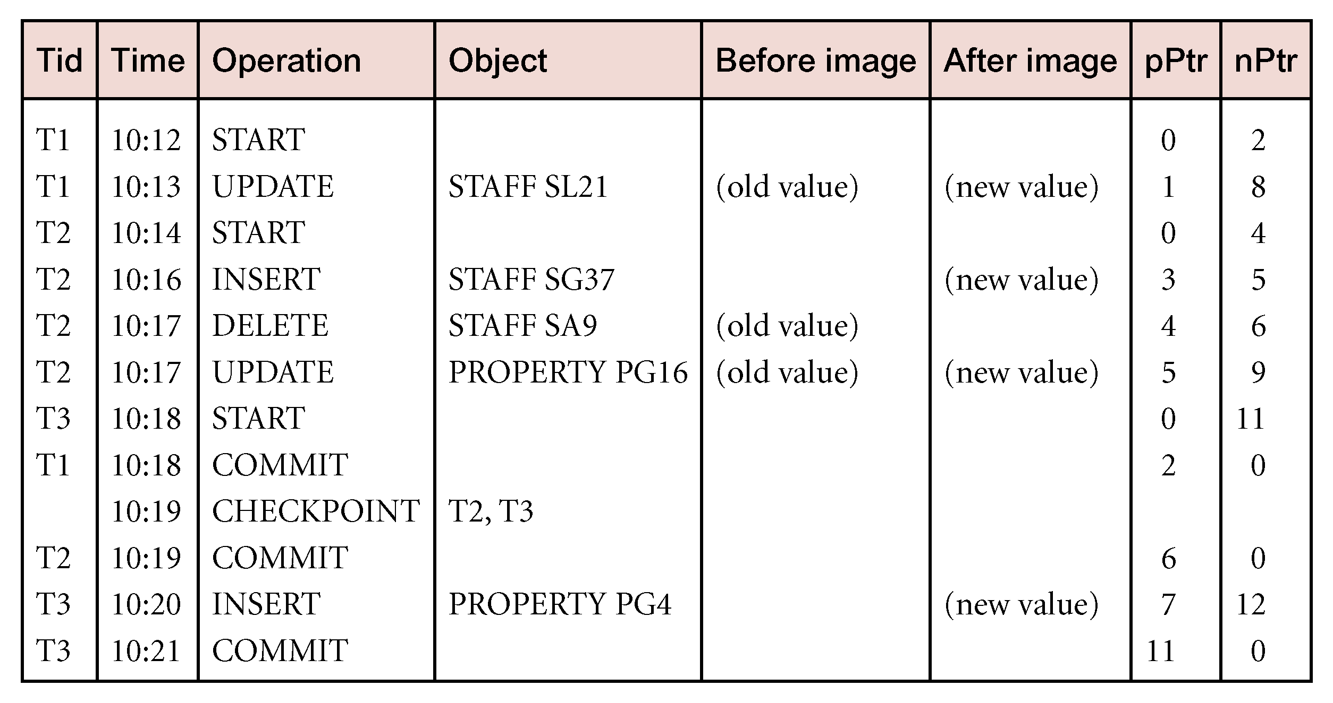
Sample Log File
Pearson Education © 2014

Slide 69
Log File
Log file sometimes split into two separate random-access files.
Potential bottleneck; critical in determining overall performance.
Pearson Education © 2014

Slide 70
Checkpointing
  Checkpoint
  Point of synchronization between database and log file. All buffers are force-written to secondary storage.
Checkpoint record is created containing identifiers of all active transactions.
When failure occurs, redo all transactions that committed since the checkpoint and undo all transactions active at time of crash.
Pearson Education © 2014

Slide 71
Checkpointing
In previous example (see slide 64), with checkpoint at time t_{c}, changes made by T₂ and T₃ have been written to secondary storage.
Thus:
  only redo T₄ and T₅,
  undo transactions T₁ and T6.
Pearson Education © 2014

Slide 72
Recovery Techniques
If database has been damaged:
  Need to restore last backup copy of database and reapply updates of committed transactions using log file.
If database is only inconsistent:
  Need to undo changes that caused inconsistency. May also need to redo some transactions to ensure updates reach secondary storage.
  Do not need backup, but can restore database using before- and after-images in the log file.
Pearson Education © 2014

