Slide 1
Chapter 31
Data Warehouse Concepts
Notes:
September 98
1
Chapter Name

Slide 2

Chapter Objectives
How data warehousing evolved.
The main concepts and benefits associated with data warehousing.
How online transaction processing (OLTP) systems differ from a data warehouse.
The problems associated with data warehousing.
The architecture and main components of a data warehouse.

Slide 3
Chapter Objectives
The tools associated with data warehousing.
The main requirements for a data warehouse DBMS and the importance of managing meta data.
The concept of a data mart and the main reasons for implementing a data mart.

Slide 4
The Evolution of Data Warehousing
Since 1970s, organizations gained competitive advantage through systems that automate business processes to offer more efficient and cost-effective services to the customer.
This resulted in accumulation of growing amounts of data in operational databases.

Slide 5
The Evolution of Data Warehousing
Organizations now focus on ways to use operational data to support decision-making, as a means of gaining competitive advantage. However, operational systems were never designed to support such business activities.
Businesses typically have numerous operational systems with overlapping and sometimes contradictory definitions.

Slide 6
The Evolution of Data Warehousing
Organizations need to turn their archives of data into a source of knowledge, so that a single integrated / consolidated view of the organization’s data is presented to the user.
A data warehouse (DW) was deemed the solution to meet the requirements of a system capable of supporting decision-making, receiving data from multiple operational data sources.

Slide 7
Data Warehousing Concepts
A Data Warehouse is a subject-oriented, integrated, time-variant, and non-volatile collection of data in support of management’s decision-making process (Inmon, 1993).

Slide 8
Subject-oriented Data
The warehouse is organized around the major subjects of the enterprise (e.g. customers, products, and sales) rather than the major application areas (e.g. customer invoicing, stock control, and product sales).
This is reflected in the need to store decision-support data rather than application-oriented data.

Slide 9
Integrated Data
The data warehouse integrates corporate application-oriented data from different source systems, which often includes data that is inconsistent (e.g. address in different formats).
The integrated data source must be made consistent to present a unified view of the data to the users.

Slide 10
Time-variant Data
Data in the warehouse is only accurate and valid at some point in time or over some time interval.
Time-variance is also shown in the extended time that the data is held, the implicit or explicit association of time with all data, and the fact that the data represents a series of snapshots.

Slide 11
Non-volatile Data
Data in the warehouse (DW) is not normally updated in real-time (RT) but is refreshed from operational systems on a regular basis. (However, emerging trend is towards RT or near RT DWs)
New data is always added as a supplement to the database, rather than a replacement.

Slide 12
Benefits of Data Warehousing
Potential high returns on investment
Competitive advantage
Increased productivity of corporate decision-makers

Slide 13
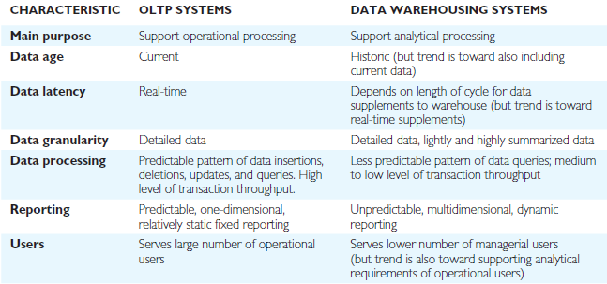
Comparison of OLTP Systems and Data Warehousing

Slide 14

Data Warehouse Queries
The types of queries that a data warehouse is expected to answer ranges from the relatively simple to the highly complex and is dependent on the type of end-user access tools used.
End-user access tools include:
  Traditional reporting and query
  OLAP
  Data mining

Slide 15
Data Warehouse Queries
What was the total revenue for Scotland in the third quarter of 2001?
What was the total revenue for property sales for each type of property in Great Britain in 2000?
What are the three most popular areas in each city for the renting of property in 2001 and how does this compare with the figures for the previous two years?
What is the monthly revenue for property sales at each branch office, compared with rolling 12-monthly prior figures?
Which type of property sells for prices above the average selling price for properties in the main cities of Great Britain and how does this correlate to demographic data?
What is the relationship between the total annual revenue generated by each branch office and the total number of sales staff assigned to each branch office?

Slide 16
Problems of Data Warehousing
Underestimation of resources for data loading
Hidden problems with source systems
Required data not captured
Increased end-user demands
Data homogenization
High demand for resources
Data ownership
High maintenance
Long duration projects
Complexity of integration

Slide 17
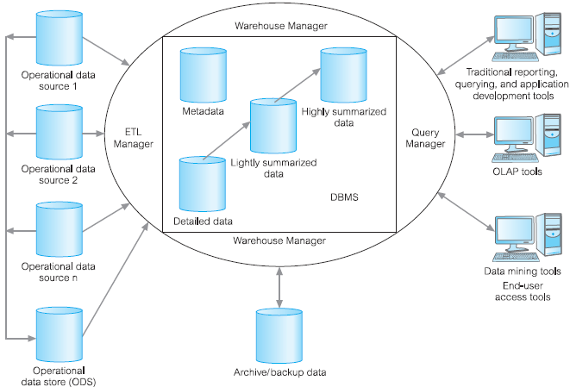
Example Data Warehouse Architecture

Slide 18
Operational Data Sources
Main sources are online transaction processing (OLTP) databases.
Also include sources such as personal databases and spreadsheets, Enterprise Resource Planning (ERP) files, and web usage log files.

Slide 19
Operational Data Store (ODS)
Holds current and integrated operational data for analysis.
Often structured and supplied with data in the same way as the data warehouse.
May act as staging area for data to be moved into the warehouse.
Often created when legacy operational systems are found to be incapable of achieving reporting requirements.

Slide 20
ETL Manager
Nowadays there are tools that automate the extraction, transformation, and loading (ETL) processes and also offer additional facilities such as data profiling, data quality control, and metadata management.

Slide 21
Warehouse Manager
Performs all the operations associated with the management of the data in the warehouse such as:
    Analysis of data to ensure consistency.
    Transformation and merging of source data from temporary storage into data warehouse tables.
    Creation of indexes and views on base tables.
    Generation of denormalizations, (if necessary).
    Generation of aggregations, (if necessary).
    Backing-up and archiving data.

Slide 22
Query Manager
Performs the operations associated with the management of user queries such as –
    Directing queries to the appropriate tables and scheduling the execution of queries.
    In some cases, the query manager also generates query profiles to allow the warehouse manager to determine which indexes and aggregations are appropriate.

Slide 23
Metadata
Used for a variety of purposes and so the effective management of metadata is critical in achieving a fully integrated DW.
Metadata (data about data) definitions are used by processes in the DW such as:
    To map data sources to a common view of information within the warehouse.
    To automate the production of summary tables.
    To direct a query to the most appropriate data source.

Slide 24
End-User Access Tools
Main purpose of DW is to support decision makers and this is achieved through the provision of a range of access tools including:
  reporting and querying,
  application and development,
  OLAP,
  data mining.

Slide 25
Data Warehousing Tools and technologies – ETL Processes
Extraction
  Targets one or more data sources and these sources typically include OLTP databases but can also include personal databases and spreadsheets, Enterprise Resource Planning (ERP) files, and web usage log files.
  The data sources are normally internal but can also include external sources such as the systems used by suppliers and/or customers.

Slide 26
Data Warehousing Tools and technologies – ETL Processes
Transformation
  Applies a series of rules or functions to the extracted data, which determines how the data will be used for analysis and can involve transformations such as data summations, data encoding, data merging, data splitting, data calculations, and creation of surrogate keys.

Slide 27
Data Warehousing Tools and technologies – ETL Processes
Loading
  As data loads additional constraints defined in the database schema can be activated (such as uniqueness, referential integrity, and mandatory fields), which contribute to the overall data quality performance of the ETL process.

Slide 28
Data Warehousing Tools and technologies – ETL Tools
Data profiling and quality control
  Provides important information about the quantity and quality of the data coming from the source systems.
Metadata management
  Understanding a query result can require consideration of the data history i.e. What happened to the data during the ETL process? The answers are held in the metadata repository.

Slide 29
Data Warehouse DBMS Requirements
Load performance
Load processing
Data quality management
Query performance
Terabyte scalability
Mass user scalability
Networked data warehouse
Warehouse administration
Integrated dimensional analysis
Advanced query functionality

Slide 30
Data Mart
A database that contains a subset of corporate data to support the analytical requirements of a particular business unit (such as the Sales department) or to support users who share the same requirements to analyse a particular business process (such as property sales).

Slide 31
Reasons for Creating a Data Mart
To give users access to the data they need to analyze most often.
To provide data in a form that matches the collective view of the data by a group of users in a department or business application area.
To improve end-user response time due to the reduction in the volume of data to be accessed.
To provide appropriately structured data as dictated by the requirements of the end-user access tools.

Slide 32
Reasons for Creating a Data Mart
Building a data mart is simpler compared with establishing an enterprise-wide DW (EDW).
The cost of implementing data marts is normally less than that required to establish a EDW.
The future users of a data mart are more easily defined and targeted to obtain support for a data mart than an enterprise-wide data warehouse project.

Slide 33
Data Warehousing and Temporal Databases
Data warehousing systems must manage relationships that exist between the historical data and the new data.
Data warehouses are described as being temporal (relating to time) databases.

Slide 34
Data Warehousing and Temporal Databases
Temporal data is data that changes over time.
A temporal database contains time-varying historical data with the possible inclusion of current and future data and has the ability to manipulate this data.

Slide 35
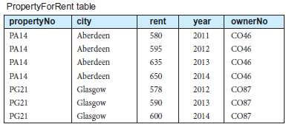
Data Warehousing and Temporal Databases
Shows historical property records with PK {propertyNo, year}

Slide 36
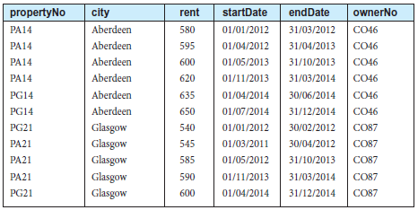
Data Warehousing and Temporal Databases
Shows historical property records with PK {propertyNo, startDate, endDate}

Slide 37
Temporal Extensions to SQL – For Teacher
T180 system-versioned tables
T181 application-time period tables

