Slide 1
Chapter 32
Data Warehousing Design
Notes:
September 98
1
Chapter Name

Slide 2

Chapter Objectives
The activities associated with initiating a data warehouse project.
The concepts associated with dimensionality modeling, which is a core technique of Kimball’s Business Dimensional Lifecycle.
The Dimensional Modeling stage of Kimball’s Business Dimensional Lifecycle.

Slide 3
Chapter Objectives
The step-by-step creation of a dimensional model (DM) using the DreamHome case study.
The issues associated with the development of a data warehouse.

Slide 4

Designing Data Warehouses
To begin a data warehouse project, we need to find answers for questions such as:
  Which user requirements are most important and which data should be considered first?
  Which data should be considered first?
  Should the project be scaled down into something more manageable?
  Should the infrastructure for a scaled down project be capable of ultimately delivering a full-scale enterprise-wide data warehouse?

Slide 5
Designing Data Warehouses
For many enterprises the way to avoid the complexities associated with designing a data warehouse is to start by building one or more data marts.
Data marts allow designers to build something that is far simpler and achievable for a specific group of users.

Slide 6
Designing Data Warehouses
Few designers are willing to commit to an enterprise-wide design that must meet all user requirements at one time.
Despite the interim solution of building data marts, the goal remains the same: that is, the ultimate creation of a data warehouse that supports the requirements of the enterprise.

Slide 7
Designing Data Warehouses
The requirements collection and analysis stage of a data warehouse project involves interviewing appropriate members of staff (such as marketing users, finance users, and sales users) to enable the identification of a prioritized set of requirements that the data warehouse must meet.

Slide 8
Designing Data Warehouses
At the same time, interviews are conducted with members of staff responsible for operational systems to identify, which data sources can provide clean, valid, and consistent data that will remain supported over the next few years.

Slide 9
Designing Data Warehouses
Interviews provide the necessary information for the top-down view (user requirements) and the bottom-up view (which data sources are available) of the data warehouse.
The database component of a data warehouse is described using a technique called dimensionality modeling.

Slide 10
Data Warehouse Development Methodologies
There are two main methodologies that incorporate the development of an enterprise data warehouse (EDW) and these are proposed by the two key players in the data warehouse arena.
  Kimball’s Business Dimensional Lifecycle (Kimball, 2008)
  Inmon’s Corporate Information Factory (CIF) methodology (Inmon, 2001).

Slide 11
Dimensionality modeling
A logical design technique that aims to present the data in a standard, intuitive form that allows for high-performance access
Every dimensional model (DM) is composed of one table with a composite primary key, called the fact table, and a set of smaller tables called dimension tables.

Slide 12
Dimensionality modeling
Each dimension table has a simple (non-composite) primary key that corresponds exactly to one of the components of the composite key in the fact table.
Forms ‘star-like’ structure, which is called a star schema or star join.

Slide 13
Dimensionality modeling
All natural keys are replaced with surrogate keys. Means that every join between fact and dimension tables is based on surrogate keys, not natural keys.
Surrogate keys allows the data in the warehouse to have some independence from the data used and produced by the OLTP systems.

Slide 14
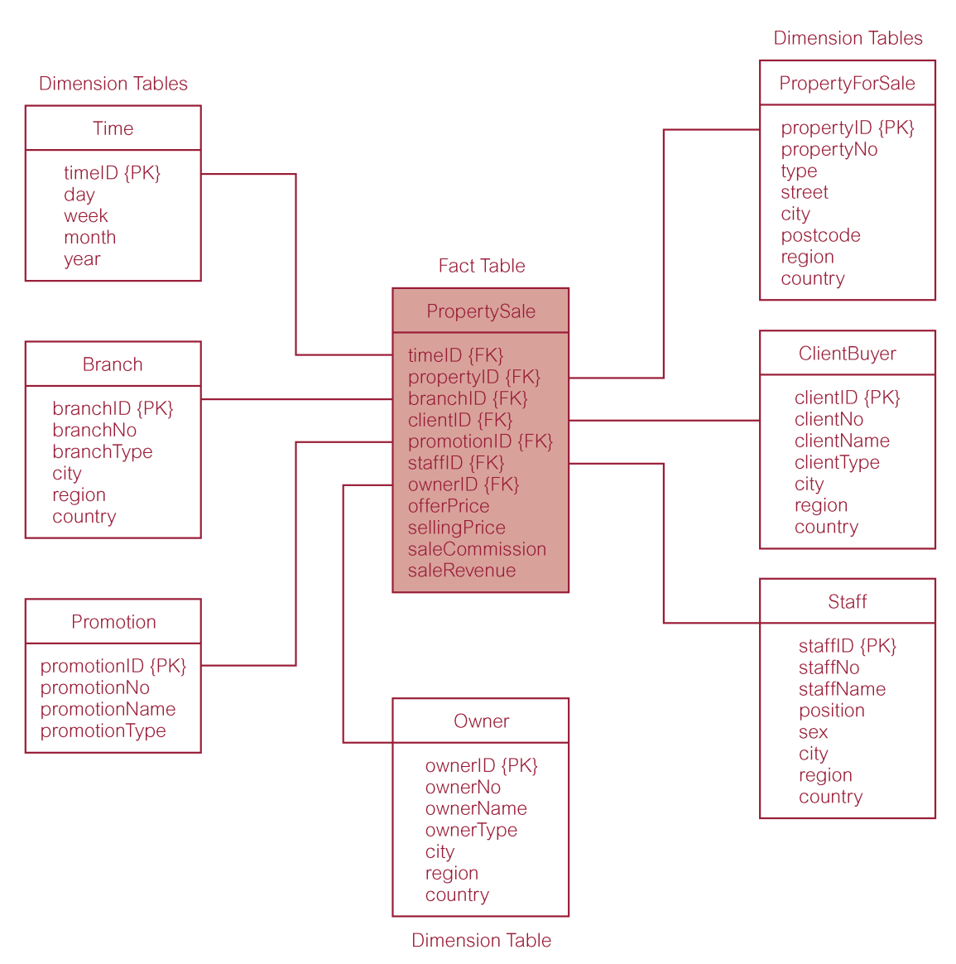
Star schema (dimensional model) for property sales of DreamHome

Slide 15
Dimensionality modeling
Star schema is a logical structure that has a fact table (containing factual data) in the center, surrounded by denormalized dimension tables (containing reference data).
Facts are generated by events that occurred in the past, and are unlikely to change, regardless of how they are analyzed.

Slide 16
Dimensionality modeling
Bulk of data in data warehouse is in fact tables, which can be extremely large.
Important to treat fact data as read-only reference data that will not change over time.
Most useful fact tables contain one or more numerical measures, or ‘facts’ that occur for each record and are numeric and additive(e.g. sellingPrice).

Slide 17
Dimensionality modeling
Dimension tables usually contain descriptive textual information.
Dimension attributes are used as the constraints in data warehouse queries (e.g. ‘where city = London’).
Star schemas can be used to speed up query performance by denormalizing reference information into a single dimension table.

Slide 18
Dimensionality modeling
Snowflake schema is a variant of the star schema that has a fact table in the center, surrounded by normalized dimension tables .
Starflake schema is a hybrid structure that contains a mixture of star (denormalized) and snowflake (normalized) dimension tables.

Slide 19
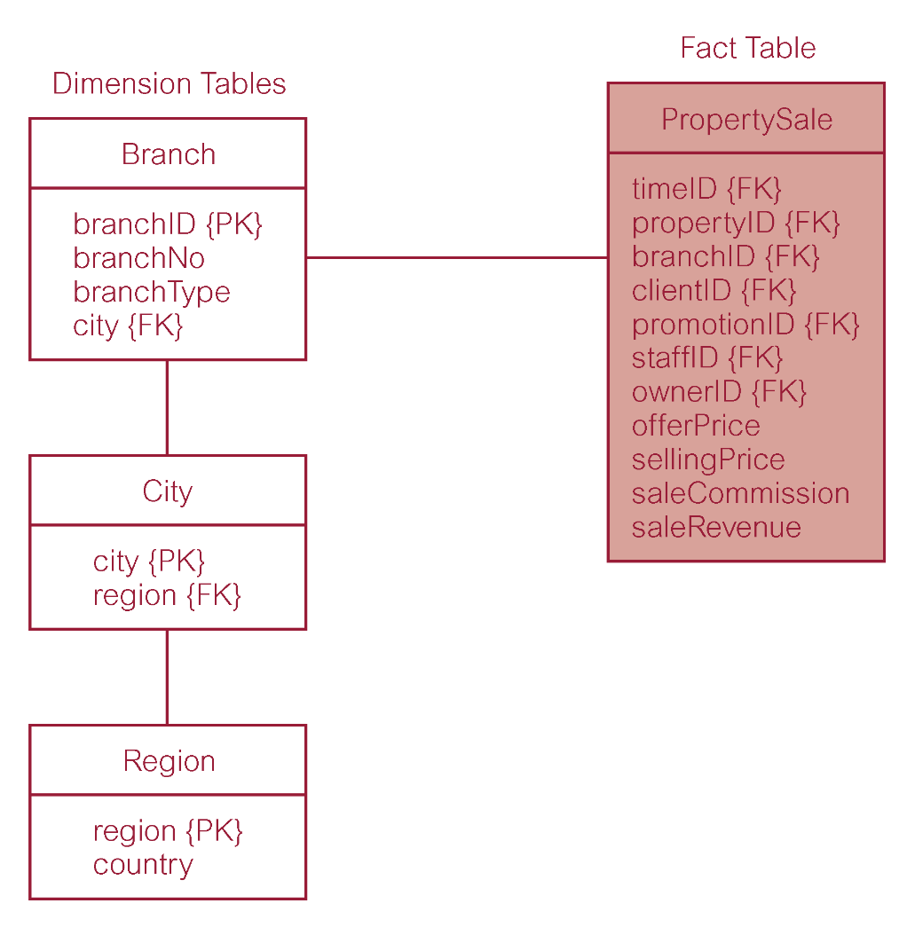
Property sales with normalized version of Branch dimension table
Optional

Slide 20
Dimensionality modeling
Predictable and standard form of the underlying dimensional model offers important advantages:
  Efficiency
  Ability to handle changing requirements
  Extensibility
  Ability to model common business situations
  Predictable query processing

Slide 21
Comparison of DM and ER models
A single ER model normally decomposes into multiple DMs.
Multiple DMs are then associated through ‘shared’ dimension tables (they have different fact tables).

Slide 22
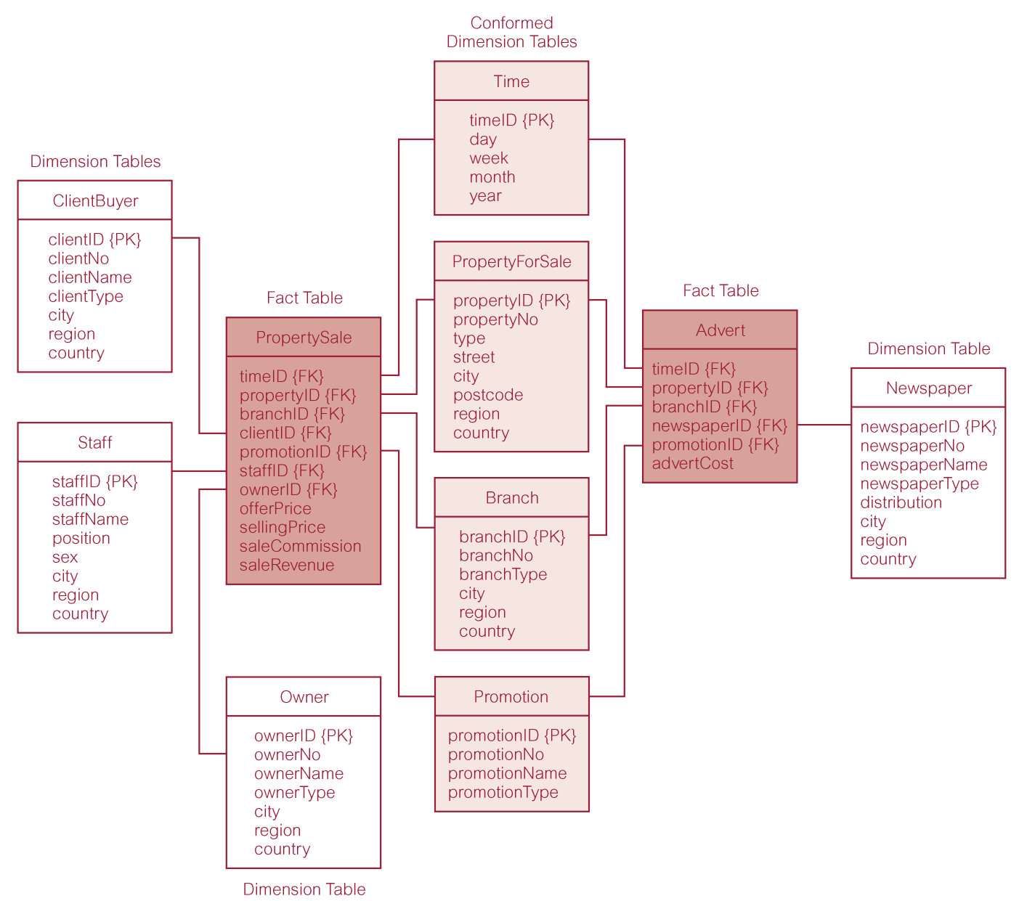
Star schemas for property sales and property advertising
Briefly

