Slide 1
Chapter 33
OLAP

Slide 2

Chapter - Objectives
The purpose of Online Analytical Processing (OLAP).
The relationship between OLAP and data warehousing.
The key features of OLAP applications.

Slide 3
Chapter - Objectives
How to represent multi-dimensional data.
The rules for OLAP tools.
The main categories of OLAP tools.
OLAP extensions to the SQL standard.

Slide 4
Business Intelligence Refers to :
Data Warehousing + OLAP +
Data Mining
(To support Business Intelligence , SQL Server has a Business Intelligence Suite.)

Slide 5
Business Intelligence Technologies
Accompanying the growth in data warehousing is an ever-increasing demand by users for more powerful access tools that provide advanced analytical capabilities.
There are two main types of access tools available to meet this demand, namely Online Analytical Processing (OLAP) and data mining.

Slide 6
Business Intelligence Technologies
OLAP and Data Mining differ in what they offer the user and because of this they are complementary technologies.
An environment that includes a data warehouse (or more commonly one or more data marts) together with tools such as OLAP and /or data mining are collectively referred to as Business Intelligence (BI) technologies.

Slide 7
Online Analytical Processing (OLAP)
Original definition - The dynamic synthesis, analysis, and consolidation of large volumes of multi-dimensional data, Codd (1993).
Describes a technology that is designed to optimize the storing and querying of large volumes of multi-dimensional data that is aggregated (summarized) to various levels of detail to support the analysis of this data.

Slide 8
Online Analytical Processing (OLAP)
Enables users to gain a deeper understanding and knowledge about various aspects of their corporate data through fast, consistent, interactive access to a wide variety of possible views of the data.
Allows users to view corporate data in such a way that it is a better model of the true dimensionality of the enterprise.

Slide 9
Online Analytical Processing (OLAP)
Can easily answer ‘who?’ and ‘what?’ questions, however, ability to answer ‘why?’ type questions distinguishes OLAP from general-purpose query tools.
Types of analysis ranges from basic navigation and browsing (slicing and dicing) to calculations, to more complex analyses such as time series and complex modeling.

Slide 10
OLAP Benchmarks
OLAP Council published an analytical processing benchmark referred to as the APB-1 (OLAP Council, 1998).
Aim is to measure a server’s overall OLAP performance rather than the performance of individual tasks.

Slide 11

OLAP Benchmarks
APB-1 assesses the most common business operations including:
  bulk loading of data from internal or external data sources
  incremental loading of data from operational systems;
  aggregation of input level data along hierarchies;

Slide 12
OLAP Benchmarks
APB-1 assesses the most common business operations including (continued):
  calculation of new data based on business models;
  time series analysis;
  queries with a high degree of complexity;
  drill-down through hierarchies;
  ad hoc queries;
  multiple online sessions.

Slide 13
OLAP Benchmarks
OLAP applications are judged on their ability to provide just-in-time (JIT) information, a core requirement of supporting effective decision-making.
This requirement is more than measuring processing performance but includes its abilities to model complex business relationships and to respond to changing business requirements.

Slide 14
OLAP Benchmarks
APB-1 uses a standard benchmark metric called AQM (Analytical Queries per Minute).
AQM represents the number of analytical queries processed per minute including data loading and computation time. Thus, the AQM incorporates data loading performance, calculation performance, and query performance into a singe metric.

Slide 15
OLAP Applications
JIT information is computed data that usually reflects complex relationships and is often calculated on the fly. Also as data relationships may not be known in advance, the data model must be flexible.

Slide 16
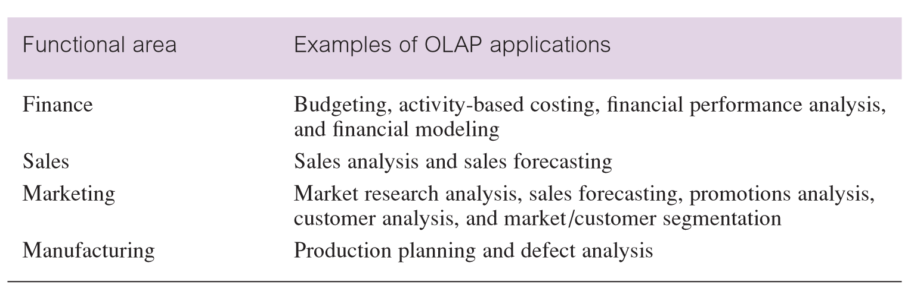
Examples of OLAP applications in various functional areas

Slide 17
OLAP Applications
Although OLAP applications are found in widely divergent functional areas, they all have the following key features:
  multi-dimensional views of data
  support for complex calculations
  time intelligence

Slide 18
OLAP Applications - multi-dimensional views of data
Core requirement of building a ‘realistic’ business model.
Provides basis for analytical processing through flexible access to corporate data.
The underlying database design that provides the multi-dimensional view of data should treat all dimensions equally.

Slide 19
OLAP Applications - support for complex calculations
Must provide a range of powerful computational methods such as that required by sales forecasting, which uses trend algorithms such as moving averages and percentage growth.
Mechanisms for implementing computational methods should be clear and non-procedural.

Slide 20
OLAP Applications – time intelligence
Key feature of almost any analytical application as performance is almost always judged over time.
Time hierarchy is not always used in the same manner as other hierarchies.
Concepts such as year-to-date and period-over-period comparisons should be easily defined.

Slide 21
Multi-dimensional Data and OLAP cubes
Multi-dimensional data is facts (numeric measurements) such as property sales revenue data and the association of this data with dimensions such as location (of the property) and time (of the property sale).
Which is the best representation of multi-dimensional data: relational table, matrix or data cube?

Slide 22
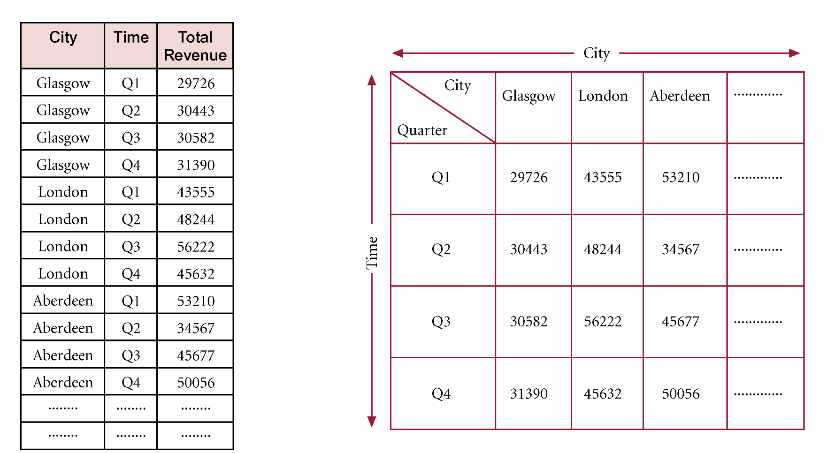
Multi-dimensional Data as 3-field Table versus 2-D Matrix

Slide 23
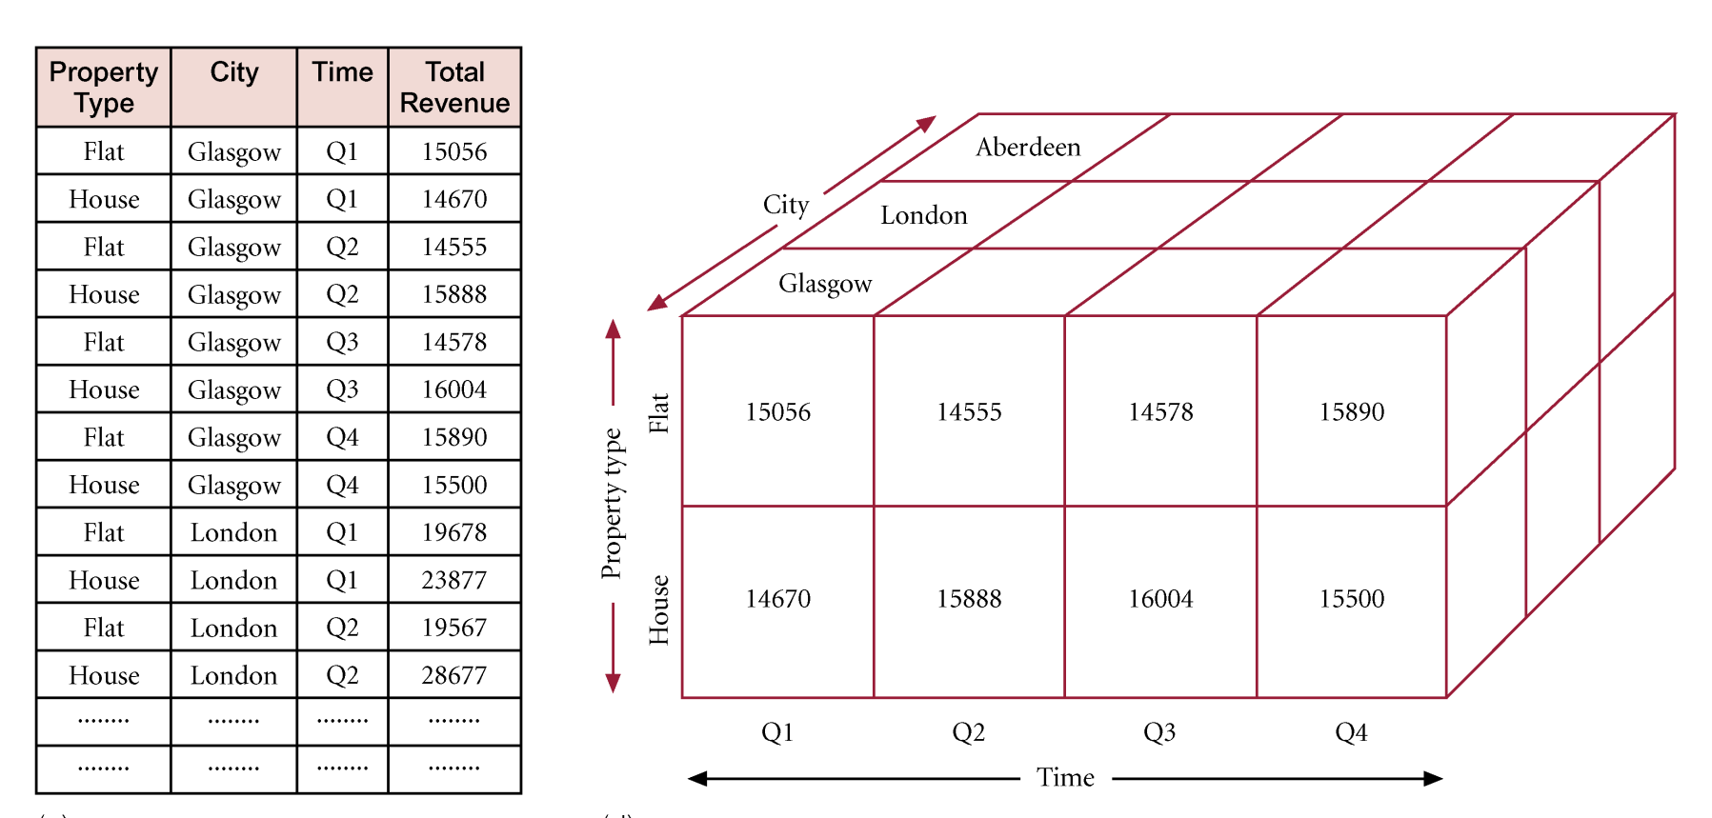
Multi-dimensional Data as 4-field Table versus 3-D Cube

Slide 24
Multi-dimensional data and OLAP cubes
We consider cubes as solid 3-D structures with equal sides. However, the OLAP cube is n-dimensional structure (with sides that need not be equal).
Alternative representation for n-dimensional data is to consider a data cube as a lattice of cuboids. Each cuboid represents a subset of the given dimensions.

Slide 25
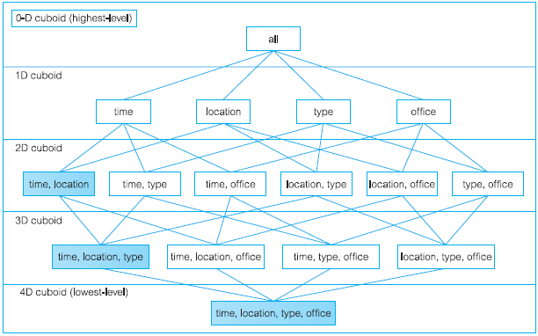
Multi-dimensional data and OLAP cubes - Optional

Slide 26
Dimensional Hierarchy
The lattice of cuboids does not show the hierarchies that are commonly associated with dimensions.
A dimensional hierarchy defines mappings from a set of lower-level concepts to higher level concepts.

Slide 27
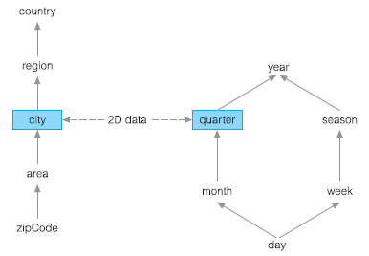
Dimensional Hierarchy - Optional

Slide 28
OLAP Tools
There are many varieties of OLAP tools available in the marketplace.
This choice has resulted in some confusion with much debate regarding what OLAP actually means to a potential buyer and in particular what are the available architectures for OLAP tools.

Slide 29
Codd’s Rules for OLAP Systems
In 1993, E.F. Codd formulated twelve rules as the basis for selecting OLAP tools.

Slide 30
Codd’s Rules for OLAP Systems
Multi-dimensional conceptual view
Transparency
Accessibility
Consistent reporting performance
Client-server architecture
Generic dimensionality

Slide 31
Codd’s rules for OLAP
Dynamic sparse matrix handling
Multi-user support
Unrestricted cross-dimensional operations
Intuitive data manipulation
Flexible reporting
Unlimited dimensions and aggregation levels

Slide 32
OLAP Extensions to SQL
Advantages of SQL include that it is easy to learn, non-procedural, free-format, DBMS-independent, and that it is a recognized international standard.
However, major limitation of SQL is the inability to answer routinely asked business queries such as computing the percentage change in values between this month and a year ago or to compute moving averages, cumulative sums, and other statistical functions.

Slide 33
OLAP Extensions to SQL
Answer is ANSI adopted a set of OLAP functions as an extension to SQL to enable these calculations as well as many others that used to be impossible or even impractical within SQL.
IBM and Oracle jointly proposed these extensions early in 1999 and they now form part of the current SQL standard, namely SQL: 2011.

Slide 34
OLAP Extensions to SQL - RISQL
The extensions are collectively referred to as the ‘OLAP package’ and are described as follows:
  Feature T431, ‘Extended Grouping capabilities’
  Feature T611, ‘Extended OLAP operators’

Slide 35
Extended Grouping Capabilities
Aggregation is a fundamental part of OLAP. To improve aggregation capabilities the SQL standard provides extensions to the GROUP BY clause such as the ROLLUP and CUBE functions.

Slide 36
Extended Grouping Capabilities
ROLLUP supports calculations using aggregations such as SUM, COUNT, MAX, MIN, and AVG at increasing levels of aggregation, from the most detailed up to a grand total.
CUBE is similar to ROLLUP, enabling a single statement to calculate all possible combinations of aggregations. CUBE can generate the information needed in cross-tabulation reports with a single query.

Slide 37
Extended Grouping Capabilities
ROLLUP and CUBE extensions specify exactly the groupings of interest in the GROUP BY clause and produces a single result set that is equivalent to a UNION ALL of differently grouped rows.

Slide 38
Extended Grouping Capabilities
ROLLUP Extension to GROUP BY
  enables a SELECT statement to calculate multiple levels of subtotals across a specified group of dimensions. ROLLUP appears in the GROUP BY clause in a SELECT statement using the following format:
  SELECT ... GROUP BY ROLLUP(columnList)

Slide 39
Extended Grouping Capabilities
  ROLLUP creates subtotals that roll up from the most detailed level to a grand total, following a column list specified in the ROLLUP clause.
  ROLLUP first calculates the standard aggregate values specified in the GROUP BY clause and then creates progressively higher level subtotals, moving from right to left through the column list until finally completing with a grand total.

Slide 40
Extended Grouping Capabilities
  ROLLUP creates subtotals at n + 1 levels, where n is the number of grouping columns. For instance, if a query specifies ROLLUP on grouping columns of propertyType, yearMonth, and city (n = 3), the result set will include rows at 4 aggregation levels.

Slide 41
Example - Using the ROLLUP Group Function
Show the totals for sales of flats or houses by branch offices located in Aberdeen, Edinburgh, or Glasgow for the months of August and September of 2013.

Slide 42
Example - Using the ROLLUP Group Function
    SELECT propertyType, yearMonth, city, SUM(saleAmount) AS sales
    FROM Branch, PropertyFor Sale, PropertySale
    WHERE Branch.branchNo = PropertySale.branchNo
    AND PropertyForSale.propertyNo = PropertySale.propertyNo
    AND PropertySale.yearMonth IN ('2013-08', '2013-09')
    AND Branch.city IN (‘Aberdeen’, ‘Edinburgh’, ‘Glasgow’)
    GROUP BY ROLLUP(propertyType, yearMonth, city);

Slide 43
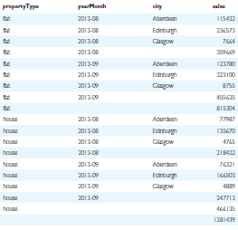
Example - Using the ROLLUP Group Function

Slide 44
Extended Grouping Capabilities
CUBE Extension to GROUP BY
  CUBE takes a specified set of grouping columns and creates subtotals for all of the possible combinations. CUBE appears in the GROUP BY clause in a SELECT statement using the following format:
  SELECT ... GROUP BY CUBE(columnList)

Slide 45
Extended Grouping Capabilities
  CUBE generates all the subtotals that could be calculated for a data cube with the specified dimensions.
  CUBE can be used in any situation requiring cross-tabular reports. The data needed for cross-tabular reports can be generated with a single SELECT using CUBE. Like ROLLUP, CUBE can be helpful in generating summary tables.

Slide 46
Example - Using the CUBE Group Function
Show all possible subtotals for sales of properties by branches offices in Aberdeen, Edinburgh, and Glasgow for the months of August and September of 2013.

Slide 47
Example - Using the CUBE Group Function
    SELECT propertyType, yearMonth, city, SUM(saleAmount) AS sales
    FROM Branch, PropertyFor Sale, PropertySale
    WHERE Branch.branchNo = PropertySale.branchNo
    AND PropertyForSale.propertyNo = PropertySale.propertyNo
    AND PropertySale.yearMonth IN ('2008-13', '2013-09')
    AND Branch.city IN (‘Aberdeen’, ‘Edinburgh’, ‘Glasgow’)
    GROUP BY CUBE(propertyType, yearMonth, city);

Slide 48

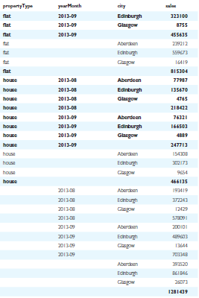
Example - Using
CUBE Group
Function

Slide 49
Elementary OLAP Operators
Supports a variety of operations such as rankings and window calculations.
Ranking functions include cumulative distributions, percent rank, and N-tiles.
Windowing allows the calculation of cumulative and moving aggregations using functions such as SUM, AVG, MIN, and COUNT.

Slide 50
Elementary OLAP Operators
Ranking Functions
  Computes the rank of a record compared to other records in the dataset based on the values of a set of measures. There are various types of ranking functions, including RANK and DENSE_RANK.
  The syntax for each ranking function is:
  RANK( ) OVER (ORDER BY columnList)
  DENSE_RANK( ) OVER (ORDER BY columnList)

Slide 51
Elementary OLAP Operators
The difference between RANK and DENSE_RANK is that DENSE_RANK leaves no gaps in the sequential ranking sequence when there are ties for a ranking.

Slide 52
Example - Using the RANK and DENSE_RANK Functions
Rank the total sales of properties for branch offices in Edinburgh.
    SELECT branchNo, SUM(saleAmount) AS sales,
    RANK() OVER (ORDER BY SUM(saleAmount)) DESC AS ranking,
    DENSE_RANK() OVER (ORDER BY SUM(saleAmount)) DESC AS dense_ranking
    FROM Branch, PropertySale
    WHERE Branch.branchNo = PropertySale.branchNo
    AND Branch.city = ‘Edinburgh’
    GROUP BY(branchNo);

Slide 53
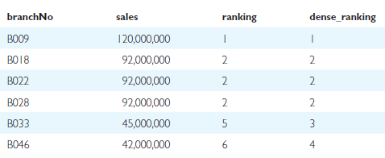
Example - Using the RANK and DENSE_RANK Functions

Slide 54
Elementary OLAP Operators
Supports a variety of operations such as rankings and window calculations.
Ranking functions include cumulative distributions, percent rank, and N-tiles.
Windowing allows the calculation of cumulative and moving aggregations using functions such as SUM, AVG, MIN, and COUNT.

Slide 55
Elementary OLAP Operators
Windowing Calculations
  Can be used to compute cumulative, moving, and centered aggregates. They return a value for each row in the table, which depends on other rows in the corresponding window.

Slide 56
Elementary OLAP Operators
Windowing Calculations
  Can be used to compute cumulative, moving, and centered aggregates. They return a value for each row in the table, which depends on other rows in the corresponding window.
  These aggregate functions provide access to more than one row of a table without a self-join and can be used only in the SELECT and ORDER BY clauses of the query.

Slide 57
Example - Using Windowing Calculations
Show the monthly figures and three-month moving averages and sums for property sales at branch office B003 for the first six months of 2013.

Slide 58
Example - Using Windowing Calculations
    SELECT yearMonth, SUM(saleAmount) AS monthlySales, AVG(SUM(saleAmount))
    OVER (ORDER BY yearMonth, ROWS 2 PRECEDING) AS 3-month moving avg,
    SUM(SUM(salesAmount)) OVER (ORDER BY yearMonth ROWS 2 PRECEDING)
    AS 3-month moving sum
    FROM PropertySale
    WHERE branchNo = ‘B003’
    AND yearMonth BETWEEN ('2013-01' AND '2013-06’)
    GROUP BY yearMonth
    ORDER BY yearMonth;

Slide 59
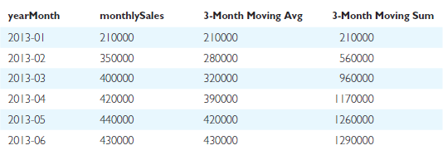
Example - Using Windowing Calculations

