Slide 1
Chapter 34
Data Mining
Notes:
September 98
1
Chapter Name

Slide 2

Chapter Objectives
The concepts associated with data mining.
The main features of data mining operations, including predictive modeling, database segmentation, link analysis, and deviation detection.
The techniques associated with the data mining operations.

Slide 3
Chapter Objectives
The process of data mining.
Important characteristics of data mining tools.
The relationship between data mining and data warehousing.

Slide 4
Data Mining
The process of extracting valid, previously unknown, comprehensible, and actionable information from large databases and using it to make crucial business decisions, (Simoudis,1996).
Involves the analysis of data and the use of software techniques for finding hidden and unexpected patterns and relationships in sets of data.

Slide 5
Data Mining
Reveals information that is hidden and unexpected, as there is little value in finding patterns and relationships that are already intuitive.
Patterns and relationships are identified by examining the underlying rules and features in the data.

Slide 6
Data Mining
Tends to work from the data up and most accurate results normally require large volumes of data to deliver reliable conclusions.
Starts by developing an optimal representation of structure of sample data, during which time knowledge is acquired and extended to larger sets of data.

Slide 7
Data Mining
Data mining can provide huge paybacks for companies who have made a significant investment in data warehousing.
Relatively new technology, however already used in a number of industries.

Slide 8

Examples of Applications of Data Mining
Retail / Marketing
  Identifying buying patterns of customers
  Finding associations among customer demographic characteristics
  Predicting response to mailing campaigns
  Market basket analysis

Slide 9
Examples of Applications of Data Mining
Banking
  Detecting patterns of fraudulent credit card use
  Identifying loyal customers
  Predicting customers likely to change their credit card affiliation
  Determining credit card spending by customer groups

Slide 10
Examples of Applications of Data Mining
Insurance
  Claims analysis
  Predicting which customers will buy new policies
Medicine
  Characterizing patient behavior to predict surgery visits
  Identifying successful medical therapies for different illnesses

Slide 11
Data Mining Operations
Four main operations include:
  Predictive modeling
  Database segmentation
  Link analysis
  Deviation detection
There are recognized associations between the applications and the corresponding operations.
  e.g. Direct marketing strategies use database segmentation.

Slide 12
Data Mining Techniques
Techniques are specific implementations of the data mining operations.
Each operation has its own strengths and weaknesses.

Slide 13
Predictive Modeling
Similar to the human learning experience
  uses observations to form a model of the important characteristics of some phenomenon.
Uses generalizations of ‘real world’ and ability to fit new data into a general framework.
Can analyze a database to determine essential characteristics (model) about the data set.

Slide 14
Predictive Modeling
Model is developed using a supervised learning approach, which has two phases: training and testing.
  Training builds a model using a large sample of historical data called a training set.
  Testing involves trying out the model on new, previously unseen data to determine its accuracy and physical performance characteristics.

Slide 15
Predictive Modeling
Applications of predictive modeling include customer retention management, credit approval, cross selling, and direct marketing.
There are two techniques associated with predictive modeling: classification and value prediction, which are distinguished by the nature of the variable being predicted.

Slide 16
Predictive Modeling - Value Prediction
Linear regression attempts to fit a straight line through a plot of the data, such that the line is the best representation of the average of all observations at that point in the plot.
Problem is that the technique only works well with linear data and is sensitive to the presence of outliers (that is, data values, which do not conform to the expected norm).

Slide 17
Predictive Modeling - Value Prediction
Although nonlinear regression avoids the main problems of linear regression, it is still not flexible enough to handle all possible shapes of the data plot.
Statistical measurements are fine for building linear models that describe predictable data points, however, most data is not linear in nature.

Slide 18
Database Segmentation
Aim is to partition a database into an unknown number of segments, or clusters, of similar records.
Uses unsupervised learning to discover homogeneous sub-populations in a database to improve the accuracy of the profiles.

Slide 19
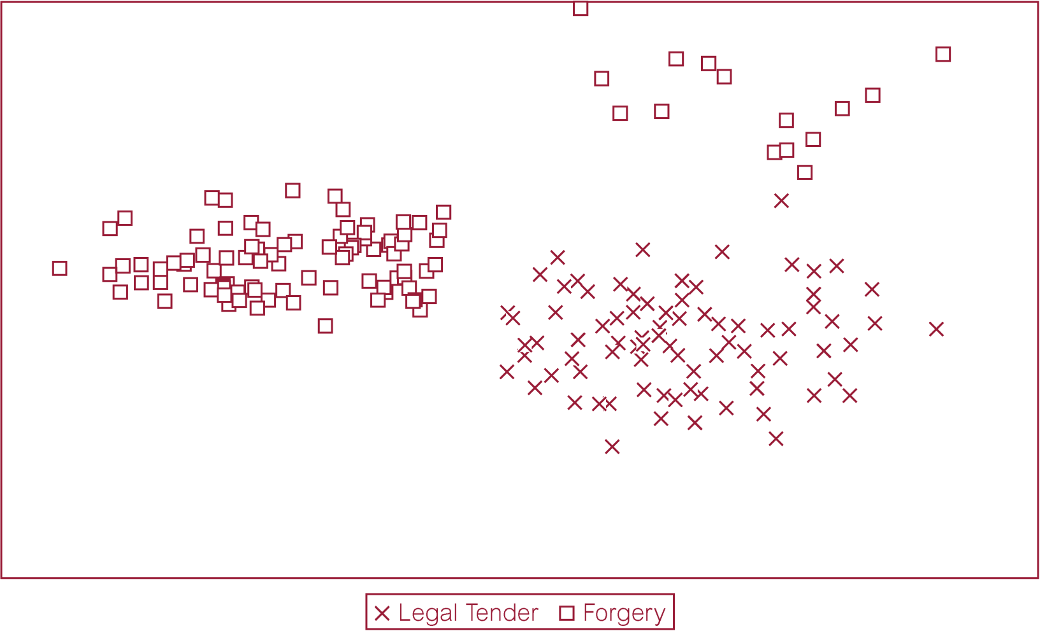
Example of Database Segmentation using a Scatterplot

Slide 20
Database Segmentation
Associated with demographic or neural clustering techniques, which are distinguished by
  Allowable data inputs
  Methods used to calculate the distance between records
  Presentation of the resulting segments for analysis

Slide 21
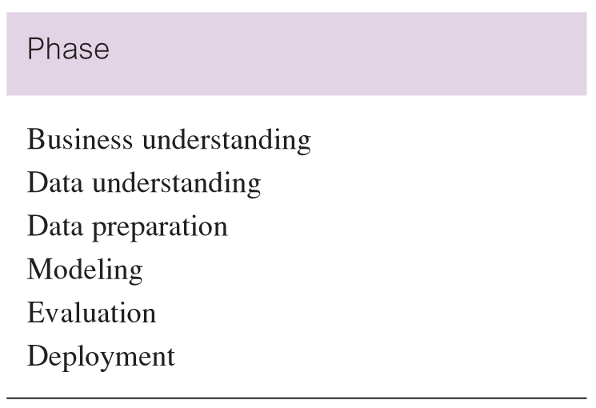
Phases of the CRISP-DM Model
Optional

Slide 22
Data Mining Tools
Data preparation facilities
  Data preparation is the most time-consuming aspect of data mining.
  Functions supported include: data preparation, data cleansing, data describing, data transforming and data sampling.

Slide 23
Data Mining Tools
Product scalability and performance
  Capable of dealing with increasing amounts of data, possibly with sophisticated validation controls.
  Maintaining satisfactory performance may require investigations into whether a tool is capable of supporting parallel processing using technologies such as SMP or MPP.

Slide 24
Data Mining and Data Warehousing
Major challenge to exploit data mining is identifying suitable data to mine.
Data mining requires single, separate, clean, integrated, and self-consistent source of data.

Slide 25
Data Mining and Data Warehousing
A data warehouse is well equipped for providing data for mining.
Data quality and consistency is a pre-requisite for mining to ensure the accuracy of the predictive models. Data warehouses are populated with clean, consistent data.

Slide 26
Data Mining and Data Warehousing
It is advantageous to mine data from multiple sources to discover as many interrelationships as possible. Data warehouses contain data from a number of sources.
Selecting the relevant subsets of records and fields for data mining requires the query capabilities of the data warehouse.

Slide 27
Data Mining and Data Warehousing
The results of a data mining study are useful if there is some way to further investigate the uncovered patterns. Data warehouses provide the capability to go back to the data source.

