Slide 1
Chapter 12
Entity-Relationship Modeling

Slide 2
1) Analysis
2) Design (ER Diagram)
3) Implementation

Slide 3

Chapter 12 - Objectives
How to use Entity–Relationship (ER) modeling in database design.
Basic concepts associated with ER model.
Diagrammatic technique for displaying ER model using Unified Modeling Language (UML).
How to identify and resolve problems with ER models called connection traps.
How to build an ER model from a requirements specification.

Slide 4
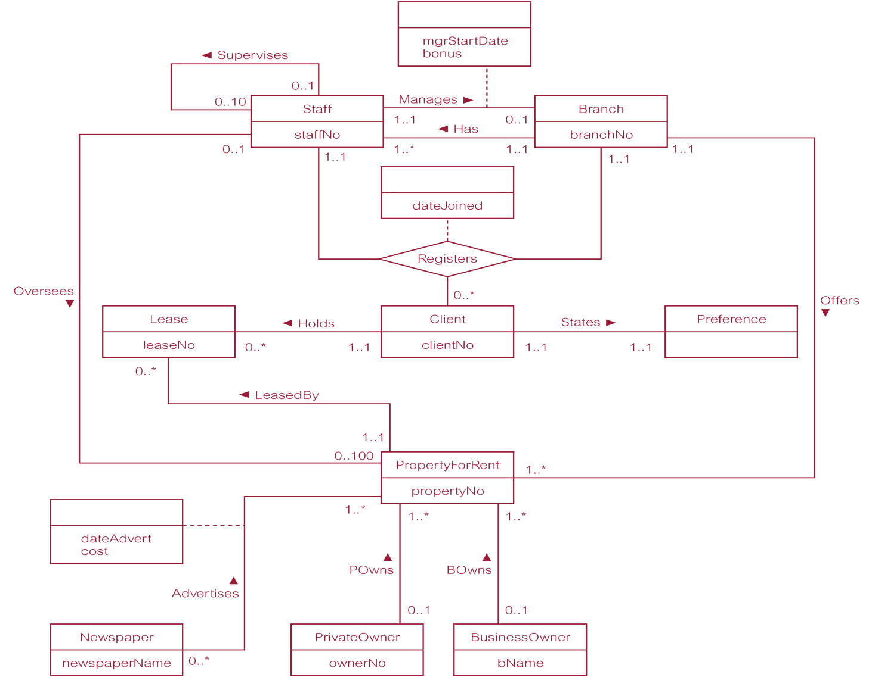
ER diagram of Branch user views of DreamHome (also at very end)

Slide 5
Concepts of the ER Model
Entity types
Relationship types
Attributes
Please note that any text in blue is optional for you. You are not responsible for blue text.

Slide 6

Entity Type
Entity type
  Group of objects with same properties, identified by enterprise as having an independent existence.
Entity occurrence
  Uniquely identifiable object of an entity type.

Slide 7
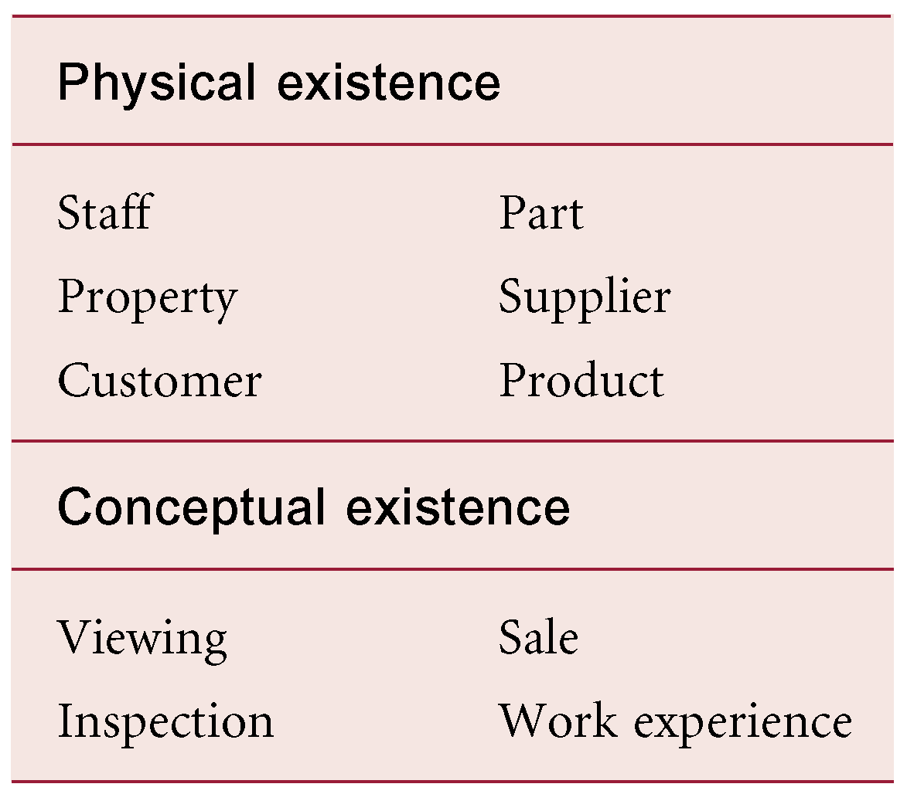
Examples of Entity Types

Slide 8
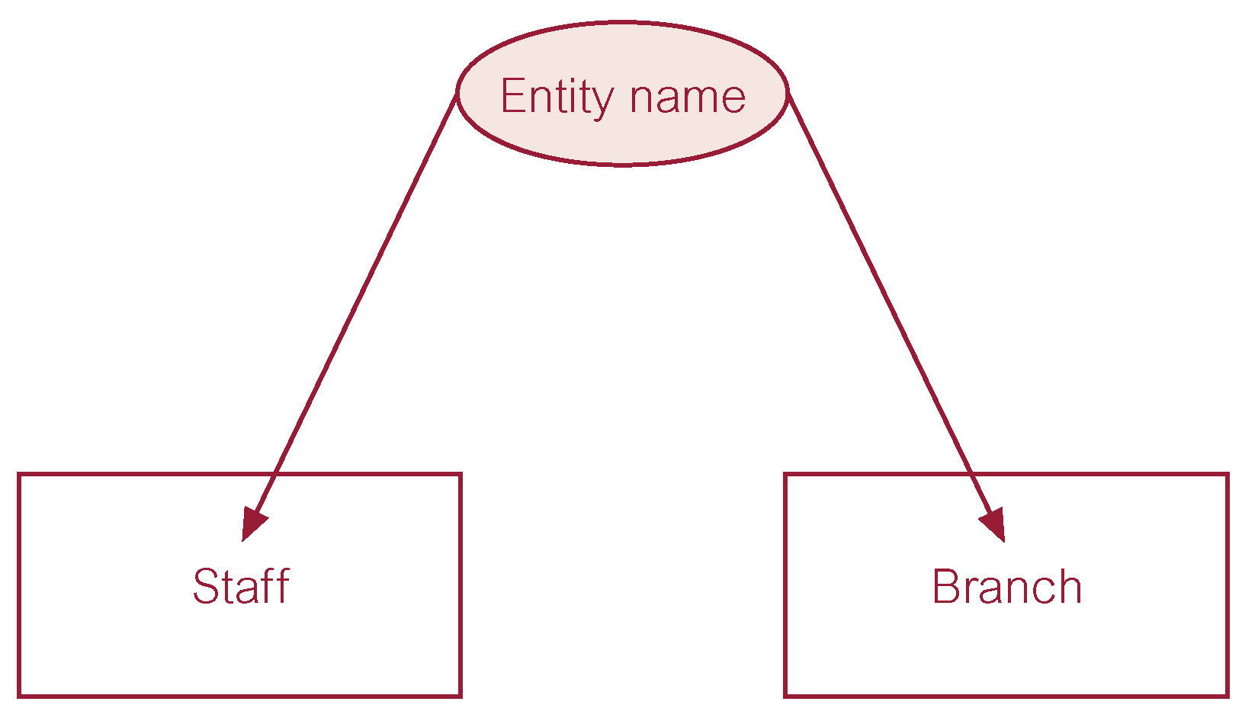
ER diagram of Staff and Branch entity types

Slide 9
Relationship Types
Relationship type
  Set of meaningful associations among entity types.
Relationship occurrence
  Uniquely identifiable association, which includes one occurrence from each participating entity type.

Slide 10
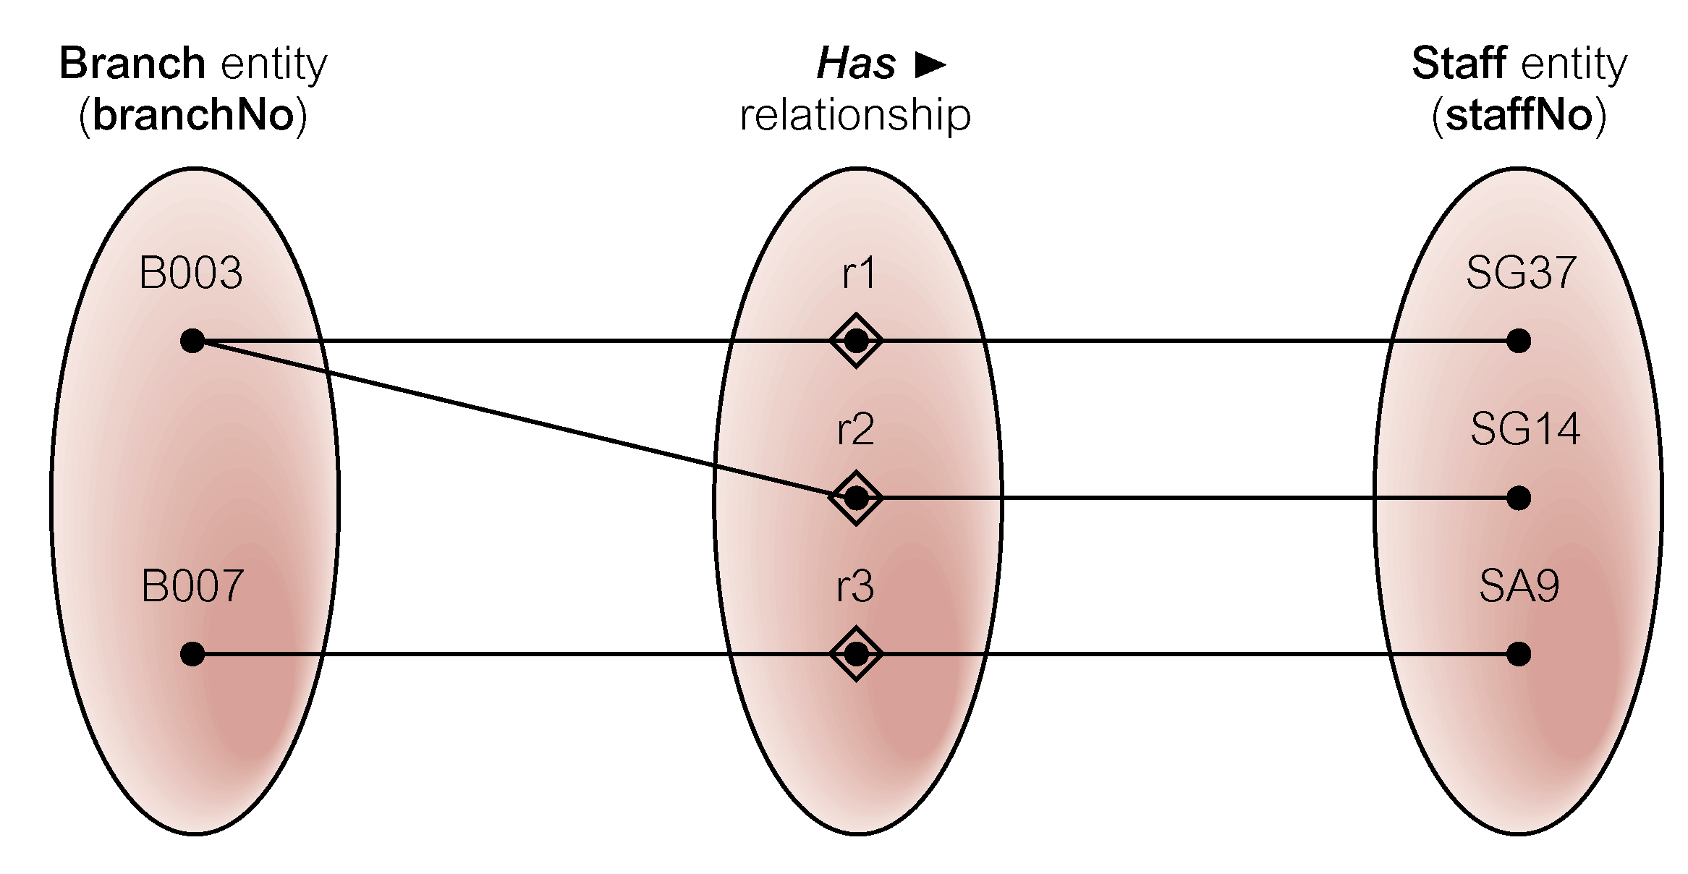
Semantic net of Has relationship type

Slide 11
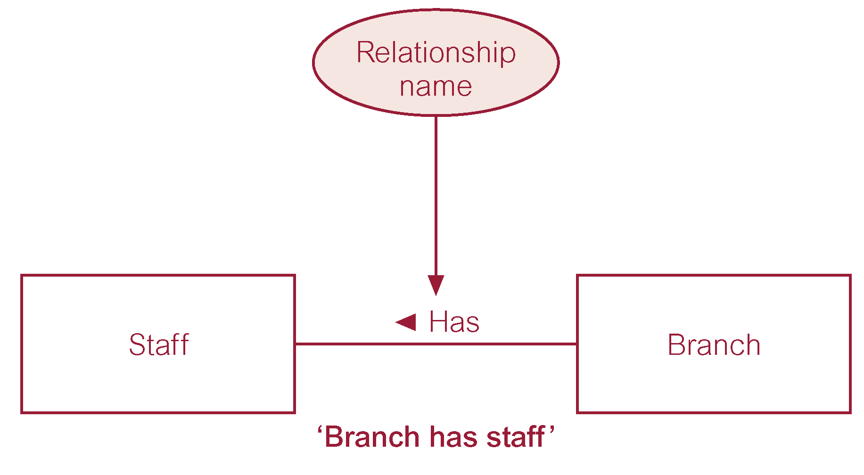
ER diagram of Branch Has Staff relationship

Slide 12
Relationship Types
Degree of a Relationship
  Number of participating entities in relationship.
Relationship of degree :
  two is binary
  three is ternary
  four is quaternary.

Slide 13
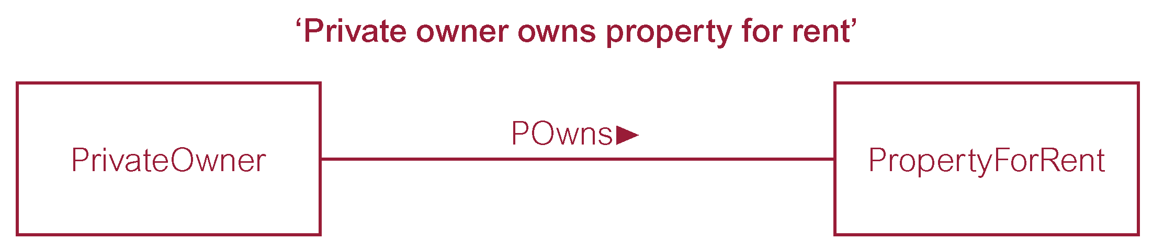
Binary relationship called POwns

Slide 14
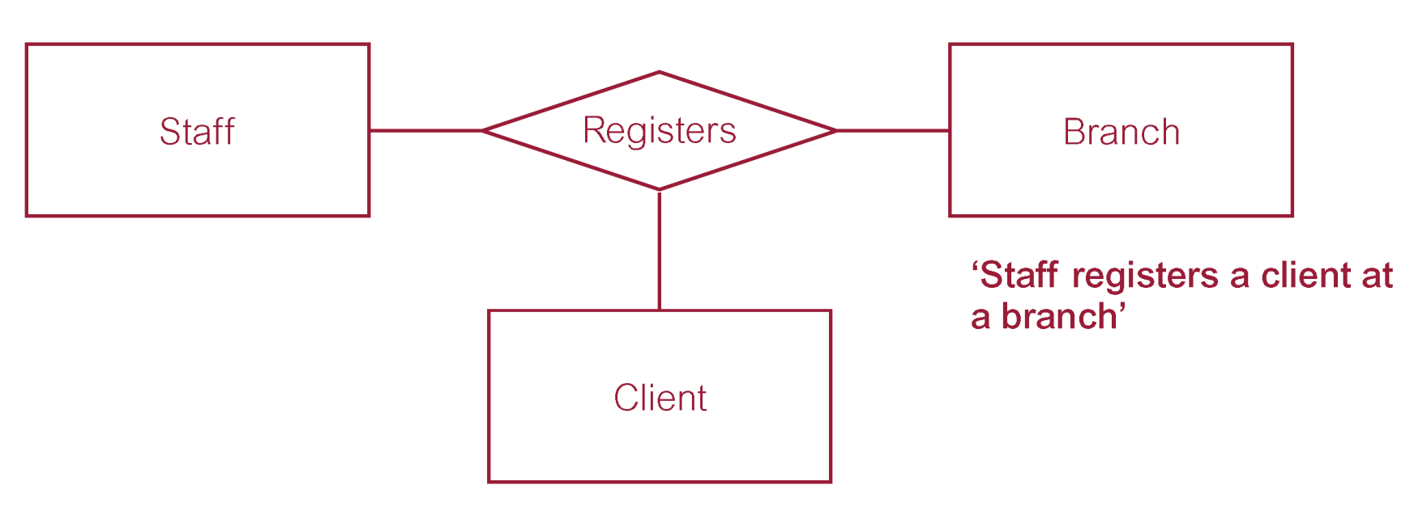
Ternary relationship called Registers

Slide 15
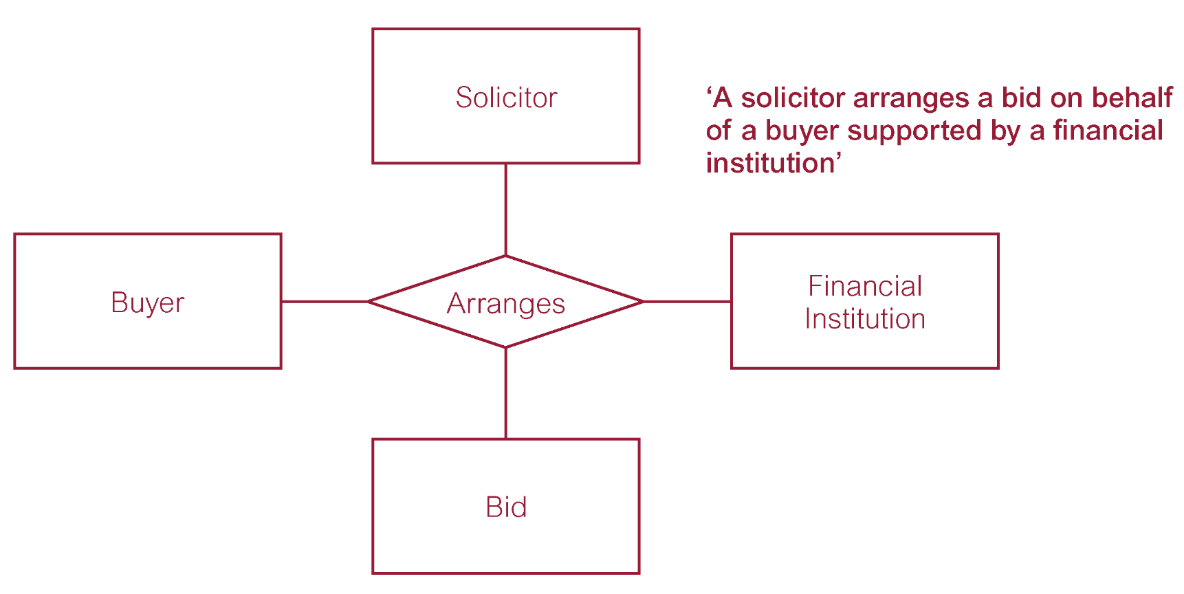
Quaternary relationship called Arranges
We will Not use in our class.

Slide 16
Relationship Types
Recursive Relationship
  Relationship type where same entity type participates more than once in different roles.
Relationships may be given role names to indicate purpose that each participating entity type plays in a relationship.

Slide 17
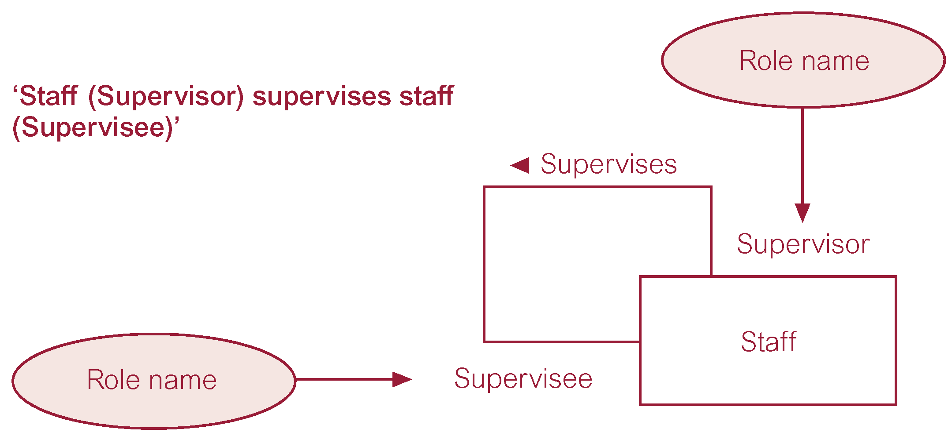
Recursive relationship called Supervises with role names

Slide 18
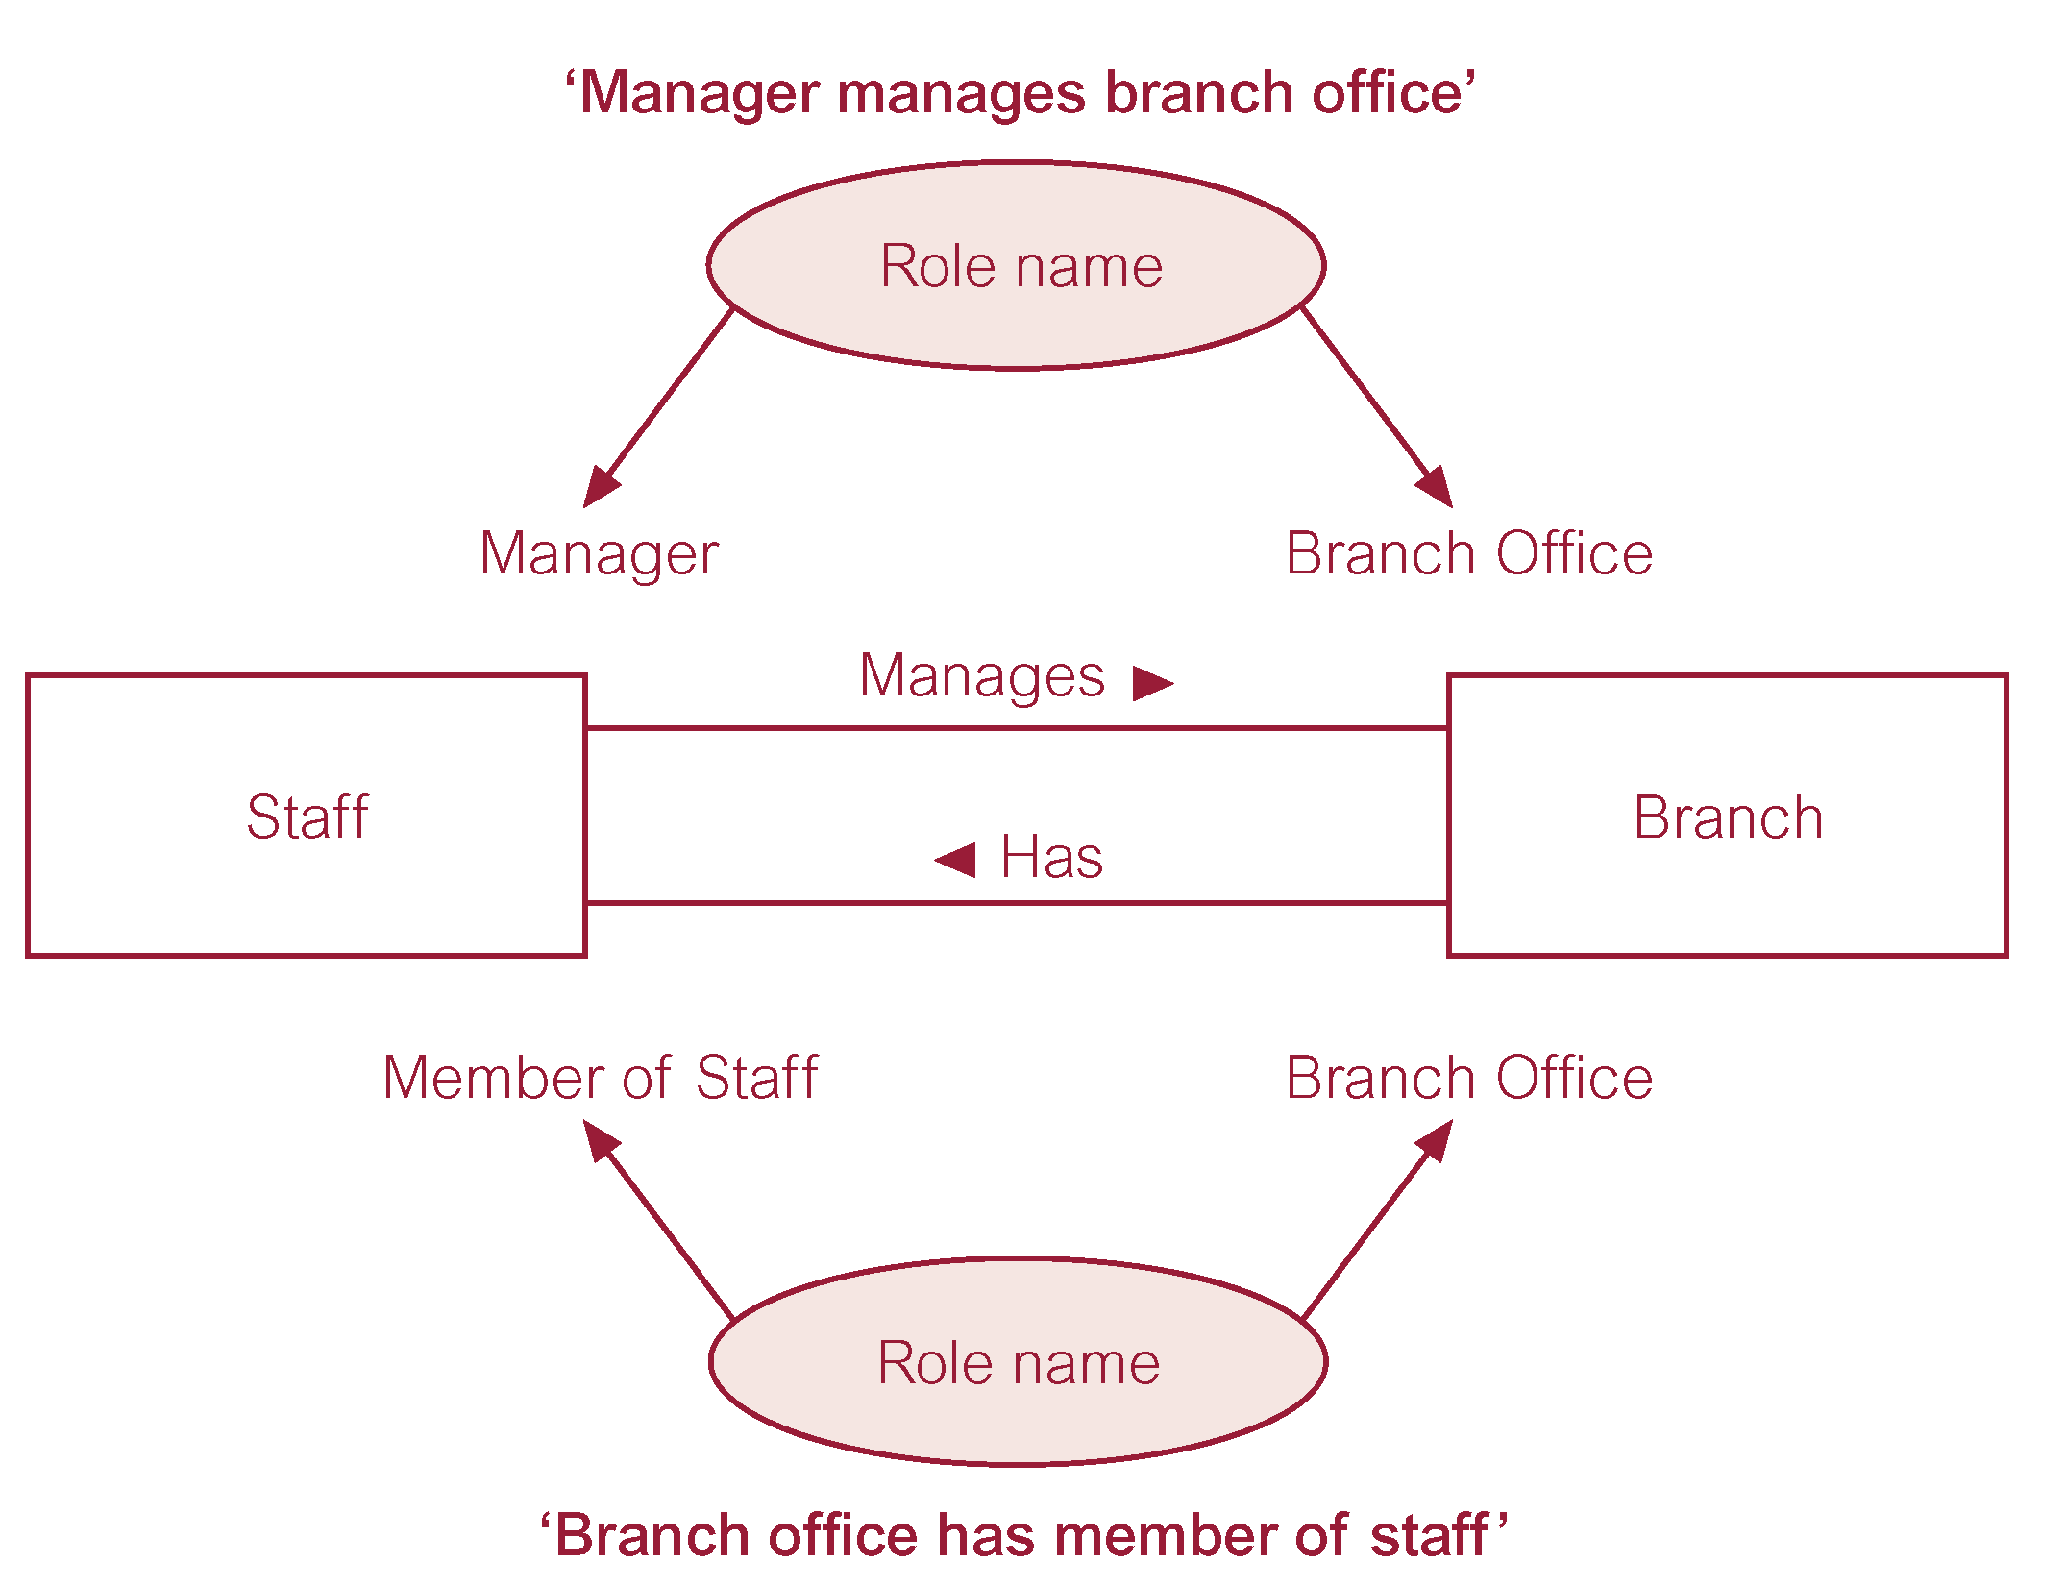
Entities associated through two distinct relationships with role names

Slide 19
Attributes
Attribute
  Property of an entity or a relationship type.
Attribute Domain
  Set of allowable values for one or more attributes.

Slide 20
Attributes
Simple Attribute
  Attribute composed of a single component with an independent existence.
  Can not subdivide (atomic).
Composite Attribute
  Attribute composed of multiple components, each with an independent existence. For example address.

Slide 21
Attributes
Single-valued Attribute
  Attribute that holds a single value for each occurrence of an entity type.
  (This single value could be a composite
  value like address.)
Multi-valued Attribute
  Attribute that holds multiple values for each occurrence of an entity type.
  For example phone.

Slide 22
Attributes
Derived Attribute
  Attribute that represents a value that is derivable from value of a related attribute, or set of attributes, not necessarily in the same entity type.
  For example if we have yearly salary, we
  can get monthly salary by dividing by 12.

Slide 23
Keys
Candidate Key
  Minimal set of attributes that uniquely identifies each occurrence of an entity type.
Primary Key
  Candidate key selected to uniquely identify each occurrence of an entity type.
Composite Key
  A candidate key that consists of two or more attributes.

Slide 24
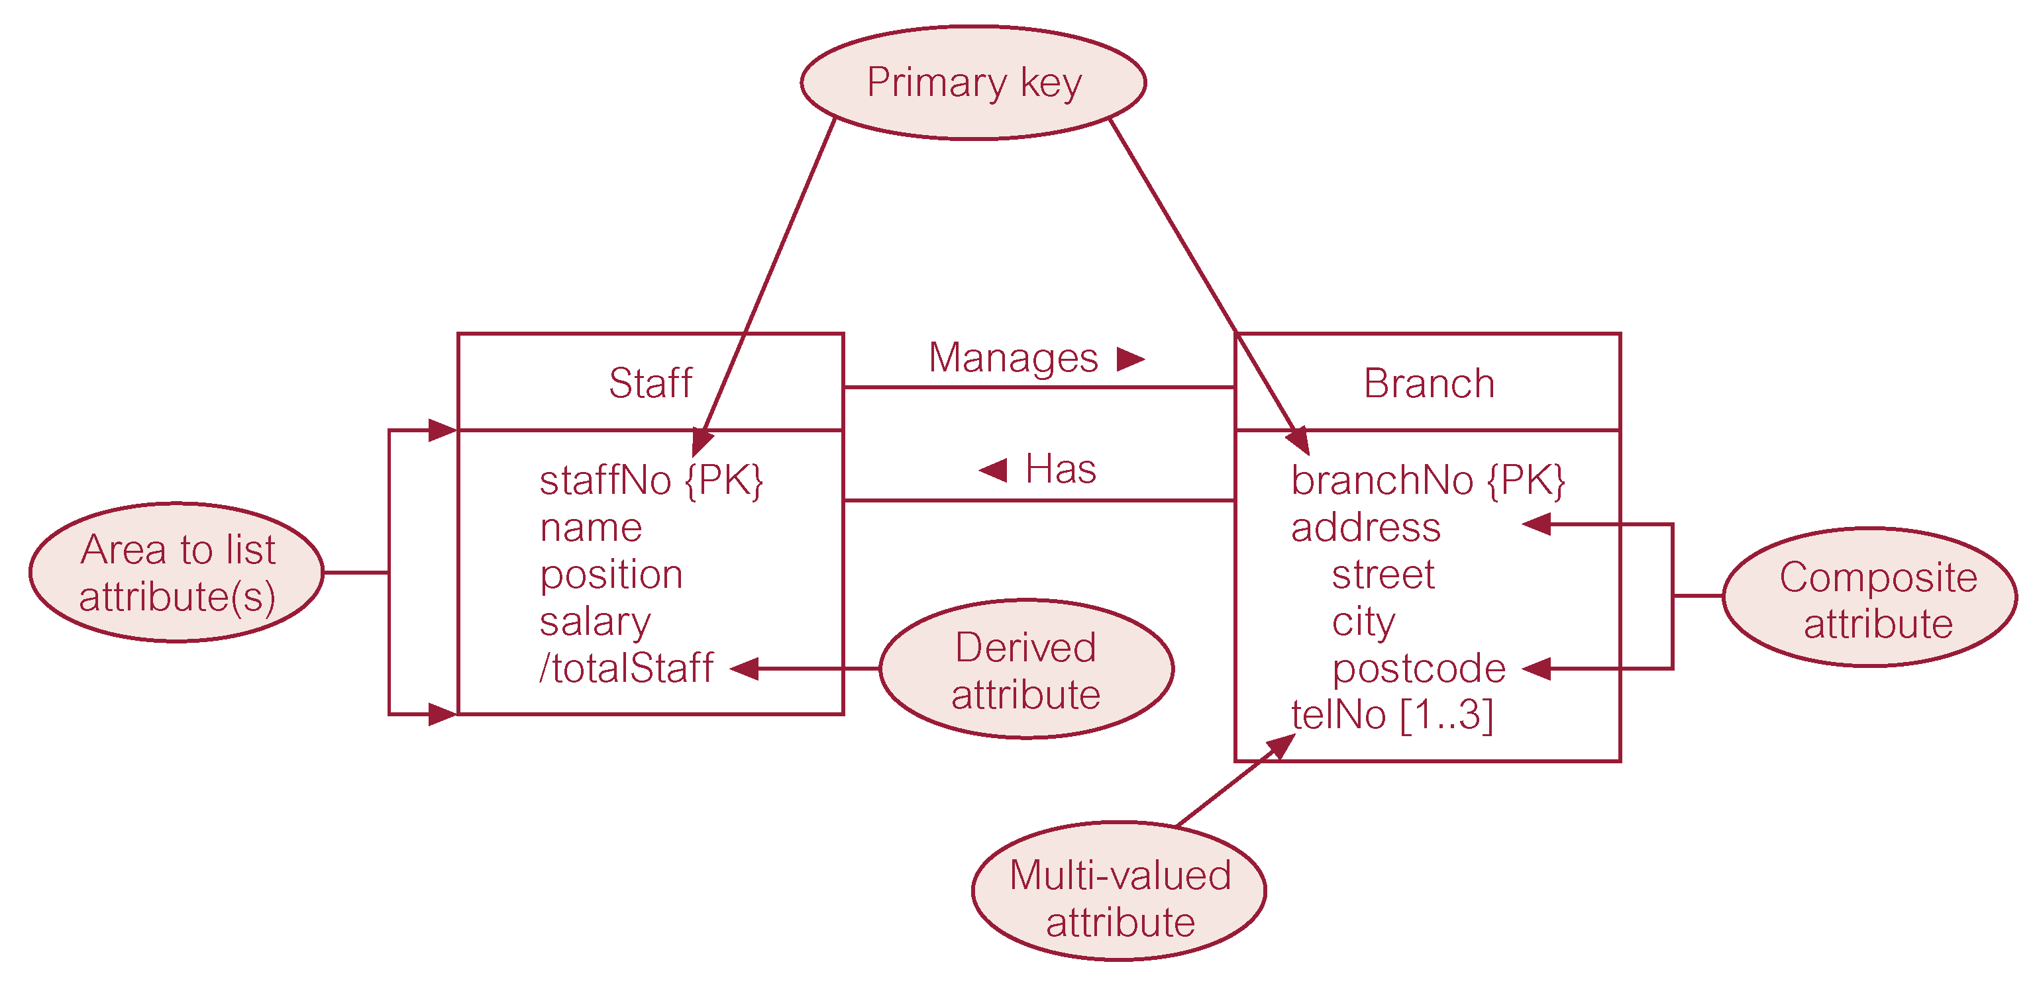
ER diagram of Staff and Branch entities and their attributes

Slide 25
Entity Type
Strong Entity Type
  Entity type that is not existence-dependent on some other entity type.
Weak Entity Type
  Entity type that is existence-dependent on some other entity type.

Slide 26
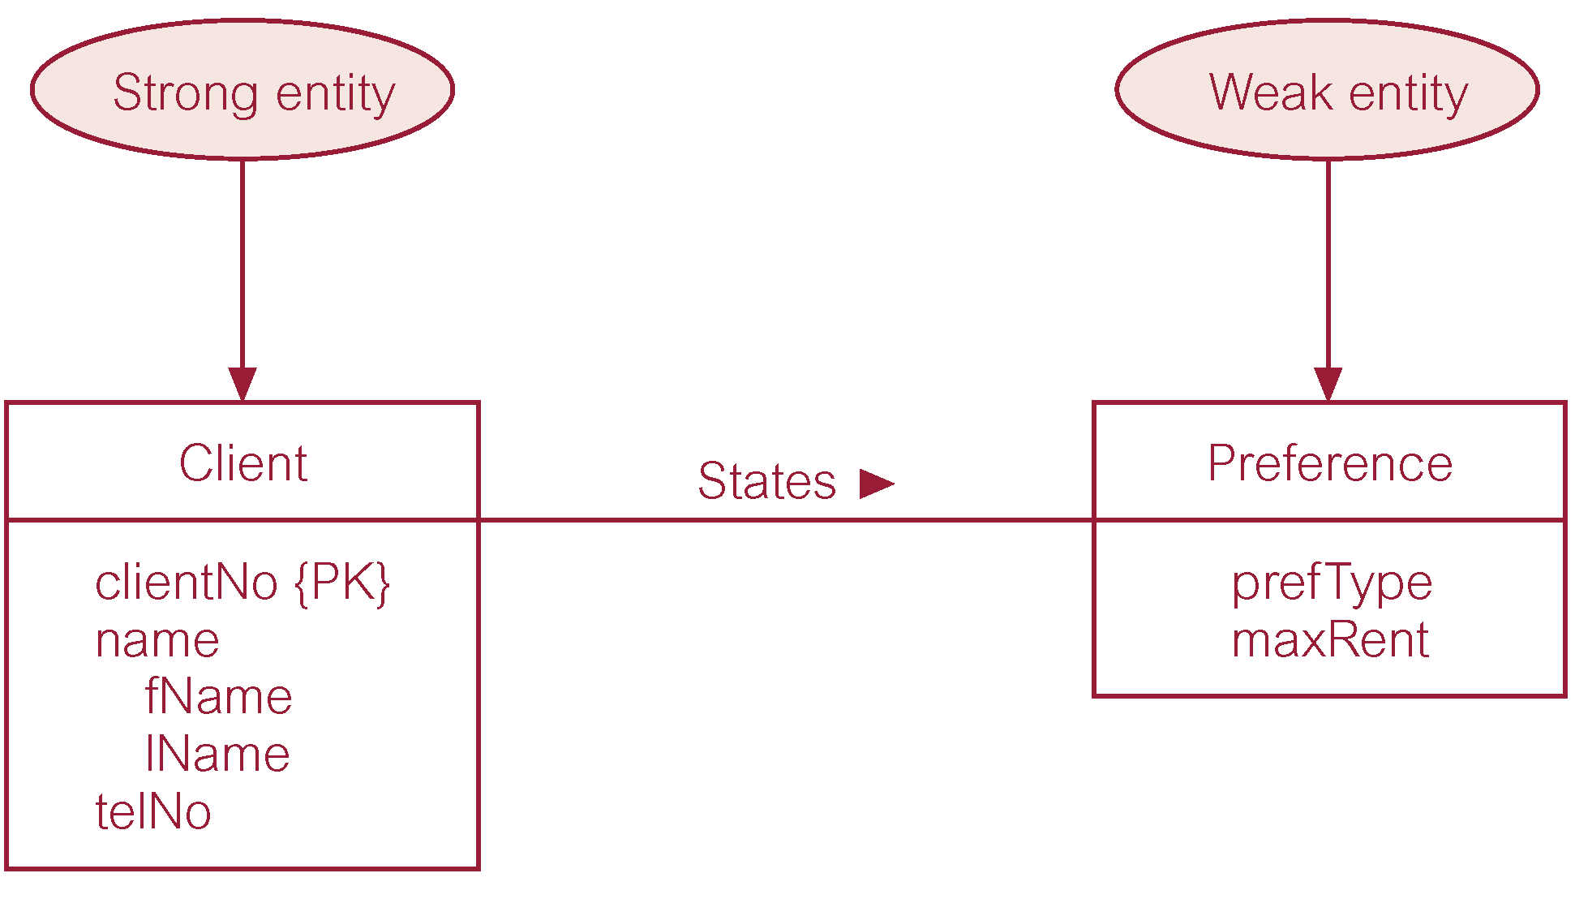
Strong entity type called Client and weak entity type called Preference

Slide 27
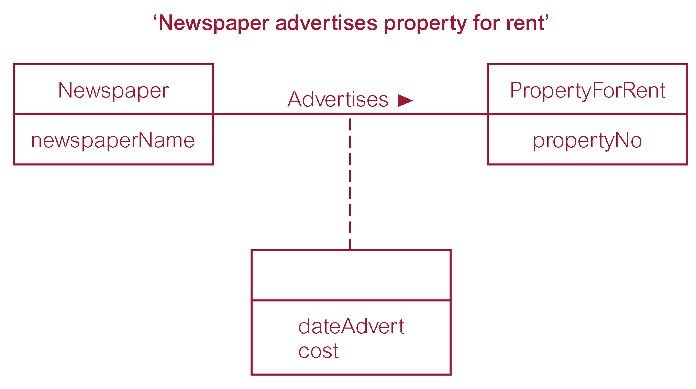
Relationship called Advertises with attributes

Slide 28
Structural Constraints
Main type of constraint on relationships is called multiplicity.
Multiplicity - number (or range) of possible occurrences of an entity type that may relate to a single occurrence of an associated entity type through a particular relationship.
(Consider ALL possibilities in the real world.)
Represents policies (called business rules) established by user or company.

Slide 29
Structural Constraints
The most common degree for relationships is binary.
Binary relationships are generally referred to as being:
  one-to-one (1:1)
  one-to-many (1:*)
  many-to-many (*:*)

Slide 30
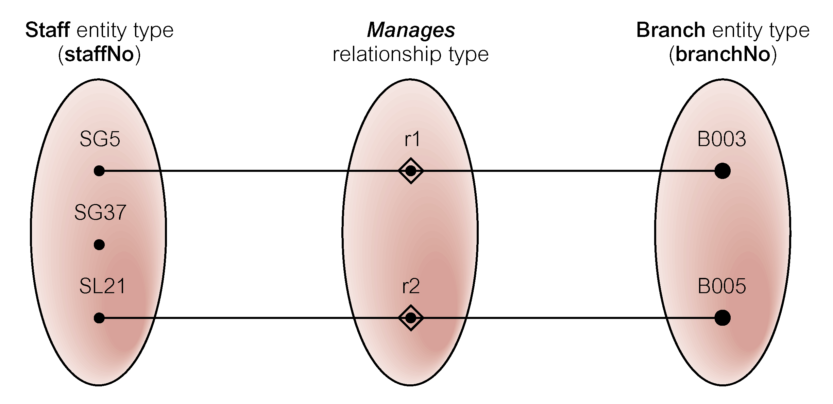
Semantic net of Staff Manages Branch relationship type

Slide 31
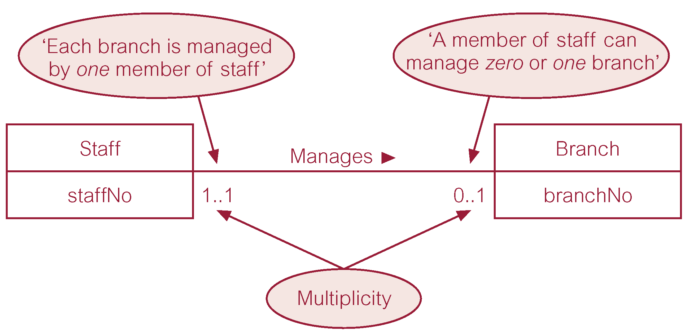
Multiplicity of Staff Manages Branch (1:1) relationship

Slide 32
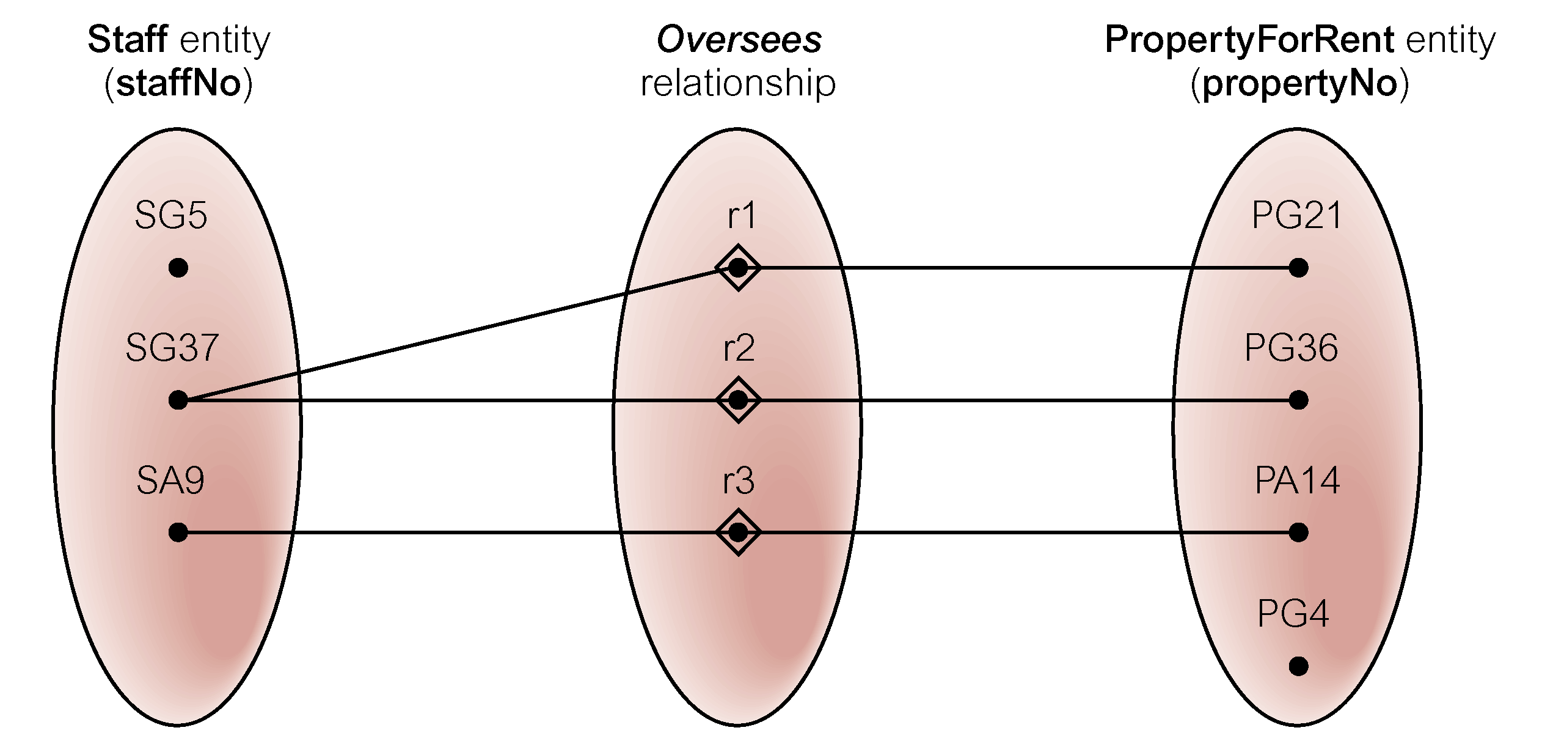
Semantic net of Staff Oversees PropertyForRent relationship type

Slide 33
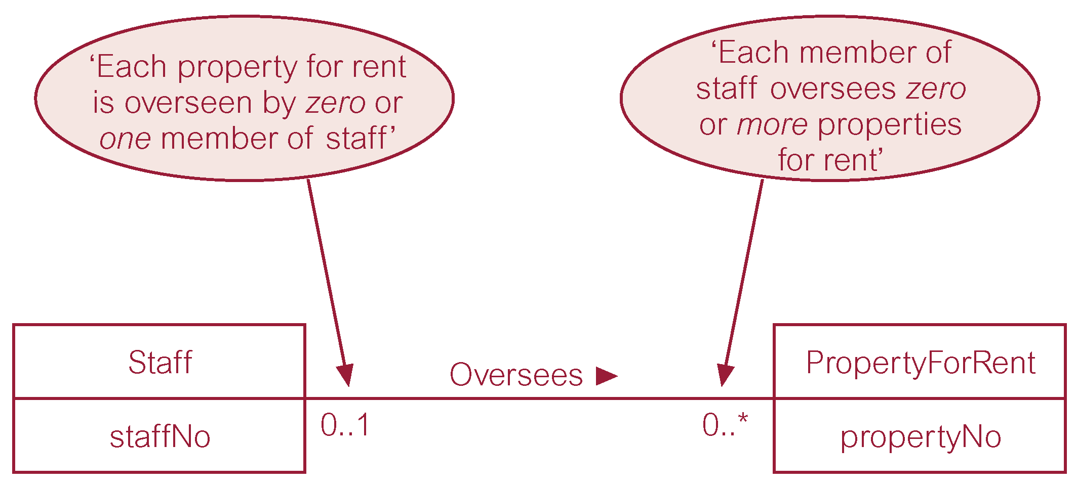
Multiplicity of Staff Oversees PropertyForRent (1:*) relationship type

Slide 34
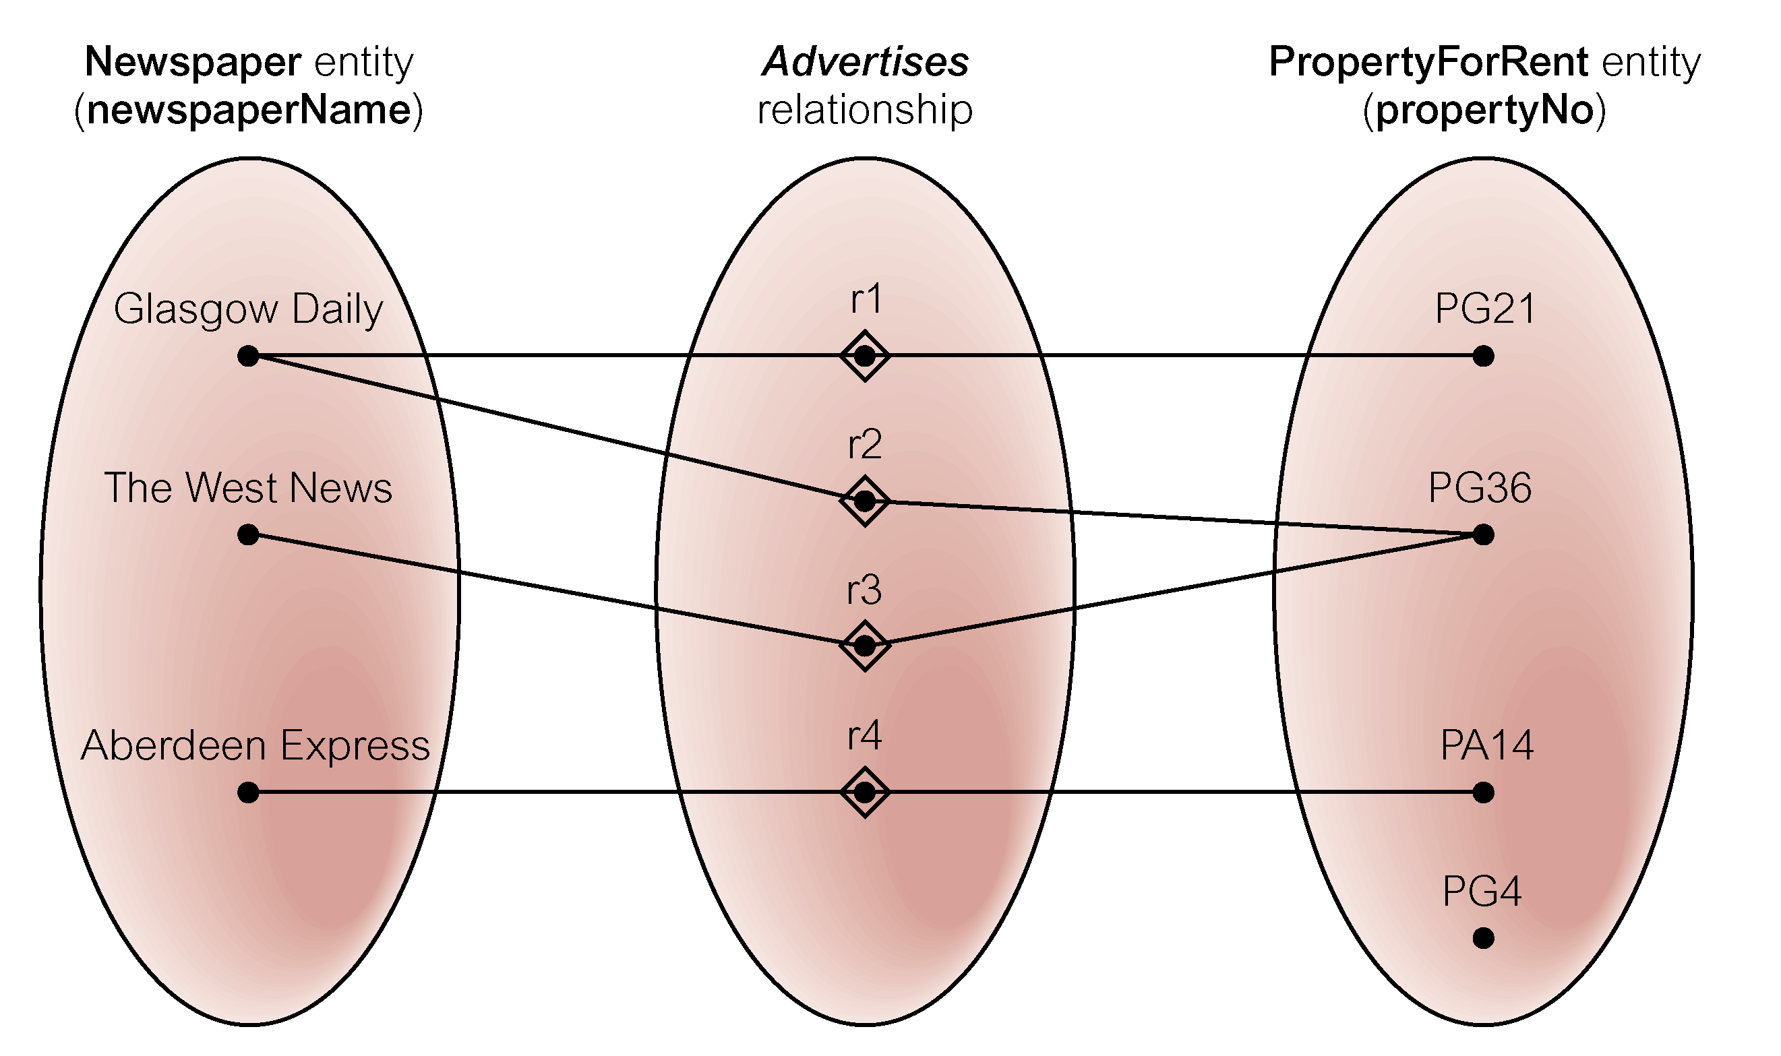
Semantic net of Newspaper Advertises PropertyForRent relationship type

Slide 35
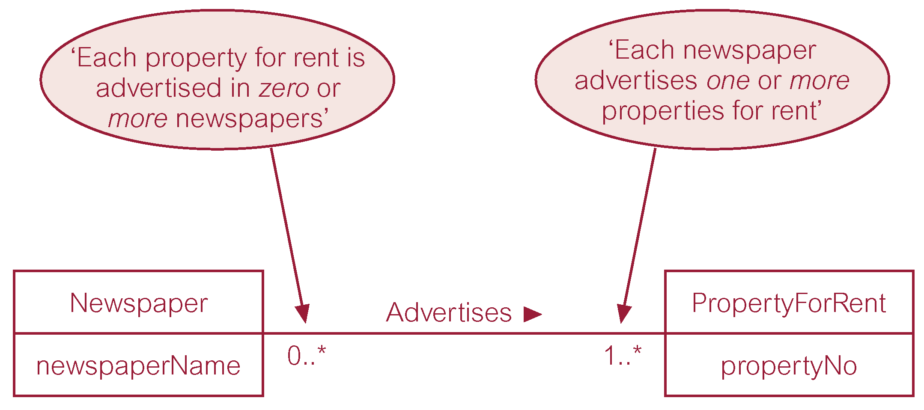
Multiplicity of Newspaper Advertises PropertyForRent (*:*) relationship

Slide 36
Structural Constraints
Multiplicity for Complex Relationships
  Number (or range) of possible occurrences of an entity type in an n-ary relationship when other (n-1) values are fixed.

Slide 37
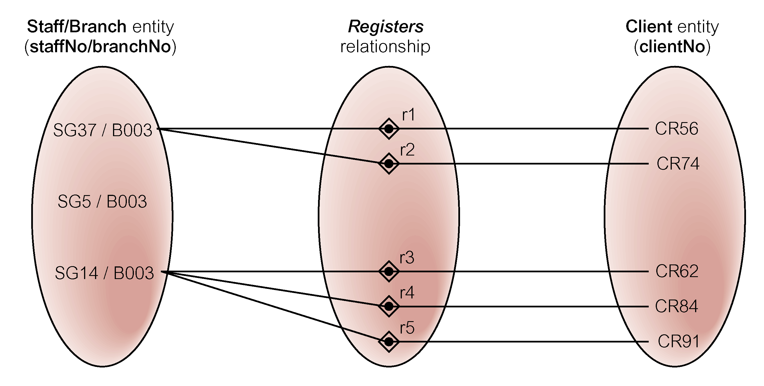
Semantic net of ternary Registers relationship with values for Staff and Branch entities fixed

Slide 38
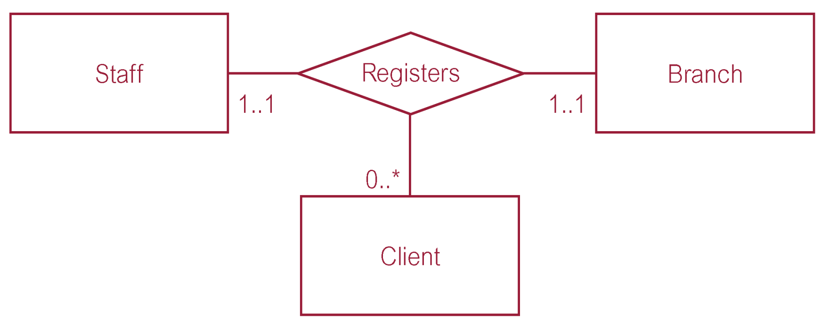
Multiplicity of ternary Registers relationship

Slide 39
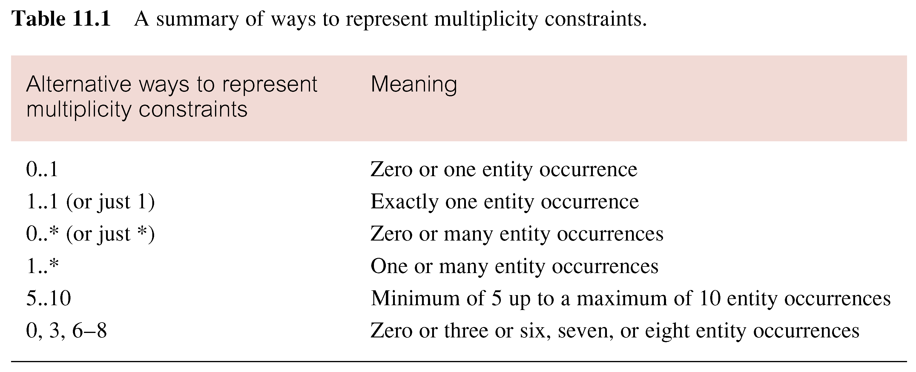
Summary of multiplicity constraints
The multiplicity should be whatever is true in the real-world application.

Slide 40
Structural Constraints
Multiplicity is made up of two types of restrictions on relationships: cardinality and participation.

Slide 41
Structural Constraints
Cardinality
  Describes maximum number of possible relationship occurrences for an entity participating in a given relationship type.
Participation
  Determines whether all or only some entity occurrences participate in a relationship.

Slide 42
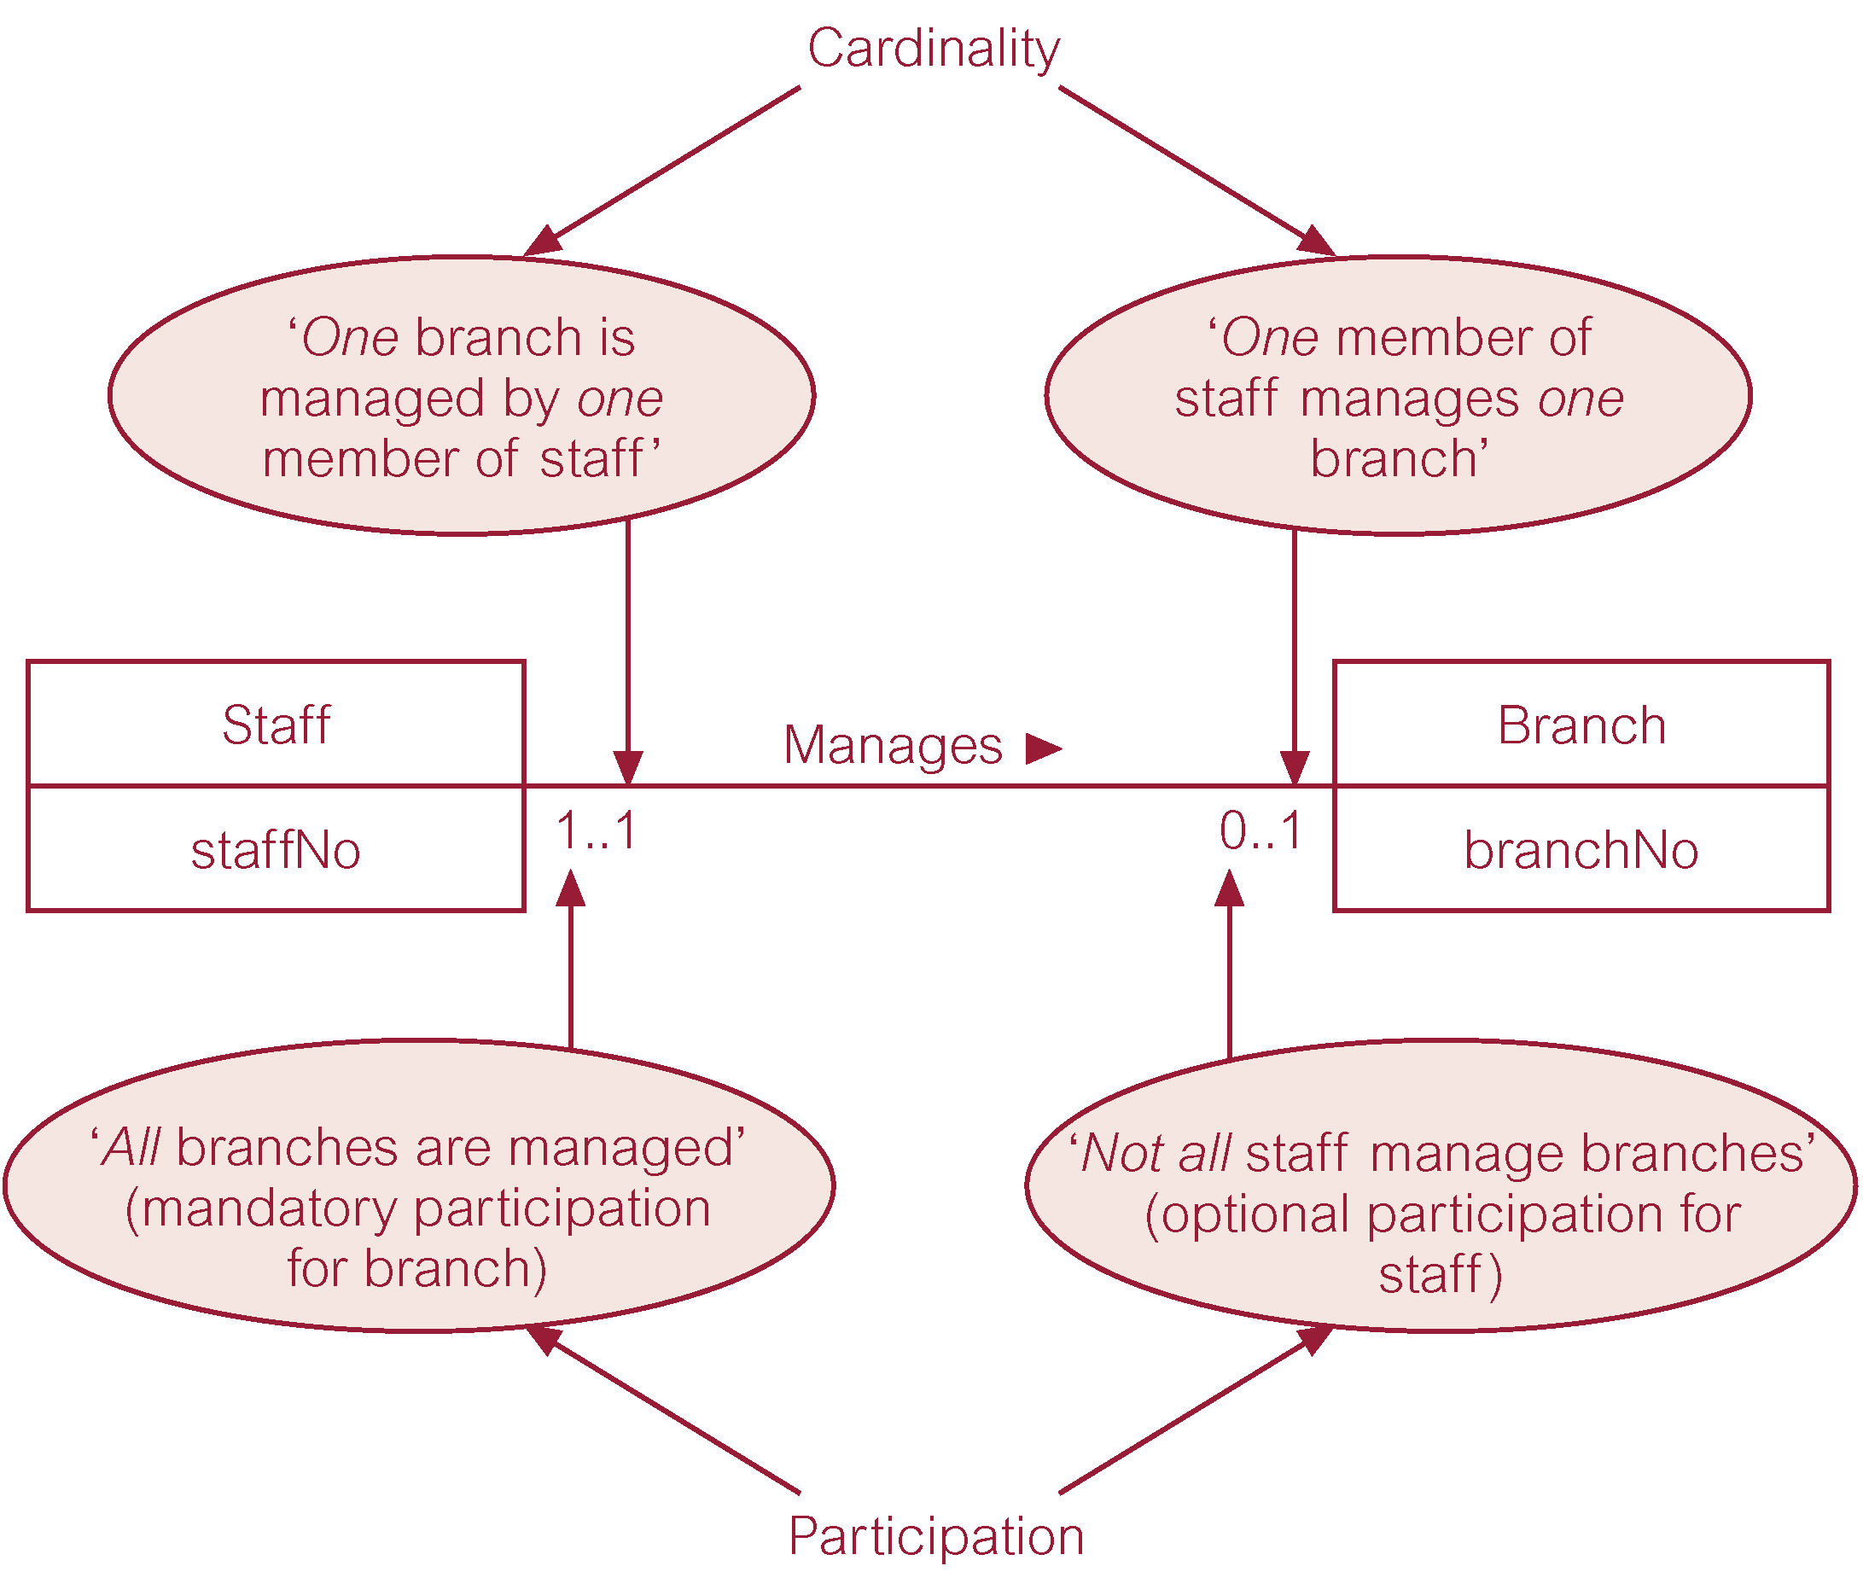
Multiplicity as cardinality and participation constraints

Slide 43
Problems with ER Models
Problems may arise when designing a conceptual data model called connection traps.
Often due to a misinterpretation of the meaning of certain relationships.
Two main types of connection traps are called fan traps and chasm traps.

Slide 44
Problems with ER Models
Fan Trap
  Where a model represents a relationship between entity types, but pathway between certain entity occurrences is ambiguous.
Chasm Trap
  Where a model suggests the existence of a relationship between entity types, but pathway does not exist between certain entity occurrences.

Slide 45

An Example of a Fan Trap

Slide 46
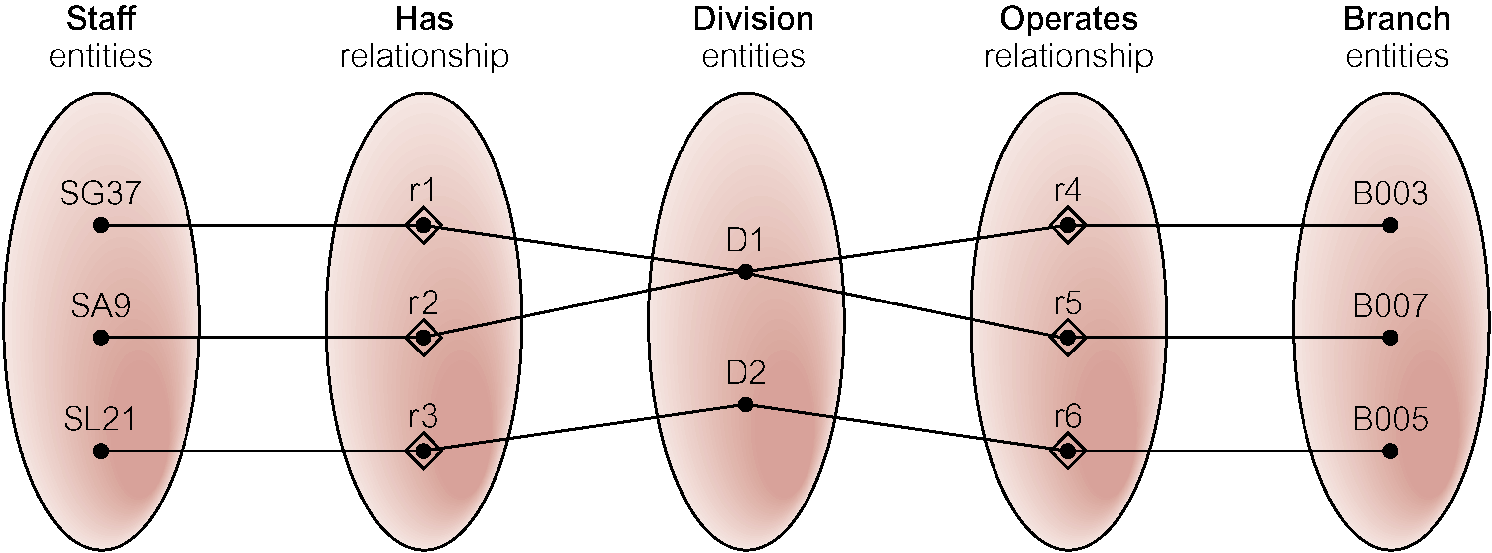
Semantic Net of ER Model with Fan Trap
At which branch office does staff number SG37 work?

Slide 47
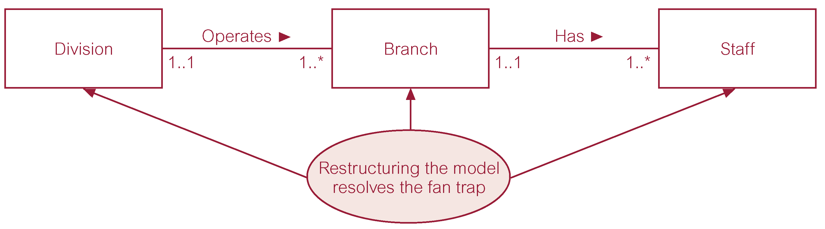
Restructuring ER model to remove Fan Trap

Slide 48
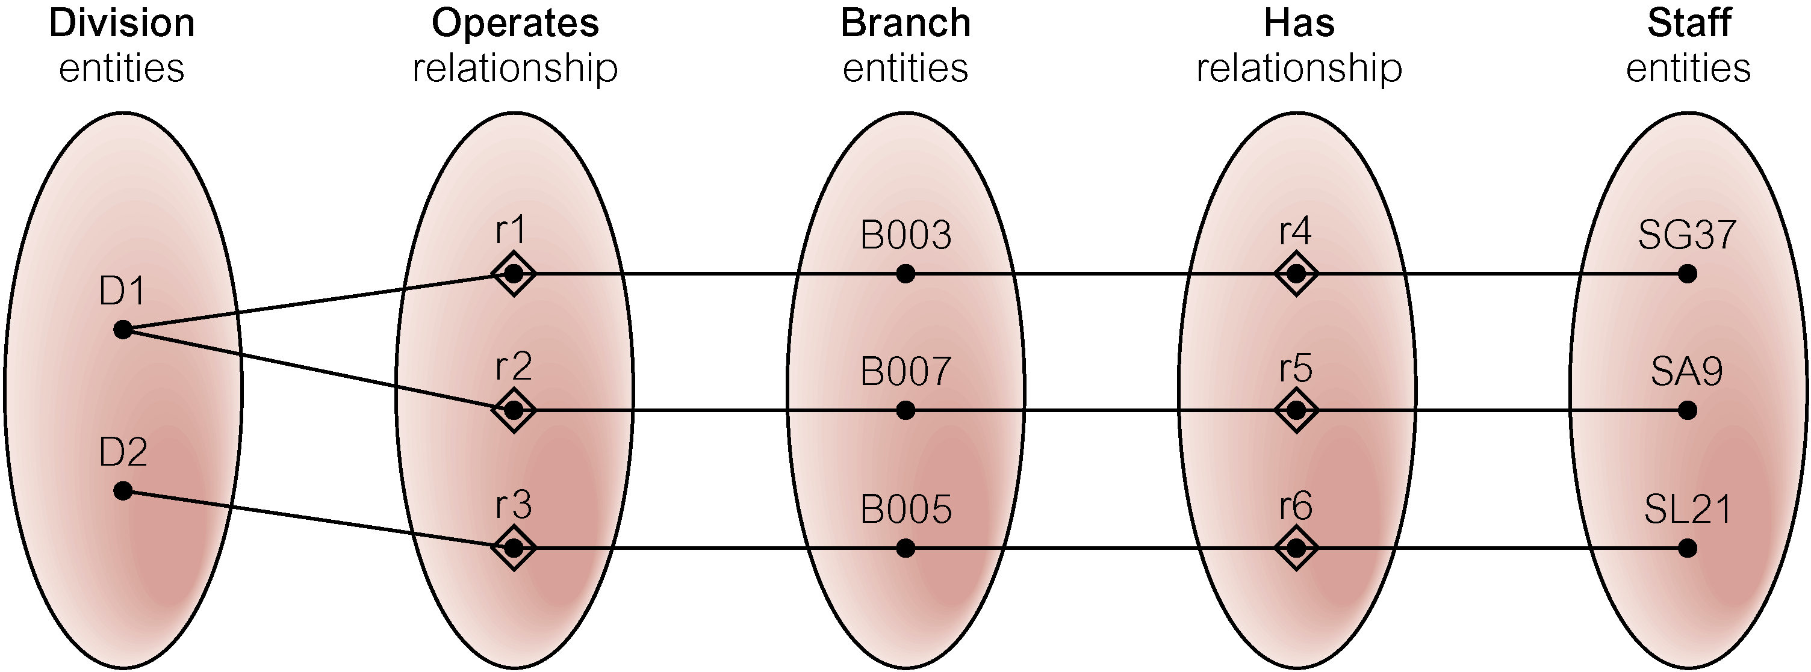
Semantic Net of Restructured ER Model with Fan Trap Removed
SG37 works at branch B003.

Slide 49

An Example of a Chasm Trap

Slide 50
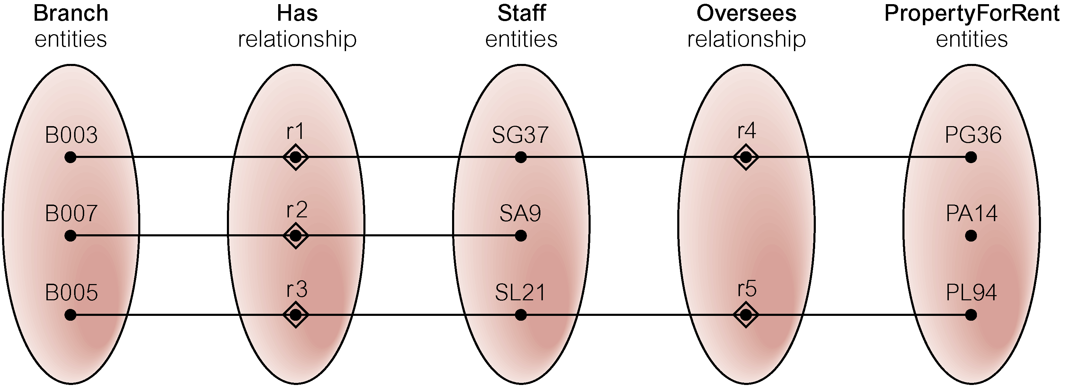
Semantic Net of ER Model with Chasm Trap
At which branch office is property PA14 available?

Slide 51
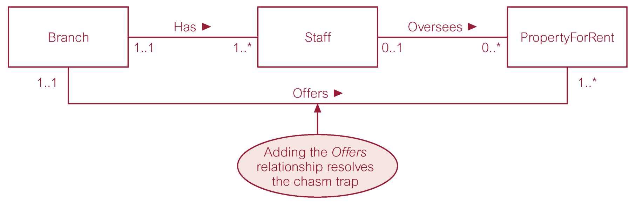
ER Model restructured to remove Chasm Trap

Slide 52
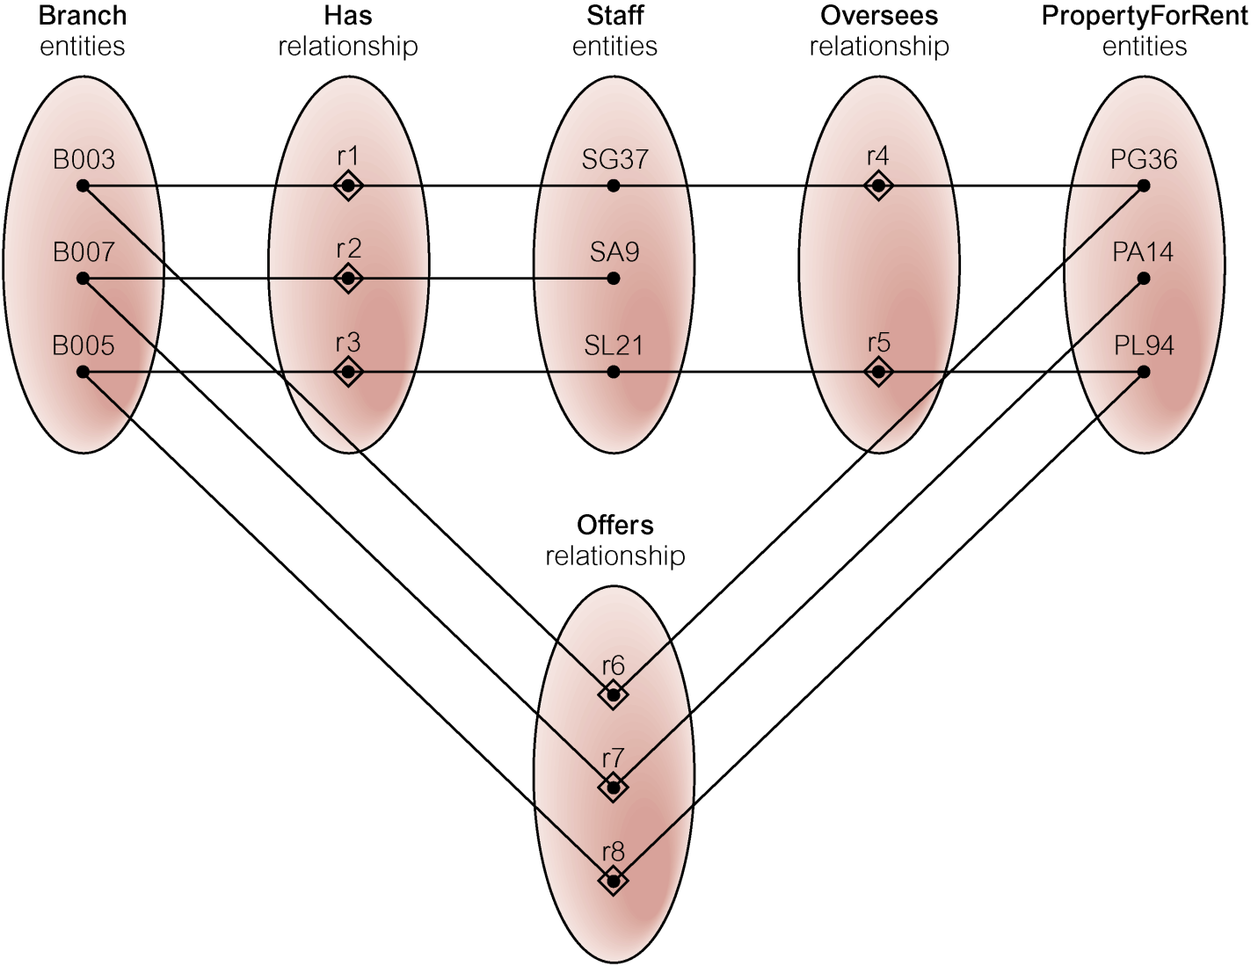
Semantic Net of Restructured ER Model with Chasm Trap Removed

Slide 53
ER diagram of Branch user views of DreamHome (also at very end)

Slide 54
Show appendix C-4
(Alternative Notation)

Slide 55
Do Part 2 of this lesson

