Slide 1
Chapter 17
Methodology
Logical Database Design for the Relational Model

Slide 2

Chapter 17 - Objectives
How to derive a set of relations from a conceptual data model.
How to validate these relations using the technique of normalization.

Slide 3
Chapter 17 - Objectives
How to validate a logical data model to ensure it supports the required transactions.
How to merge local logical data models based on one or more user views into a global logical data model that represents all user views.
How to ensure that the final logical data model is a true and accurate representation of the data requirements of the enterprise.

Slide 4
Step 2 Build and Validate Logical Data Model
To translate the conceptual data model into a logical data model and then to validate this model to check that it is structurally correct using normalization and supports the required transactions.

Slide 5

Step 2 Build and Validate Logical Data Model
Step 2.1 Derive relations for logical data model
  To create relations for the logical data model to represent the entities, relationships, and attributes that have been identified.

Slide 6
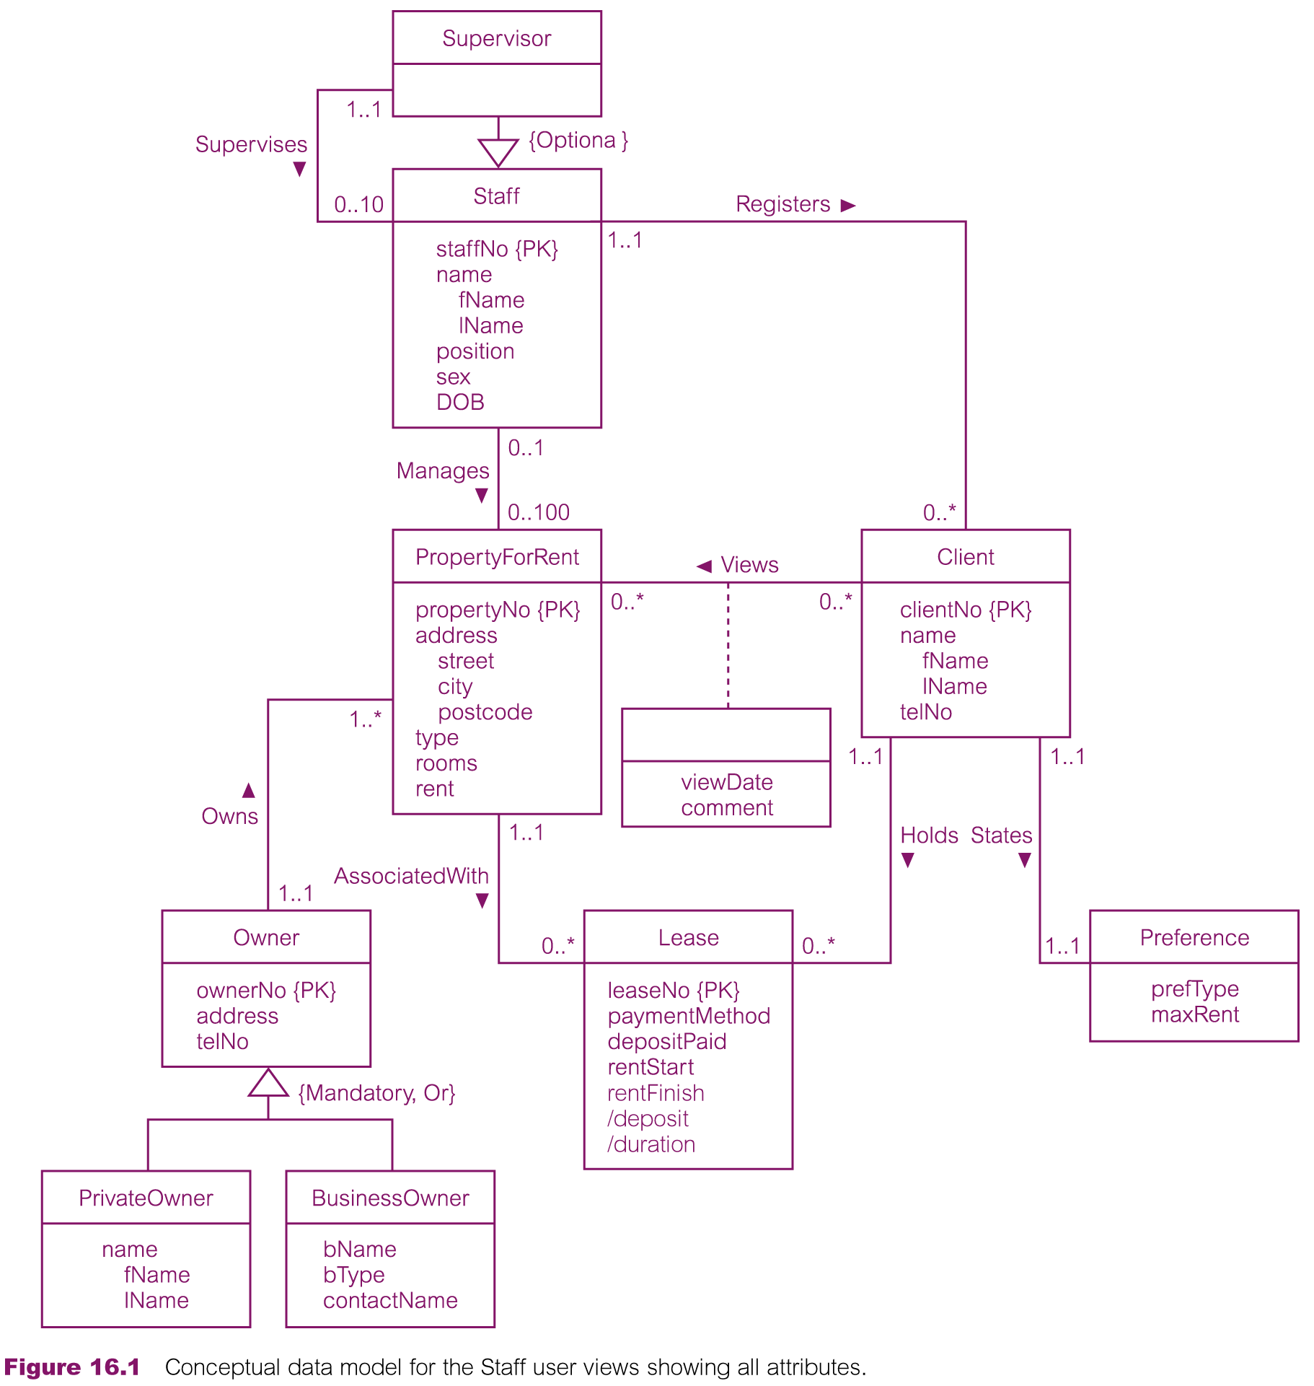
Conceptual data model for Staff view showing all attributes

Slide 7
Show page 483 middle picture
Show page 484 bottom picture
Show page 488 top picture
Show page 488 bottom picture
Show page 489 bottom picture

Slide 8
Step 2.1 Derive relations for logical data model
(1) Strong entity types
  For each strong entity in the data model, create a relation that includes all the simple attributes of that entity. For composite attributes, include only the constituent simple attributes.
  Weak entity types
  For each weak entity in the data model, create a relation that includes all the simple attributes of that entity. The primary key of a weak entity is partially or fully derived from each owner entity and so the identification of the primary key of a weak entity cannot be made until after all the relationships with the owner entities have been mapped.

Slide 9
Step 2.1 Derive relations for logical data model
(3) One-to-many (1:*) binary relationship types
  For each 1:* binary relationship, the entity on the ‘one side’ of the relationship is designated as the parent entity and the entity on the ‘many side’ is designated as the child entity. To represent this relationship, post a copy of the primary key attribute(s) of parent entity into the relation representing the child entity, to act as a foreign key.
  Show an example from the E-R diagram above.

Slide 10
Step 2.1 Derive relations for logical data model
(4) One-to-one (1:1) binary relationship types
  Creating relations to represent a 1:1 relationship is more complex as the cardinality cannot be used to identify the parent and child entities in a relationship. Instead, the participation constraints are used to decide whether it is best to represent the relationship by combining the entities involved into one relation or by creating two relations and posting a copy of the primary key from one relation to the other.
  Consider the following
    (a) mandatory participation on both sides of 1:1 relationship;
    (b) mandatory participation on one side of 1:1 relationship;
    (c) optional participation on both sides of 1:1 relationship.

Slide 11
Step 2.1 Derive relations for logical data model
(a) Mandatory participation on both sides of 1:1 relationship
  Combine entities involved into one relation and choose one of the primary keys of original entities to be primary key of the new relation, while the other (if one exists) is used as an alternate key. For example …
(b) Mandatory participation on one side of a 1:1 relationship
  Identify parent and child entities using participation constraints. Entity with optional participation in relationship is designated as parent entity, and entity with mandatory participation is designated as child entity. A copy of primary key of the parent entity is placed in the relation representing the child entity. If the relationship has one or more attributes, these attributes should follow the posting of the primary key to the child relation. For example …

Slide 12
Step 2.1 Derive relations for logical data model
(c) Optional participation on both sides of a 1:1 relationship
    In this case, the designation of the parent and child entities is arbitrary unless we can find out more about the relationship that can help a decision to be made one way or the other. Consider which happens more,
    for example Staff and CompanyCar

Slide 13
Step 2.1 Derive relations for logical data model
(5) One-to-one (1:1) recursive relationships
  For a 1:1 recursive relationship, follow the rules for participation as described above for a 1:1 relationship.
    mandatory participation on both sides, represent the recursive relationship as a single relation with two copies of the primary key.
    mandatory participation on only one side, option to create a single relation with two copies of the primary key, or to create a new relation to represent the relationship. The new relation would only have two attributes, both copies of the primary key. As before, the copies of the primary keys act as foreign keys and have to be renamed to indicate the purpose of each in the relation.
    optional participation on both sides, again create a new relation as described above.

Slide 14
Step 2.1 Derive relations for logical data model
(6) Superclass/subclass relationship types
  Identify superclass entity as parent entity and subclass entity as the child entity. There are various options on how to represent such a relationship as one or more relations.
  The selection of the most appropriate option is dependent on a number of factors such as the disjointness and participation constraints on the superclass/subclass relationship, whether the subclasses are involved in distinct relationships, and the number of participants in the superclass/subclass relationship.
  Draw an example or two on the board.

Slide 15
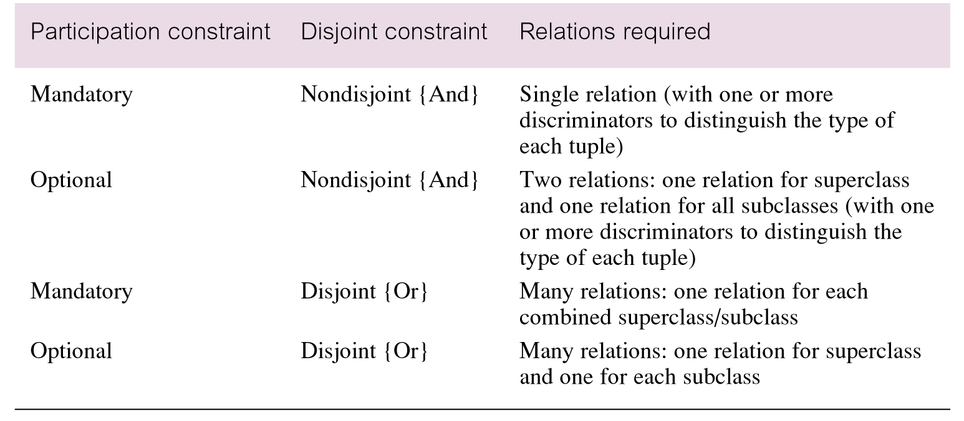
Guidelines for representation of superclass / subclass relationship

Slide 16
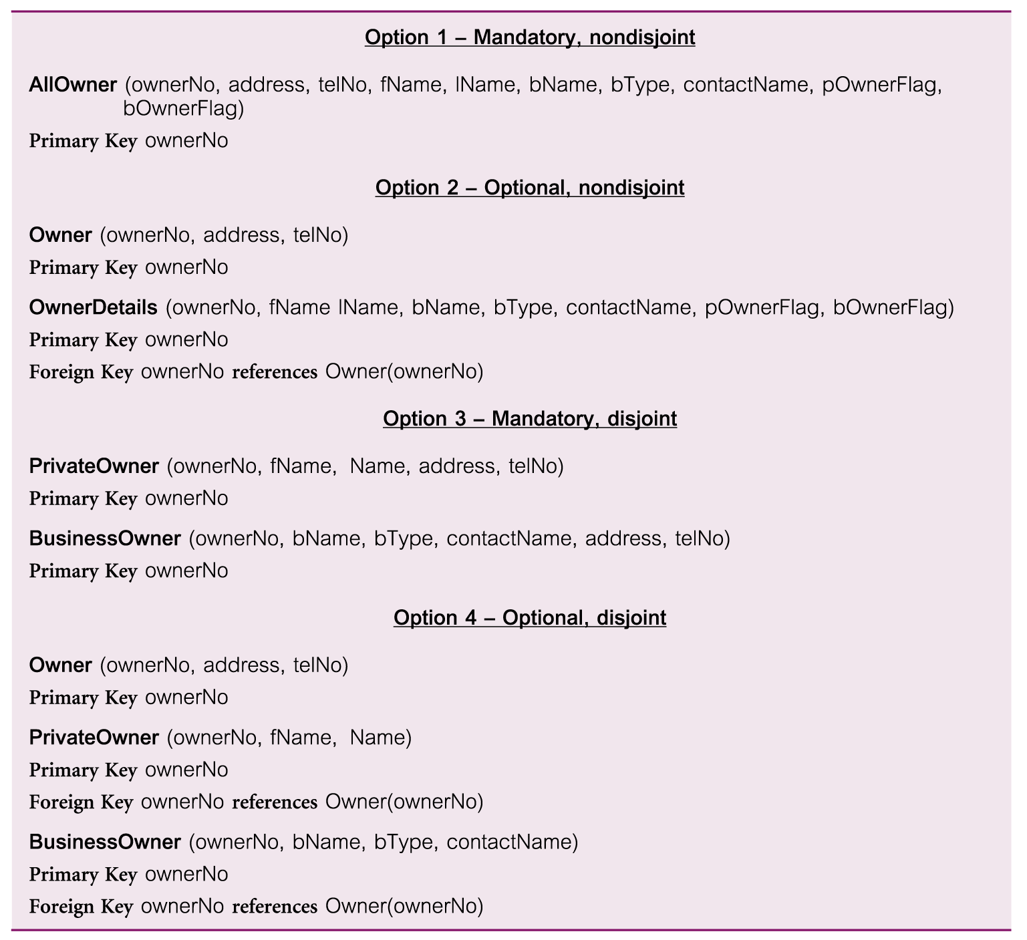
Representation of superclass / subclass relationship based on participation and disjointness

Slide 17
The above is for guidance
(for inheritance).
They are not absolute rules.

Slide 18
Step 2.1 Derive relations for logical data model
(7) Many-to-many (*:*) binary relationship types
  Create a relation to represent the relationship and include any attributes that are part of the relationship. We post a copy of the primary key attribute(s) of the entities that participate in the relationship into the new relation, to act as foreign keys. These foreign keys will also form the primary key of the new relation, possibly in combination with some of the attributes of the relationship.
  Give an example.

Slide 19
Step 2.1 Derive relations for logical data model
(8) Complex relationship types
  Create a relation to represent the relationship and include any attributes that are part of the relationship. Post a copy of the primary key attribute(s) of the entities that participate in the complex relationship into the new relation, to act as foreign keys. Any foreign keys that represent a ‘many’ relationship (for example, 1..*, 0..*) generally will also form the primary key of this new relation, possibly in combination with some of the attributes of the relationship.
  Give an example.

Slide 20
Step 2.1 Derive relations for logical data model
(9) Multi-valued attributes
  Create a new relation to represent multi-valued attribute and include primary key of entity in new relation, to act as a foreign key. Unless the multi-valued attribute is itself an alternate key of the entity, the primary key of the new relation is the combination of the multi-valued attribute and the primary key of the entity.
  Give an example (telephone number).

Slide 21
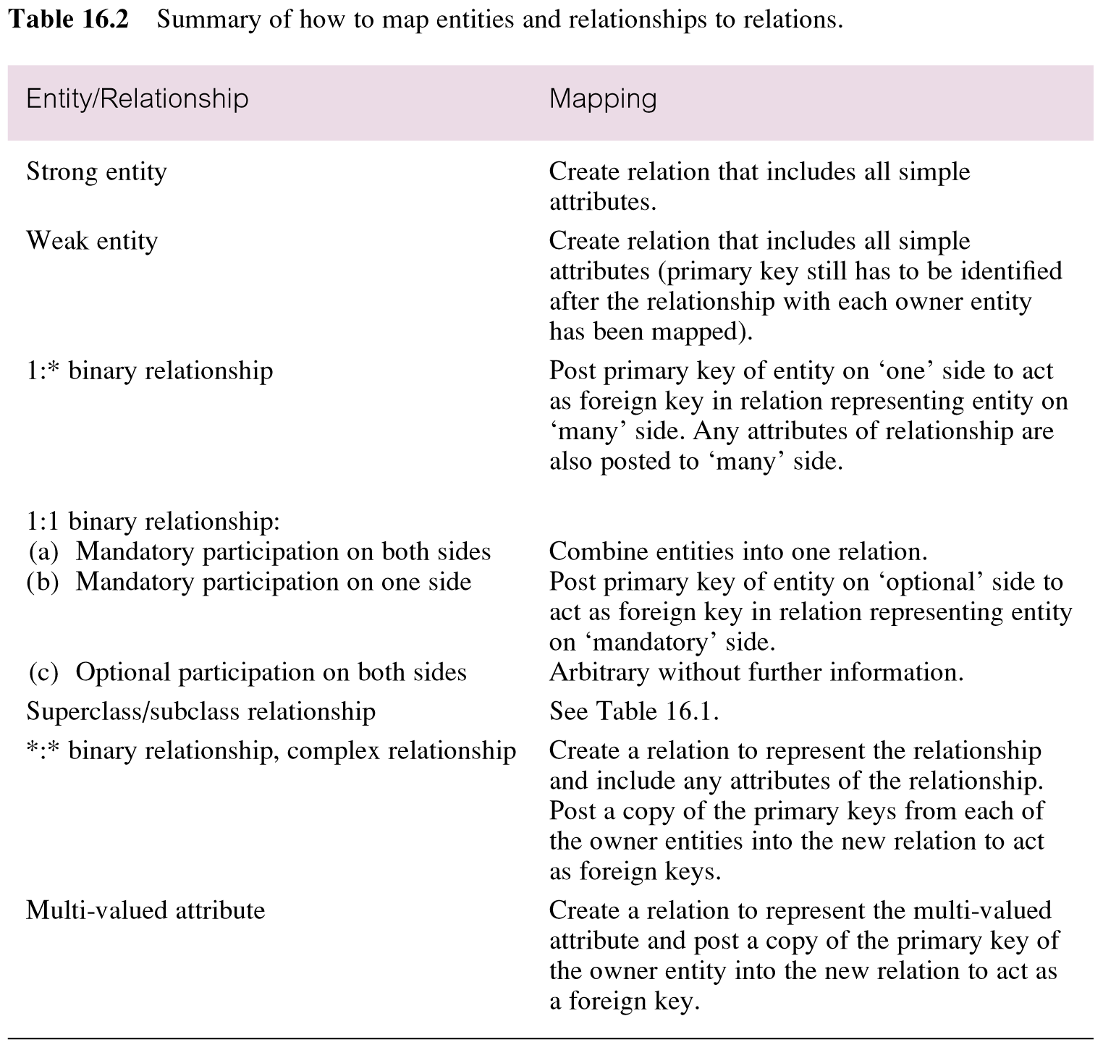
Summary of how to map entities and relationships to relations

Slide 22
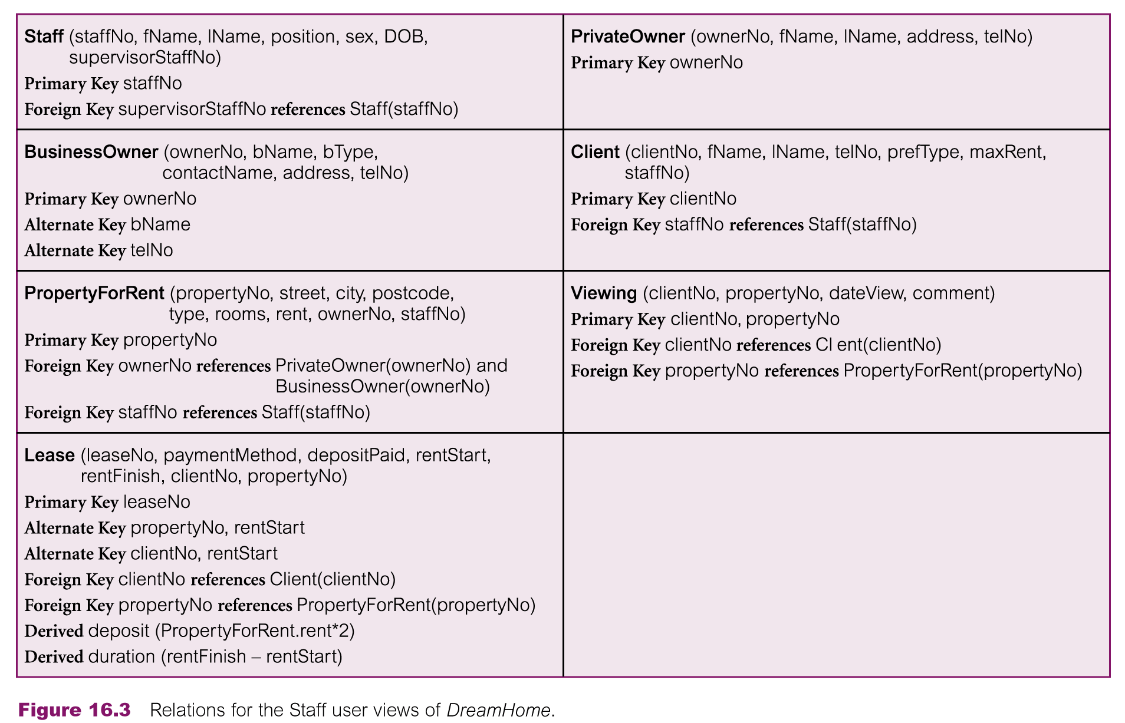
Relations for the Staff user views of DreamHome

Slide 23
Step 2.2 Validate relations using normalization
To validate the relations in the logical data model using normalization.

Slide 24
Step 2.3 Validate relations against user transactions (queries)
To ensure that the relations in the logical data model support the required transactions.

Slide 25

Step 2.4 Check integrity constraints
To check integrity constraints are represented in the logical data model. This includes identifying:
    Required data
    Attribute domain constraints
    Multiplicity
    Entity integrity
    Referential integrity
    General constraints

Slide 26
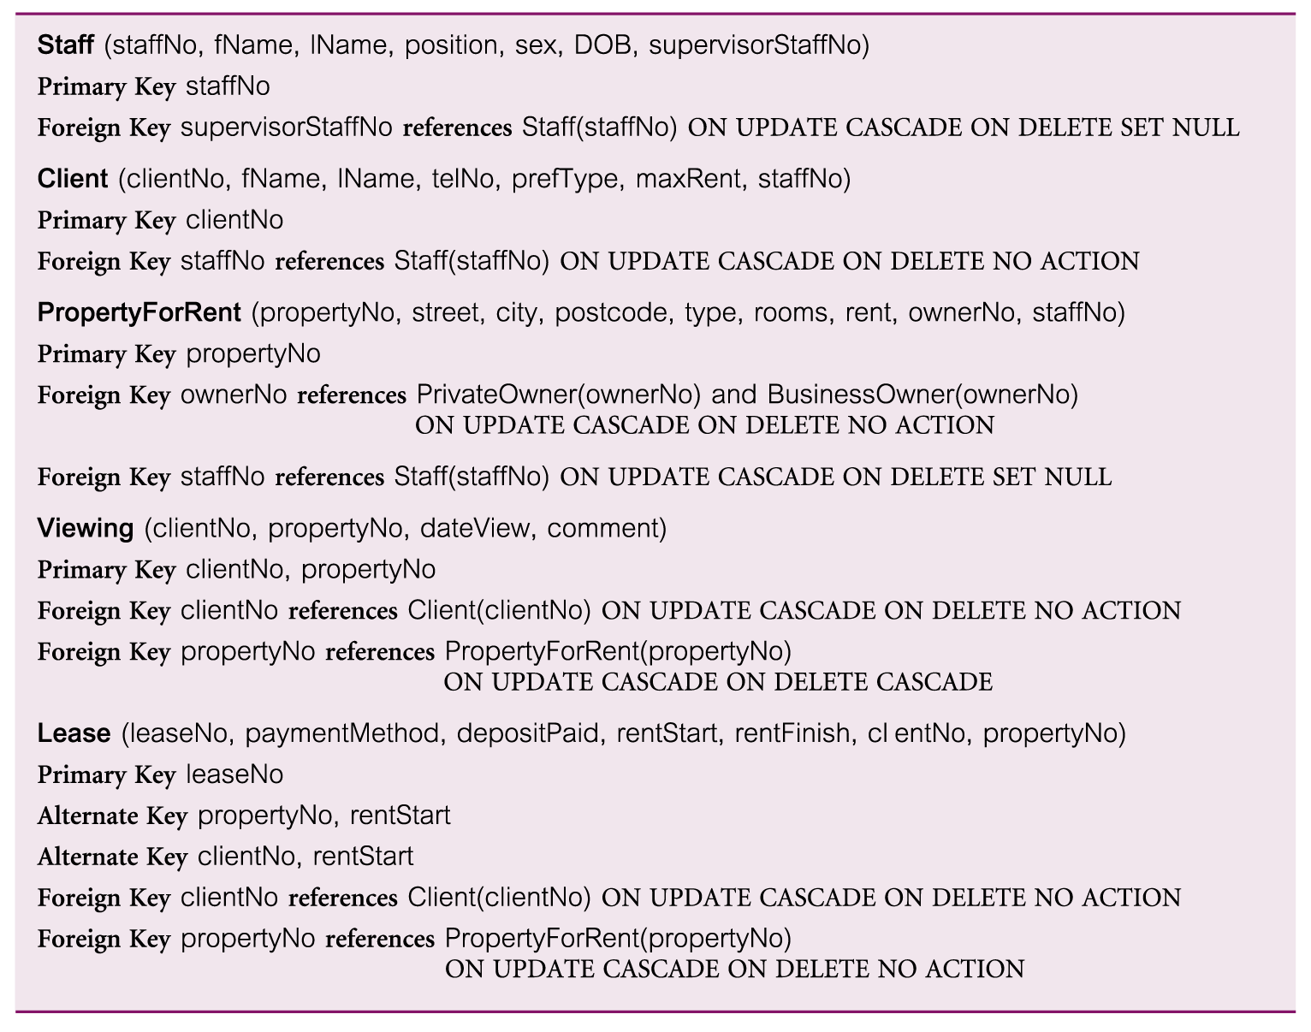
Referential integrity constraints for relations in Staff user views of DreamHome

Slide 27
You can make the foreign key NOT NULL if that is appropriate for the particular situation.

Slide 28
Step 2.5 Review logical data model with user
To review the logical data model with the users to ensure that they consider the model to be a true representation of the data requirements of the enterprise.

Slide 29
Step 2.6 Merge logical data models into global Model (optional step)
To merge logical data models into a single global logical data model that represents all user views of a database.

Slide 30
Step 2.6.1 Merge local logical data models into global model
To merge local logical data model into a single global logical data model.
The activities in this step include:
  Step 2.6.1 Merge local logical data models into global model
  Step 2.6.2 Validate global logical data model
  Step 2.6.3 Review global logical data model with users.

Slide 31
Step 2.6.1 Merge logical data models into a global model
Tasks typically includes:
    (1) Review the names and contents of entities/relations and their candidate keys.
    (2) Review the names and contents of relationships/foreign keys.
    (3) Merge entities/relations from the local data models
    (4) Include (without merging) entities/relations unique to each local data model
    (5) Merge relationships/foreign keys from the local data models.
    (6) Include (without merging) relationships/foreign keys unique to each local data model.
    (7) Check for missing entities/relations and relationships/foreign keys.
    (8) Check foreign keys.
    (9) Check Integrity Constraints.
    (10) Draw the global ER/relation diagram
    (11) Update the documentation.

Slide 32
Step 2.6.2 Validate global logical data model
To validate the relations created from the global logical data model using the technique of normalization and to ensure they support the required transactions, if necessary.

Slide 33
Step 2.6.3 Review global logical data model with users
To review the global logical data model with the users to ensure that they consider the model to be a true representation of the data requirements of an enterprise.

Slide 34
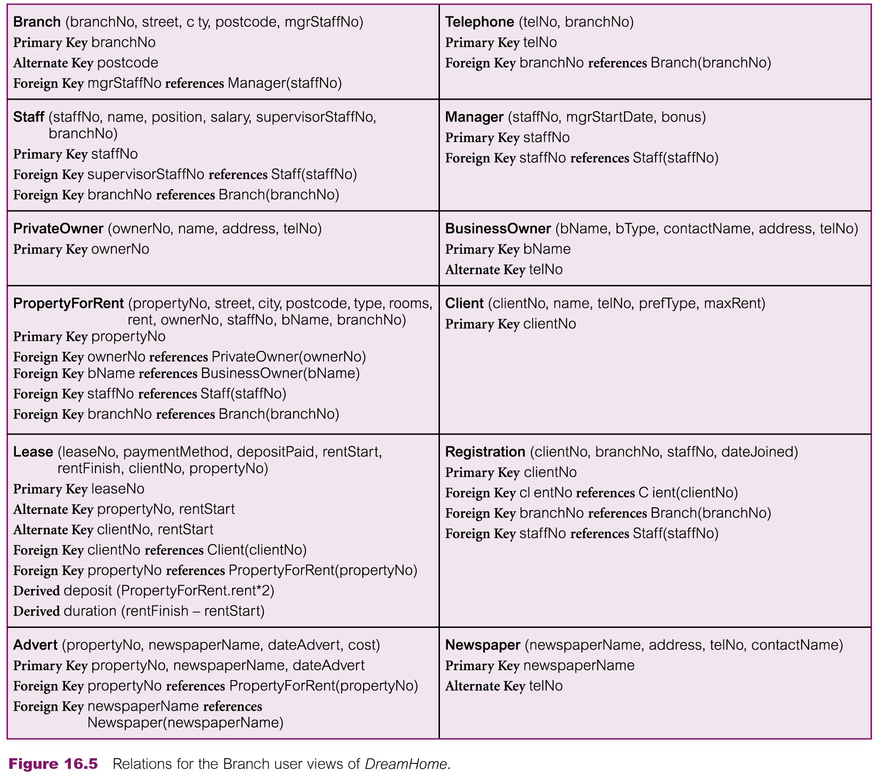
Relations for the Branch user views of DreamHome

Slide 35
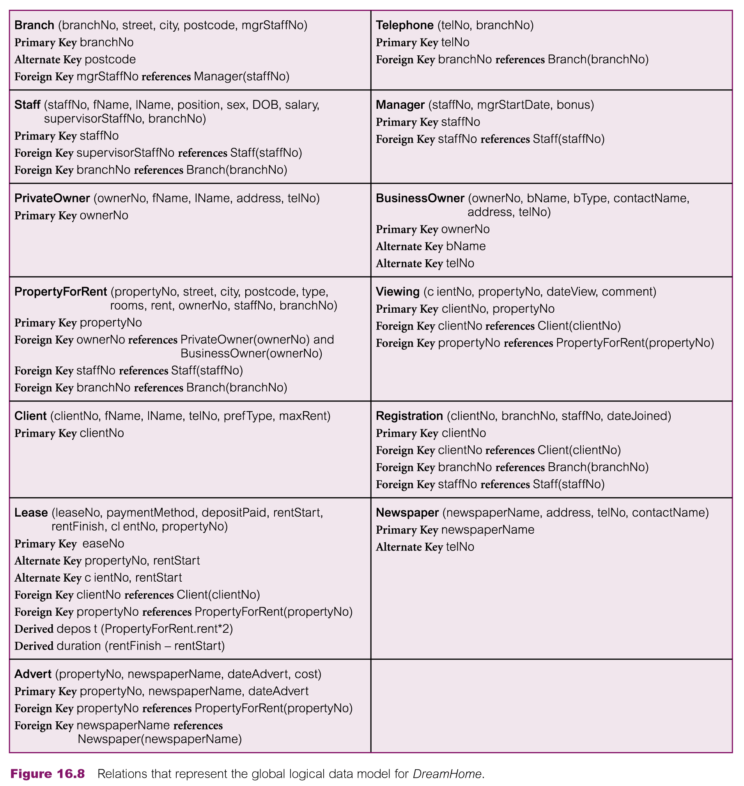
Relations that represent the global logical data model for DreamHome

Slide 36
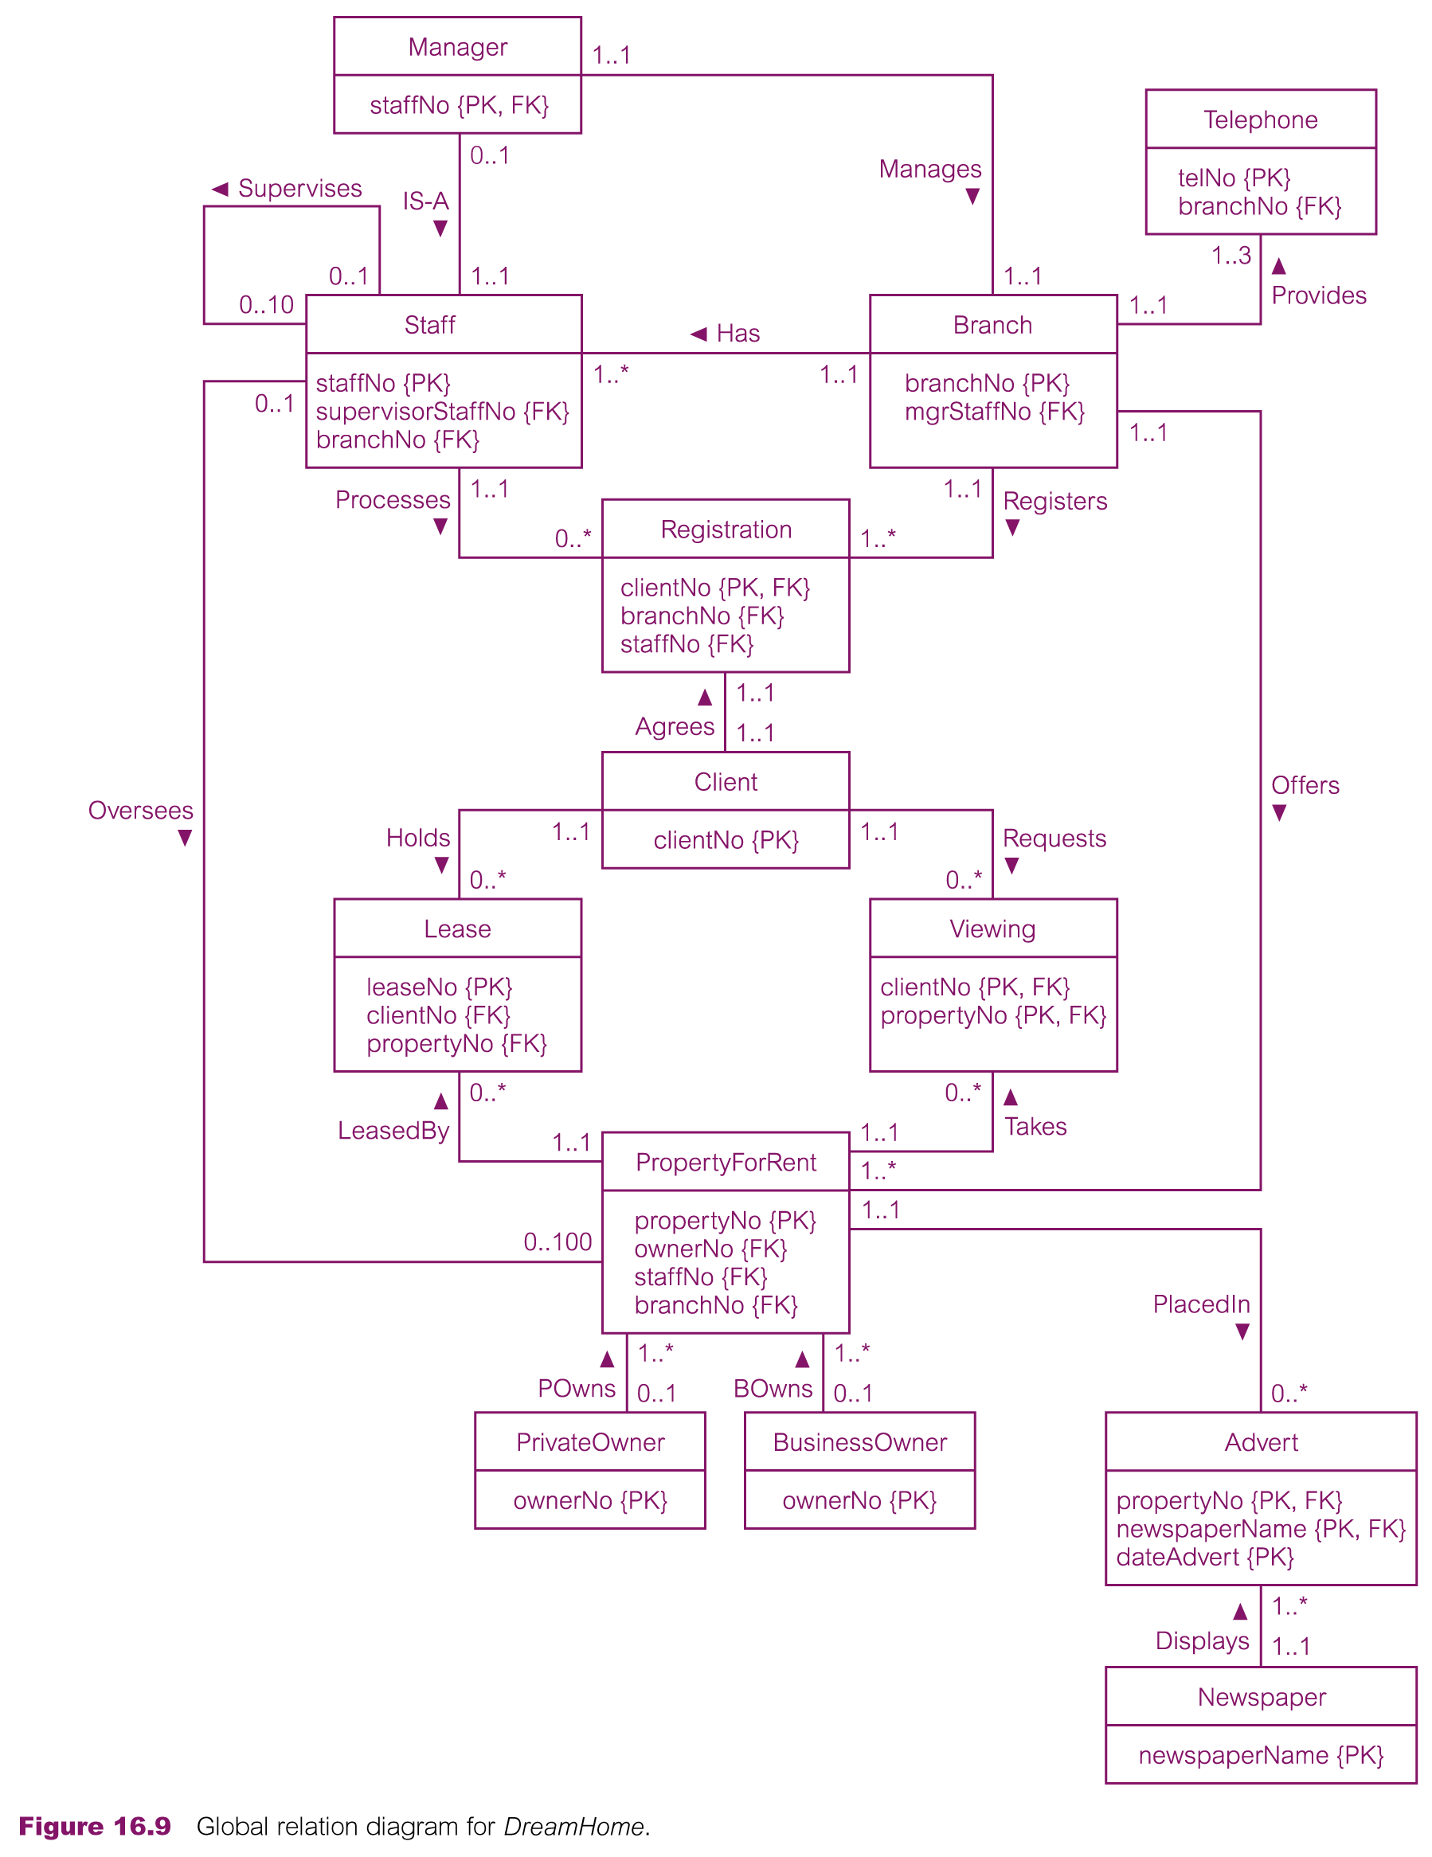
Global relation diagram for DreamHome

