Slide 1
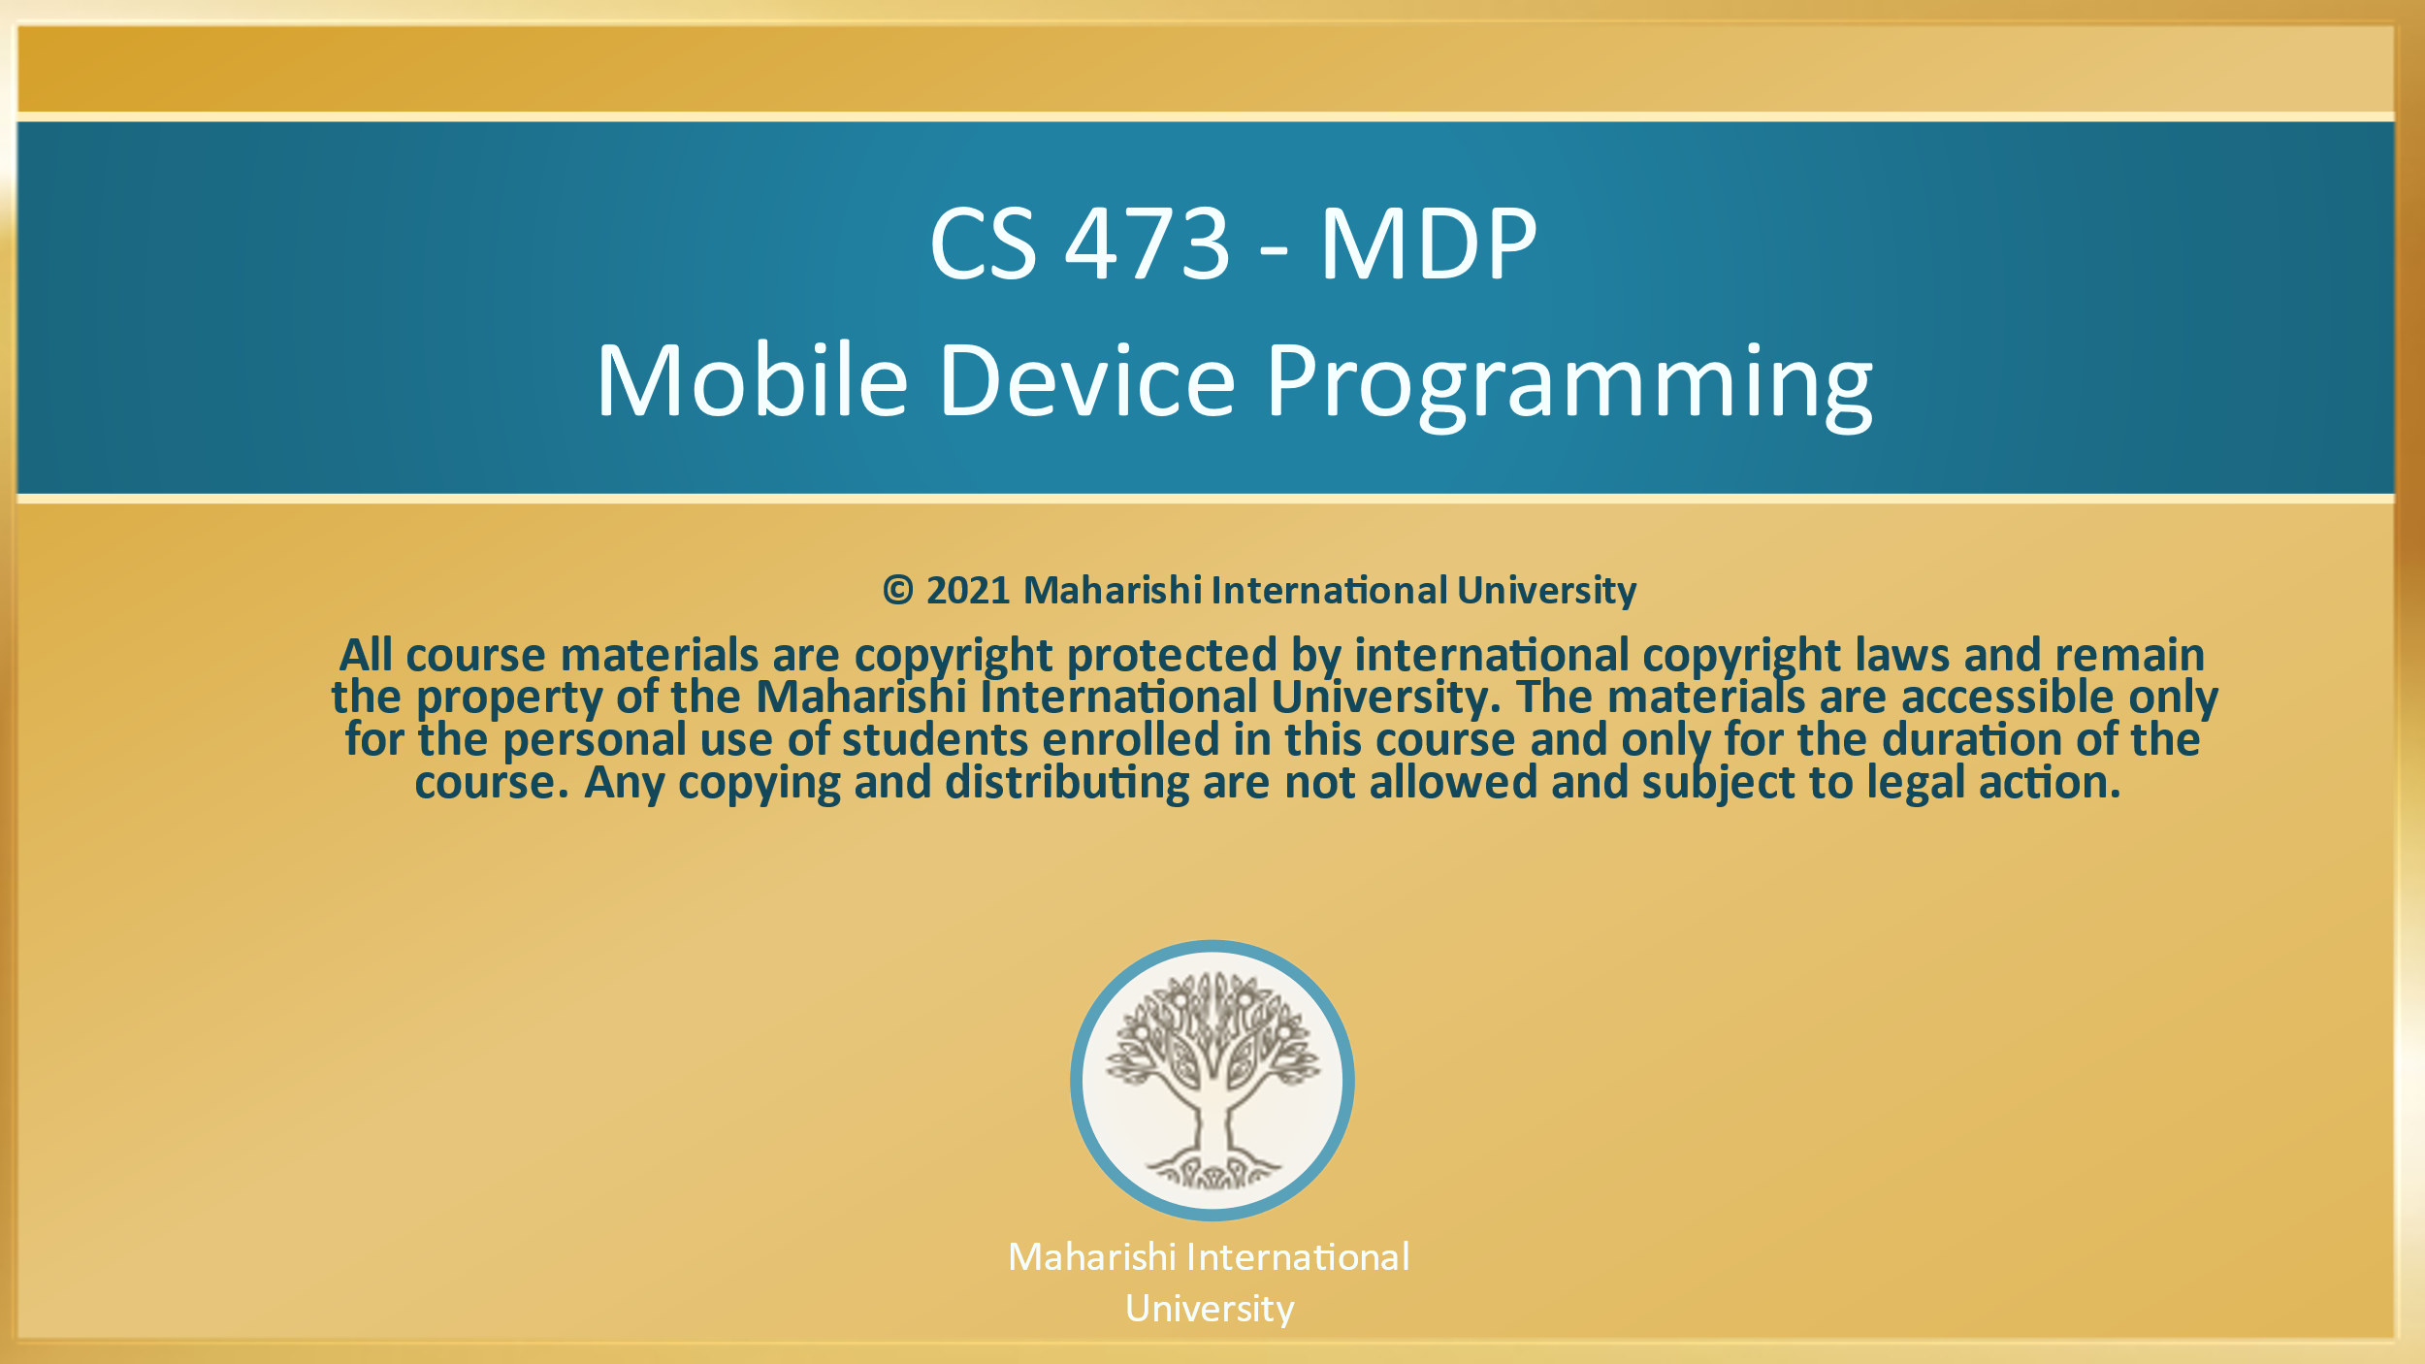
Maharishi International
University

Slide 2
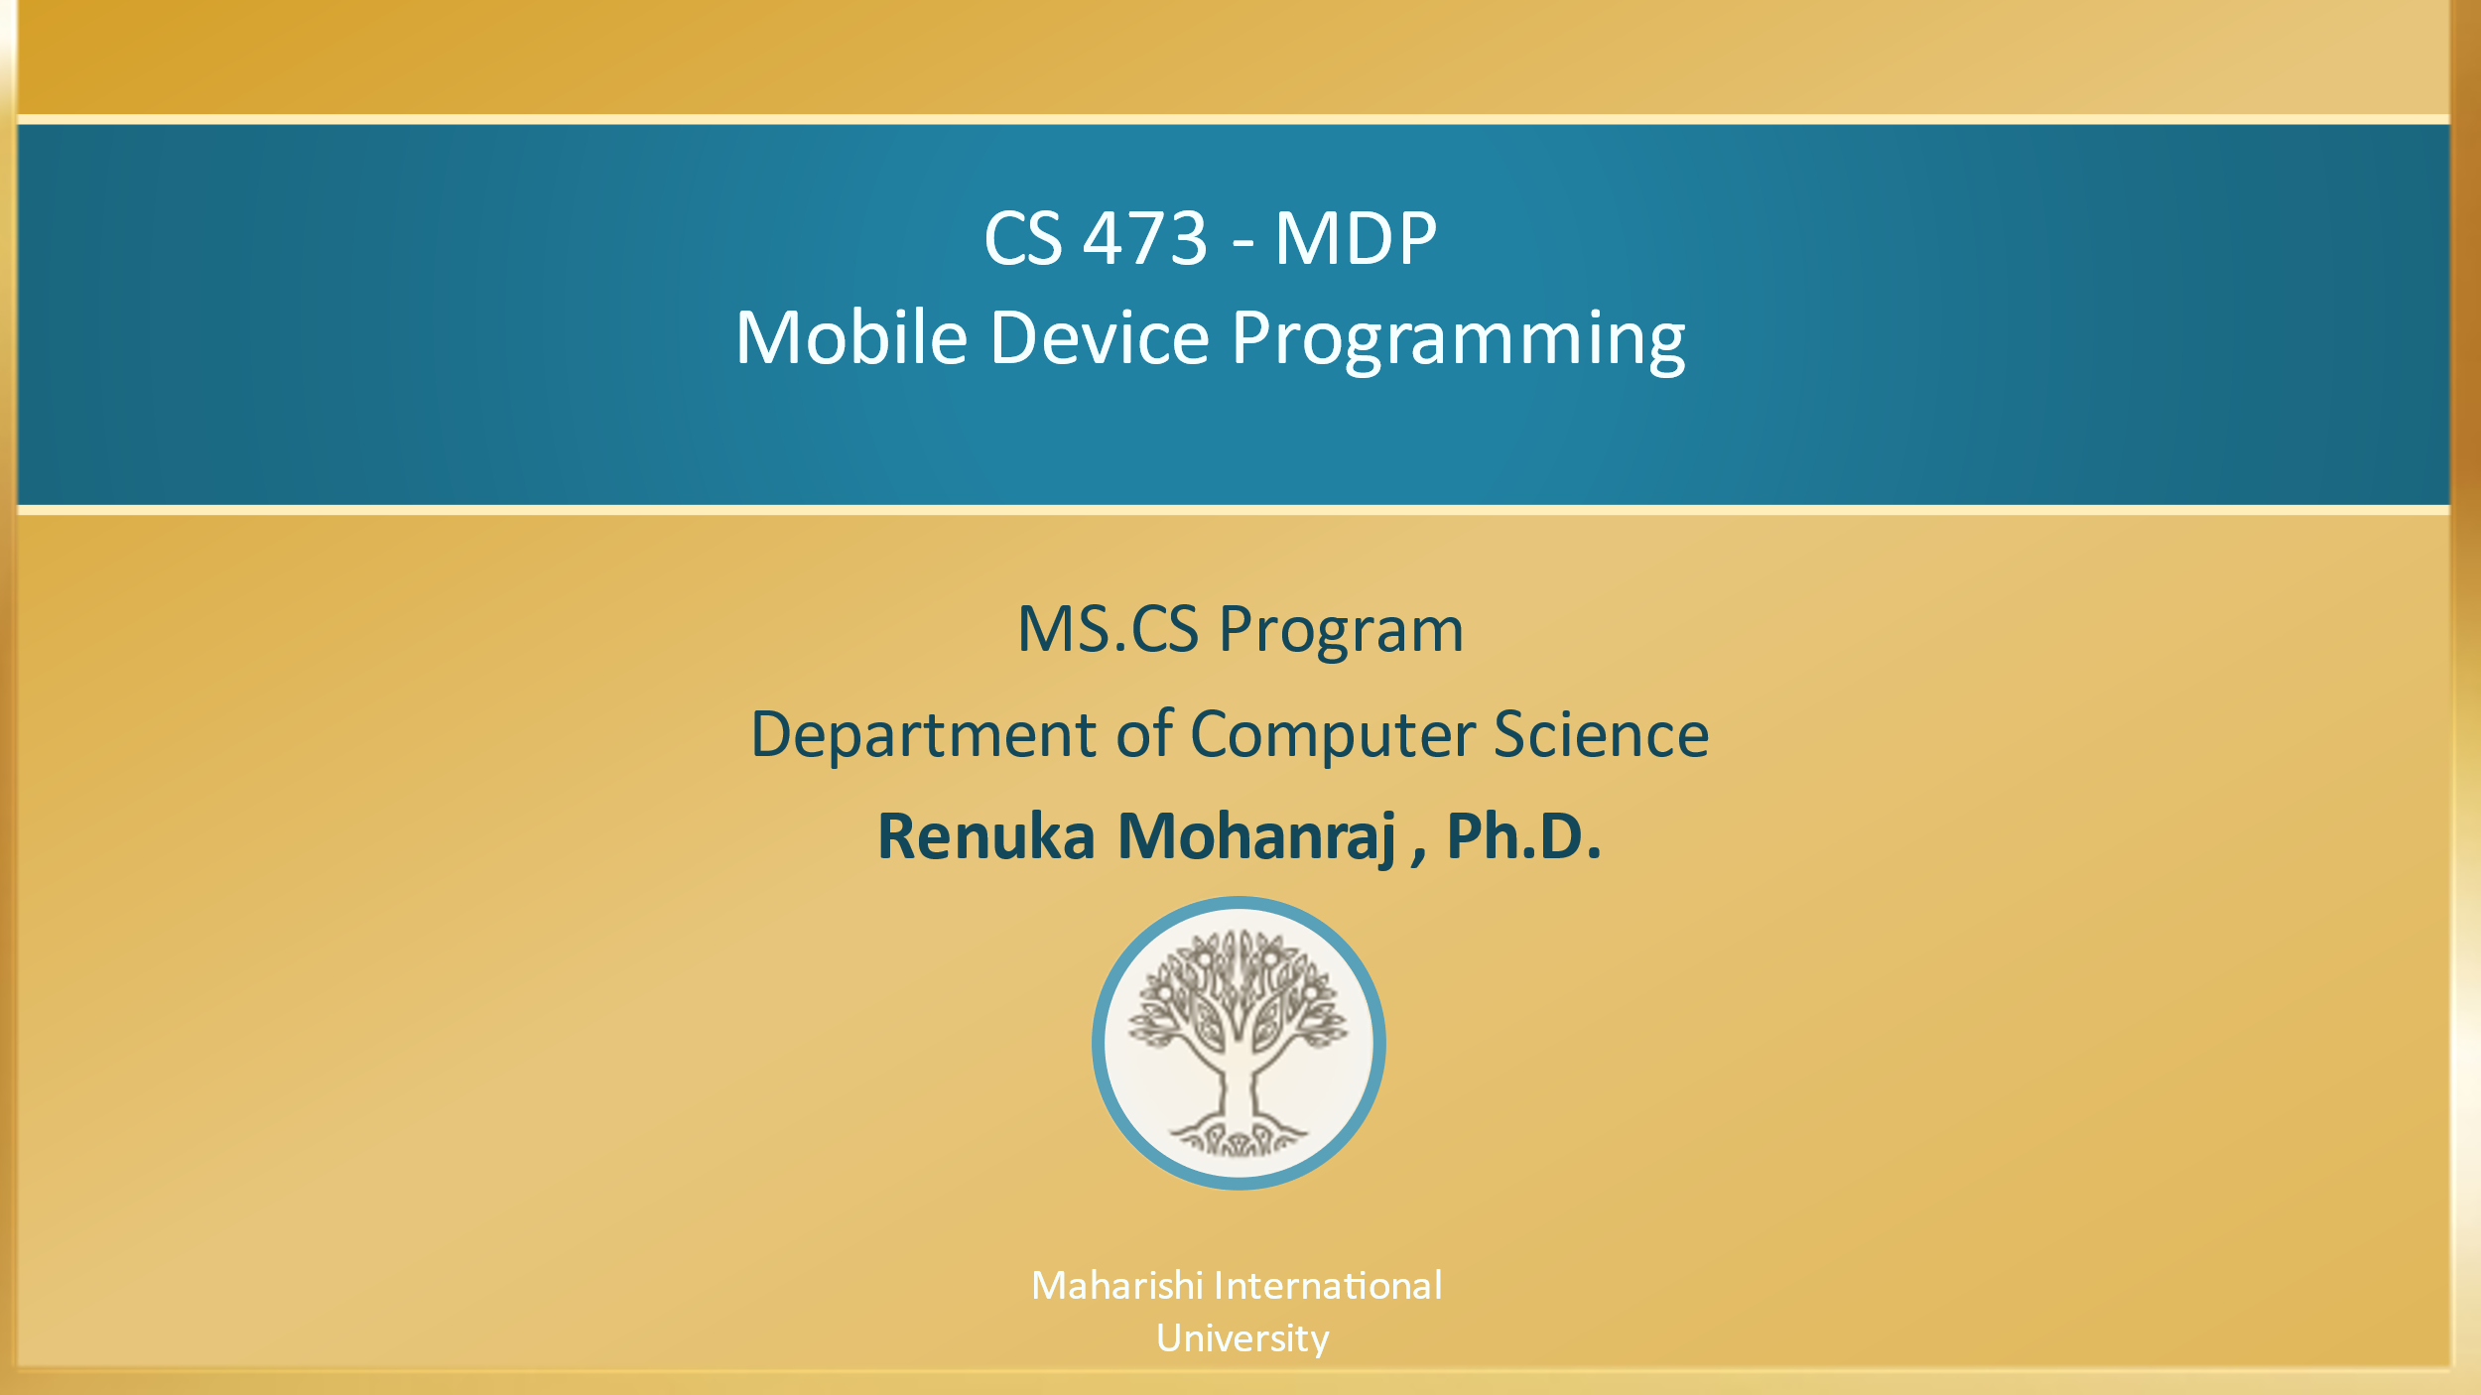

Slide 3

CS 473 – MDP
Mobile Device Programming
Lesson 1
Introduction to Android
Maharishi International
University
Maharishi International University

Slide 4
Wholeness of this lesson
This lecture serves as an introduction to Android Programming. We will briefly cover the basics of Android such as Architecture, Features, Releases and the Components. This will give us a solid foundation before creating android applications. Similarly, why we want to start the day with TM; to make sure our mind is clear and rested before starting activity.

Slide 5
Agenda
What is Android?
Android Architecture
Android Features
Android History and Releases
Android Components

Slide 6
What is Android?
Android is a Mobile Platform which consist of OS(Linux), Middleware (Libraries and Application Framework) and Key Applications.
Mobile operating system based on Linux kernel(Component of Linux OS)
User Interface for touch screens
Used on over 80% of all smartphones
Powers devices such as Watches, Tablets, TVs, IoT, and Cars[Android auto App]
Over 3.5 Million Android apps in Google Play store
Highly customizable for devices / by vendors
Open source to everyone
To know more about What is Android Click the Link: https://www.android.com/what-is-android/
Notes:
Android Vendors
HTC
LG
Samsung
Dell
Toshiba
Google OnePlus
Moto G
Nokia

Slide 7
Android Architecture https://developer.android.com/guide/platform

Slide 8

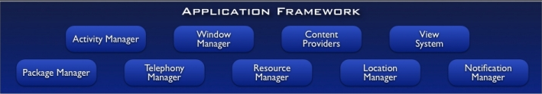
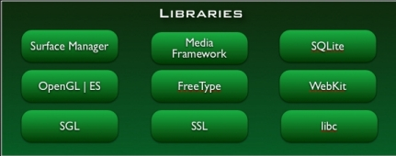
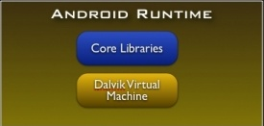
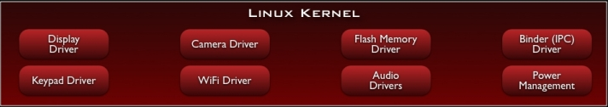
Notes:
Android architecture is a software stack of components to support mobile device needs.
Android is a Mobile Platform which consist of OS(Linux), Middleware (Libraries and Application Framework) and Key Applications.
The Android architecture as shown in figure is made up of different layers. Each layer consists of several program components. All the layers are connected to each other.
The Android architecture consists of the following four layers and divided into five sections:
Linux Kernel – Hardware and Software interaction. IPC stands for Inter-Process Communication.
Libraries : Example : (Native language(C/C++) libraries for other support – OpenGL | ES – Graphics Library to display. ES – Embedded Systems
SGL stands for "Scalable Graphics Library“
SSL stands for “Secure Socket Layer”
Android Runtime(ART) : meet the needs of running in an embedded environment ,i.e., where is limited battery, limited Memory and limited CPU.
DALVIK VIRTUAL MACHINE:
→ The Dalvik VM executes applications that require minimum processing power and memory.
→ It is similar to the Java Virtual Machine (JVM).
→ The JVM runs .class files whereas the Dalvik VM runs .dex files, which are tailored to provide higher efficiency.
→ The Dalvik VM provides support for security, memory management, isolation, and threading.
→ DVM allows every Android application to run as a separate process, but with its own instance of DVM.
→ DVM is a virtual machine that is created when a process starts and is destroyed when the process exits
Android Libraries:
In addition to a set of standard Java development libraries, the Android development environment also includes the Android Libraries.
Application Framework : Provides a readymade library for doing several task. (Eg : GPS, Wi-Fi)
Applications : At this top layer are the applications that ship with the Android device(such as Phone, Contacts, Browser, and so on), as well as
applications that you download and install from the Android Market. Any applications that you write are located at this layer.

Slide 9
Android Architecture https://developer.android.com/guide/platform
The Android architecture consists of the following four layers and divided into five sections:
Linux Kernel – Hardware and Software interaction.
It provides Security, Process management, Memory management, Device management and Multitasking.
It is also responsible for a level of abstraction between device hardware and upper layers of Android architecture. It consists of device drivers like camera, flash memory, Display, keypad, Wifi etc. IPC stands for Inter-Process Communication.

Slide 10
Android Architecture
2. Libraries and Android Runtime
In addition to a set of standard Java development libraries, the Android development environment also includes the Android Libraries.
(Native language(C/C++) libraries for other support – OpenGL – Graphics Library to display.
SGL stands for "Scalable Graphics Library“
SSL stands for “Secure Socket Layer”
ES – Embedded System
Android Runtime(ART) : Meets the need of running in an embedded environment.
Notes:
Libc – C Runtime library
Android also includes a set of core runtime libraries that provide most of the functionality of the Java programming language, including some Java 8 language features, that the Java API framework uses.

Slide 11
Android Architecture
DALVIK VIRTUAL MACHINE
It is like Java uses Java Virtual Machine (JVM).
The JVM runs .class files whereas the Dalvik VM runs .dex files, which are tailored to provide higher efficiency.
In android Dalvik Virtual Machine(DVK) takes the Java byte code as input and produce light weight format file called .dex.
Byte codes are suitable for the heavy devices like PC. But mobile don’t have huge memory power or RAM capacity. DVM uses the compression technique to make a lightweight single file called .dex (Dalvik Executable code).
The Dalvik VM provides support for security, memory management, isolation, and threading.

Slide 12
Android Architecture
3. Application Framework :
Provides a readymade library for doing several task. (Eg: GPS, Wi-Fi, Bluetooth etc.,)
Notes:
Activity Manager: The method in this class uses testing and debugging methods.
Content provider: It provides data from application to other layers.
Resource Manager: It provides access to non-code resources.
Notification Manager: The users get notification about all the actions happening in the background.
View System: It acts as a base class for widgets and is responsible for event handling.

Slide 13
Android Architecture
4. Applications :
At this top layer are the applications that ship with the Android device(such as Phone, Contacts, Browser, and so on), as well as applications that you download and install from the Android Market i.e. Google Play Store.
Any applications that you develop are located at this layer.

Slide 14
Android Features
Complete, open, and free mobile platform with secure OS and robust framework.
Dalvik Virtual Machine is optimized for mobile devices.
Telephony support
Integrated browser based on the open source WebKit engine for rendering web pages
Media support for common audio, video, and still-image formats (MPEG-4, H.264, MP3, AAC, AMR, JPG, PNG, GIF)
Android includes support for high performance 2D and 3D graphics with the Open Graphics Library
GPS support, Wi-Fi support
XML and JetPack Compose support for Designing. This course focused on XML approach.
SQLite for structured data storage by default. [ Room DB will be discussed ]
Multi-touch and Multi-tasking
Notes:
Robust Security : When you have Android, you have security that’s right there out of the box and never stops working. Google Play Protect scans all your apps, the software gets regular security updates and the platform is always improving. It’s like a security guard that never takes a break, a nap or a vacation.
Multi-tasking
User can jump from one task to another and same time various application can run simultaneously.
Why should I use Jetpack Compose?
Jetpack Compose is Android’s modern toolkit for building native UI. It simplifies and accelerates UI development on Android bringing your apps to life with less code, powerful tools, and intuitive(declarative) Kotlin APIs. It makes building Android UI faster and easier.
https://developer.android.com/jetpack/compose/tutorial

Slide 15
Android History and Releases
Android did not originate with Google. Instead, Android was initially developed by Android Inc., California–based startup company.
Google bought this company in the summer of 2005 and released a beta version of the Android Software Development Kit (SDK) in November 2007.
On September 23, 2008, Google released Android 1.0, whose core features included a web browser, camera support, Google Search, and more.
Table from the next slide outlines subsequent releases. (Starting with version 1.0, each major release comes under a code name that’s based on a dessert item.)
More Info : https://source.android.com/setup/build-numbers

Slide 16
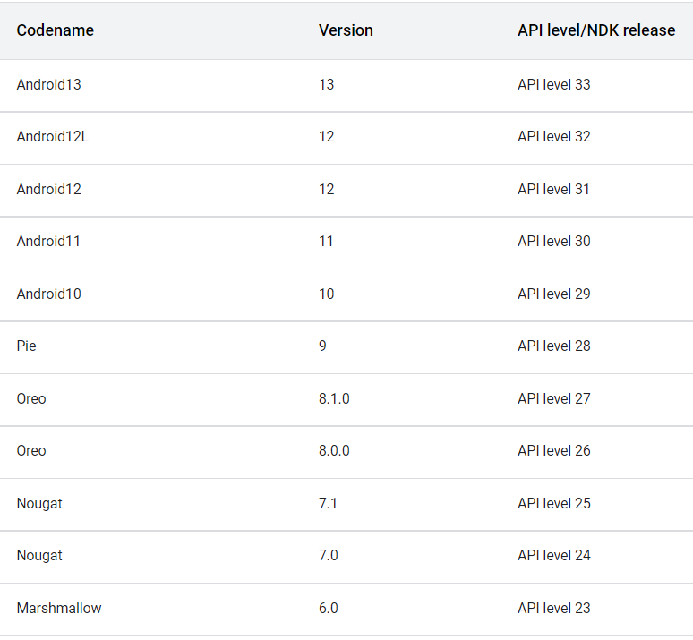
Android Version, Codename, API Level Ref : https://source.android.com/setup/start/build-numbers
Notes:
NDK (Native Development Kit)
The Android NDK is a toolset that lets you implement parts of your app in native code, using languages such as C and C++. For certain types of apps, this can help you reuse code libraries written in those languages.
12L refines the system UI to make it more beautiful and easier to use on large screens.
Supporting devices → Pixel 3a and 3a XL and above versions.

Slide 17
Main Point 1
Android programming opens a world of creativity allowing you to express yourself in ways you never dreamed of with the help of its unique architectures and features. Science of Consciousness: With clear intellectual understanding of higher states of consciousness, students grasp more comprehensive, powerful laws of nature in their own consciousness, resulting in thought, speech and action that express more and more total potential of their creativity.

Slide 18
Challenges of Android development
Multiple screen sizes and resolutions (Solution : Weight Property, Constraint Layout)
Performance: make your apps responsive and smooth.
(Ref : https://developer.android.com/topic/performance/)
Security: keep source code and user data safe
To make your Android Package(APK) file as small as possible, you should enable shrinking to remove unused code and resources in your release.
(Ref : https://developer.android.com/studio/build/shrink-code)
Apply encryption techniques to secure your app data.
Compatibility: run well on older platform versions.
Some versions of android does not support many features. So, choose the version used by majority of people.
Marketing: understand the market and your users
Monetize, analyze, and promote your mobile apps with AdMob.
Notes:
Monetize means earn revenue

Slide 19
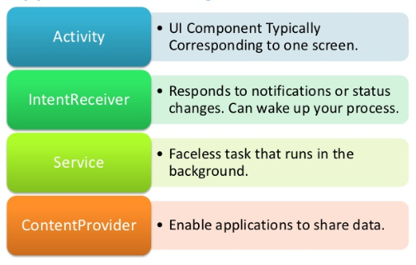
Android Components
App components are the essential building blocks of an Android app. Each component is an entry point through which the system or a user can enter your app. Some components depend on others.
BroadCastReceiver
Notes:
AIDL (Android Interface Definition Language) is an IDL language used to generate code that enables two processes on an Android-powered device to talk using inter process communication (IPC).
Android Components – These classes are actually the contract between the application and the operating system.

Slide 20
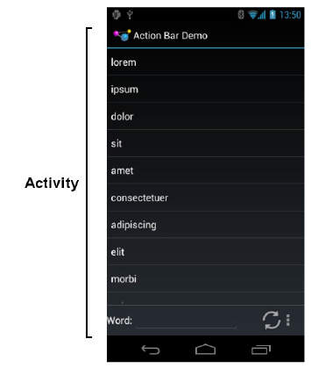
1. Activity
Every single screen is one activity. It’s a Java or Kotlin file. We use Kotlin codes.
The building block of the user interface is the activity.
It represents a chunk of your user interface and, in some cases, a discrete entry point into your app (i.e., a way for other apps to link to your app).
When you make an interactive Android program, you start by sub classing the AppCompatActivity.
Activities provide the reusable, interchangeable parts of the flow of UI components across Android applications.

Slide 21
2. Service
The Android Service class is for background tasks that may be active but not visible on the screen. It works without user interaction.
Examples
When you receive your email updates in inbox it is a service. You get the notification of new e-mail even if you are not using the e-mail app or doing something else.
Wi-Fi availability status, listening to music in the background, playing games while downloading from the play store.

Slide 22
3. Content Providers
Applications can not directly share data between them in Android. It is one of the important security feature. But Content Providers implement a mechanism for the sharing of data between applications.
A content provider component supplies data from one application to others on request.
Example: WhatsApp can read data from Contacts with the help of Content Providers.
Photos, System Dictionary( add words and use if other apps)

Slide 23
4. Broadcast Receiver
The BroadcastReceiver simply respond to broadcast messages from other applications or from the system.
It is registered for system announcements.
Example : Once you insert a headphone, automatically your phone recognize that by showing a headphone symbol, device starts charging, data downloaded, pressing power button, battery low etc.,
Learn more info : https://developer.android.com/guide/components/fundamentals

Slide 24
Quiz
Name the top and bottom layers of Android architecture.
Which one of the Android app component helps to share the data between different apps?
a) Activity b) Service c) Content Provider

Slide 25
Main Point 2
App components are the essential building blocks of an Android app. Each component is an entry point through which the system or a user can enter your app. Some components depend on others. Science of Consciousness: Regular practice Transcendental Meditation is essential entry point to achieve different aspects of their lives. Life become more orderly, and more rewarding and more successful.

Slide 26
