Slide 1
UNLOCKED
Microsoft
NeuroAR
Problem Statement & Context
Students (Class 9–12) struggle to visualize 3D anatomy from 2D textbook diagrams.
Learning is passive — no feedback on what a student understands or repeatedly gets wrong.
Existing AR apps show 3D models but offer zero personalization or adaptive guidance.
No system connects what a student studied, for how long, and where they keep failing.
Teachers cannot identify individual weak spots at scale across a classroom.
Result: shallow understanding, low engagement, and poor exam outcomes.
The gap between textbooks and real anatomical understanding

Slide 2
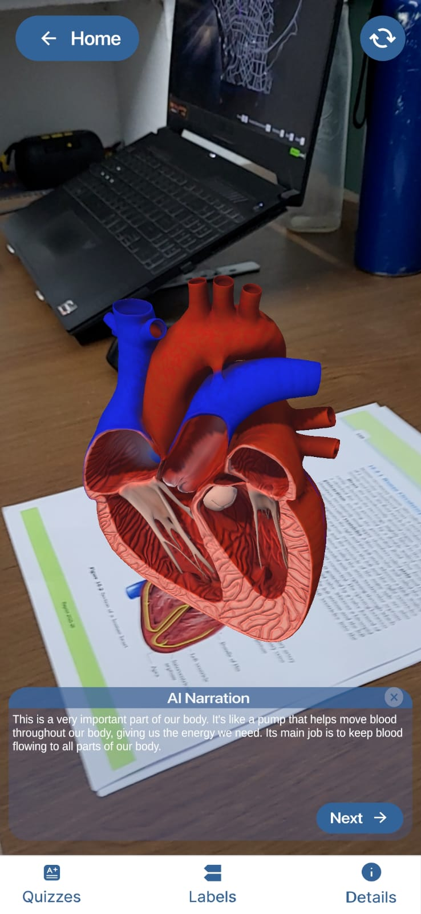
UNLOCKED
Microsoft
NeuroAR
Solution Overview
Scan a physical flashcard → 3D interactive organ model appears in Augmented Reality
Three AI agents adapt the full experience to each individual student in real time.
Agent 1 (Profile Agent): builds a live learner profile — tracks organs studied, quiz history, and weak concepts.
Agent 2 (Narration Agent): Groq generates a personalised narration when an organ is detected.
Agent 3 (Quiz Agent): Groq generates 5 MCQs targeted at the student's weakest concepts.
Frontend: Unity + Vuforia (Android) | Backend: Node.js + MongoDB Atlas + Llama
AR Anatomy — AI-powered personalised anatomy learning on Android

Slide 3
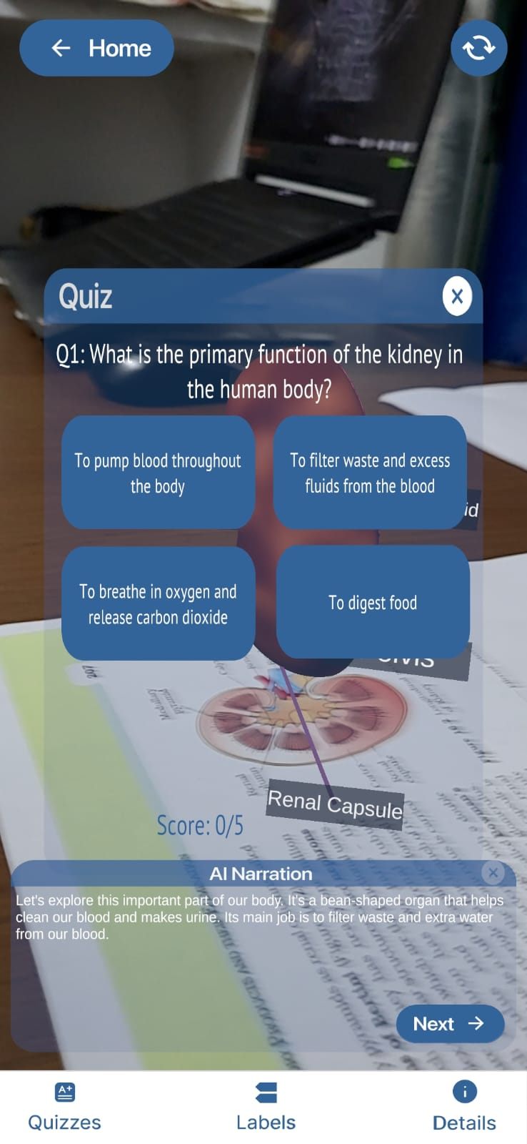
UNLOCKED
Microsoft
NeuroAR
Key Features & User Flow
AR Visualisation — scan card → 3D organ (basic/detailed toggle), anatomical label overlay, pinch-to-zoom
AI Narration (Agent 2) — level-appropriate 60-word narration displayed on every organ detection.
Smart Quiz (Agent 3) — Llama generates quiz questions targeting the student's weakest concepts.
Adaptive Profile (Agent 1) — tracks every session, quiz result, time spent; computes overall Level + weak Concepts.
Onboarding — collects grade, prior knowledge, and learning goal on first login.
User Flow: Login → Profile loads → Scan flashcard → 3D model + AI narration → View labels → Take quiz → Results saved → Profile updated → Next organ recommended
From scan to personalised learning in under 3 seconds

Slide 4
UNLOCKED
Microsoft
NeuroAR
Architecture & Technology
Unity (Android) sends HTTP POST requests with JSON to an Express server — 7 REST endpoints.
Endpoints: /api/profile/load, /api/profile/save, /api/organ/log, /api/quiz/submit, /api/agent/narrate, /api/agent/question.
MongoDB Atlas stores one document per student: organ History, quiz History, agent Summary.
Llama 70b8192 powers all three agents — summary computation, narration, quiz generation.
All Unity agents degrade gracefully to offline mode if the backend is unreachable.
AR layer: Vuforia 11.4 image targets → Observer Behaviour → TRACKED / LOST events drive all agent hooks.
Stack: Unity 2022 + C# | Vuforia 11.4 | Node.js + LangChain.js | MongoDB Atlas | Llama
Unity frontend ↔ Node.js backend ↔ Llama intelligence

Slide 5
UNLOCKED
Microsoft
NeuroAR
Design Decisions & Trade-offs
Thoughtful choices made under real constraints
Unity over native Android: best-in-class AR via Vuforia; single codebase deployable to multiple platforms.
Node.js over Azure Functions: no cold-start delays, instant local testing, easier iterative development.
Silent offline fallback on all 3 agents: students never see a broken experience if backend is unreachable.
Lazy-initialized HTTP service: URL set after component creation, fixing a silent config bug.
Dropped: TTS audio narration — text narration delivers the same educational value faster to implement.
Dropped: LangGraph orchestration — direct Express routes are simpler and fully sufficient for current scope.
Rate limiting (60 req/min) added to all API routes to prevent Llama quota abuse

Slide 6
UNLOCKED
Microsoft
NeuroAR
Current Status, Limitations & Next Steps
Fully functional:
Vuforia AR tracking, 3D organ models (basic + detailed), label overlay, fade animations.
All 3 AI agents implemented in Unity with offline fallback and graceful degradation.
Node.js backend with all 6 endpoints, MongoDB integration, Llama prompts.
Login (demo + guest mode), onboarding flow, profile dashboard with live Agent 1 stats.
Partially implemented / Limitations:
Firebase Google login — code complete, awaiting Firebase SDK package import.
Backend runs locally — ready for deployment to Azure App Service or Railway.
Embeddings model — huggingface sentence-transformers/all-miniLM-L6-v2.
Narration is text-only (no TTS audio); quiz quality depends on Llama anatomy knowledge.
Next Steps:
Deploy Azure AI Speech for audio narration, auto organ detection for any anatomy book.
Expand organ library; add RAG for verified anatomy facts.
Honest assessment and a clear path forward

