Slide 1
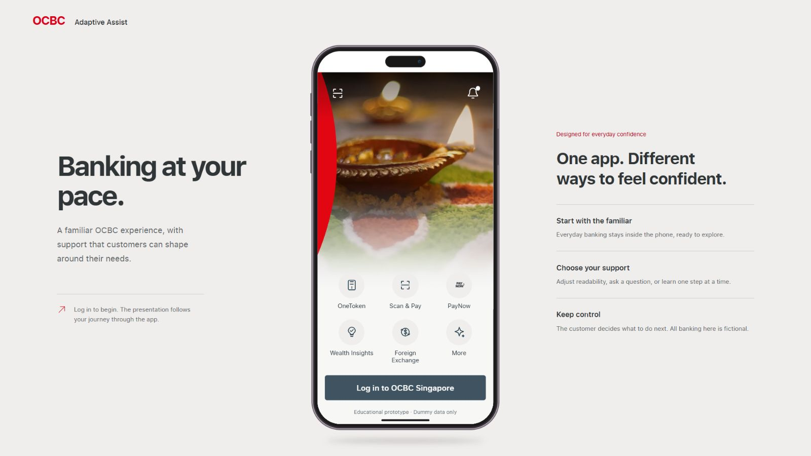
Notes:
Pitch beat 1 - Problem
The same customer can want speed for familiar tasks and explanation for unfamiliar ones.
Actual UI screenshot: 01-problem-login.png
Source: http://localhost:3000/ (25 October 2026). Speaking-flow reference: pitch-notes-adaptive-assist.md.
Static capture: no live web interaction or animation.

Slide 2
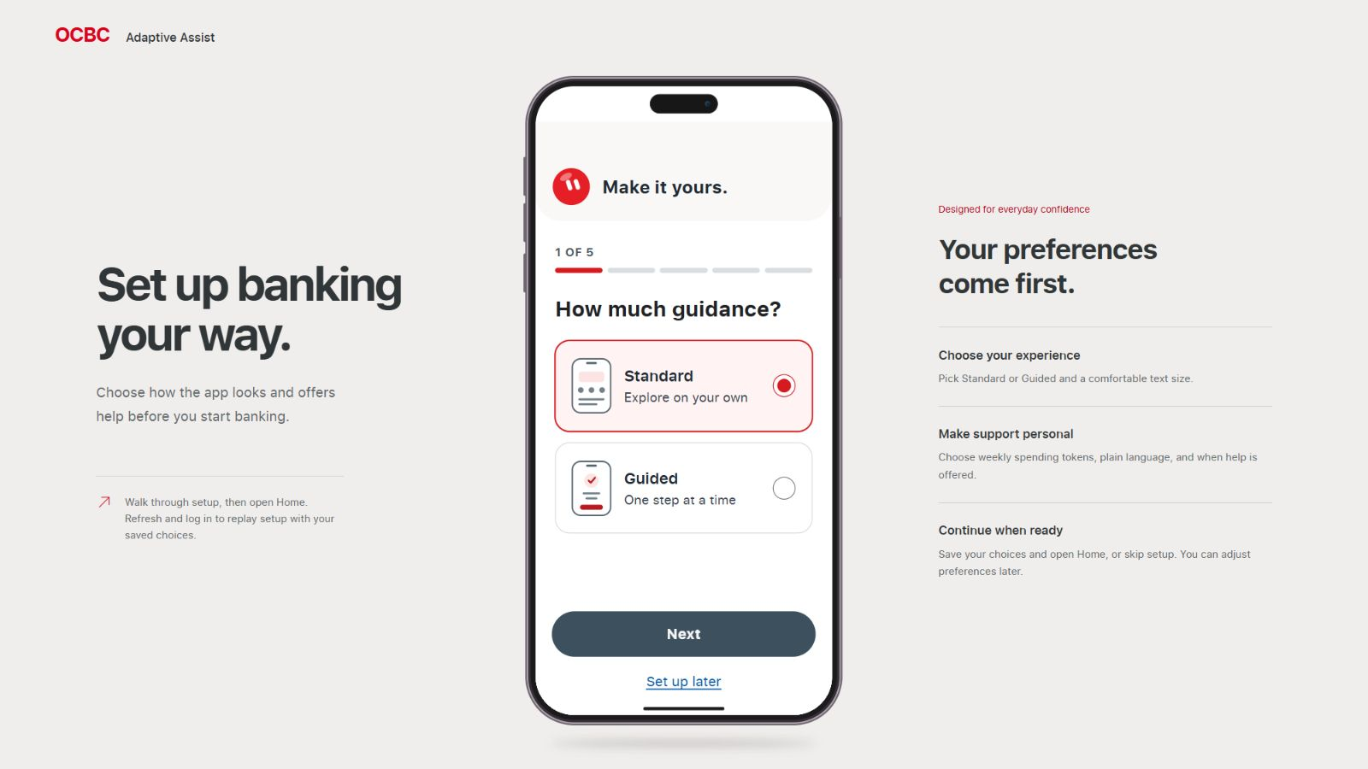
Notes:
Pitch beat 2 - Customer control
Support starts with a choice made by the customer.
Actual UI screenshot: 02-customer-choice.png
Source: http://localhost:3000/ (25 October 2026). Speaking-flow reference: pitch-notes-adaptive-assist.md.
Static capture: no live web interaction or animation.

Slide 3
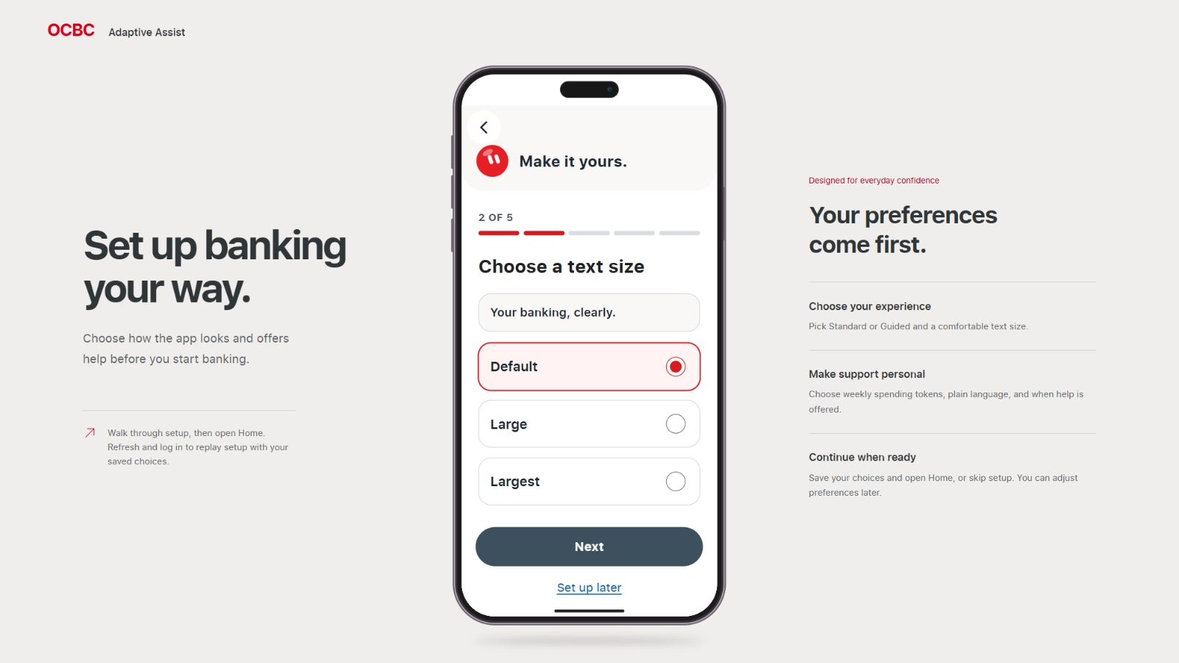
Notes:
Pitch beat 3 - Preferences
Readability is chosen by the customer. This capture preserves the saved Default choice.
Actual UI screenshot: 03a-readability.png
Source: http://localhost:3000/ (25 October 2026). Speaking-flow reference: pitch-notes-adaptive-assist.md.
Static capture: no live web interaction or animation.

Slide 4
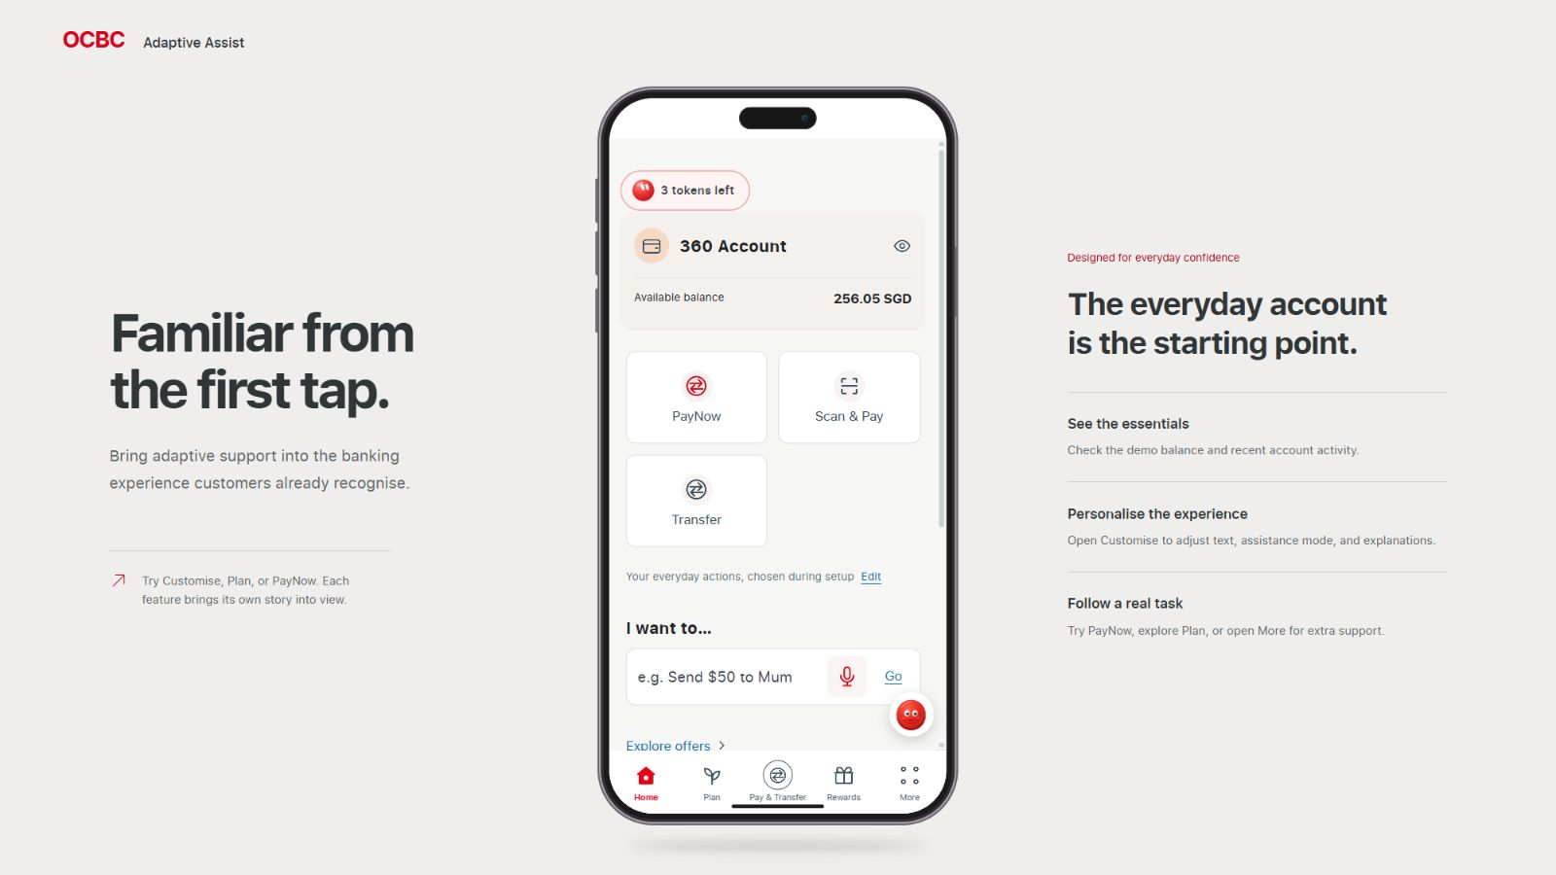
Notes:
Pitch beat 3 - Calm Home
Setup can be postponed. Home shows essentials and the everyday-language entry.
Actual UI screenshot: 03b-calm-home.png
Source: http://localhost:3000/ (25 October 2026). Speaking-flow reference: pitch-notes-adaptive-assist.md.
Static capture: no live web interaction or animation.

Slide 5
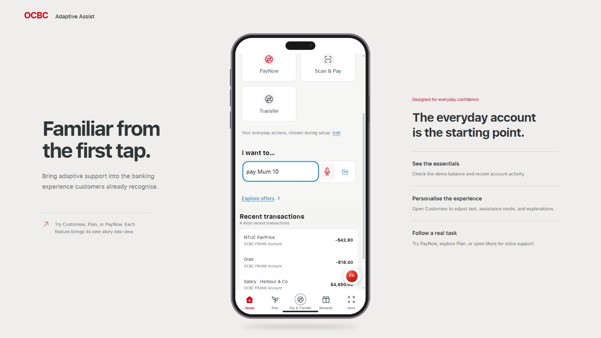
Notes:
Pitch beat 4 - Familiar task
The request prepares a supported task. It does not send money.
Actual UI screenshot: 04a-payment-request.png
Source: http://localhost:3000/ (25 October 2026). Speaking-flow reference: pitch-notes-adaptive-assist.md.
Static capture: no live web interaction or animation.

Slide 6
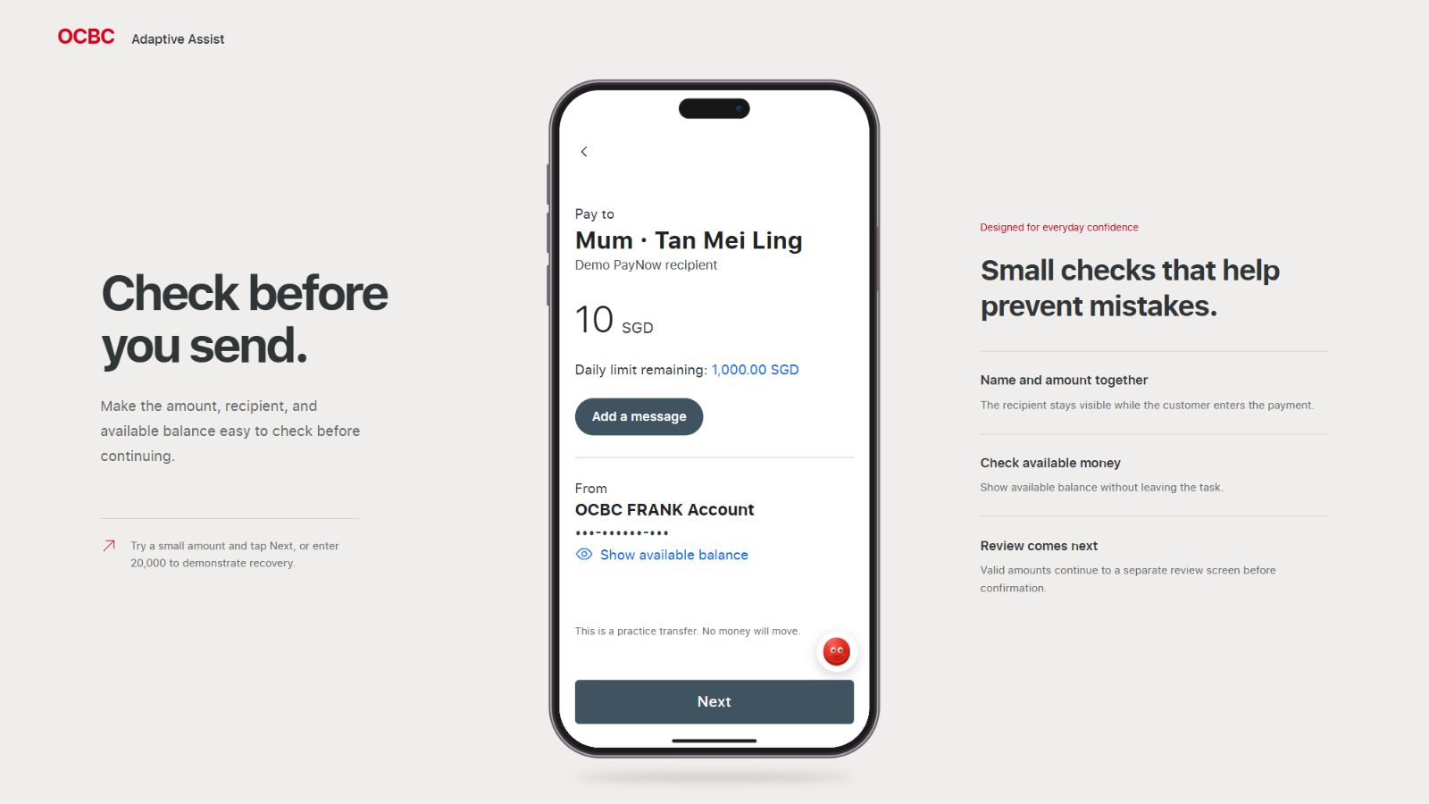
Notes:
Pitch beat 4 - Payment draft
The recipient and amount are ready for the customer to inspect. The optional related offer was dismissed.
Actual UI screenshot: 04b-payment-details.png
Source: http://localhost:3000/ (25 October 2026). Speaking-flow reference: pitch-notes-adaptive-assist.md.
Static capture: no live web interaction or animation.

Slide 7
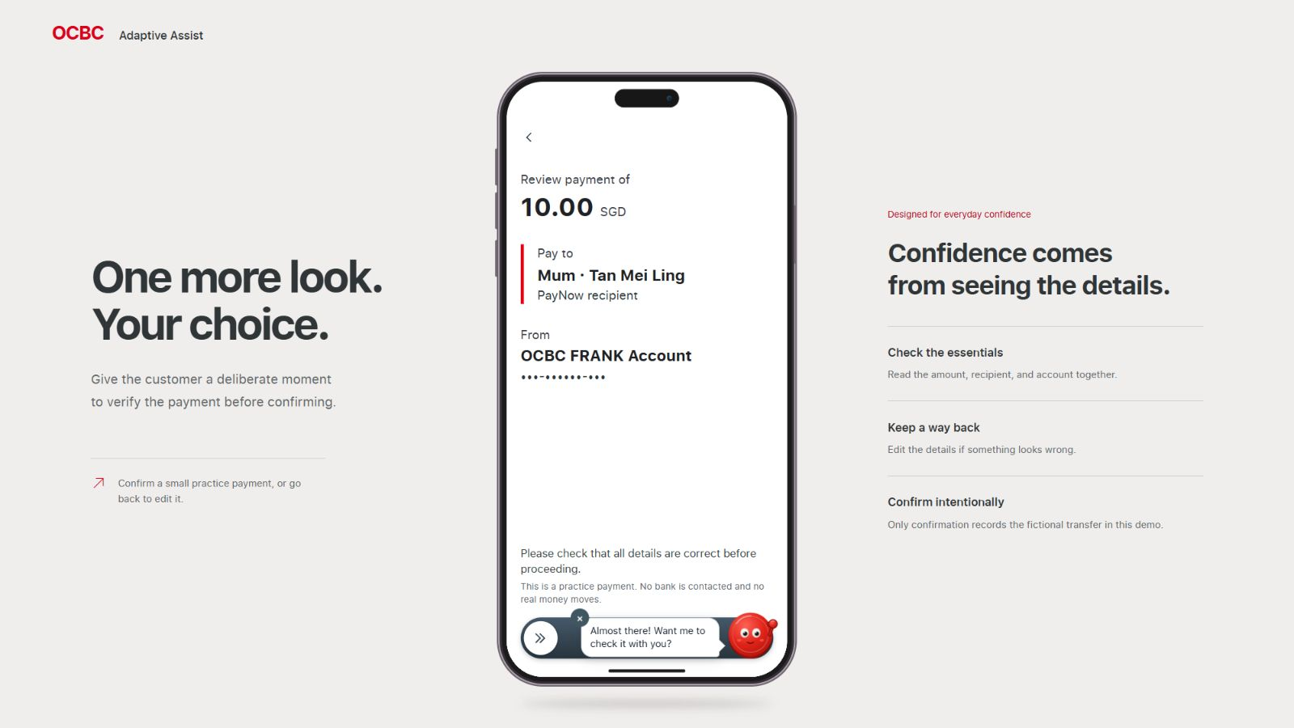
Notes:
Pitch beat 4 - Customer review
The customer checks recipient, amount and account. No confirmation was made during this capture.
Actual UI screenshot: 04c-payment-review.png
Source: http://localhost:3000/ (25 October 2026). Speaking-flow reference: pitch-notes-adaptive-assist.md.
Static capture: no live web interaction or animation.

Slide 8
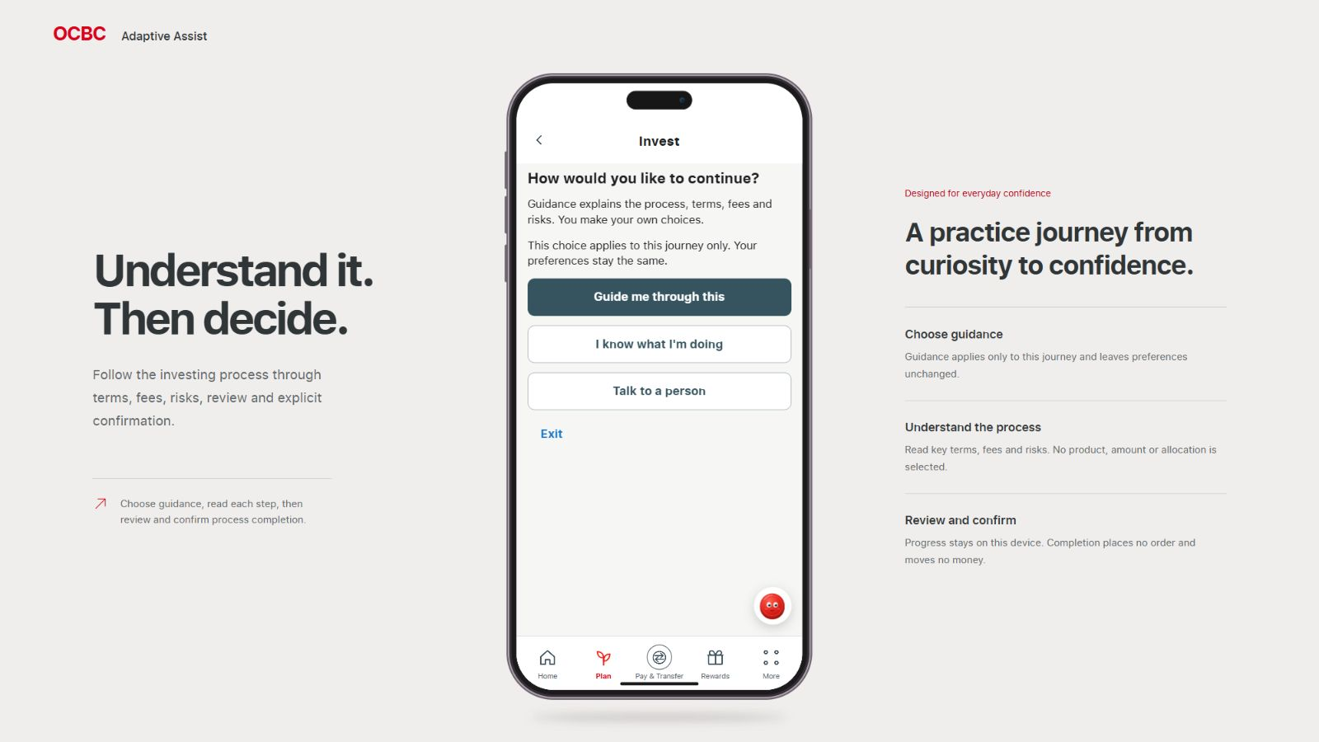
Notes:
Pitch beat 5 - Unfamiliar task
The same customer can choose guidance for this journey. Overall preferences stay the same.
Actual UI screenshot: 05a-journey-choice.png
Source: http://localhost:3000/ (25 October 2026). Speaking-flow reference: pitch-notes-adaptive-assist.md.
Static capture: no live web interaction or animation.

Slide 9
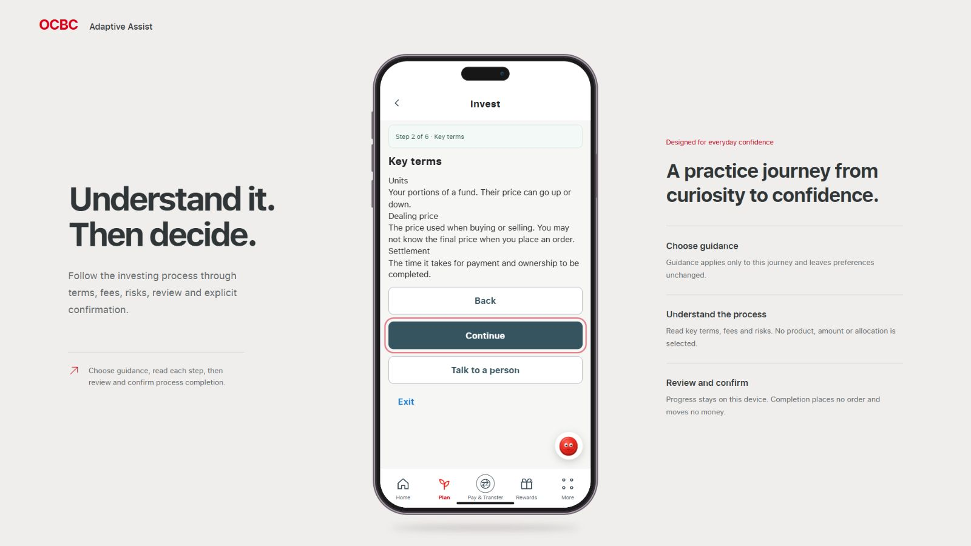
Notes:
Pitch beat 5 - Help for this task
Plain-language process guidance. No product, investment amount or allocation is selected.
Actual UI screenshot: 05b-guided-terms.png
Source: http://localhost:3000/ (25 October 2026). Speaking-flow reference: pitch-notes-adaptive-assist.md.
Static capture: no live web interaction or animation.

Slide 10
Notes:
Pitch beat 6 - Contribution and validation
Visual context only: no validation page exists. Improved understanding and efficiency remain hypotheses. Propose testing completion, errors, comprehension and perceived control.
Actual UI screenshot: 06-validation-context.png
Source: http://localhost:3000/ (25 October 2026). Speaking-flow reference: pitch-notes-adaptive-assist.md.
Static capture: no live web interaction or animation.

Slide 11
Notes:
Pitch beat 7 - Closing
Adapt support to the task while leaving the decision with the customer.
Actual UI screenshot: 07-customer-control.png
Source: http://localhost:3000/ (25 October 2026). Speaking-flow reference: pitch-notes-adaptive-assist.md.
Static capture: no live web interaction or animation.

