Slide 1
Control Systems Lab SC42045
Group 3
Eveline Drijver 4457590
Rudy de Lange 4304632
Mees Matthieu 4436792

Slide 2
Contents
Introduction
State-Space Representation
White-Box Model
Black-Box Model
Controllers
Results & Validation
Questions

Slide 3
Introduction

Slide 4
State-Space Representation

Slide 5
White-Box Model

Slide 6
Black-Box Model

Slide 7
Controllers

Slide 8
Results & Validation

Slide 9
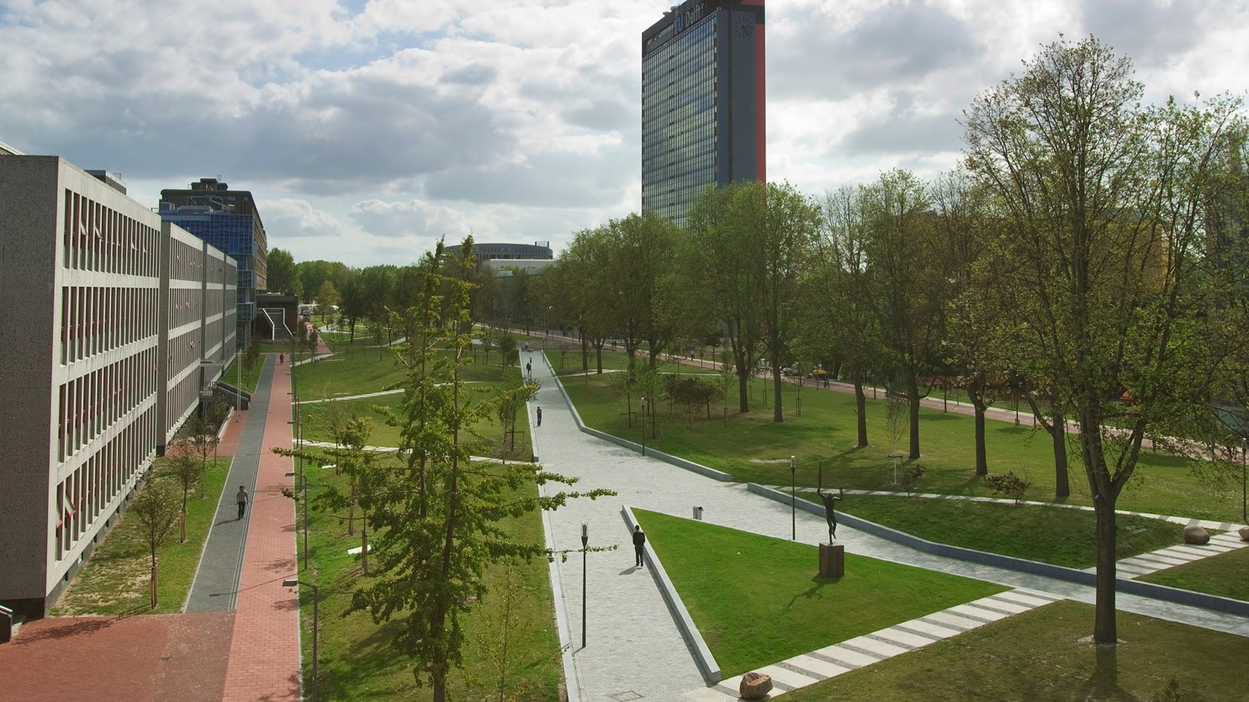
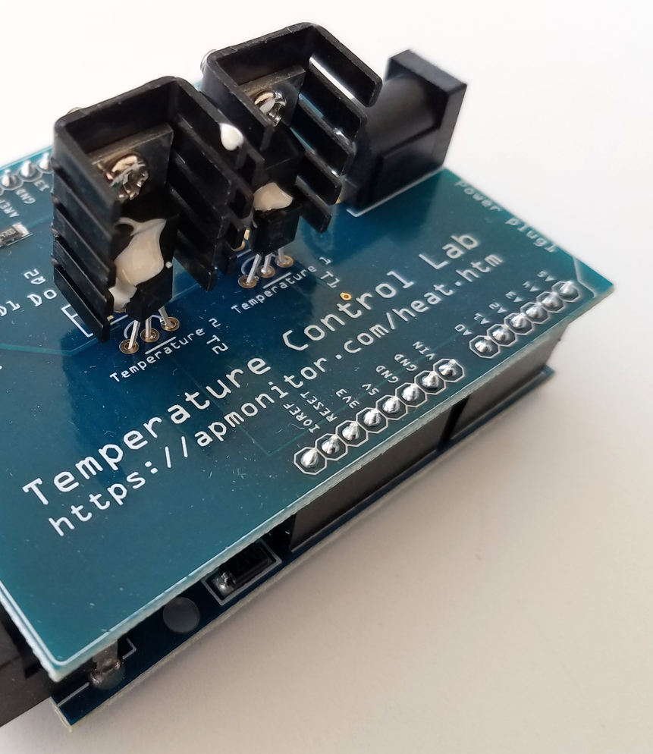
Questions?

Slide 10
Thank you!

