Slide 1

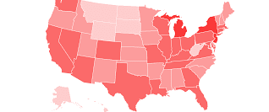
Impact of COVID-19 in U.S.
Python Project by: MKFG
Contributors: Rudy Duvnjak, Joby Augustine, Karla Robles, Alex Lorin

Slide 2
Project Description: Analyze impact of COVID-19 in U.S using data from CDC API. We use visualization to illustrate trends in number of deaths. Analysis by state, by age group and by gender
Questions:
Are there discrepancies in number of deaths between male and female?
Is there any correlation between number of deaths and age groups?
What states were affected the most and what states were affected the least?
Do we have any outliers?

Slide 3
Data for Analysis
Development Tools Used
CDC’s Covid-19 mortality data (https://data.cdc.gov/resource/9bhg-hcku)
Python
Dependencies used:
Pandas
NumPy
Matplotlib
Stats
JSON
Requests

Slide 4
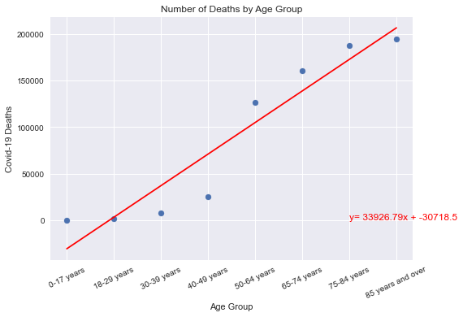
Scatter plot for Number of deaths by age group
Age Group | Number of Deaths
0-17 years | 0
18-29 years | 1,673
30-39 years | 7,921
40-49 years | 24,726
50-64 years | 125,340
65-74 years | 160,076
75-84 years | 186,964
85 years and over | 193,903
In this chart, we were able to confirm that there is a positive correlation between the age and number of deaths caused by COVID-19

Slide 5
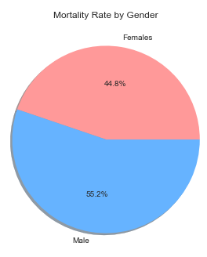
Number of Deaths by Gender
Gender | COVID-19 Deaths | Total Deaths
Female | 313,830 | 2,535,160
Male | 386,773 | 2,809,640
Per our study, there were higher number of deaths in male than female.
In this study, the number of deaths between male and female from COVID-19 corresponds to total number of deaths due to COVID-19, pneumonia, and influenza during same period.

Slide 6
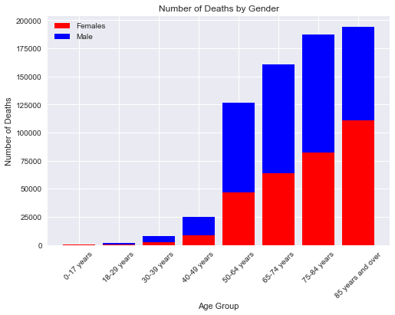
Number of Deaths by Gender and by Age Groups
Gender | Age Group | COVID-19 Deaths | Total Deaths
Female | 0-17 years | 0 | 15,804
 | 18-29 years | 589 | 13,275
 | 30-39 years | 2,657 | 23,575
 | 40-49 years | 8,367 | 54,497
 | 50-64 years | 45,992 | 339,439
 | 65-74 years | 63,572 | 464,811
 | 75-84 years | 81,811 | 641,122
 | 85 years and over | 110,842 | 982,637
Male | 0-17 years | 0 | 22,581
 | 18-29 years | 1,084 | 35,594
 | 30-39 years | 5,264 | 56,712
 | 40-49 years | 16,359 | 111,050
 | 50-64 years | 79,348 | 580,369
 | 65-74 years | 96,504 | 663,306
 | 75-84 years | 105,153 | 712,593
 | 85 years and over | 83,061 | 627,435

Slide 7
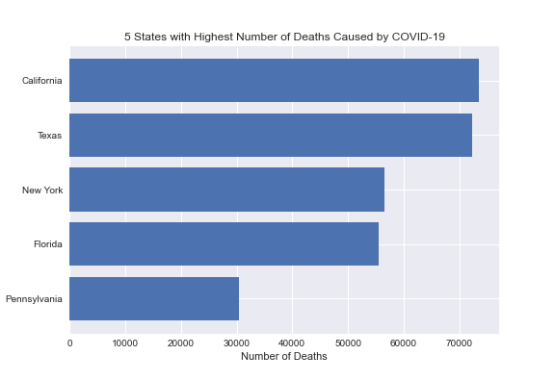
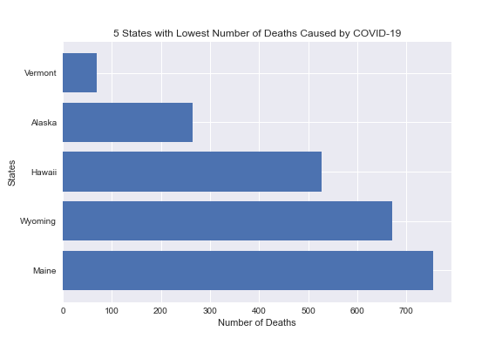
Number of Deaths by States
Number of deaths represented in two graphs above shows that we had higher number of deaths in the states with higher population density and lower number of death in the states with lower population density

Slide 8
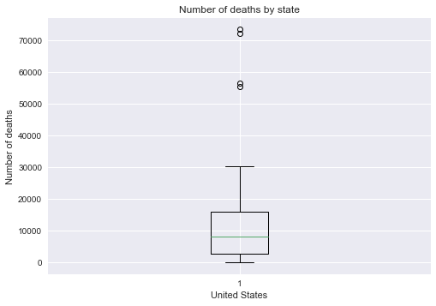
Number of deaths by States (Box and Whisker)
The lower quartile of number of deaths is: 2,703.25
The upper quartile of number of deaths is: 16,107.5
The interquartile range of number of deaths is: 13,404.25
The the median of number of deaths is: 8,143.5
Values above 36,213.875 could be outliers.

Slide 9
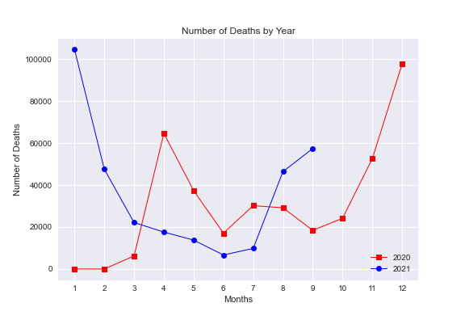
Number of Deaths by Years
Highest number of deaths occurred in December 2020 and January 2021. Since then, the numbers have been dropping, but in most recent months, the number of deaths has increased.

Slide 10
Conclusion
In our data, we could observe that there is substantially higher number of deaths among males compared to females
We could also observe a positive correlation between number of deaths and age.
We observed that the correlation translates when we analyzed the data by gender AND age groups. Males generally had higher percentage of deaths in each age group.
In our data, we were able to observe that states with higher population density have higher number of deaths. Which seem to support the idea that social distancing will lower the number of death caused by COVID-19.
Even though we saw decrease in number of deaths this year with vaccination rollout, the recent data shows higher increase in number of deaths when compared to same time last year.

