Slide 1
House Predictions using AMES dataset
Author: Rudy Meza

Slide 2
Introduction
The following analysis will take a look at the AMES Housing dataset.
The goal is to perform the following steps:
EDA
Preprocess the data for modeling
Implement LASSO Model and Select Features
Implement Linear Regression Model w/ Selected Features
Next Slide For more detail
*Please add slides as required.

Slide 3
The Data
Shape:
82 columns, 100 rows
Information of DF
4 numeric variables
36 integer variables
42 categorial variables
Variables included in the final model:
The variables included in the final model:
Property Size
Location
Property type (Townhome, Duplex, Etc.)
Quality of the property
*Please add slides as required.

Slide 4
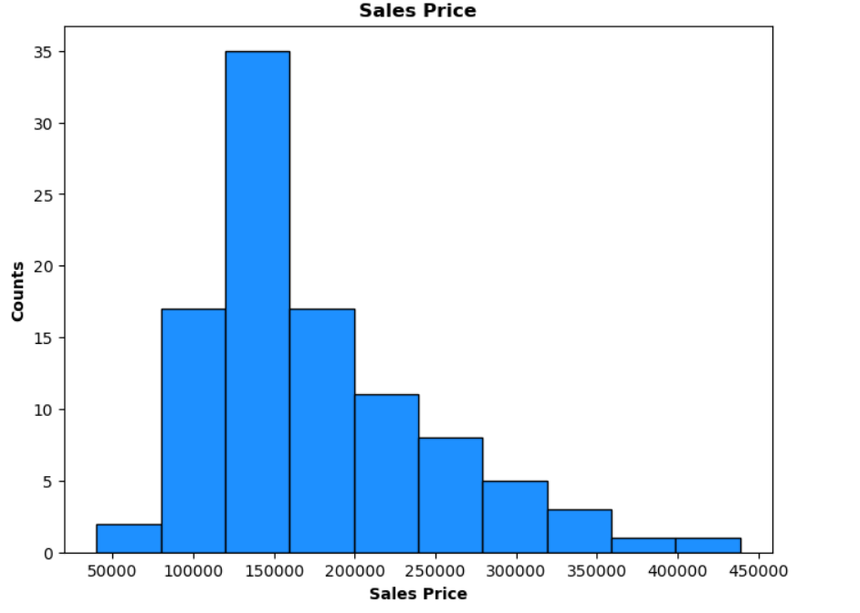
Data Exploration: Sales Price

Slide 5
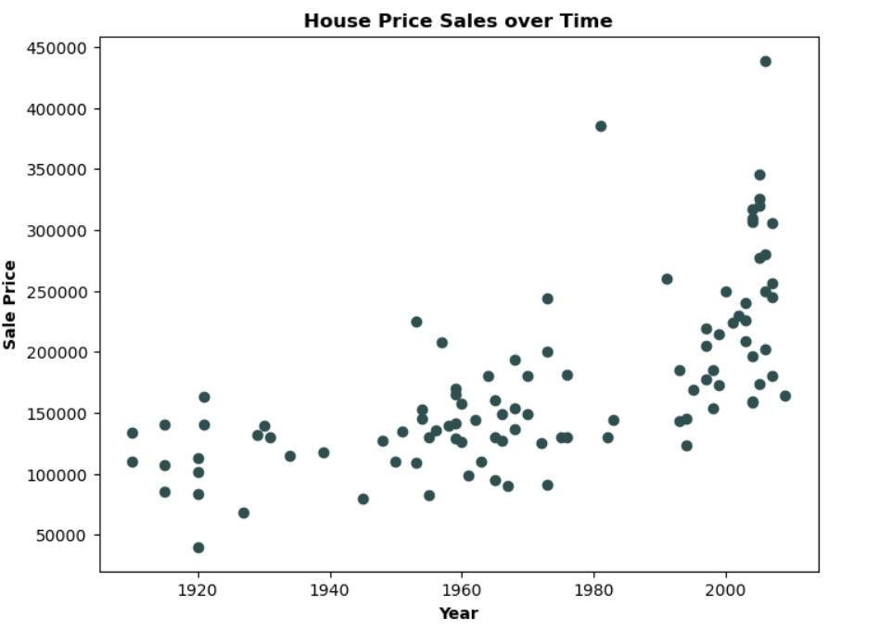
Data Exploration: Sales Price over Time

Slide 6
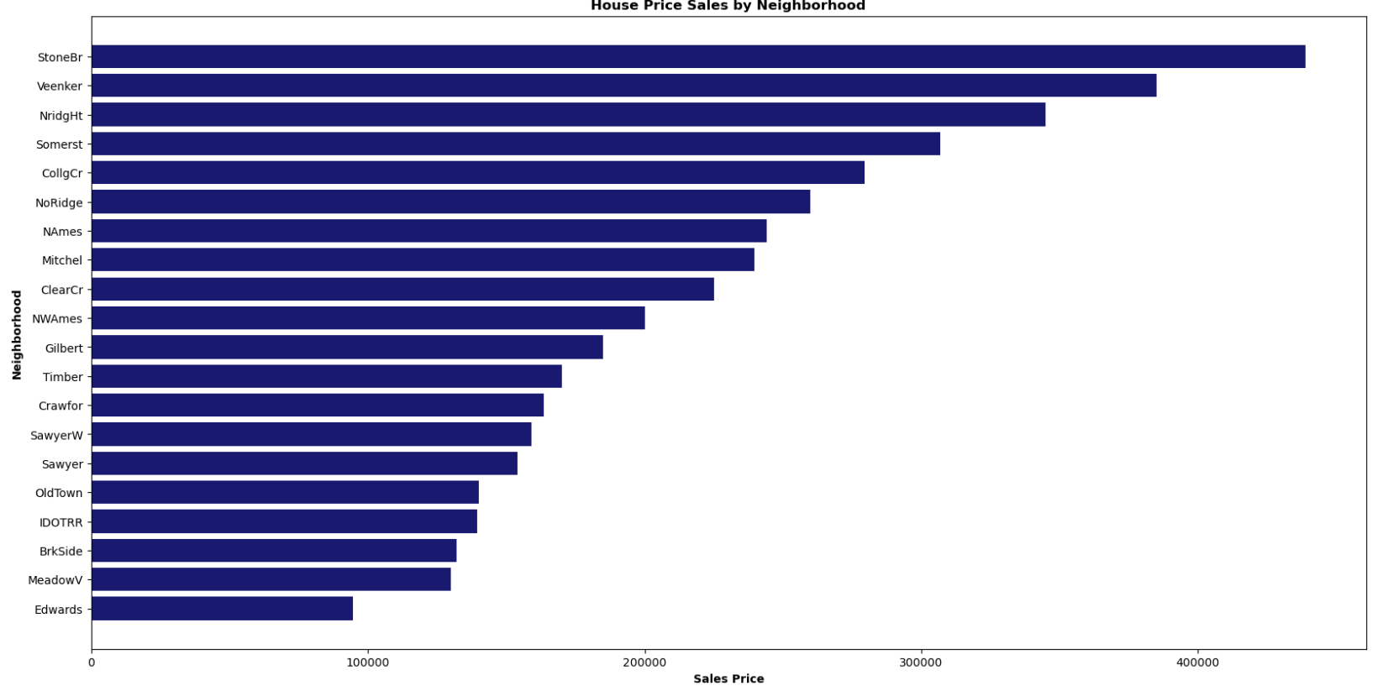
Data Exploration: Sales Price by Neighborhood

Slide 7
Data Preparation
Drop NA values in rows
OneHotEncoder-Create indicator variables for all our categorical variables. Later, the get_dummies function will do this for the linear regresison model.
Scale - Apply a scaler to all out predictors in the training dataset. This is required for the LASSO model.
Cross Validation- This is needed to test how our model performs for different subsets of the data and variable selection
Fit and Assess final model- We will fit on the training and testing of the dataset.
Extarct Features - extarcts the important features from the LASSO model
Apply the Linear Regression model
Assess the final results
*Please add slides as required.

Slide 8
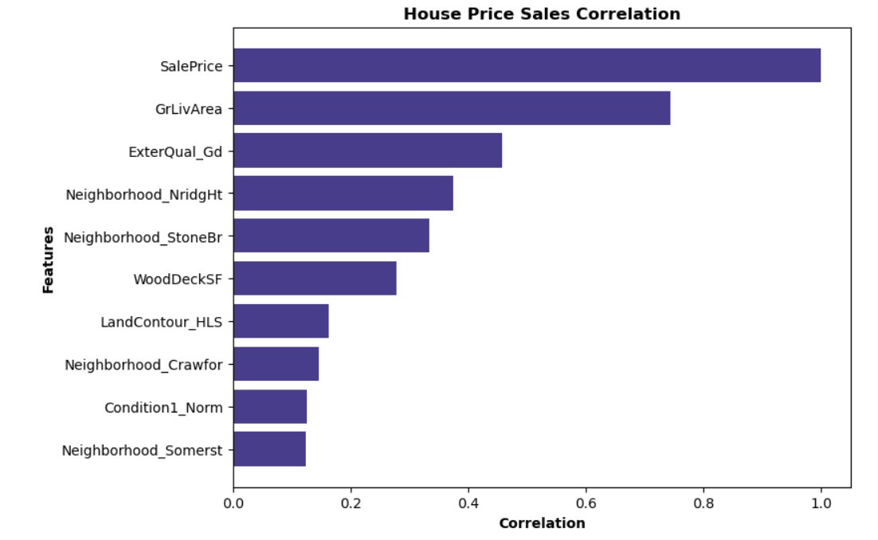
Correlation
GrLivArea has the highest correlation with Sales Price
The Neighborhood Somerst has the lowest correlation with Sales Prices
* Final result for jtest dataset

Slide 9
Project Description
High Cardinality Data
Least Absolute Shrinkage and Selection (LASSO) Regression model
Variable Selector
Top Positive Predictors
Used for Linear Regression Model
Final Predictions
*Please add slides as required.

Slide 10
Analysis and Results
The variables included in the final model:
Property Size
Location
Property type (Townhome, Duplex, Etc.)
Quality of the property
The size of the property makes sense on the effected sales price, but also the location of the Neighborhood. If the property is in a nice location, we’d expect the demand for that property to be high.
Also, the property type in that location and size will affect the price too along with the quality of the property
*Please add slides as required.

Slide 11
Verification
The final model for the testing data:
Model Score: 85%
The training model for the training data:
Model Score: 95%
Overall, the final model performed well.
This was a naïve approach using the LASSO regression model.
Additional feature engineering could have been applied to our original variables such as:
Logs
Polynomials
Differences
Standardizing
bins
*Please add slides as required.

Slide 12
Conclusion
The results show that dealing with 'High Cardinality' data can benefit from using the LASSO Regression model.
This specific model implements feature selection.
We can extract and apply those particular features to the linear regression model.
Our final results show a model score of 85%.
This is an improvement and more realistic since it's less than our training score of 95%. The latter is a vital sign of overfitting.
Overfitting isn't an issue with the jtest results. We expect our testing score to underperform our training score.
If there were opposite results, then I would be concerned with overfitting.
Lastly, the final scatter plot compares SalePrice and Predictions regarding the test data.
*Please add slides as required.

Slide 13
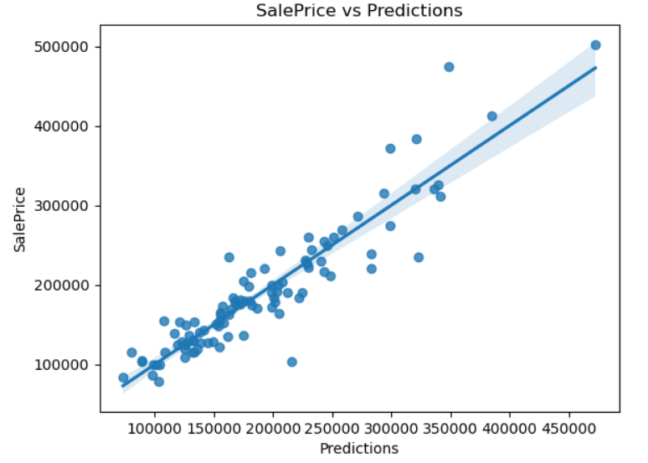
Conclusion
We still see a strong, positive correlation.
The data points are farther from the regression line than the training.
Overall, the model does an excellent job of predicting
*Please add slides as required.

Slide 14
References
Use this format for articles:
- James, Gareth, et al. An Introduction to Statistical Learning: With Applications in Python. Springer, 2023.
Use this format for websites:
- Author Simon, Laura and Young, Derek. “STAT 501” Name of Website. 2024. https://online.stat.psu.edu/stat501/ .
.
*Please add slides as required.

