Slide 1
Zenodo-GitHub-Integration
Arne Rümmler, SLUB Dresden

Slide 2
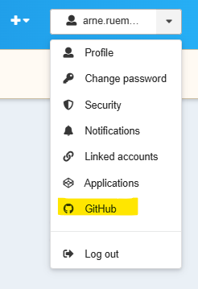
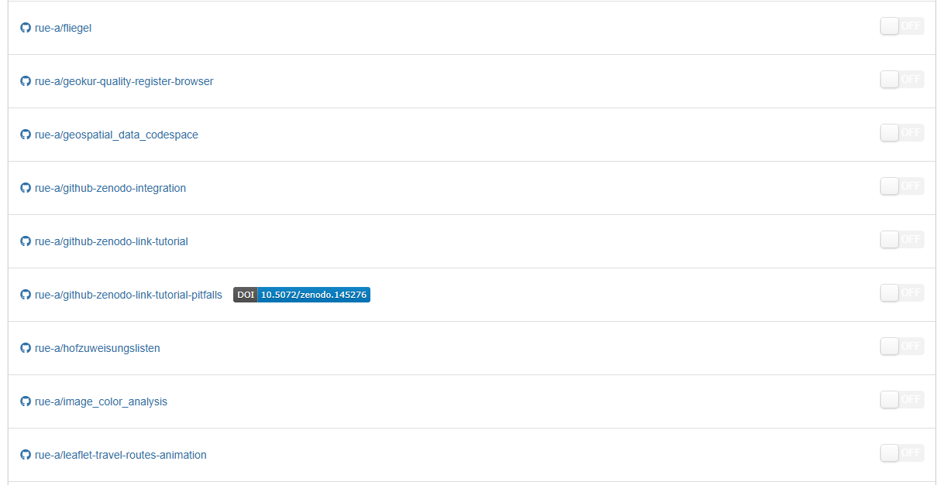
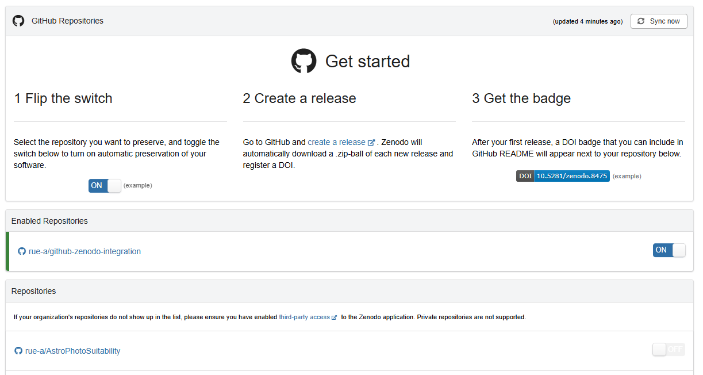
Enabling
https://sandbox.zenodo.org/account/settings/github/

Slide 3
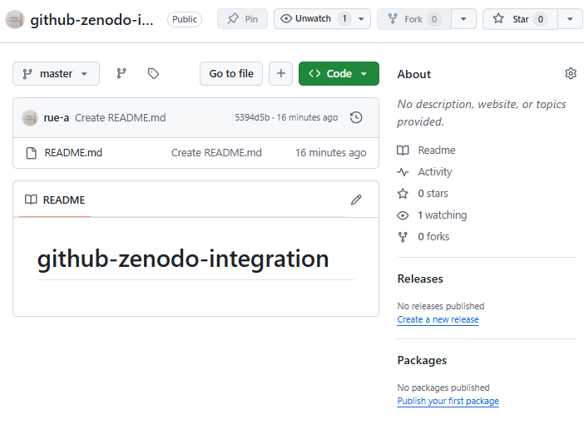
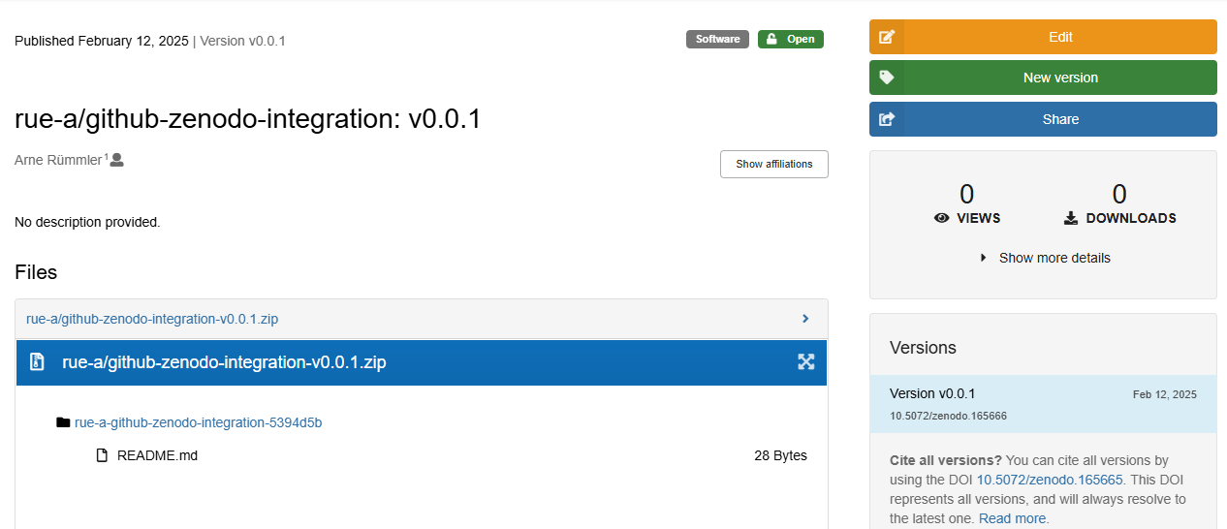
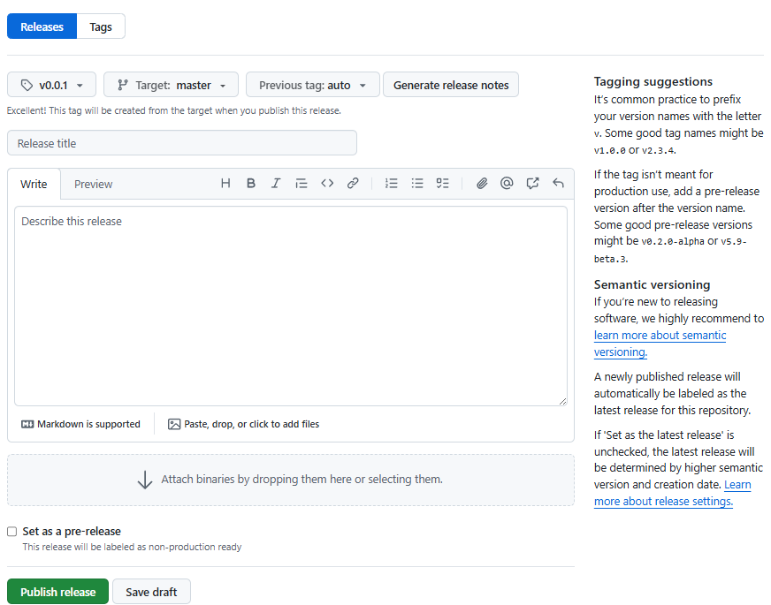
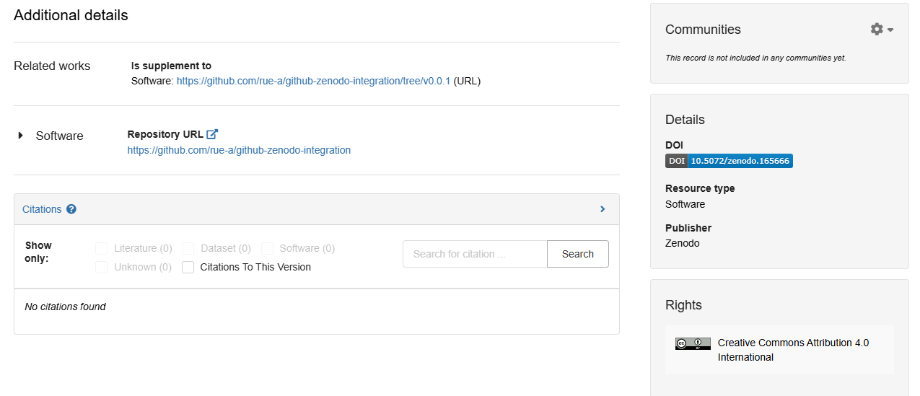
GitHub ⇾ Zenodo
Insufficient!

Slide 4
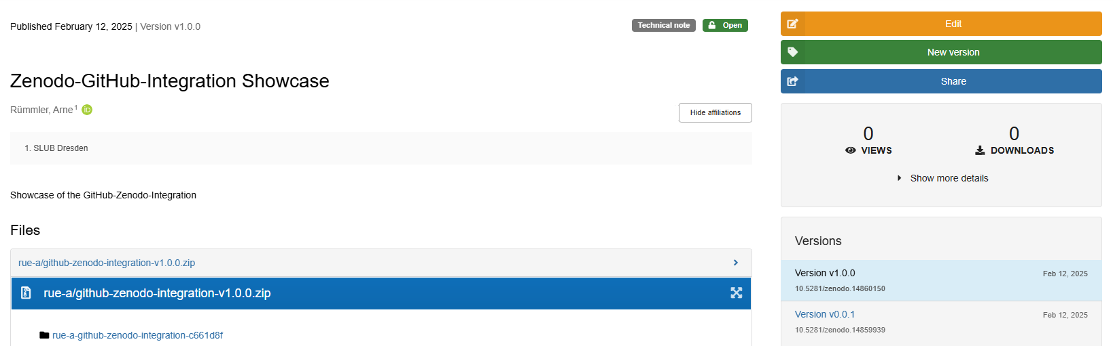
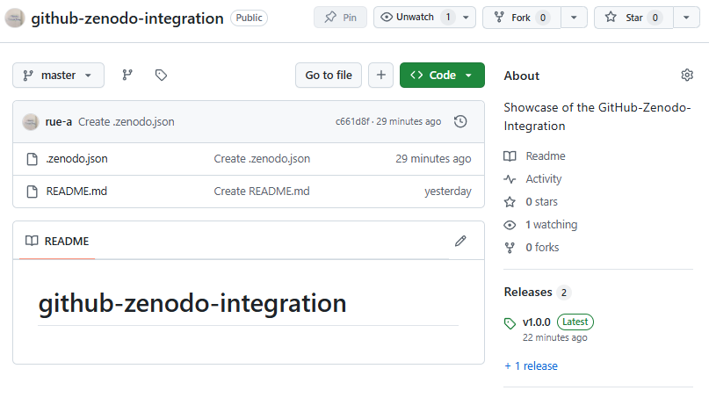
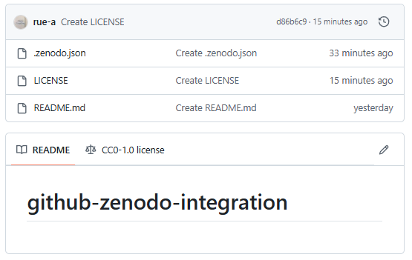
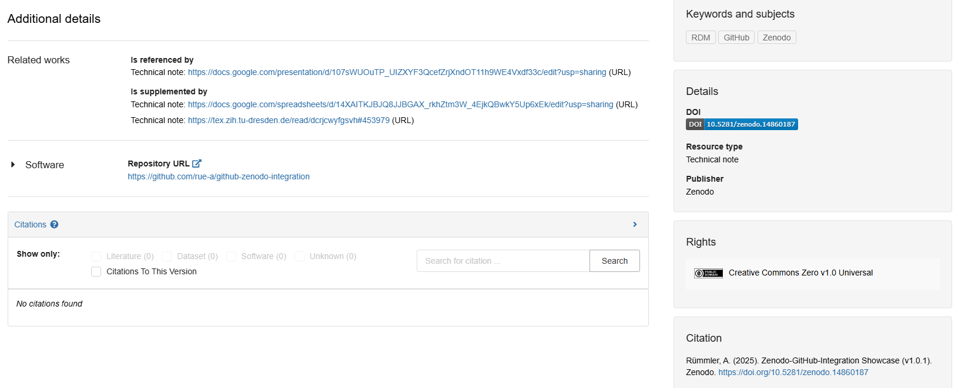

Slide 5
GitHub Repository Metadata Sources
GitHub About fields
?
.zenodo.json file
CITATION.cff file
LICENSE file
Zenodo record
GitHub Release fields

Slide 6
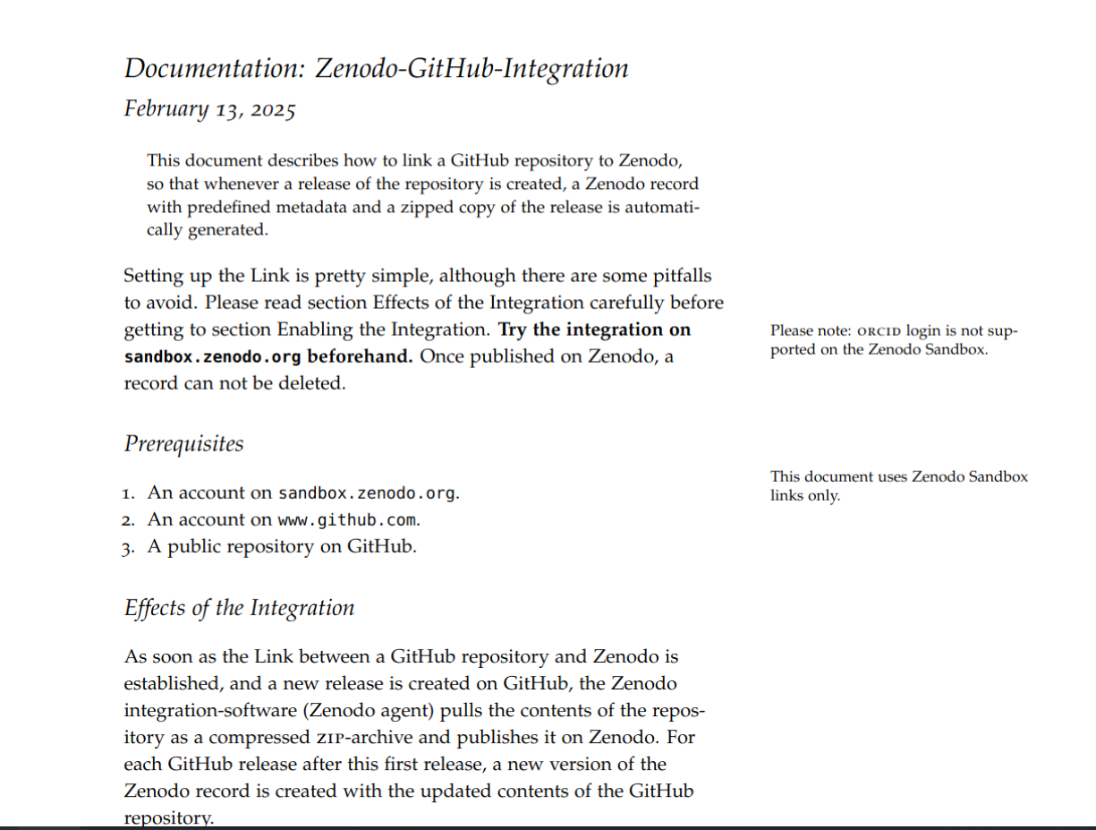
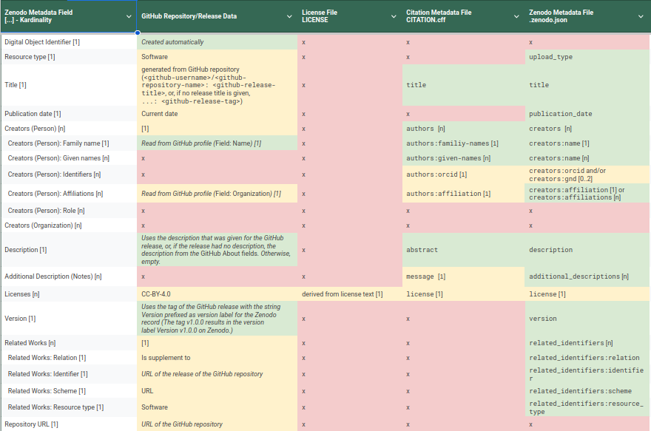
Feedback Request
Detailed Guide https://tex.zih.tu-dresden.de/read/dcrjcwyfgsvh#453979
Mapping from GitHub Metadata sources to Zenodo metadata schema https://docs.google.com/presentation/d/107sWUOuTP_UIZXYF3QcefZrjXndOT11h9WE4Vxdf33c/edit?usp=sharing

Slide 7

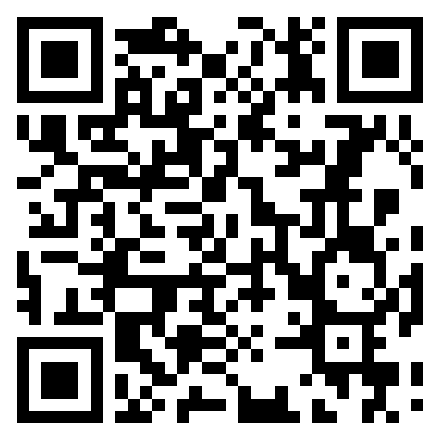
arne.ruemmler@slub-dresden.de |
openscience@slub-dresden.de
End of Presentation

