Slide 1

Local Clouds in the Sky with Diamonds
Nick Ruest
John Fink

Slide 2
Cloud Computing
What is it?
How does it work?
Where is it going?

Slide 3
What is it?
“Cloud Computing is location-independent computing, whereby shared servers provide resources, software, and data to computers and other devices on demand, as with the electricity grid.”
Wikipedia

Slide 4
How does it work?

Slide 5
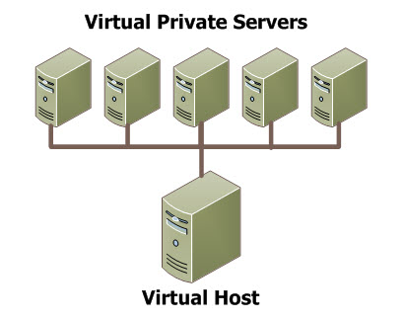

Slide 6
Who is doing it?

Slide 7
Losing Control

Slide 8
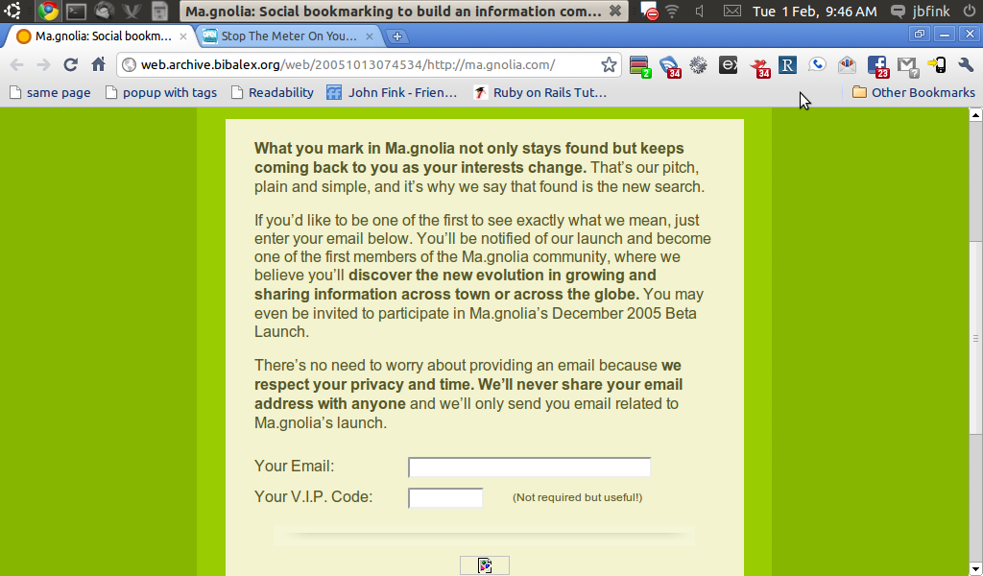
Social Bookmarking – A Cautionary Tale

Slide 9
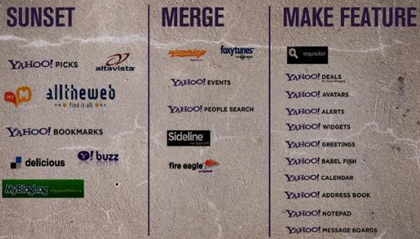

Slide 10
My own del.icio.us stats:
User since September 2004
16650 bookmarks
Everything that I found on the web that I wanted to keep track of I stuck in there.
EVERYTHING.

Slide 11
What did I do?
Made a script to grab all my del.icio.us in xml
Put it in git for good measure
Signed up for Pinboard (http://pinboard.in)

Slide 12
I apologize in advance for the following slide.

Slide 13
FUCK THE CLOUD
(C) Jason Scott
“By the cloud, of course, I mean this idea that you have a local machine, a box running some OS, and a vital, distinct part of what you do and what you’re about or what you consider important to you is on other machines that you don’t run, don’t control, don’t buy, don’t administrate, and don’t really understand. These machines are connected via the internet, and if you have a company then these other machines are not machines run by your company, and if you’re a person they are giving it to you without you signing anything accompanied by cash or payment that says “and I mean it“.
Can I be clearer than that? It's a sucker's game. It's a game suckers play. If you are playing it, you are a sucker.”

Slide 14
Don't put anything into the cloud that you don't already have a copy of.

Slide 15
My ideal cloud data store would be:
Open source (natch)
Easily replicated and compact
Have identical content on the local and the remote
Have that content digitally signed
Be easy to use.
<plug>.

Slide 16
So what's actually good about the remote cloud?

Slide 17
It's cheap (usually)
It's easy (often enough)
It allows you to do Things you might not be able to do without talking to or hiring cantankerous sysadmins and programmers.
Or librarians. :)

Slide 18
So we love the cloud (in theory) and we want to do things with it, but we also want our control.

Slide 19
Our own fluffy local cloud
So we made our own and did it with:
Two Big Servers
Ubuntu Linux
KVM
To host (nearly) any x86 operating system
In about 15 minutes.

Slide 20
And we built things like
Local IM
Bug trackers
Random virtual machine instances for our developers to tinker with for the ILS, our CMS systems, or anything they'd like.

Slide 21
Other cloud stuff we haven't done but would love an excuse to try:
GlusterFS
Hadoop
Eucalyptus

Slide 22


Slide 23
What is it?

Slide 24
Why did we use it?

Slide 25

Problems?

Slide 26
Conclusions

Slide 27
contact
email: john.fink@gmail.com
twitter: @adr
email: ruestn@mcmaster.ca
twitter: @ruebot

