Slide 1
Diagnostic Assessment
Technical Training and Evaluation Division
October 2013
Notes:
April 2, 2007

Slide 2
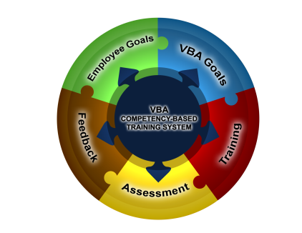
Diagnostic Assessment
The Diagnostic Assessment has been developed to:
  Assess each employee’s ability to perform technical, job specific duties
  Provide feedback and remediation based on assessment results
  As required, prepare each employee to take a Skills Certification or mastery level test
2

Slide 3
Diagnostic Assessment
The diagnostic assessment consists of several small assessments, called testlets.
Based on policy decisions, the testlets may be completed all at once or over an extended period of time.
At predetermined intervals, the appropriate diagnostic assessment will be automatically added to the employee’s TMS “To Do” list.
3

Slide 4

Diagnostic Assessment
When the employee completes the diagnostic assessment the following occur:
  The employee receives credit in TMS for completing the assessment.
  An onscreen Individual Feedback Report (IFR) is generated that identifies areas where the employee performed well and areas that need improvement.
  In areas that need improvement, the associated training items are automatically added to the TMS Learning Plan.
  The employee receives appropriate credit as each training item is completed.
  As required, feedback reports will be provided to the regional office to assist with remediation and future training decisions
4

Slide 5
Diagnostic Assessment
The Individual Feedback Report (IFR) provides the employee with the following information:
  Overall and specific performance on the diagnostic assessment.
  Performance related to error codes, KSAs, and other key areas related to the competencies that were tested.
  Recommended training that will provide remediation in specific areas for improvement.
A link to the IFR will always be accessible through the “Completed Works”
section in TMS.
5

Slide 6
Resources
Information about diagnostic assessments for each service/position can be accessed from the left navigation menu.
6

Slide 7

The End

