Slide 1
Competency-based Training System
Technical Training and Evaluation Division
October 2013
Notes:
April 2, 2007

Slide 2
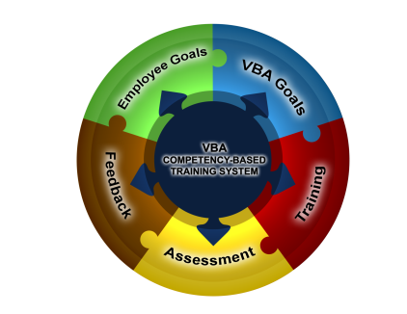
What is the CBTS?
A Competency-based Training System (CBTS) ensures the technical training for each employee is aligned with the competencies that have been identified for the position, at the appropriate level, and that required training is specifically targeted to meet the employee’s current job requirements and training needs.
Assessments
Performance
Job Requirements
Training
2
Notes:
April 2, 2007

Slide 3
What is the CBTS?
VBA’s Competency-based Training System (CBTS) has the following benefits:
  Identifies the technical requirements of each job position including, the tools, training, and resources needed to perform the job.
  Uses a diagnostic assessment to determine each employee’s ability to perform in a specific job position.
  Provides individualize, tailored training to each employee based on diagnostic assessment results, career goals, and developmental needs.
  Eliminates redundant training.
  Minimizes the gap between organizational expectations and what the employees are actually able to do.
  Allows employees to take control of their training needs.
  Provides “just-in-time” training support to the regional offices, service, and the employee
  Identifies employees who have mastered specialized training topics and have a high level of job performance who can serve as mentors or fill vacancies when needed.
3

Slide 4
What is the CBTS?
As each employee’s Competency Proficiency Level and/or job responsibilities change and the employee completes a diagnostic assessment, the TMS “To Do” list will reflect the following training:
  Remedial/Refresher – Allows the employee an opportunity to take training that can help to improve assessment performance.
  Skill Maintenance – Allows the employee who performed well on the diagnostic assessment an opportunity to build skills in new areas such as leadership.
4
Notes:
April 2, 2007

Slide 5

What is the CBTS?
VBA’s Competency-based Training System (CBTS):
5

Slide 6
Resources
Information about diagnostic assessments for each Service and position can be accessed from the left-hand navigation menu.
6

Slide 7

The End
7

