Slide 1
Competency Model
Technical Training and Evaluation Division
October 2013
Notes:
April 2, 2007

Slide 2
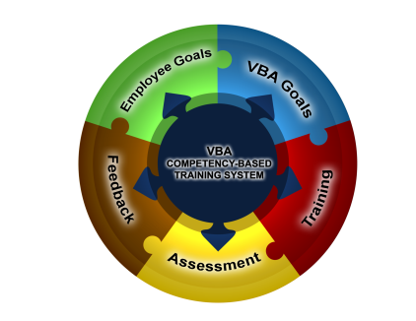
What are Competencies?
Competencies are a collection of the knowledge, skills, abilities, or other characteristics (KSAOs) that individuals need to successfully perform their work. Competencies define, in a common language that can be understood by all members of an organization, how employee behavior contributes to organizational success.
With the support and participation of senior management, employees, training managers, and supervisors, competencies provide a framework for effective development and management of training, assessments, and immediate and lifelong career goals.
Notes:
April 2, 2007

Slide 3

What are Competencies?
Competencies can have different levels of specificity:
All Employee Competencies – Very broad, such that they are applicable to everyone in the organization.
Technical Competencies – Specifically address occupation-specific or technical skills required for successful performance in certain occupations or jobs (e.g., VSRs, RVSRs, Field Examiners, Vocational Rehabilitation Counselors).
Leadership Competencies – Narrowly defined and apply only to a
subset of individuals employed within certain levels of an organization.
Notes:
April 2, 2007

Slide 4
Examples of Competencies
All Employee | Technical | Leadership
Communication Teamwork Written Communication Stress Management | Benefits Accounting Claims Processing VBA Applications Veterans Benefits and Eligibility | Leading Change Business Acumen Results Driven Global Perspective Leading People
Notes:
April 2, 2007

Slide 5
What is a Competency Model
A competency model:
  Contains the competency names and descriptions with KSAOs and behavioral indicators that describe the full range of acceptable performance at predefined levels.
  Clearly defines successful job performance in a specific work setting.
  Provides a clear description of what a person needs to know and be able to do – the KSAOs– to perform well in a specific job, occupation, or industry.

Slide 6
How Does the Employee Benefit?
A competency model provides the information that allows each employee an opportunity to demonstrate behaviors that are consistent with the organization's mission, culture, and priorities.
  A competency model benefits the employee by providing:
    Clear direction on performance expectations.
    A defined roadmap for building strengths and closing performance gaps.
    Opportunities for assessment of an employee’s job performance based on measurable standards.
Notes:
April 2, 2007

Slide 7
How Does the Organization Benefit?
All competencies (all employee, technical, and leadership) serve as the backbone for employee development efforts and provide a unifying framework for all VBA competency models.
  A competency model benefits the organization by:
    Specifying the information required to attract, develop, and retain exceptional employees.
    Ensuring a common understanding of each employee’s role in achieving organizational success.
    Allowing the organization to align employees’ performance with the overall business strategy.
Notes:
April 2, 2007

Slide 8
Resources
Competencies for each service/position can be accessed from the left navigation menu.

Slide 9
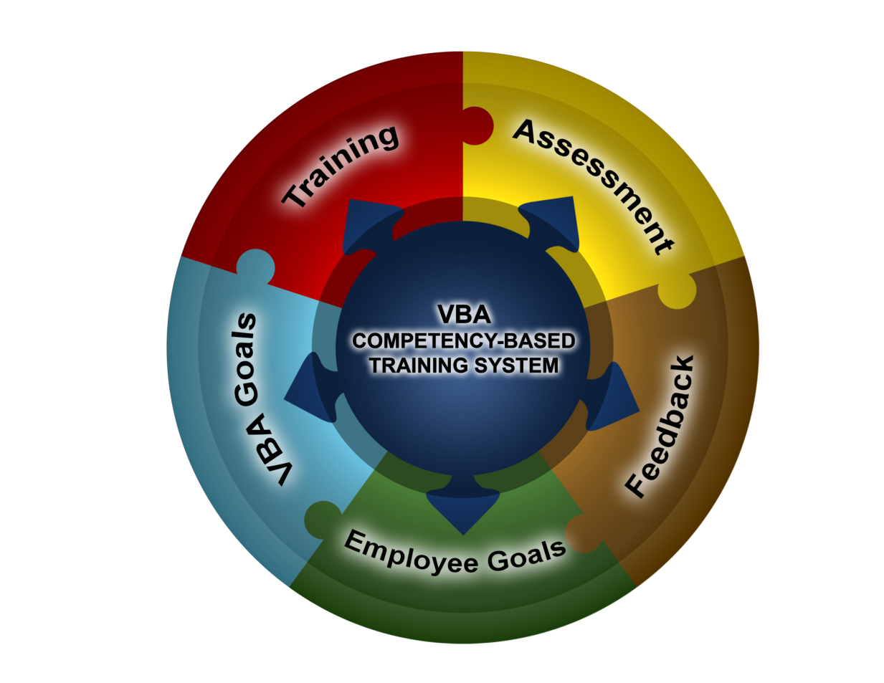
The End

