Slide 1
Competency Model Reports
Technical Training and Evaluation Division
October 2013
Notes:
April 2, 2007

Slide 2
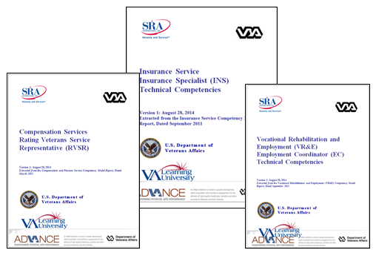
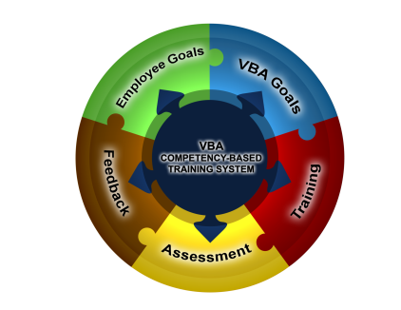
Competency Model Reports
Competency Model Reports provide a list of all technical competencies for each Service and position. Each report also contains the associated Competency Profiles. Each Competency Profile contains the:
  Competency description/definition
  Competency Proficiency Level
  Competency Proficiency Ratings
  Behavioral Indicators
Notes:
April 2, 2007

Slide 3
Competency Proficiency Levels
Within the Competency Model Report, each position has three (3) Competency Proficiency Levels:
  E – Entry
  A – Apprentice/Intermediate
  J – Journey
At each level, the types of activities performed (Behavioral Indicators) and level of supervision (Competency Proficiency Ratings) required are also identified.
Notes:
April 2, 2007

Slide 4
Competency Proficiency Ratings
Each position has five (5) Competency Proficiency Ratings:
  Basic/Novice
  Foundational
  Intermediate/Apprentice
  Advanced
  Expert
Competency Proficiency Ratings are used to define the level of complexity an individual should demonstrate in a particular competency.
*These ratings vary by position and Competency Proficiency Level.
Notes:
April 2, 2007

Slide 5
Competency Behavioral Indicators
Competency Behavioral Indicators are observable and help to describe the full range of proficiency. They further define Competency Proficiency Levels and Ratings.
Notes:
April 2, 2007

Slide 6
Competency Profile Examples
FE Technical Competency Profile Training
Competency Proficiency Rating | Behavioral Indicators | Competency Proficiency Levels
 |  | A | J
3 - Intermediate | Develop training materials and courses. | 
4 - Advanced | Identify training and development needs within an organization. |  | 

Slide 7
Resources
Competency Model Reports for each service/position can be accessed from the left navigation menu.

Slide 8

The End

