Slide 1
Diagnostic Assessment
Technical Training and Evaluation Division
October 2013
Notes:
April 2, 2007

Slide 2
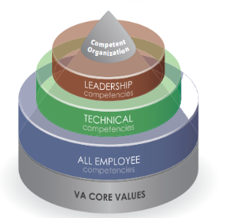
Diagnostic Assessment
The Diagnostic Assessment has been developed to:
  Assess each employee’s ability to perform technical, job specific duties
  Provide feedback and remediation based on assessment results
  As required, prepare each employee to take the Skills Certification Tes

Slide 3
Diagnostic Assessment
At a predetermined interval, the appropriate diagnostic assessment will be automatically added to the employee’s TMS “To Do” list.
The employee will be required to complete the assessment within a specified period of time.
At the conclusion of the assessment the following occurs:
  The employee receives credit in TMS for completing the assessment.
  An onscreen Individual Feedback Report (IFR) is generated that identifies areas where the employee performed well and areas that need improvement.
  In areas that need improvement, the associated training items are automatically added to the TMS Learning Plan.
  The employee receives appropriate credit as each item is completed.
  Feedback reports will be provided to the regional office to assist with remediation and future training decisions

Slide 4
Diagnostic Assessment
Feedback Report – Image and explanation. TBD

Slide 5
Resources
Information about diagnostic assessments for each position can be accessed from the left-hand navigation menu.

Slide 6
Resources
Information about diagnostic assessments for each position can be accessed from the left-hand navigation menu.

Slide 7
The End

