Slide 1
Competency Model
Technical Training and Evaluation Division
October 2013
Notes:
April 2, 2007

Slide 2
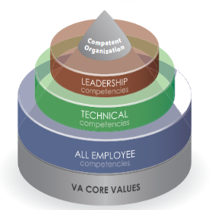
What are Competencies?
Competencies are a collection of the knowledge, skills, abilities, or other characteristics (KSAOs) that individuals need to successfully perform their work. Competencies define, in a common language that can be understood by all members of an organization, how employee behavior contributes to organizational success.
With the support and participation of employees, training managers, and supervisors, competencies provide a framework for effective development and management of training, assessments, and immediate and lifelong career goals.
Notes:
April 2, 2007

Slide 3
What are Competencies?
Competencies can have different levels of specificity:
All Employee “Core” Competencies – Very broad, such that they are applicable to everyone in an organization.
Technical Competencies – Specifically address occupation-specific or technical skills required for successful performance in certain occupations or jobs (e.g., VSRs, RVSRs, Field Examiners, Vocational Rehabilitation Counselors).
Leadership Competencies – Narrowly defined and apply only to a
subset of individuals employed within certain levels of an organization.
Notes:
April 2, 2007

Slide 4
Examples of Competencies
All Employee (Core) | Technical | Leadership
Communication Teamwork Written Communication Stress Management | Benefits Accounting Claims Processing VBA Applications Veterans Benefits and Eligibility | Leading Change Business Acumen Results Driven Global Perspective Leading People
Notes:
April 2, 2007

Slide 5
What is a Competency Model
A competency model:
  Contains the competency names and descriptions with KSAOs and behavioral indicators that describe the full range of acceptable performance at predefined levels.
  Clearly defines successful job performance in a specific work setting.
  Provides a clear description of what a person needs to know and be able to do – the KSAOs– to perform well in a specific job, occupation, or industry.

Slide 6
How Does the Employee Benefit?
A competency model allows each employee an opportunity to demonstrate behaviors that are consistent with the organization's mission, culture, and priorities.
  A competency model benefits the employee by providing:
    Clear direction on performance expectations.
    A defined roadmap for building strengths and closing performance gaps.
    Opportunities for assessment of an employee’s job performance based on measurable standards.
Notes:
April 2, 2007

Slide 7
How Does the Organization Benefit?
All competencies (all employee “core”, technical, and leadership) serve as the backbone for employee development efforts and provide a unifying framework for all VBA competency models.
  A competency model benefits the organization by:
    Specifying the information required to attract, develop, and retain exceptional employees.
    Ensuring a common understanding of each employee’s role in achieving organizational success.
    Allowing the organization to align employees’ performance with the overall business strategy.
Notes:
April 2, 2007

Slide 8
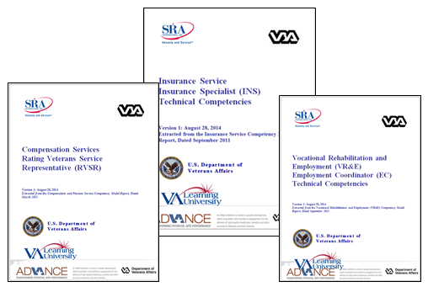
Competency Model Reports
Competency Model Reports for each service/position can be found in the “Competency Model by Service” tab in the left navigation pane.
Each document provides a list of all technical competencies for the position and a Competency Profile that describes the:
  Competency description/definition
  Competency Proficiency Level
  Competency Proficiency Ratings
  Behavioral Indicators
Notes:
April 2, 2007

Slide 9
Competency Proficiency Levels
Each position has three (3) Competency Proficiency Levels:
  E – Entry
  A – Apprentice/Intermediate
  J – Journey
At each level, the types of activities performed (Behavioral Indicators) and level of supervision (Competency Proficiency Ratings) required are also identified.
Not every level is applicable to every position.
Notes:
April 2, 2007

Slide 10
Competency Proficiency Ratings
Each position has five (5) Competency Proficiency Ratings:
  Basic/Novice
  Foundational
  Intermediate/Apprentice
  Advanced
  Expert
Competency Proficiency Ratings are used to define the level of complexity an individual should demonstrate in a particular competency.
These ratings vary by position and Competency Proficiency Level.
Notes:
April 2, 2007

Slide 11
Competency Behavioral Indicators
Competency Behavioral Indicators are observable and help to describe the full range of proficiency. They further define Competency Proficiency Levels and Ratings.
Notes:
April 2, 2007

Slide 12
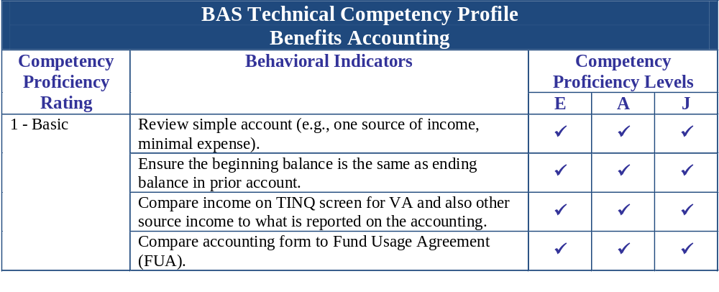
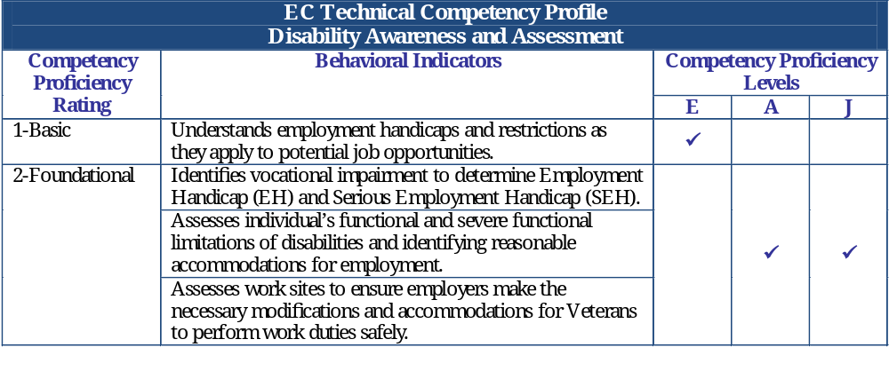
Competency Profile Examples
FE Technical Competency Profile Training
Competency Proficiency Rating | Behavioral Indicators | Competency Proficiency Levels
 |  | A | J
3 - Intermediate | Develop training materials and courses. | 
4 - Advanced | Identify training and development needs within an organization. |  | 

Slide 13
Resources
Competency Model Reports for each position can be accessed from the left-hand navigation menu.

Slide 14
The End

