Slide 1


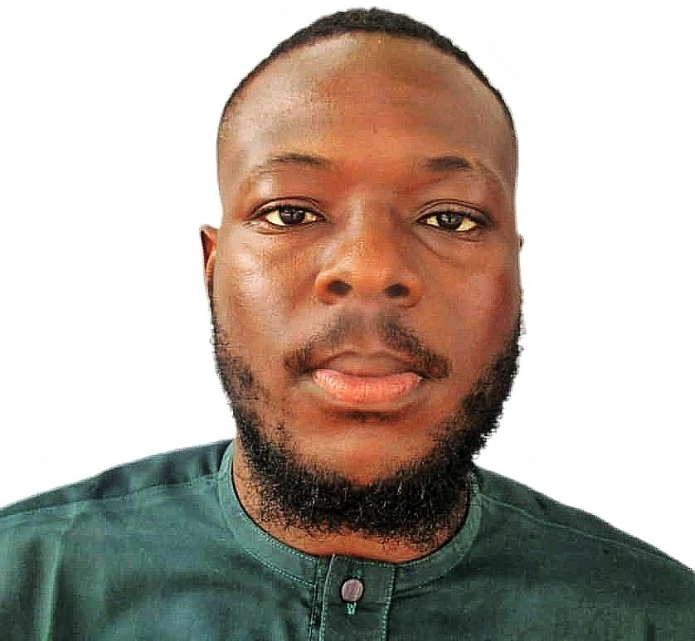

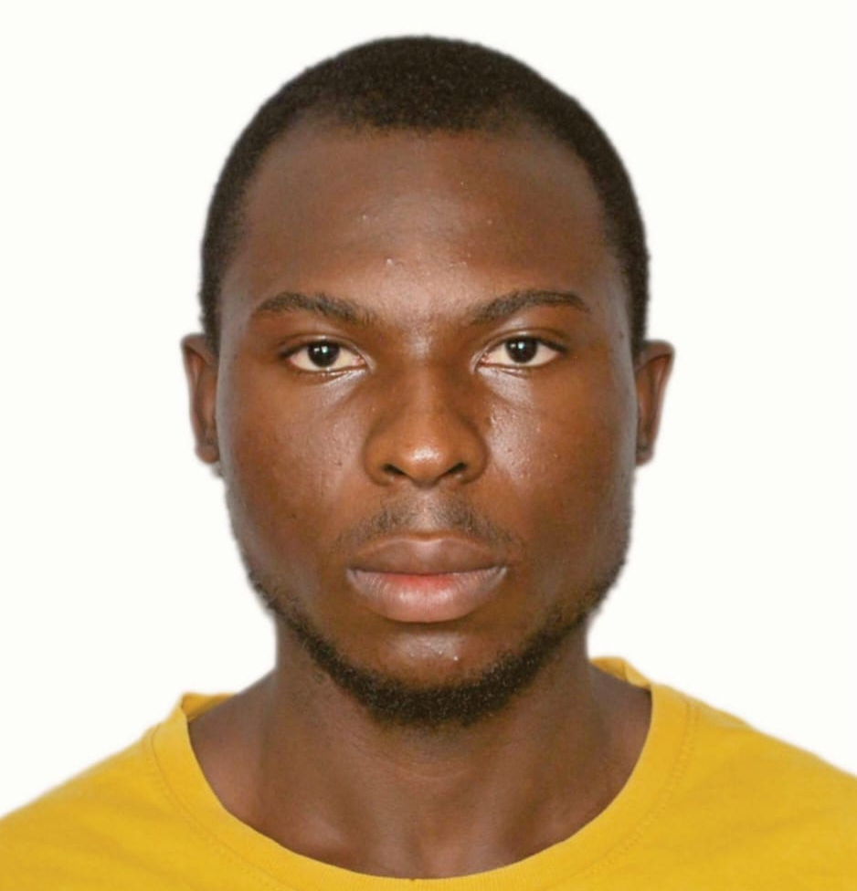
TEAM
Who built SentinelX
A five-person team coordinating across the one-week build window.
FREDRICK JOHN
IORHEN TOMNA
ADEYANJU ADEBAYO
AHMAN SOLOMON
OGUNYEMI HABEEB
Team Lead
AI/ML Lead
Asst. AI/ML Lead
Mobile Developer
UI/UX Designer
Architecture, responsible AI design, coordination
Bi-LSTM training pipeline, model architecture
Gemini integration, evaluation, contextual NLP
React Native (Expo) app — SOS, Safe Chat, Detect
NGO analyst dashboard, triage workflows, XAI views
USAII Global AI Hackathon 2026 · Graduate Track · Challenge Brief 5, Direction A
1 / 1

