Slide 1




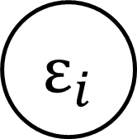

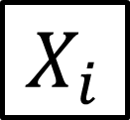
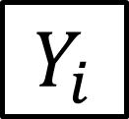


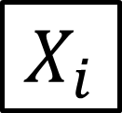







SAR
SEM
SLX
$$ε_{i}$$
$$ε_{j}$$
$$ε_{i}$$
$$ε_{j}$$
$$ε_{i}$$
$$ε_{j}$$
$$Y_{i}$$
$$Y_{j}$$
$$Y_{i}$$
$$Y_{j}$$
$$Y_{i}$$
$$Y_{j}$$
$$X_{i}$$
$$X_{j}$$
$$X_{i}$$
$$X_{j}$$
$$X_{i}$$
$$X_{j}$$
Spatial Interdependence
Clustering on unobservables
Spillovers from covariates

