Slide 1
Chapter 21: Parallel and Distributed Storage

Slide 2
Introduction
Parallel machines have become quite common and affordable
prices of microprocessors, memory and disks have dropped sharply
Data storage needs are growing increasingly large
user data at web-scale
100’s of millions of users, petabytes of data
transaction data are collected and stored for analysis.
multimedia objects like images/videos
Parallel storage system requirements
storing large volumes of data
processing time-consuming decision-support queries
providing high throughput for transaction processing
Very high demands on scalability and availability

Slide 3
Parallel/Distributed Data Storage History
1980/1990s
Distributed database systems with tens of nodes
2000s:
Distributed file systems with 1000s of nodes
Millions of Large objects (100’s of megabytes)
Web logs, images, videos, …
Typically create/append only
Distributed data storage systems with 1000s of nodes
Billions to trillions of smaller (kilobyte to megabyte) objects
Social media posts, email, online purchases, …
Inserts, updates, deletes
Key-value stores
2010s: Distributed database systems with 1000s of nodes

Slide 4
I/O Parallelism
Reduce the time required to retrieve relations from disk by partitioning the relations on multiple disks, on multiple nodes (computers)
Our description focuses on parallelism across nodes
Same techniques can be used across disks on a node
Horizontal partitioning – tuples of a relation are divided among many nodes such that some subset of tuple resides on each node.
Contrast with vertical partitioning, e.g. r(A,B,C,D) with primary key A into r1(A,B) and r2(A,C,D)
By default, the word partitioning refers to horizontal partitioning

Slide 5
I/O Parallelism
Partitioning techniques (number of nodes = n):
Round-robin:
Send the i^{th} tuple inserted in the relation to node i mod n.
Hash partitioning:
Choose one or more attributes as the partitioning attributes.
Choose hash function h with range 0…n - 1
Let i denote result of hash function h applied to the partitioning attribute value of a tuple. Send tuple to node i.

Slide 6
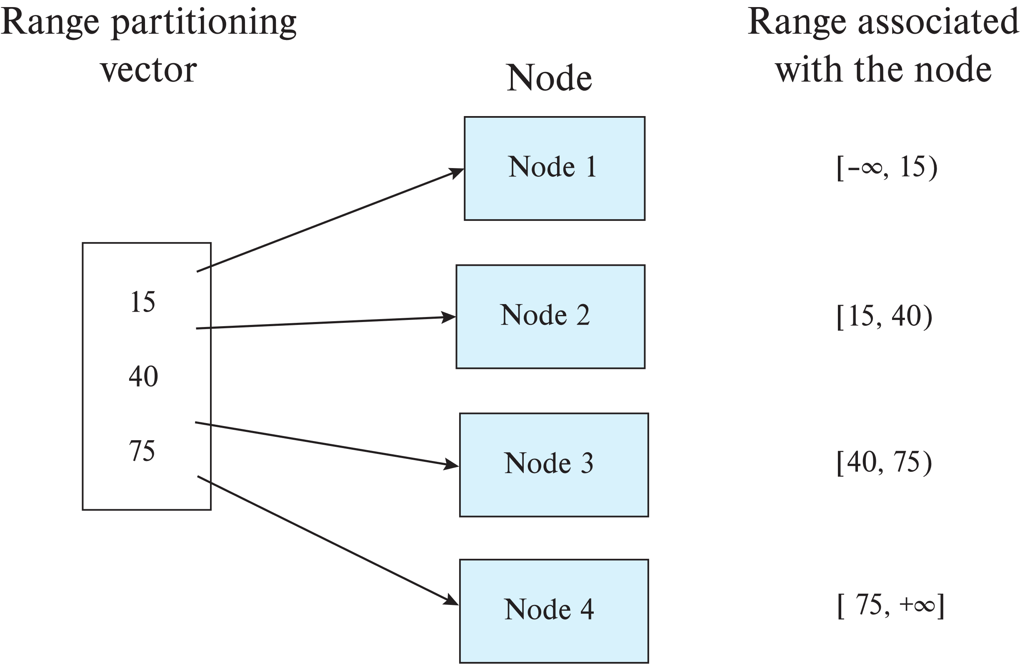
Range Partitioning

Slide 7
I/O Parallelism (Cont.)
Partitioning techniques (cont.):
Range partitioning:
Choose an attribute as the partitioning attribute.
A partitioning vector [v_{o}, v₁, ..., v_{n-2}] is chosen.
Let v be the partitioning attribute value of a tuple. Tuples such that v_{i} ≤ v_{i+1} go to node I + 1. Tuples with v < v₀ go to node 0 and tuples with v ≥ v_{n-2} go to node n-1.
E.g., with a partitioning vector [5,11]
a tuple with partitioning attribute value of 2 will go to node 0,
a tuple with value 8 will go to node 1, while
a tuple with value 20 will go to node2.

Slide 8
Comparison of Partitioning Techniques
Evaluate how well partitioning techniques support the following types of data access:
1. Scanning the entire relation.
2. Locating a tuple associatively – point queries.
E.g., r.A = 25.
3. Locating all tuples such that the value of a given attribute
lies within a specified range – range queries.
E.g., 10 ≤ r.A < 25.
Do above evaluation for each of
Round robin
Hash partitioning
Range partitioning

Slide 9
Comparison of Partitioning Techniques (Cont.)
Round robin:
Best suited for sequential scan of entire relation on each query.
All nodes have almost an equal number of tuples; retrieval work is thus well balanced between nodes.
All queries must be processed at all nodes
Hash partitioning:
Good for sequential access
Assuming hash function is good, and partitioning attributes form a key, tuples will be equally distributed between nodes
Good for point queries on partitioning attribute
Can lookup single node, leaving others available for answering other queries.
Range queries inefficient, must be processed at all nodes

Slide 10
Comparison of Partitioning Techniques (Cont.)
Range partitioning:
Provides data clustering by partitioning attribute value.
Good for sequential access
Good for point queries on partitioning attribute: only one node needs to be accessed.
For range queries on partitioning attribute, one to a few nodes may need to be accessed
Remaining nodes are available for other queries.
Good if result tuples are from one to a few blocks.
But if many blocks are to be fetched, they are still fetched from one to a few nodes, and potential parallelism in disk access is wasted
Example of execution skew.

Slide 11
Handling Small Relations
Partitioning not useful for small relations which fit into a single disk block or a small number of disk blocks
Instead, assign the relation to a single node, or
Replicate relation at all nodes
For medium sized relations, choose how many nodes to partition across based on size of relation
Large relations typically partitioned across all available nodes.

Slide 12
Types of Skew
Data-distribution skew: some nodes have many tuples, while others may have fewer tuples. Could occur due to
Attribute-value skew.
Some partitioning-attribute values appear in many tuples
All the tuples with the same value for the partitioning attribute end up in the same partition.
Can occur with range-partitioning and hash-partitioning.
Partition skew.
Imbalance, even without attribute –value skew
Badly chosen range-partition vector may assign too many tuples to some partitions and too few to others.
Less likely with hash-partitioning

Slide 13
Types of Skew (Cont.)
Note that execution skew can occur even without data distribution skew
E.g. relation range-partitioned on date, and most queries access tuples with recent dates
Data-distribution skew can be avoided with range-partitioning by creating balanced range-partitioning vectors
We assume for now that partitioning is static, that is partitioning vector is created once and not changed
Any change requires repartitioning
Dynamic partitioning once allows partition vector to be changed in a continuous manner
More on this later

Slide 14
Handling Skew in Range-Partitioning
To create a balanced partitioning vector
Sort the relation on the partitioning attribute.
Construct the partition vector by scanning the relation in sorted order as follows.
After every 1/n^{th} of the relation has been read, the value of the partitioning attribute of the next tuple is added to the partition vector.
n denotes the number of partitions to be constructed.
Imbalances can result if duplicates are present in partitioning attributes.
To reduce cost
Partitioning vector can be created using a random sample of tuples
Alternatively histograms can be used to create the partitioning vector

Slide 15
Histograms
Histogram on attribute age of relation person
Equi-width histograms
Equi-depth histograms
break up range such that each range has (approximately) the same number of tuples
E.g. (4, 8, 14, 19)
Assume uniform distribution within each range of the histogram
Create partitioning vector for required number of partitions based on histogram

Slide 16
Virtual Node Partitioning
Key idea: pretend there are several times (10x to 20x) as many virtual nodes as real nodes
Virtual nodes are mapped to real nodes
Tuples partitioned across virtual nodes using range-partitioning vector
Hash partitioning is also possible
Mapping of virtual nodes to real nodes
Round-robin: virtual node i mapped to real node (i mod n)+1
Mapping table: mapping table virtual_to_real_map[] tracks which virtual node is on which real node
Allows skew to be handled by moving virtual nodes from more loaded nodes to less loaded nodes
Both data distribution skew and execution skew can be handled

Slide 17
Handling Skew Using Virtual Node Partitioning
Basic idea:
If any normal partition would have been skewed, it is very likely the skew is spread over a number of virtual partitions
Skewed virtual partitions tend to get spread across a number of nodes, so work gets distributed evenly!
Virtual node approach also allows elasticity of storage
If relation size grows, more nodes can be added and virtual nodes moved to new nodes

Slide 18
Dynamic Repartitioning
Virtual node approach with a fixed partitioning vector cannot handle significant changes in data distribution over time
Complete repartitioning is expensive and intrusive
Dynamic repartitioning can be done incrementally using virtual node scheme
Virtual nodes that become too big can be split
Much like B+-tree node splits
Some virtual nodes can be moved from a heavily loaded node to a less loaded node
Virtual nodes in such a scheme are often called tablets

Slide 19
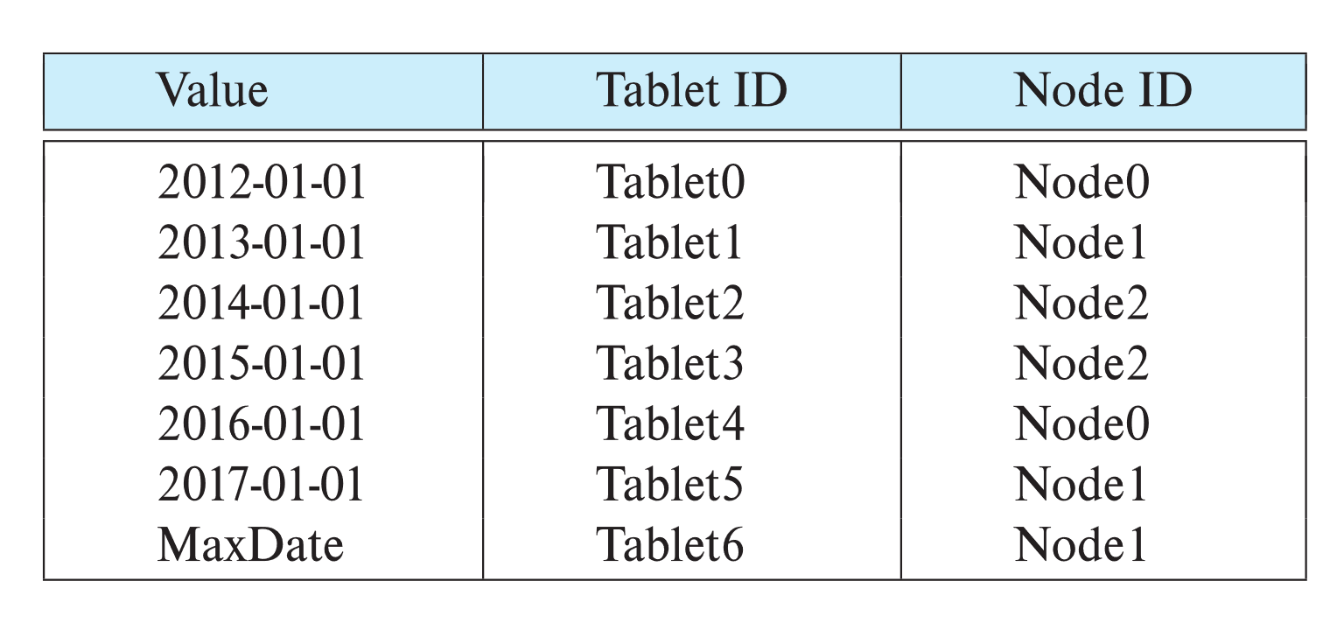
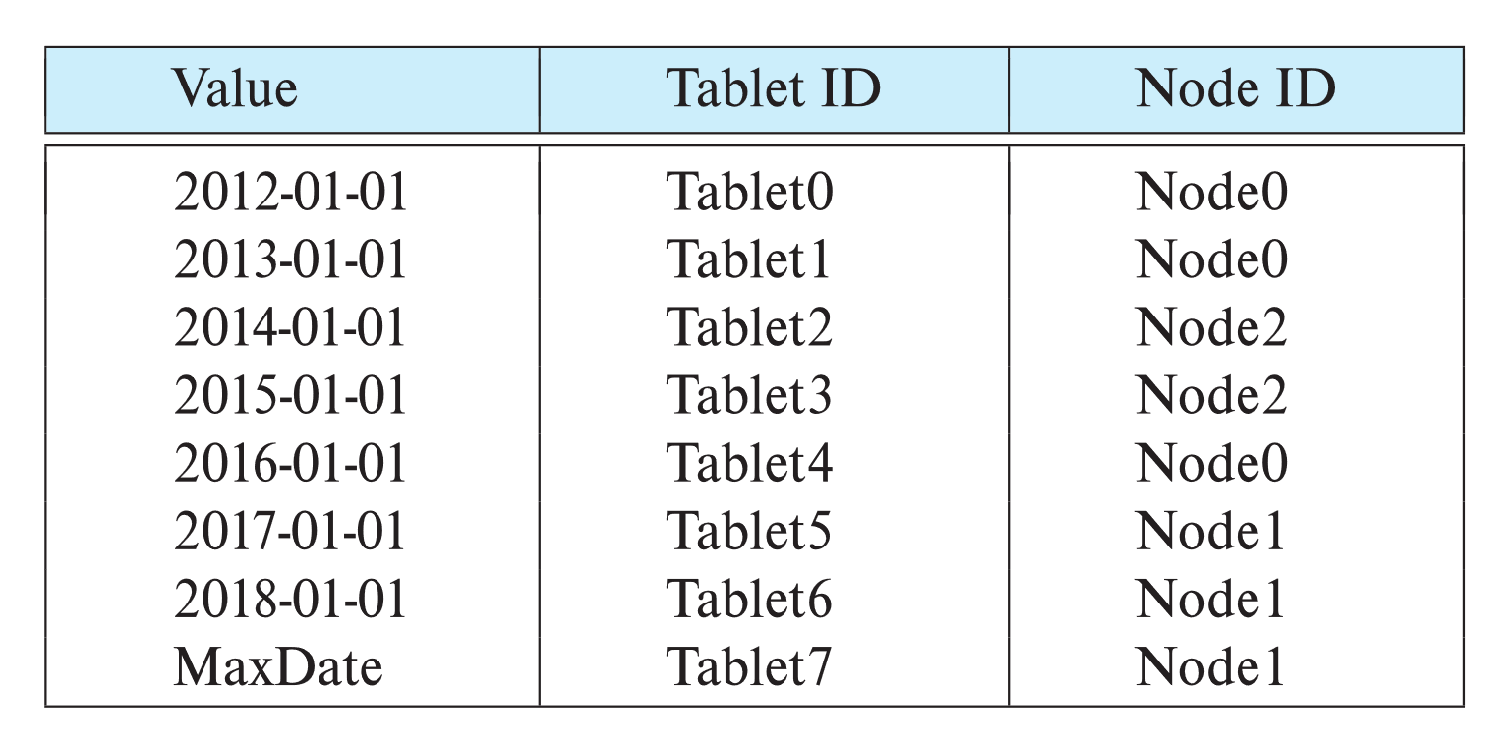
Dynamic Repartitioning
Virtual nodes in such a scheme are often called tablets
Example of initial partition table and partition table after a split of tablet 6 and move of tablet 1
Tablet move
Tablet split

Slide 20
Routing of Queries
Partition table typically stored at a master node, and at multiple routers
Queries are sent first to routers, which forward them to appropriate node
Consistent hashing is an alternative fully-distributed scheme
without any master nodes, works in a completely peer-to-peer fashion
Distributed hash tables are based on consistent hashing
work without master nodes or routers; each peer-node stores data and performs routing
See book for details of consistent hashing and distributed hash tables

Slide 21
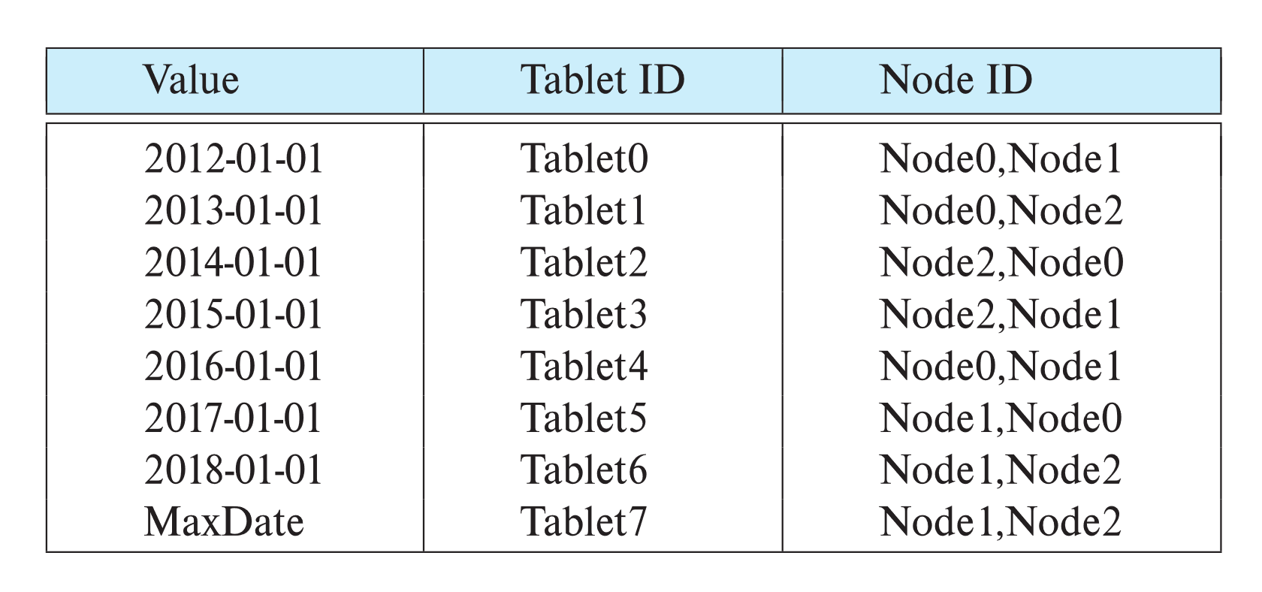
Replication
Goal: availability despite failures
Data replicated at 2, often 3 nodes
Unit of replication typically a partition (tablet)
Requests for data at failed node automatically routed to a replica
Partition table with each tablet replicated at two nodes

Slide 22
Basics: Data Replication
Location of replicas
Replication within a data center
Handles machine failures
Reduces latency if copy available locally on a machine
Replication within/across racks
Replication across data centers
Handles data center failures (power, fire, earthquake, ..), and network partitioning of an entire data center
Provides lower latency for end users if copy is available on nearby data center

Slide 23
Updates and Consistency of Replicas
Replicas must be kept consistent on update
Despite failures resulting in different replicas having different values (temporarily), reads must get the latest value.
Special concurrency control and atomic commit mechanisms to ensure consistency
Master replica (primary copy) scheme
All updates are sent to master, and then replicated to other nodes
Reads are performed at master
But what if master fails? Who takes over? How do other nodes know who is the new master?
Details in Chapter 23

Slide 24
Protocols to Update Replicas
Two-phase commit
Coming up in Chapter 23
Assumes all replicas are available
Persistent messaging
Updates are sent as messages with guaranteed delivery
Replicas are updated asynchronously (after original transaction commits)
Eventual consistency
Can lead to inconsistency on reads from replicas
Consensus protocols
Protocol followed by a set of replicas to agree on what updates to perform in what order
Can work even without a designated master

Slide 25
Parallel Indexing
Local index
Index built only on local data
Global index
Index built on all data, regardless of where it is stored
Index itself is usually partitioned across nodes
Global primary index
Data partitioned on the index attribute
Global secondary index
Data partitioned on the attribute other than the index attribute

Slide 26
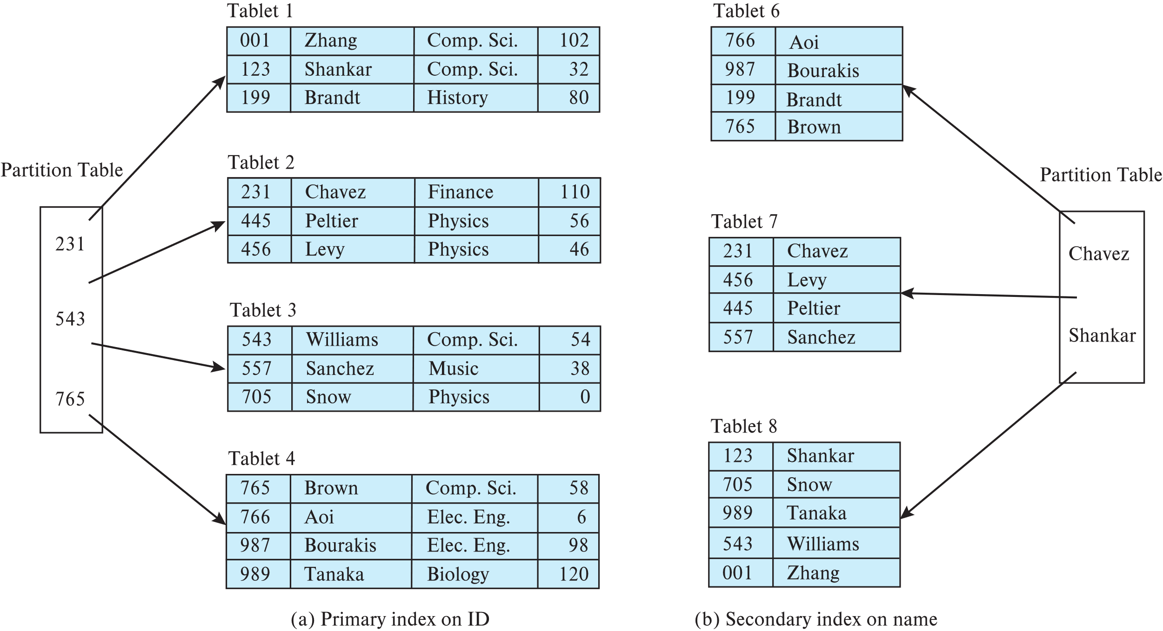
Global Primary and Secondary Indices

Slide 27
Global Secondary Index
Given relation r which is partitioned on K_{p}, to create global secondary index on attributes K_{i},
create a relation
r_{i}^{s} (K_{i}, K_{p}) if K_{p} is unique, otherwise
r_{i}^{s}(K_{i}, K_{p}, K_{u}) where (K_{p}, K_{u}) is a key for r
Partition r_{i}^{s} on K_{i}
At each node containing a partition of r, create index on (K_{p}) if K_{p} is a key, otherwise create index on (K_{p}, K_{u})
Update the relation r_{i}^{s} on any updates to r on attributes in r_{i}^{s}

Slide 28
Distributed File Systems
Google File System (GFS)
Hadoop File System (HDFS)
And older ones like CODA
And more recent ones such as Google Colossus
Basic architecture:
Master: responsible for metadata
Chunk servers: responsible for reading and writing large chunks of data
Chunks replicated on 3 machines, master responsible for managing replicas
Replication is in GFS/HDFS is within a single data center

Slide 29
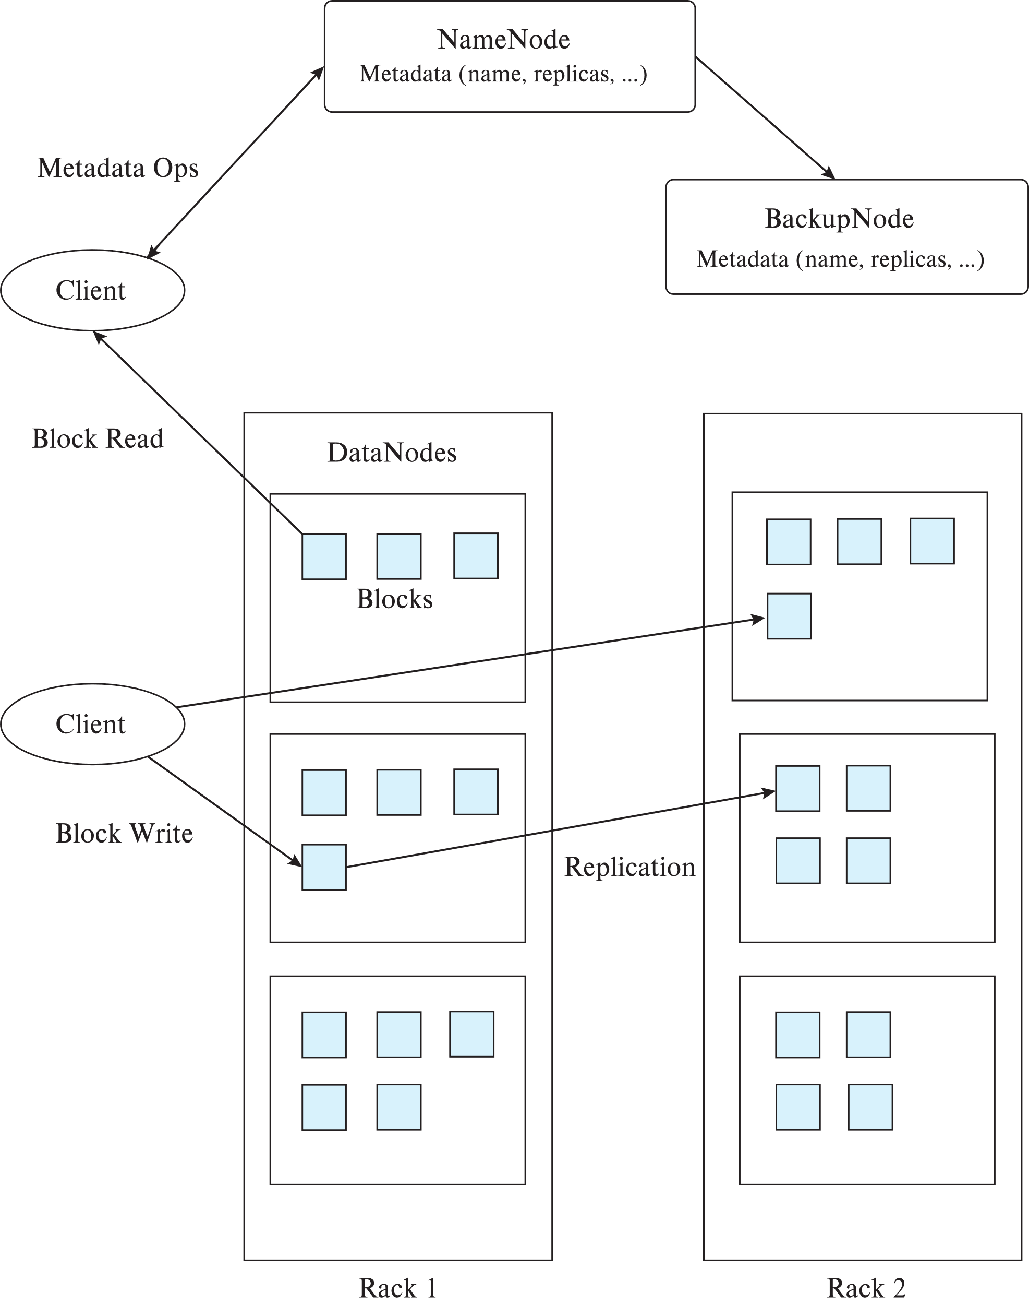
Hadoop File System (HDFS)
Client: sends filename to NameNode
NameNode
Maps a filename to list of Block IDs
Maps each Block ID to DataNodes containing a replica of the block
Returns list of BlockIDs along with locations of their replicas
DataNode:
Maps a Block ID to a physical location on disk
Sends data back to client

Slide 30
Hadoop Distributed File System
Hadoop Distributed File System (HDFS)
Modeled after Google File System (GFS)
Single Namespace for entire cluster
Data Coherency
Write-once-read-many access model
Client can only append to existing files
Files are broken up into blocks
Typically 64 MB block size
Each block replicated on multiple (e.g., 3) DataNodes
Client
Finds location of blocks from NameNode
Accesses data directly from DataNode

Slide 31
Limitations of GFS/HDFS
Central master becomes bottleneck
Keep directory/inode information in memory to avoid IO
Memory size limits number of files
Colossus file system supports distributed master
With smaller (1MB) block size
File system directory overheads per file
Not appropriate for storing very large number of objects
File systems do not provide consistency guarantees
File systems cache blocks locally
Ideal for write-once and and append only data
Can be used as underlying storage for a data storage system
E.g., BigTable uses GFS underneath

Slide 32
Sharding
Sharding (recall from Chapter 10)
Divide data amongst many cheap databases (MySQL/PostgreSQL)
Manage parallel access in the application
Partition tables map keys to nodes
Application decides where to route storage or lookup requests
Scales well for both reads and writes
Limitations
Not transparent
application needs to be partition-aware
AND application needs to deal with replication
(Not a true parallel database, since parallel queries and transactions spanning nodes are not supported)

Slide 33
Key Value Storage Systems
Recall from Chapter 10
Key-value stores may store
uninterpreted bytes, with an associated key
E.g., Amazon S3, Amazon Dynamo
Wide-column stores (can have arbitrarily many attribute names) with associated key
Google BigTable, Apache Cassandra, Apache HBase, Amazon DynamoDB, Microsoft Azure Cloud store
Allows some operations (e.g., filtering) to execute on storage node
Google MegaStore and Spanner and Yahoo! PNUTS/Sherpa support relational schema
JSON
MongoDB, CouchDB (document model)
Document stores store semi-structured data, typically JSON

Slide 34
Typical Data Storage Access API
Basic API access:
get(key) -- Extract the value given a key
put(key, value) -- Create or update the value given its key
delete(key) -- Remove the key and its associated value
execute(key, operation, parameters) -- Invoke an operation to the value (given its key) which is a special data structure (e.g., List, Set, Map .... Etc.)
Extensions to add range queries, version numbering, etc.
Notes:
-> http://horicky.blogspot.com/2009/11/nosql-patterns.html

Slide 35
Data Storage Systems vs. Databases
Distributed data storage implementations:
May have limited support for relational model (no schema, or flexible schema)
But usually do provide flexible schema and other features
Structured objects e.g. using JSON
Multiple versions of data items
Often do not support referential integrity constraints
Often provide no support or limited support for transactions
But some do!
Provide only lowest layer of database

Slide 36
Data Representation
In wide-column stores like BigTable, records may be vertically partitioned by attribute (columnar storage)
(record-identifier, attribute-name) forms a key
Multiple attributes may be stored in one file (column family)
In BigTable records are sorted by key, ensuring all attributes of a logical record in that file are contiguous
Attributes can be fetched by a prefix/range query
Record-identifiers can be structured hierarchically to exploit sorting
E.g., url: www.cs.yale.edu/people/silberschatz.html can be mapped to record identifier edu.yale.cs.www/people/silberschatz.html
Now all records for cs.yale.edu would be contiguous, as would all records for yale.edu

Slide 37
Storing and Retrieving Data
Architecture of BigTable key-value store
Table split into multiple tablets
Tablet servers manage tablets, multiple tablets per server. Each tablet is 100-200 MB
Each tablet controlled by only one server
Tablet server splits tablets that get too big
Master responsible for load balancing and fault tolerance
All data and logs stored in GFS
Leverage GFS replication/fault tolerance
Data can be accessed if required from any node to aid in recovery

Slide 38
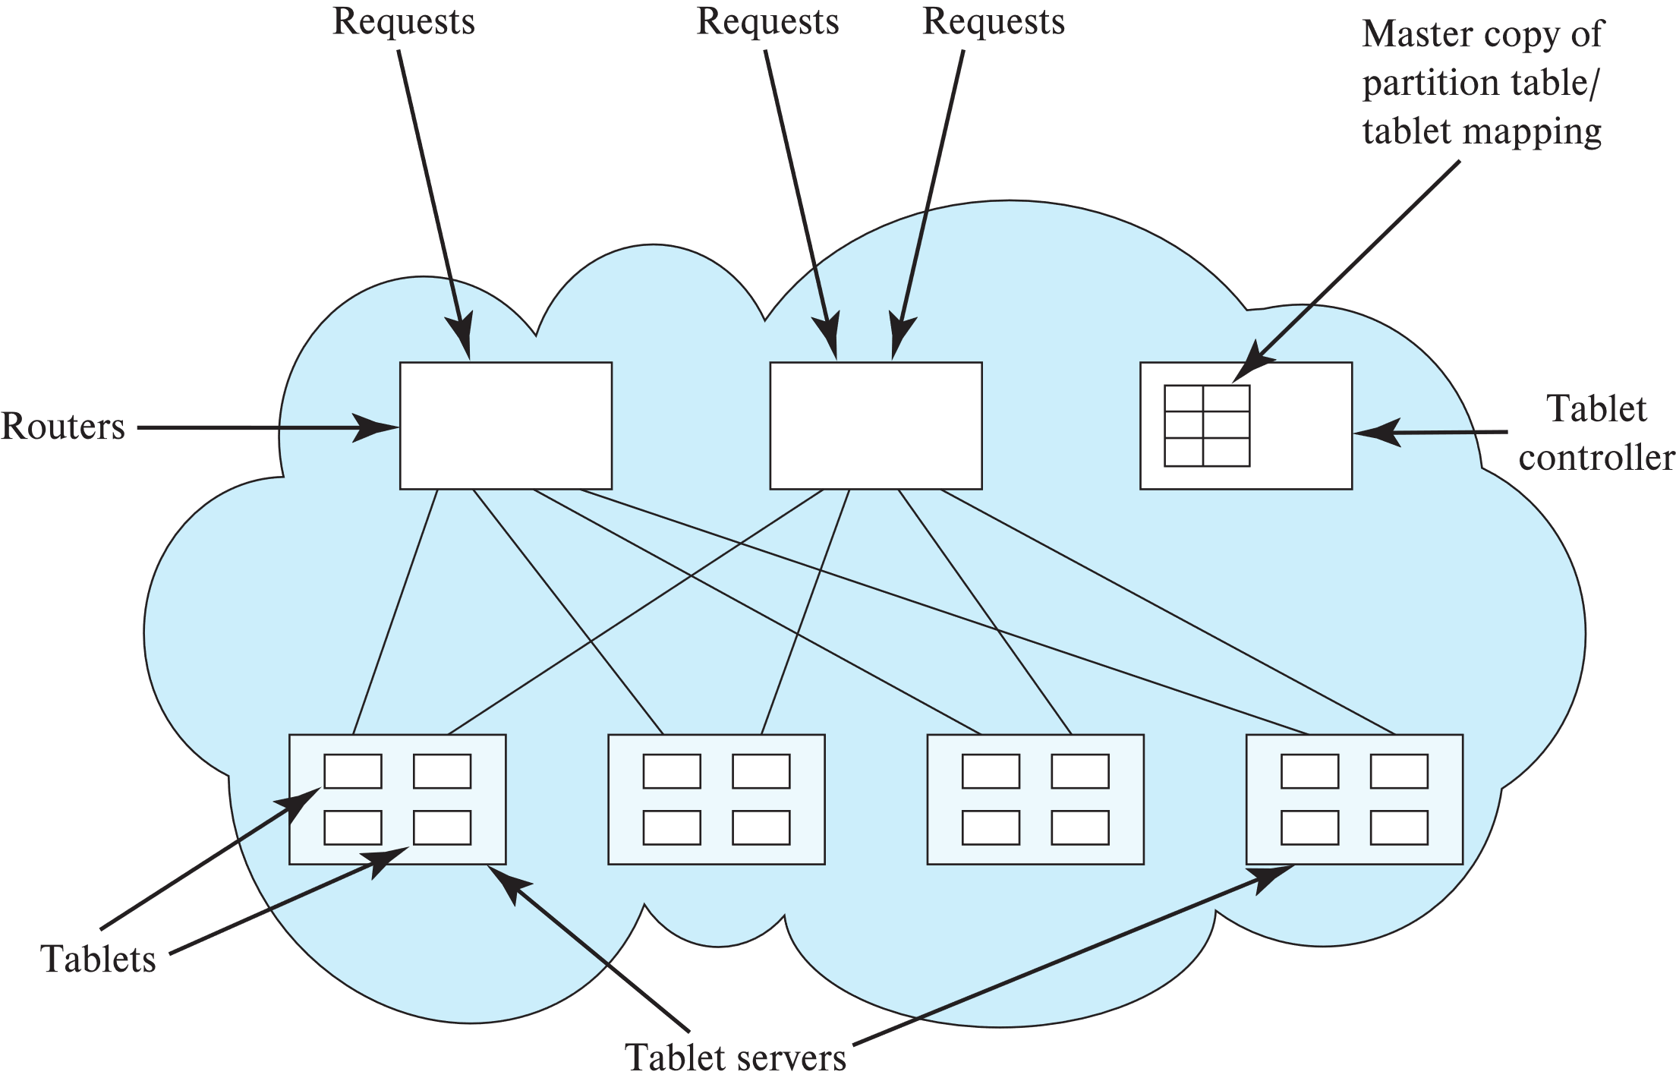
Architecture of Key-Value Store (modelled after Yahoo! PNUTS)

Slide 39
Geographically Distributed Storage
Many storage systems today support geographical distribution of storage
Motivations: Fault tolerance, latency (close to user), governmental regulations
Latency of replication across geographically distributed data centers much higher than within data center
Some key-value stores support synchronous replication
Must wait for replicas to be updated before committing an update
Others support asynchronous replication
update is committed in one data center, but sent subsequently (in a fault-tolerant way) to remote data centers
Must deal with small risk of data loss if data center fails.

Slide 40
Index Structures in Key-Value Stores
Storing data in each tablet in clustered on key benefits range queries
B⁺-tree file organization works well for range queries
Write optimized trees, especially LSM trees (Section 24.2) work well for updates as well as for range queries
Used in BigTable, HBase and many other key-value stores
Some key-value stores organize records on each node by hashing, or just build a hash index on the records

Slide 41
Transactions in Key-Value Stores
Most key-value stores don’t support full-fledged transactions
But treat each update as a transaction, to ensure integrity of internal data structure
Some key-value stores allow multiple updates to one data item to be committed as a single transaction
Without support for transactions, secondary indices cannot be maintained consistently
Some key-value stores do not support secondary indices at all
Some key-value stores support asynchronous maintenance of secondary indices
Some key-value stores support ACID transactions across multiple data items along with two-phase commit across nodes
Google MegaStore and Spanner
More details in Chapter 23

Slide 42
Transactions in Key-Value Stores
Some key-value stores support concurrency control via locking and snapshots
Some support atomic test-and-set and increment on data items
Others do not support concurrency control
Key-value stores implement recovery protocols based on logging to ensure durability
Log must be replicated, to ensure availability in spite of failures
Distributed file systems are used to store log and data files in some key-value stores such as BigTable, HBase
But distributed file systems do not support (atomic) updates of files except for appends
LSM trees provide a nice way to index data without requiring updates of files
Some systems use persistent messaging to manage logs
Details in Chapter 23

Slide 43
Querying and Performance Optimizations
Many key-value stores do not provide a declarative query language
Applications must manage joins, aggregates, etc on their own
Some applications avoid computing joins at run-time by creating (what is in effect) materialized views
Application code maintains materialized views
E.g., If a user makes a post, the application may add a summary of the post to the data items representing all the friends of the user
Many key-value stores allow related data items to be stored together
Related data items form an entity-group
e.g., user data item along with all posts of that user
Makes joining the related tuples very cheap
Other functionality includes
Stored procedures executed at the nodes storing the data
Versioning of data, along with automated deletion of old versions

Slide 44
End of Chapter 21
Notes:
44

